Slide 1
Switching Algebra
Dr. Chandan Karfa
CSE, IIT Guwahati

Slide 2
Source:
Chapter 3 of Z. Kohavi and N. Jha, Switching and Finite Automata Theory, 3rd Ed., Cambridge University Press, 2010

Slide 3
Introduction
The analysis and design of combinational switching circuits.
A combinational switching circuit is that its outputs are functions of only the present circuit inputs.
Switching algebra is the existence of a two-valued switching variable that can take either of two distinct values, 0 and 1
if x is a switching variable then
x != 0 if and only if x = 1,
x != 1 if and only if x = 0.

Slide 4
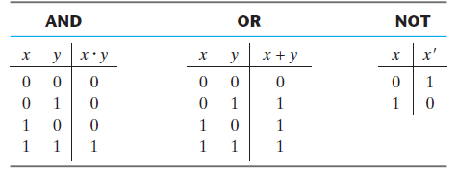
Switching algebra
A switching algebra is an algebraic system consisting of the set {0, 1}, two binary operations called OR and AND, denoted by the symbols + and · respectively, and one unary operation called NOT, denoted by a prime also known as complement and a set of postulates.

Slide 5
Applications in Combinational Circuits
Combinational circuit minimization/simplification
Equivalence of Combinational circuits
Conversion of one form to another

Slide 6
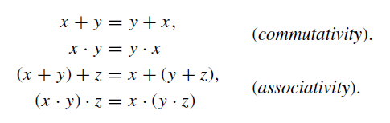



Basic properties of switching algebra
Switching algebra is known as the principle of duality.
One statement can be obtained from the other by interchanging the OR and AND operations and replacing the constants 0 and 1 by 1 and 0, respectively.

Slide 7
Switching expressions and its Simplification
A switching expression we mean the combination of a finite number of switching variables and constants (0, 1) by means of switching operations (+, ·, and )
any switching constant or variable is
a switching expression, and if T1 and T2 are switching expressions then so are T1.T2, T1 + T2, and T1T2.

Slide 8



Simplification Rules
absorption law of switching algebra
Simplification
Consensus theorem

Slide 9
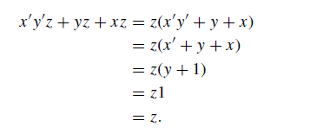
Simplification Example

Slide 10
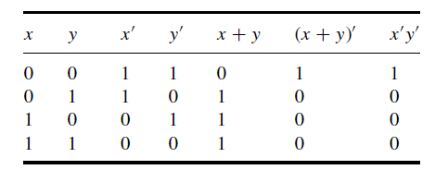


De Morgan’s theorems
Governing complementation operations
De Morgan’s theorems for two variables are
General De Morgan’s theorem: The complement of any expression can be obtained by replacing each variable and element with its complement and, at the same time, interchanging the OR and AND operations

Slide 11
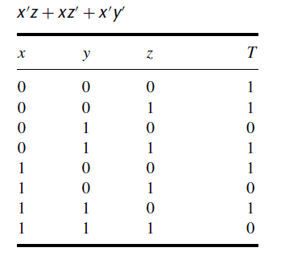
Switching functions
A switching function f (x1, x2, . . . , xn) is a correspondence that associates an element of the algebra with each of the 2^{n}combinations of variables x1, x2, . . . , xn.
This correspondence is best specified by means of a truth table.

Slide 12
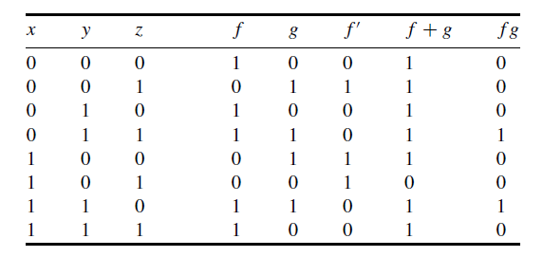
Switching functions
Complement of a function: If a function f (x1, x2, . . . , xn) is specified by means of a truth table, its complement is obtained by complementing each entry in the column headed f . New functions that are equal to the sum f + g and the product fg are obtained by adding or multiplying the corresponding entries in the f and g columns.

Slide 13
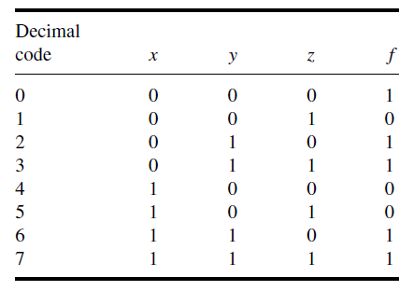
Canonical forms: Sum of Products
How to represent a function uniquely?
Minterm: A product term that contains each of the n variables as factors in either complemented or uncomplemented form is called a minterm
2^{n} possible minterms f
Sum of products (SoP): The sum of all minterms derived from those rows for which the value of the function is 1.
The SoP is the canonical representation of function

Slide 14
Canonical forms: Product of Sums
A sum term that contains each of the n variables in either a complemented or an uncomplemented form is called a maxterm.
An expression formed of the product of all maxterms for which the function takes on the value 0 is called a canonical product of sums or conjunctive normal expression
In each maxterm, a variable xi appears in uncomplemented form if it has the value 0 in the corresponding row in the truth table, and it appears in complemented form if it has the value 1.

Slide 16




Canonical forms
Sum of Products
Product of Sums

Slide 17

Converting to Canonical Form using Shannon’s Expansion Theorem
One way of obtaining the canonical forms of any switching function is by means of Shannon’s expansion theorem repeatedly.
Now apply the expansion theorem with respect to variable x2 to each of the two terms
The expansion of the function about the remaining variables yields the disjunctive normal form (SoP)

Slide 18
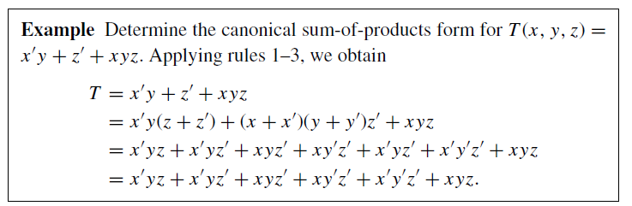
Converting to SoP form
A simpler and faster procedure for obtaining the canonical sum-of-products form of a switching function.
Examine each term; if it is a minterm, retain it, and continue to the next term.
In each product that is not a minterm, check the variables that do not occur, for each x_{i} that does not occur, multiply the product by (x_{i} + x’_{i} ).
Multiply out all products and eliminate redundant terms.

Slide 19
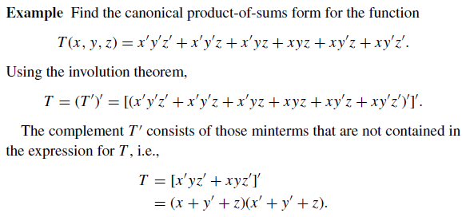
How to convert SoP to PoS and vice versa?
Option 1: Using Truth Table method
Option 2: Use involution theorem (x’)’ = x

Slide 20


Functional properties
Two switching functions are equivalent if and only if their canonical sum of products forms are identical.
A factor a_{i} is set to 1 (0) if the corresponding minterm is (is not) contained in the canonical form of the function.
There are 2^{n} coefficients, each of which can have two values, 0 and 1. Hence, thus there exist 2^(2^{n}) switching functions of n variables.
Functions with 2 variables are of our interests

Slide 21
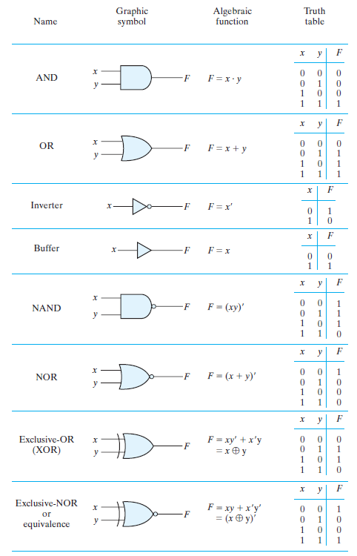
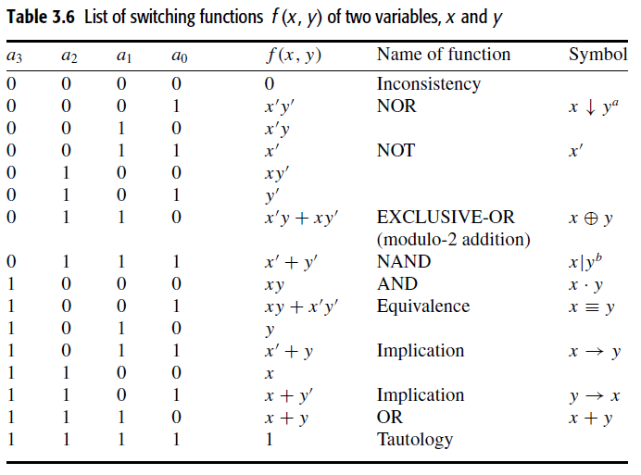

Slide 22
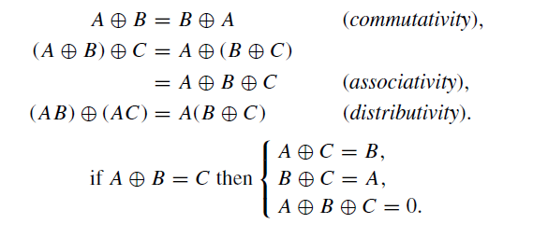
XOR
It assigns value 1 to two arguments if and only if they have complementary values; that is, A ⊕ B = 1 if either A or B is 1 but not when both A and B are 1.

Slide 23
Functionally complete operations
A set of operations is said to be functionally complete (or universal) if and only if every switching function can be expressed entirely by means of operations from this set.
Every switching function can be expressed in a canonical sum-of-products form, where each expression consists of a finite number of switching variables
{+, ·, ’} is clearly functionally complete.
Other functionally complete sets: {+, ’}, {., ‘}, {NAND}, {NOR}

Slide 24
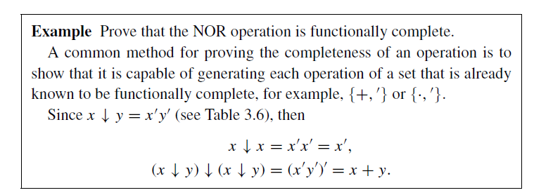

Slide 25
Boolean algebras
A Boolean algebra B is a set of elements a, b, c, . . . , together with two binary operations, + and ·, that satisfy the idempotent, commutative, absorption, and associative laws and are mutually distributive.
B contains two bounds, 0 and 1, which are the least and greatest elements, respectively; B is closed under + and . .
The A set S is closed with respect to a binary operator if, for every pair of elements of S, the binary operator specifies a rule for obtaining a unique element of S.
B has a unary operation of complementation that assigns to every element its complement. The complement a of any element a in B is unique.

Slide 26
Basic properties of switching algebra
Switching algebra is known as the principle of duality.
One statement can be obtained from the other by interchanging the OR and AND operations and replacing the constants 0 and 1 by 1 and 0, respectively.
Relation between switching algebra and Boolean algebra?

Slide 27
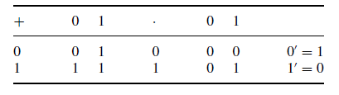
Boolean algebras
In 1854, George Boole developed an algebraic system now called Boolean algebra
In 1938, Claude E. Shannon introduced a two‐valued Boolean algebra called switching algebra
The switching algebra is two-valued Boolean algebra.
Closed under + and . . And each element has unique complement element.

Slide 28
Thank You

