Slide 1
Number Systems
Dr. Chandan Karfa
CSE IIT Guwahati
4/9/2020

Slide 2
Text Book
Chapter 1: Z. Kohavi and N. Jha, Switching and Finite Automata Theory, 3rd Ed., Cambridge University Press, 2010.
Chapter 1, Sec 1.6 M. M. Mano and M. D. Ciletti, Digital Design, 5th Ed., Pearson Education (Signed numbers)
4/9/2020

Slide 3
Number System
Convenient as the decimal number system generally is, its usefulness in machine computation is limited because of the nature of practical electronic devices.
In most present digital machines, the numbers are represented, and the arithmetic operations performed, in a different number system called the binary number system.
The representation of numbers in various systems and with methods of conversion from one system to another.
4/9/2020

Slide 4
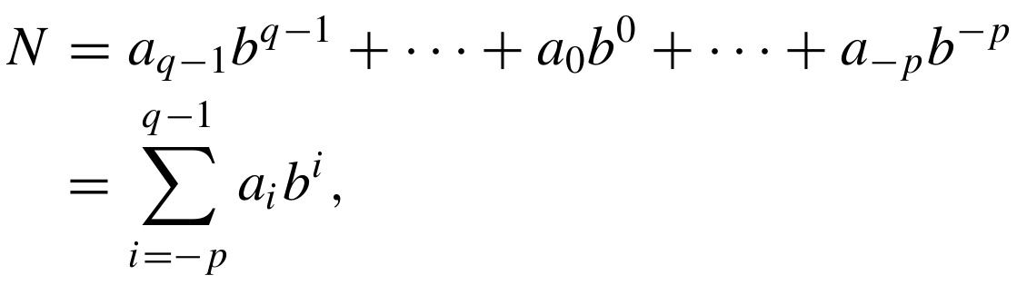
Number representation
An ordinary decimal number actually represents a polynomial in powers of 10. For example, the number 123.45 represents the polynomial This method of representing decimal numbers is known as the decimal number system, and the number 10 is referred to as the base (or radix) of the system.
In a system whose base is b, a positive number N represents the polynomial. where the base or radix b is an integer greater than 1 and the a’s are integers in the range 0 ≤ a_{i} ≤ b − 1.
4/9/2020

Slide 5
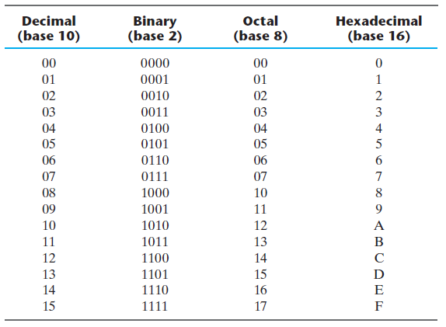
Representation of integers
4/9/2020

Slide 6
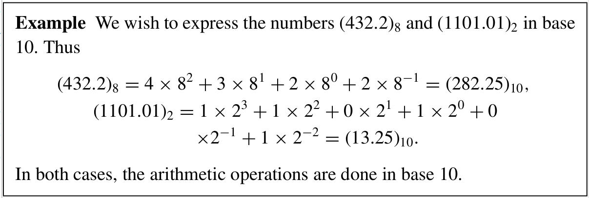
Conversion of bases
Conversion a number N from base b1 to base b2. (N)_{b1} => (X)_{b2}
Case 1: b1 < b2:
base-b2 arithmetic can be used in the conversion process.
The conversion technique involves expressing number (N)_{b1} as a polynomial in powers of b1 and evaluating the polynomial using base-b2 arithmetic.
(145)₁₀ == (X)₁₆
4/9/2020

Slide 7
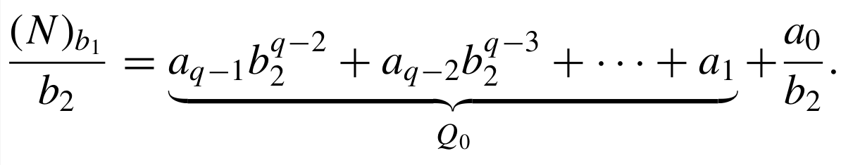
Conversion Procedure
Case 2: b1 > b2
It is more convenient to use base-b1 arithmetic. The conversion procedure will be obtained by considering separately the integer and fractional parts of N .
Let (N)_{b1} be an integer whose value in base b2 is given by
To find the values of the a’s, let us divide the above polynomial by b2 .
4/9/2020

Slide 8
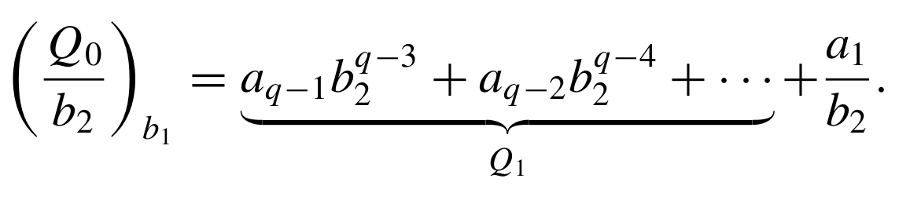
Cont'd...
Thus, the least significant digit of (N )_{b2} , i.e., a₀ , is equal to the first remainder. The next most significant digit, a₁ , is obtained by dividing the quotient Q₀ by b2 , i.e.,
The remaining a’s are evaluated by repeated divisions of the quotients until Q_{q−1} is equal to zero.
If N is finite, the process must terminate.
4/9/2020

Slide 9
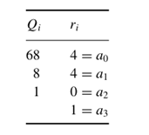
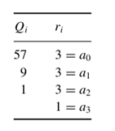
Integral Part conversion
(548)₁₀ = (1044)₈
(345)₁₀ = (1366)₆
4/9/2020

Slide 10


Fractional Part Conversion
If (N)_{b1} is a fraction, a dual procedure is employed. It can be expressed in base b2 as follows:
The most significant digit, a₋₁, can be obtained by multiplying the polynomial by b2:
If the above product is less than 1 then a₋₁ equals 0; if the product is greater than or equal to 1 then a₋₁ is equal to the integer part of the product.

Slide 11
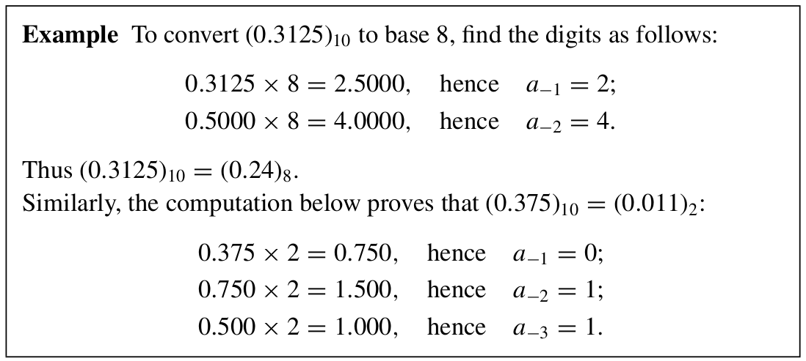
Fractional Part Conversion
The next most significant digit, a₋₂, is found by multiplying the fractional part of the above product part by b2 and determining its integer part; and so on.
This process does not necessarily terminate since it may not be possible to represent the fraction in base b2 with a finite number of digits.
4/9/2020

Slide 12
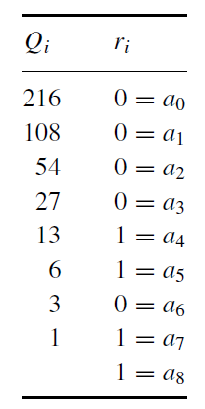
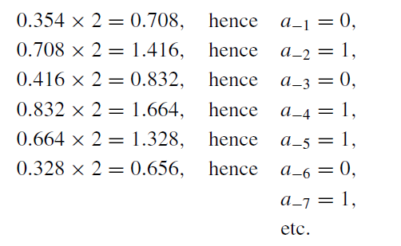



Example
Convert (432.354)₁₀ to Binary.
The conversion is usually carried
up to the desired accuracy. In our example, reconversion to base 10
shows that

Slide 13

Binary to Octal/Hexadecimal Conversion
The conversion from and to binary, octal, and hexadecimal plays an important role in digital computers, because shorter patterns of hex characters are easier to recognize than long patterns of 1’s and 0’s.
Conversion of binary to octal is accomplished by partitioning the binary number into groups of three digits each, starting from the binary point and proceeding to the left and to the right. The corresponding octal digit is then assigned to each group

Slide 14

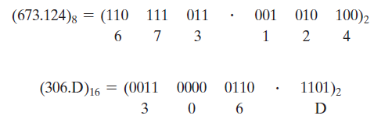
Octal/Hexadecimal to Binary Conversion
Conversion from binary to hexadecimal is similar, except that the binary number is divided into groups of four digits:
Octal or hexadecimal to binary is done by reversing the preceding procedure. Each octal digit is converted to its three‐digit binary equivalent. Similarly, each hexadecimal digit is converted to its four‐digit binary equivalent.

Slide 15
Complements of a Number
To simplify the subtraction operation
N in base r having n digits, the (r - 1)’s complement of N , i.e., its diminished radix complement, is defined as (r ^{n} - 1) – N
The 1’s complement of a binary number is formed by changing 1’s to 0’s and 0’s to 1’s.
The 1’s complement of 1011000 is 0100111.
The r’s complement of an n‐digit number N in base r is as r^{n} - N for N != 0 and as 0 for N = 0.
r’s complement is obtained by adding 1 to the (r - 1)’s complement, i.e., r ^{n} - N = [(r^{n} - 1) – N
2’s complement of 0110111 is 1001001
The 2’s complement can be formed by leaving all least significant 0’s and the first 1 unchanged and replacing 1’s with 0’s and 0’s with 1’s in all other higher significant digits.

Slide 16
The complement of the complement restores the number to its original value .
the r’s complement of N is r^{n} - N,
the complement of the complement is r^{n} - (r^{n} - N) = N and is equal to the original number

Slide 17
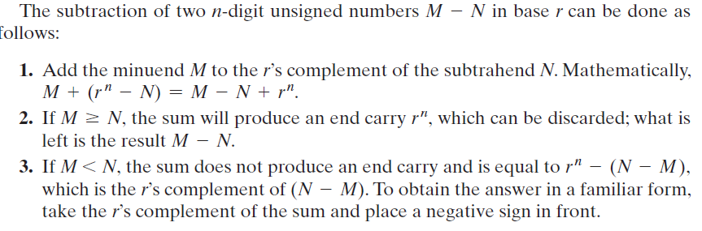
Subtraction of Unsigned Numbers

Slide 18
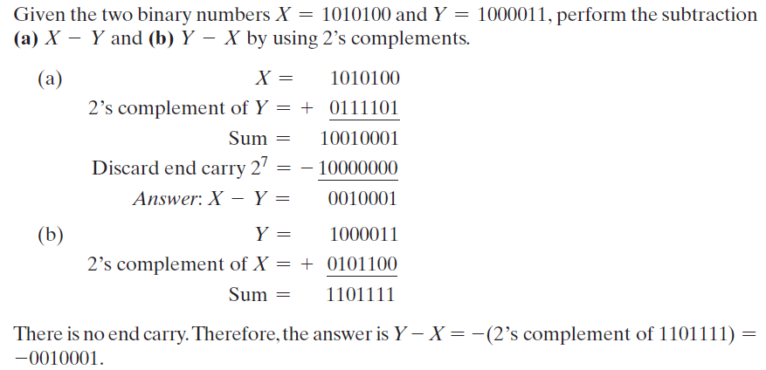
Example

Slide 19
Signed Binary Number
If binary number is signed, then the leftmost bit represents the sign and the rest of the bits represent the number.
Signed Magnitude: 10001001 (-9)
1’s complement: 11110110 (-9)
2’s complement: 11110111 (-9)
The signed‐2’s‐complement representation of -N is obtained by taking the 2’s complement of the positive number N, including the sign bit.
Signed‐2’s‐complement representation of -9: 11110111
2’s complement form is used for number representation in Digital systems

Slide 20
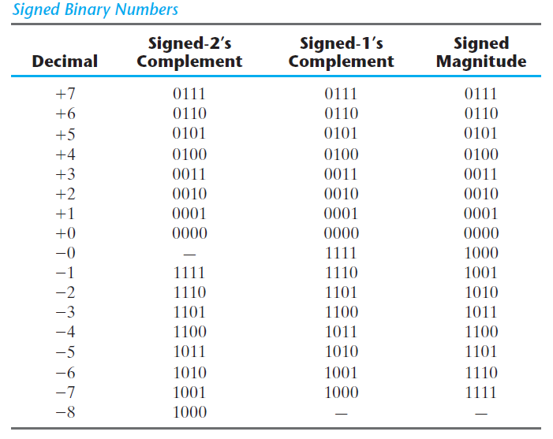

Slide 21
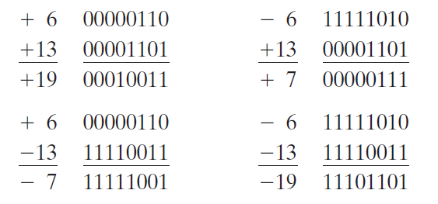
Arithmetic Addition
The addition of two signed binary numbers with negative numbers represented in signed‐ 2’s‐complement form is obtained from the addition of the two numbers, including their sign bits. A carry out of the sign‐bit position is discarded.

Slide 22

Arithmetic Subtraction
Subtraction of two signed binary numbers when negative numbers are in 2’s‐complement form is simple and can be stated as follows:
Take the 2’s complement of the subtrahend (including the sign bit) and add it to the minuend (including the sign bit). A carry out of the sign‐bit position is discarded.

Slide 23
2’s Complement
It is worth noting that binary numbers in the signed‐complement system are added and subtracted by the same basic addition and subtraction rules as unsigned numbers.
Therefore, computers need only one common hardware circuit to handle both types of arithmetic.
This consideration has resulted in the signed‐complement system being used in virtually all arithmetic units of computer systems.

Slide 24
Thank You

