Slide 1
Binary Codes
Dr. Chandan Karfa
CSE IIT Guwahati

Slide 2
Source:
Chapter 1 of Z. Kohavi and N. Jha, Switching and Finite Automata Theory, 3rd Ed., Cambridge University Press, 2010

Slide 3
Binary codes
To simplify the problem of communication between human and machine, several codes have been devised in which decimal digits are represented by sequences of binary digits.
Weighted Code
BCD
Self-complementing code
Non-weighted code
Excess-3 code
Cycle code
Gray code
Reflected code
4/9/2020

Slide 4
Weighted codes
Each binary digit is assigned a decimal “weight,” and, for each group of four bits, the sum of the weights of those binary digits whose value is 1 is equal to the decimal digit which they represent.
If w1, w2, w3, and w4 are the given weights of the binary digits and x₁, x₂, x₃, x₄ the corresponding digit values then the decimal digit
N = w₄ x₄ + w₃ x₃ + w₂ x₂ + w₁ x₁ can be represented by the binary sequence x₄x₃x₂x₁.
The sequence of binary digits that represents a decimal digit is called a code word.

Slide 5
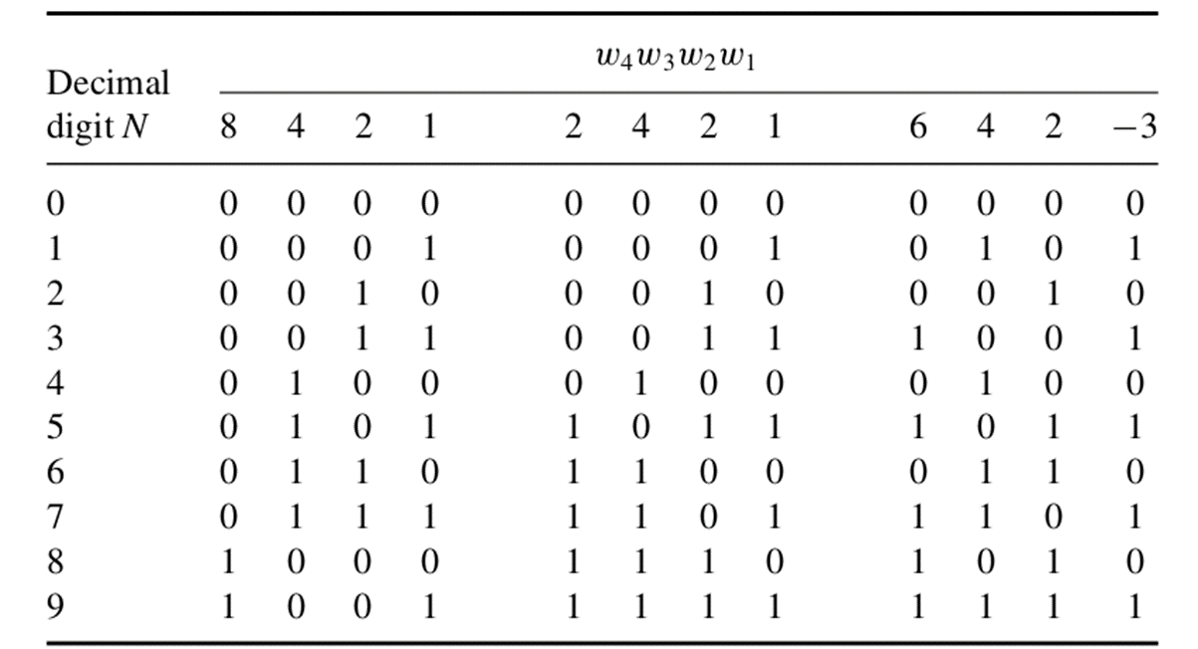
Weighted codes
The sequence x₄x₃x₂x₁ is the code word for N.
The code word 8, 4, 2, 1 is known as Binary coded Decimal(BCD).

Slide 6
Self-complementing codes
It is apparent that the representations of some decimal numbers in the (2, 4, 2, 1) and (6, 4, 2,−3) codes are not unique.
For example, in the (2, 4, 2, 1) code, decimal 7 may be represented by 1101 as well as 0111.
Adopting the representations shown in Table causes the codes to become self-complementing.
A code is said to be self-complementing if the code word of the “9’s complement of N”, i.e., 9 − N, can be obtained from the code word of N by interchanging all the 1’s and 0’s.
For example, in the (6, 4, 2,−3) code, decimal 3 is represented by 1001 while decimal 6 is represented by 0110.

Slide 7
Self-complementing codes
BCD code (8, 4, 2, 1) is not self-complementing.
A necessary condition for a weighted code to be self-complementing is that the sum of the weights must equal 9.
There exist only four positively weighted self-complementing codes, namely, (2, 4, 2, 1), (3, 3, 2, 1), (4, 3, 1, 1), and (5, 2, 1, 1).
there exist 13 self-complementing codes with positive and negative weights.

Slide 8
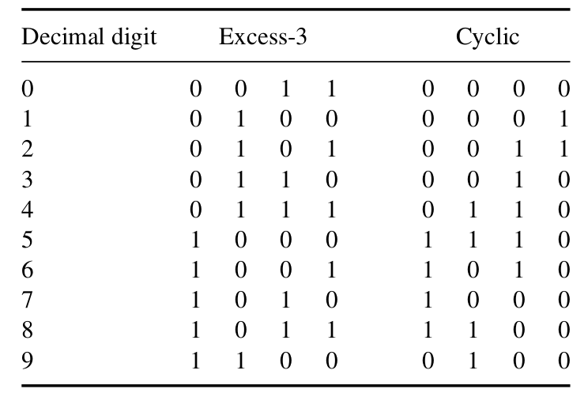
Nonweighted codes
There are many nonweighted binary codes, such as Excess-3 Code, Cyclic Code, Gray Code etc..
The Excess-3 code is formed by adding 0011 to each BCD code word.
4/9/2020

Slide 9
Cyclic codes
Code word having property of successive decimal integers differ in only one digit are referred to as cyclic codes.
Gray code also have property of successive decimal integers differ by 1 bit, so it is also a cyclic code.
Code useful is the simplicity of the procedure for converting from the binary number system into the Gray code
4/9/2020

Slide 10
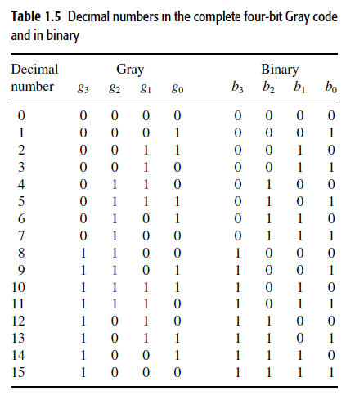
Gray Code

Slide 11
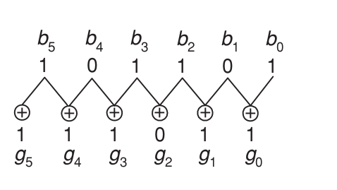

Binary code to gray code conversion
Let g_{n} · · · g₂ g₁ g₀ denote a code word in the (n + 1)^{th}-bit Gray code, and let b_{n} · · · b₂b₁ b₀ designate the corresponding binary number.
4/9/2020

Slide 12
Gray Code to Binary
Start with the leftmost digit and proceed to the least significant digit, setting bi = gi if the number of 1’s preceding gi is even and setting bi = gi’ if the number of 1’s preceding gi is odd
Gray code word 1001011 represents the binary number 1110010

Slide 13
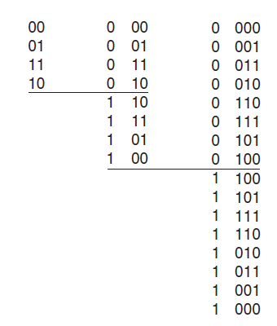
Reflected Code
The term “reflected” is used to designate codes which have the property that the n-bit code can be generated by reflecting the (n − 1)th-bit code.
Three-bit Gray code can be obtained by reflecting the two-bit code about an axis at the end of the code and assigning a most significant bit of 0 above the axis and 1 below the axis.

Slide 14
Thank You

