Slide 1
Heuristic Based two level Switching function minimization
Dr. Chandan Karfa
Department of Computer Science and Engineering
Indian Institute of Technology Guwahati

Slide 2
Two-level vs Multi-level Logic

Slide 3
The Boolean Space B^{n}
B = { 0,1}, B² = {0,1} X {0,1} = {00, 01, 10, 11} , etc.
Karnaugh Maps:
Boolean Spaces:
B⁰
B¹
B²
B³
B⁴

Slide 4
Boolean Functions
= on-set minterm (f = 1)
= off-set minterm (f = 0)
x₂
x₁

Slide 5
Set of Boolean Functions
Truth Table or Function Table:
X₁x₂x₃ F
0 0 0 1
0 0 1 0
0 1 0 1
0 1 1 0
1 0 0 1
1 0 1 0
1 1 0 1
1 1 1 0
x₃
x₂
x₁
There are 2^{n} vertices in input space B^{n}
There are 2^{2n} distinct logic functions.
Each subset of vertices is a distinct logic function: f ⊆ B^{n}

Slide 6
Representations of Boolean Functions
Forms to represent Boolean Functions
Truth table
List of cubes: Sum of Products, Disjunctive Normal Form (DNF)
List of conjuncts: Product of Sums, Conjunctive Normal Form (CNF)
Binary Decision Tree, Binary Decision Diagram
Boolean formula
Boolean network

Slide 7
Cube
A cube is defined as the product (AND) of a set of literal functions (“conjunction” of literals).
Example:
C = x₁x’₂x₃
Other examples of cubes:
= on-set minterm (f = 1)
= off-set minterm (f = 0)
c = x₁
f = x₁x₂
f = x₁x₂x₃
x₃
x₃
x₃
x₂
x₂
x₂
x₁
x₁
x₁

Slide 8
Definitions
Minterm: Product term with all n variables presenet either in its tru or complement form.
abc, abc’
Implicant: Two or more terms may be combined to get a term of reduced size that is covered by the function
F = abc + abc’. An implicant of f is ab
Prime Implicant: If a term cannot be reduced further, then it is prime implicant
Essential Prime Implicant: A prime implicant is essential if covers minterms which are not covered by others.

Slide 9
Cover minimization
bc
ac
= on-set minterm (f = 1)
= off-set minterm (f = 0)
= don’t care-set minterm (f = x)
ab
c
b
Note: each onset minterm is “covered” by at least one of the cubes and none of the offset minterms is covered.
a
Two-level minimization seeks a minimum size cover (least number of cubes). Reason: minimize number of product terms in PLA

Slide 10
Irredundant Cubes
Definition: Let F = {c₁, c₂, …, c_{k}} be a cover for f, i.e. f = ∑_{i}^{k}₌₁ c_{i}
A cube c_{i}∈ F is irredundant if F \ {c_{i}} ≠ f
A cover is irredundant if all its cubes are irredundant.
Example: f = ab + ac + bc
bc
ac
bc
ab
c
ac
b
F \ {ab} ≠ f
not covered,
so ab is irredundant
a

Slide 11
Two-level Logic Optimizations: Methods
Find prime implicants and try to cover them using minimal number of covers
Karnaugh Map based method
Quine–McCluskey method
Heuristic based approach
ESPRESSO
ESPRESSO is based on simulated annealing method

Slide 12
ESPRESSO
Start from initial cover
May be the minterm itself
Modify cover
Make it prime and irredundant,
Reduce, expand, irredundant operations
Stop when no further improvement is possible or timed out

Slide 13
Expand
Make each cube as large as possible without covering a point in the OFF-set.
It tries to expand the cubes in F with neighboring cubes with nodes in the DC-set to form larger cubes.
It takes essential sub-cubes and tries to expand them till they become prime sub-cubes
Each non prime implicant is expanded to a prime and it is replaced by a prime implicant that contains it.

Slide 14
Expand
101
101
101
c
c
c
b
b
b
000
a
000
a
000
a

Slide 15
Irredundant
Throw out redundant cubes
Irredundant: Makes a cover minimal/irredundant covering the ON-set.
Irredundant Cover: no proper subset is also cover
101
101
c
c
b
b
000
a
000
a

Slide 16
Reduce
The cubes in the cover are reduced in size.
Each implicant is reduced to a smaller one that is contained in.
Reduced one and the remaining one are still cover the ON-set.
Might exist another cover with fewer terms of fewer literals.
This allow the newly formed cubes to expand in the different direction
New larger cube can possibly be obtained by exploring the new direction

Slide 17
Reduce
101
101
101
Reduce
Expand
c
c
c
b
b
b
000
a
000
a
000
a

Slide 18
ESPRESSO
Forig = ON-set; /* vertices with expression TRUE */
R = OFF-set; /* vertices with expression FALSE */
D = DC-set; /* vertices with expression DC */
F = expand(Forig, R); /* expand cubes against OFF-set */
F = irredundant(F, D); /* remove redundant cubes */
do {
do {
F = reduce(F, D); /* shrink cubes against ON-set */
F = expand(F, R);
F = irredundant(F, D);
} until cost is “stable”;
/* perturb solution */
G = reduce_gasp(F, D); /* add cubes that can be reduced */
G = expand_gasp(G, R); /* expand cubes that cover another */
F = irredundant(F+G, D);
} until time is up;
ok = verify(F, Forig, D); /* check that result is correct */

Slide 19
Reduce_gasp and expand_gasp
Reduce_gasp:
For each cube in F, add those sub-cubes of cubes that are not covered by other cubes
It uses D to ensure that new sub-cubes are not produces for just some DC nodes.
Expand_gasp
Expand subcubes and add them if they cover another cube.
Later use “irredundant” to discard redundant cubes.

Slide 20
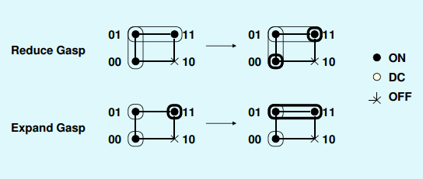

Slide 21
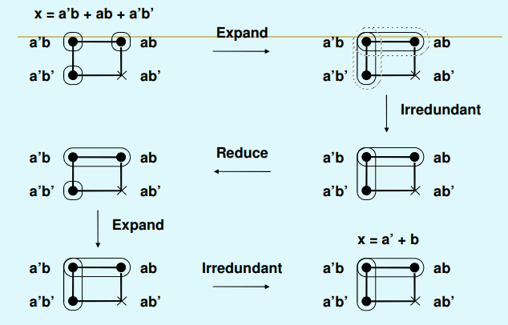
An example
Cost stable

Slide 22
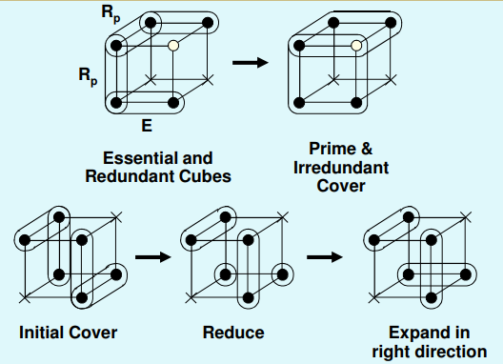

Slide 23
ESPRESSO Conclusions
The algorithm successively generates new covers until no further improvement is possible.
Produces near-optimal solutions.
Used for PLA minimization, or as a sub-function in multilevel logic minimization.
Can process very large circuits. – 10,000 literals, 100 inputs, 100 outputs
Less than 15 minutes on a high-speed workstation

Slide 24
Thank You

