Slide 1

(Academic Year:2024-25) Phase 1
Project Review 1
on
GeoToll - GPS Based Toll Tracking System
by
Group Id : BIA - 4
Group Member :
BIA01 - Omkar Aher
BIA09 - Srushti Bonde
BIA21 - Dhruv Gidwani
BIA28 - Pranav Jawale
Guide name: Dr. Bhavana Kanawade

Slide 2

Outline
Problem statement
Introduction
Literature Survey
Motivation, objectives, and scope of the project
System overview- Proposed system, Architecture
References

Slide 3
Problem statement
Current toll collection systems rely on traditional toll booths, causing traffic congestion and delays. Additionally, there is a lack of real-time monitoring for vehicle speeds and efficient handling of overspeeding violations. A modern solution is needed to streamline toll collection, enhance road safety, and provide users with detailed and timely information. To address the problems we propose a “GPS based toll tracking system”.

Slide 4
Introduction
The Toll Tracking System using GPS technology is an innovative solution designed to modernize toll collection on highways and enhance road safety by incorporating speed tracking. This system leverages GPS technology to track vehicles' movements, automatically calculating toll charges based on the distance traveled on highway. Additionally, it monitors vehicle speeds and imposes penalties for overspeeding, promoting safer driving practices. The system provides real-time notifications to users regarding toll deductions and penalties, ensuring transparency and convenience. By eliminating traditional toll booths, this system aims to reduce congestion, enhance user experience, and improve overall traffic flow.

Slide 5
Literature Survey
S.N | Title | Work Description | Year of publication | Limitations /Drawbacks
[1] | “GPS-based highway toll collection system: Novel design and operation” | The project developed a GPS-based highway toll collection system using Raspberry Pi 2. it includes modules to track vehicles, incur toll fees automatically, and maintain travel logs online. | 2017 | Dependency on GPS Accuracy: The system relies heavily on GPS accuracy, which can be affected by environmental factors such as tall buildings, tunnels, or adverse weather conditions. Internet Connectivity: Continuous internet access is required for real-time data logging and access, which might not be reliable in all areas.
[2] | “GPS Based E-Toll Gate collection System” | The project developed an automatic E-Toll gate system using GPS and GSM modules to track vehicles and charge tolls based on distance traveled, ensuring transparency and accuracy. | 2023 | Speed tracking is not implemented in these systems.
[3] | “Smart Toll Collection: A GPS Based Automated System” | The project developed a GPS-based toll collection system where a GPS device installed on vehicles communicates with a central server to calculate toll fees based on distance traveled. | 2023 | Speed tracking is not implemented in these systems.

Slide 6
Motivation
Traditional toll booths often lead to congestion, delays, and inconvenience for drivers. Additionally, manual toll collection methods are prone to errors and inefficiencies. By leveraging GPS technology, this system aims to provide a seamless and automated toll collection process.
Furthermore, the integration of speed tracking addresses the critical issue of road safety by monitoring and penalizing overspeeding, thus encouraging responsible driving behaviors.
This dual approach not only improves the user experience but also contributes to a safer and more efficient highway system.

Slide 7
Objectives of project
Automate Toll Collection
Enhance Road Safety
Improve Traffic Flow
Increase Transparency
Reduce Operational Costs

Slide 8
Scope of the project
System Development
Designing and developing a robust GPS-based system to track vehicle movements and calculate toll charges accurately.
Speed Monitoring
Implementing a speed tracking mechanism to monitor vehicle speeds and identify instances of overspeeding.
User Interface
Creating a user-friendly interface to provide real-time notifications and detailed toll and penalty information to users.

Slide 9
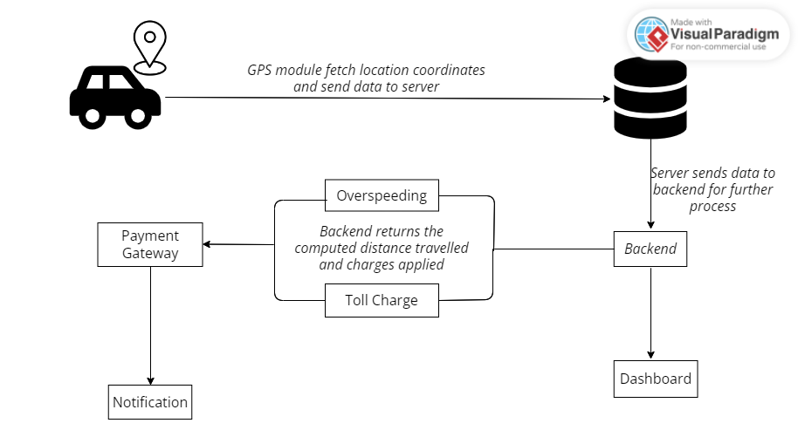
Architecture diagram

Slide 10
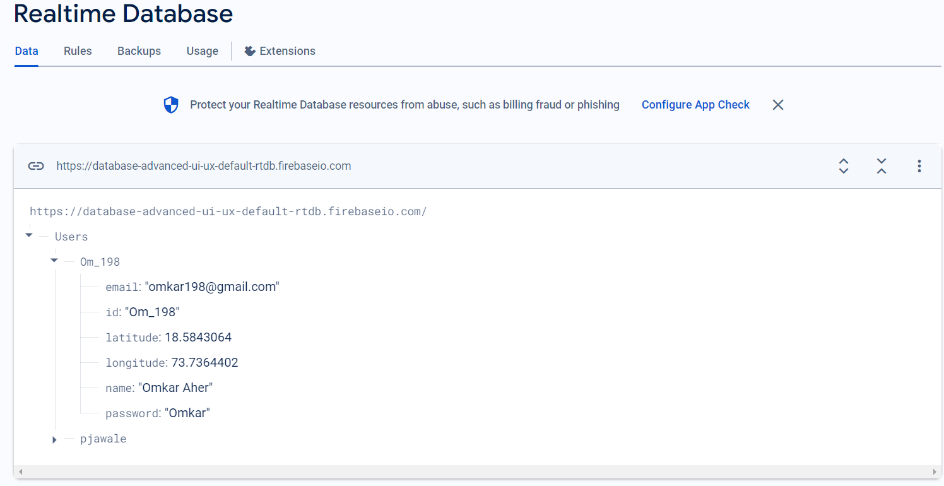
Data Collection

Slide 11
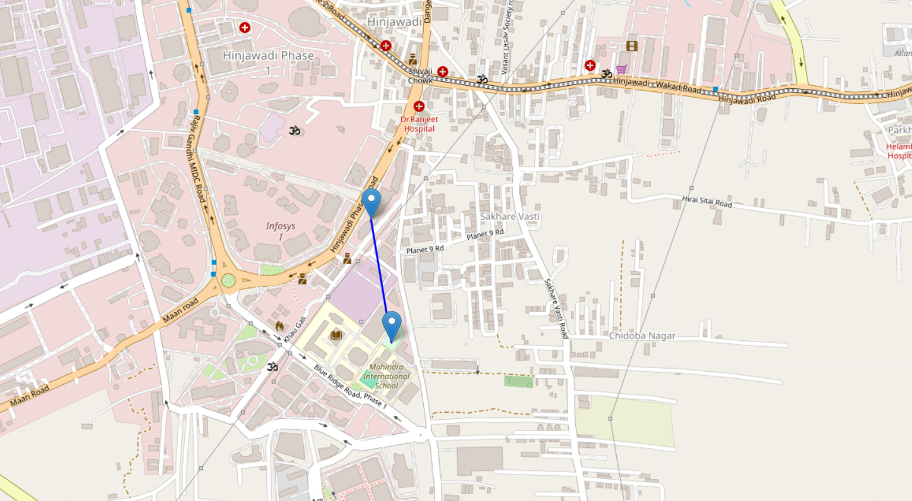
Mapping of Coordinates

Slide 12
References
1) Tan, Jin Yeong, et al.“GPS-based highway toll collection system: Novel design and operation.”Cogent Engineering 4.1 (2017): 1326199
2) Goutham, K., and M. Gowtham. "GPS Based E-Toll Gate collection System." 2023 2nd International Conference on Vision Towards Emerging Trends in Communication and Networking Technologies (ViTECoN). IEEE, 2023.
3) Subha, R., et al. "Smart Toll Collection: A GPS Based Automated System." 2023 International Conference on the Confluence of Advancements in Robotics, Vision and Interdisciplinary Technology Management (IC-RVITM). IEEE, 2023

