Slide 1
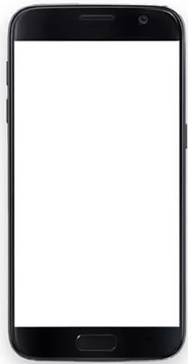
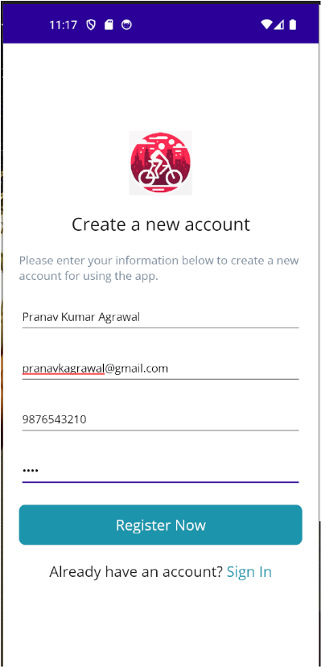
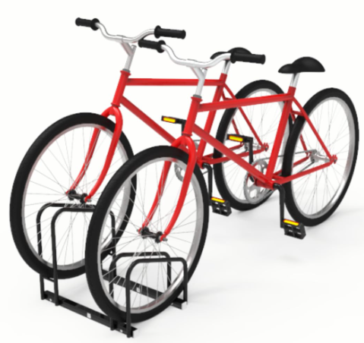
Microsoft Azure Cloud
Bike Sharing System TIET (Web App)
REST API
Payment
Gateway
This integration pending
SQL
Bike Sharing System TIET Db (SQL Database)
Lock/Unlock Commands
Over WIFI
Bike sharing system server
Fig: Architecture Diagram for Bike Sharing System

Slide 2
Bike sharing system server
Bike Sharing System TIET Db
(SQL Database)
Bike Sharing System TIET (Web App)
User fill-in the required details in the APP
Register REST API
Create a User in the database
Success
200 OK
Screen to Sign-in opens
Sequence Diagram 1: User Registration

Slide 3
Bike sharing system server
Bike Sharing System TIET Db
(SQL Database)
Bike Sharing System TIET (Web App)
User Sign-in in the APP
Sign-in REST API
Check User Exists the database
User Exists (true)
200 OK
User can Browse the App
Sequence Diagram 2: User Sign-in in the App

Slide 4
Bike sharing system server
Bike Sharing System TIET Db
(SQL Database)
Bike Sharing System TIET (Web App)
Browse and locate the required Bike in the APP and click the Book Button
Book Bike REST API
Check for the availability of the requested Bike in the database
Bike Available (true)
Payment processing logic: Assumes that payment is done
200 OK
Screen to Unlock the Bike Opens
UNLOCK Bike
Sequence Diagram 3: User Book and Unlock a Bike

