Slide 1
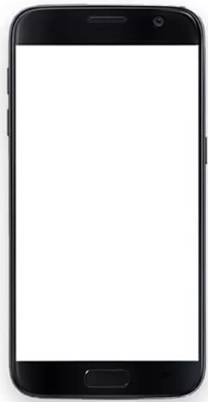
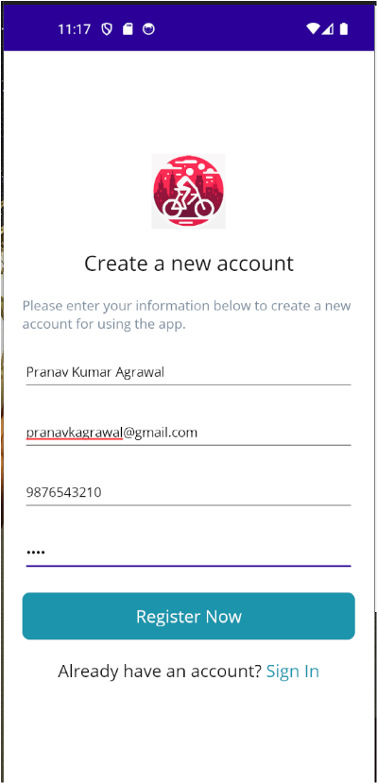
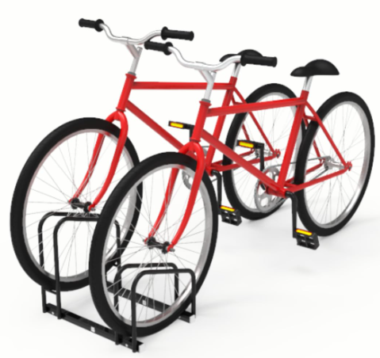
Microsoft Azure Cloud
Bike Sharing System TIET (Web App)
REST API
Payment
Gateway
This integration pending
SQL
Bike Sharing System TIET Db (SQL Database)
Lock/Unlock Commands
Over WIFI
Bike sharing system server
Fig: Architecture Diagram for Bike Sharing System

