Slide 1
Regression

Slide 2
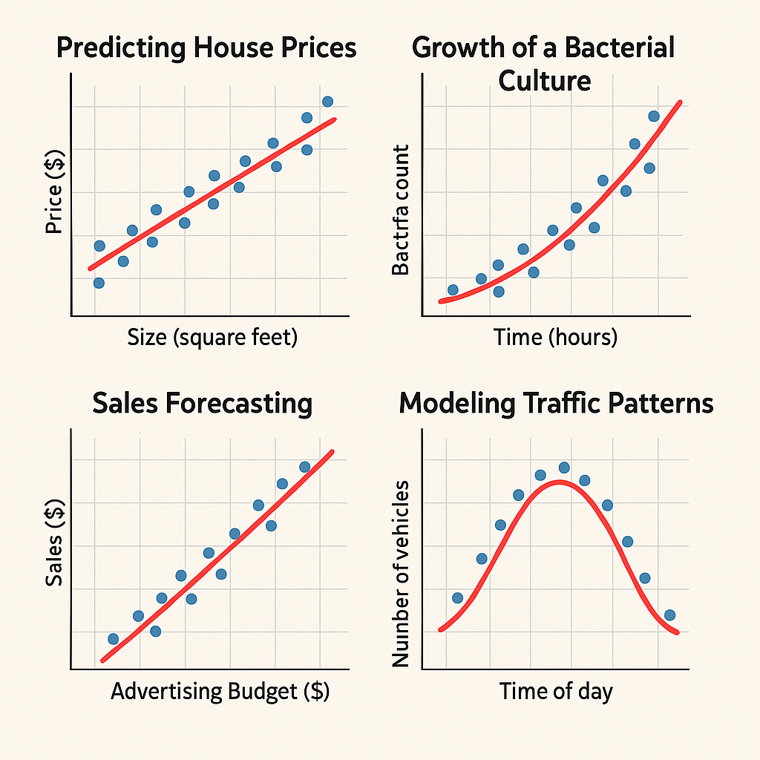

Slide 3
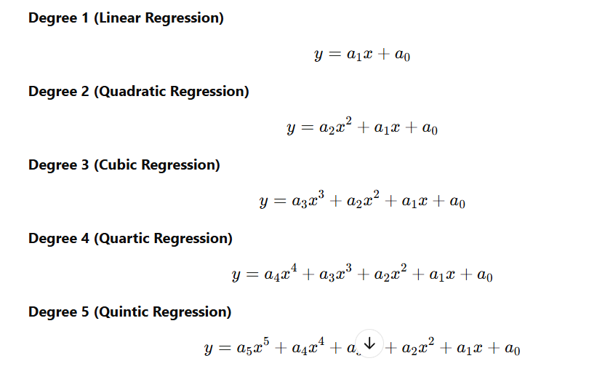
Polynomial Regression

