Slide 1
Neurons - the story

Slide 2


Slide 4
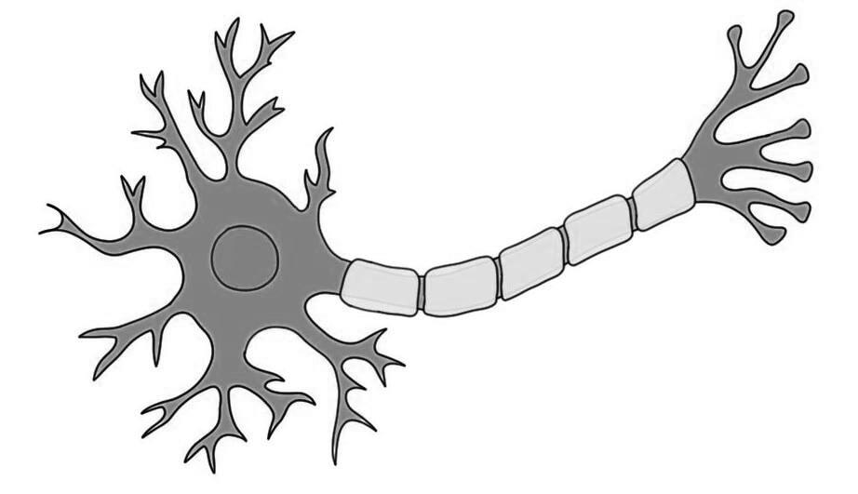
Dendrites
Axon

Slide 5


Slide 6
What did the Computing World Do?
X1
w1
X2
w2
Z
f
Y
X3
w3

