Slide 1
Neurons - the story

Slide 2


Slide 4
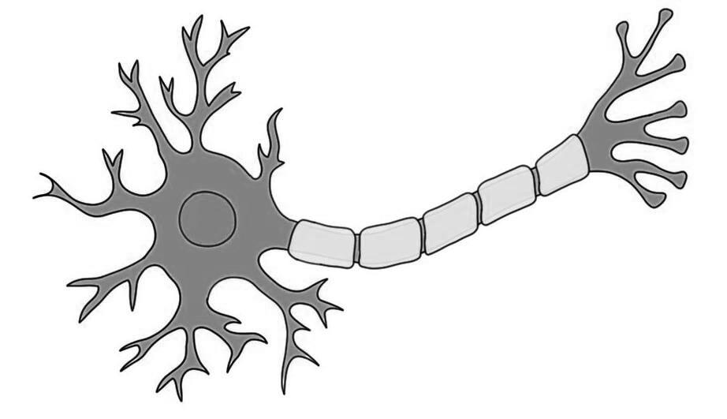
Dendrites
Axon

Slide 5


Slide 6
What did the Computing World Do?
X1
w1
X2
w2
Z
f
Y
X3
w3

Slide 8
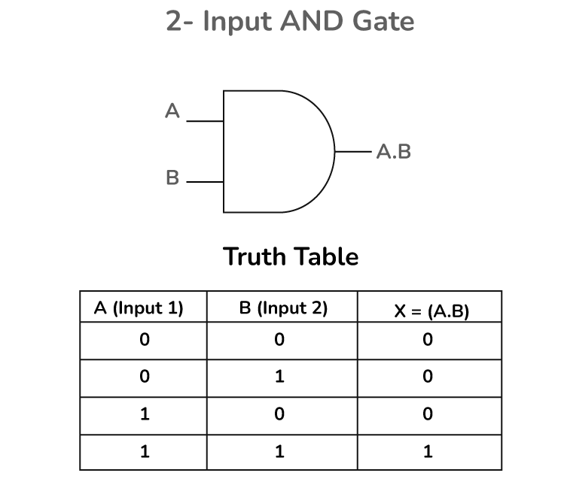
X1
X2
Y

Slide 9
Building the Perceptron
X1 w1
X2 w2
Z = x1 * w1 + x2 * w2 + bias
Bias
Threshold -- > step function
If z >= 0, output 1

