Slide 1
Ah, The Overfit!

Slide 2
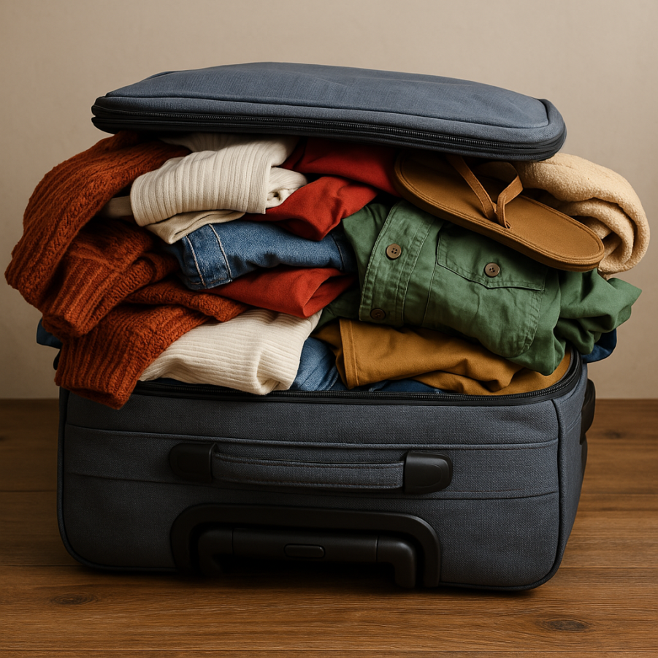
The Trip Packing
Over-Packed!!

Slide 3
Study Habits
X1 (Study Hours) | X2 (Sleep Hours) | Y (Marks Scores)
1 | 5 | 2
2 | 5 | 4
3 | 5 | 7
4 | 6 | 8
Prediction for [5, 6]

