Slide 1
Gradient Descent

Slide 2
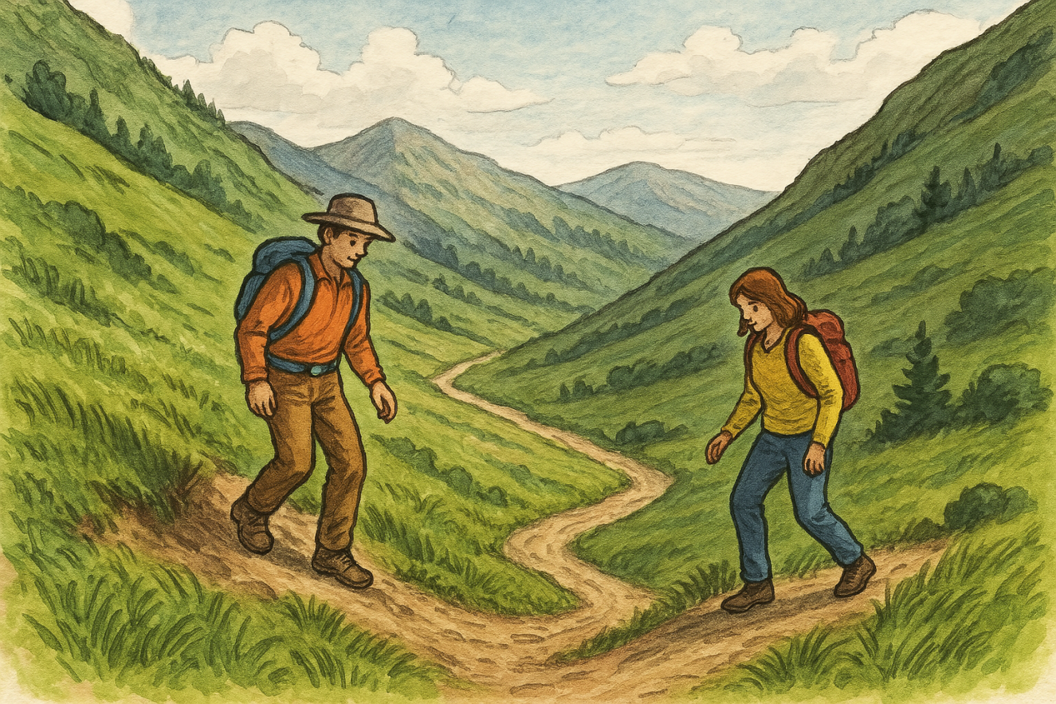
What’s up with the Hikers!!?

