Slide 1
Neurons - the story

Slide 2


Slide 4
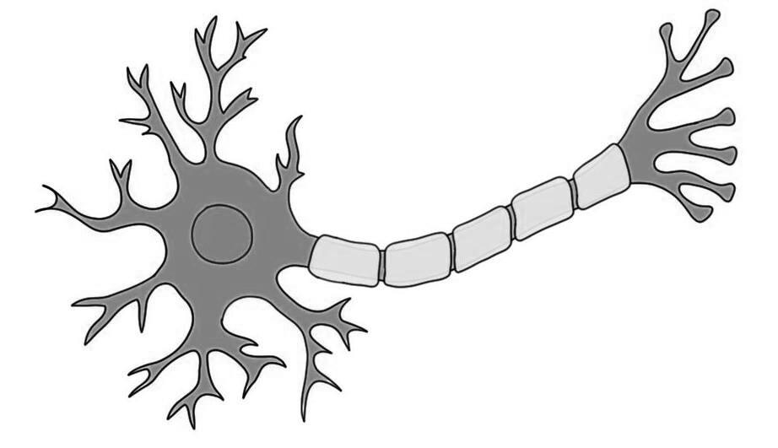
Dendrites
Axon

Slide 5


Slide 6
What did the Computing World Do?
X1
w1
X2
w2
Z
f
Y
X3
w3

Slide 8
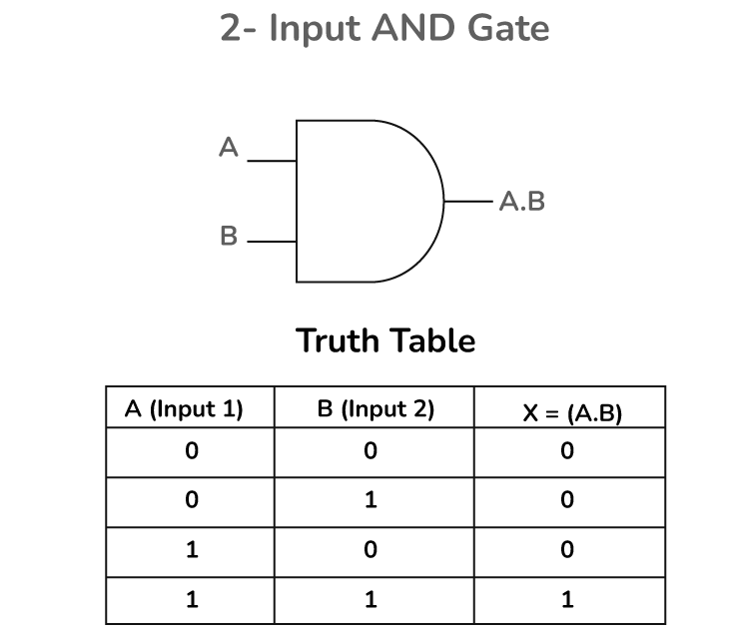
X1
X2
Y

Slide 9
Building the Perceptron
X1 w1
X2 w2
Z = x1 * w1 + x2 * w2 + bias
Bias
Threshold -- > step function
If z >= 0, output 1

Slide 10

Is it a cat?
ear
0.6
Threshold = 0.9
1, 1, 1
Z = 1.5
whisker
0.5
0.7
0.3
0.4
fur
Threshold =1.2
0.8
Z = 1.8
Input layer

