Slide 1
Images

Slide 2
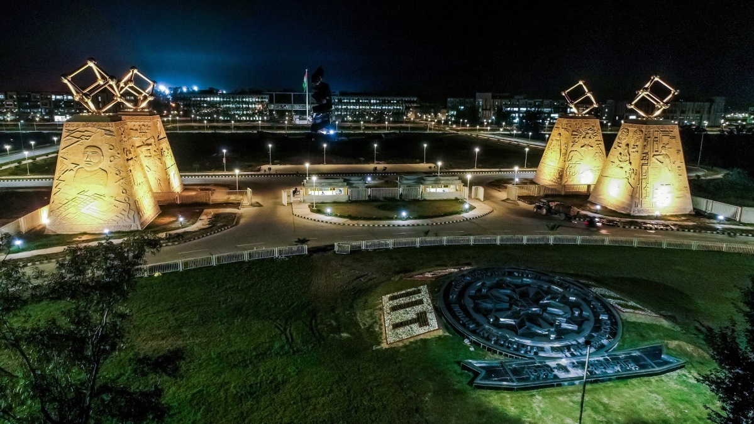
Hey, Image! – Pixelate!
Pixel?
[R, G, B] = [128, 64, 200]
[0, 255, 0]
[0, 0, 0]

Slide 3
Tasks In Computer Vision
Segmentation

