Slide 1
Neurons - the story

Slide 2


Slide 4
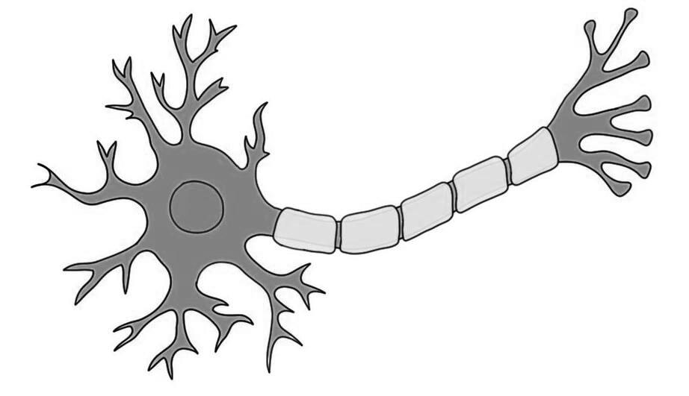
Dendrites
Axon

Slide 5


Slide 6
What did the Computing World Do?
X1
w1
X2
w2
Z
f
Y
X3
w3

Slide 8
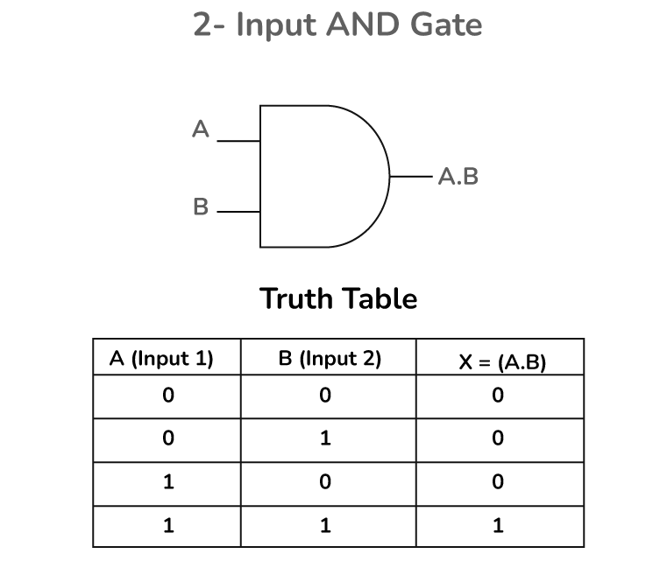
X1
X2
Y

Slide 9
Building the Perceptron
X1 w1
X2 w2
Z = x1 * w1 + x2 * w2 + bias
Bias
Threshold -- > step function
If z >= 0, output 1

Slide 10

Is it a cat?
ear
0.6
0.3
Threshold = 0.9
Z = 1.5
Threshold = 1.0
Z = 1.5
whisker
0.6
0.5
[1, 1]
[1, 1, 1 ]
0.7
0.9
Yes, it is
cat
0.4
fur
Threshold =1.2
0.8
Z = 1.8
Input layer
Hidden layer
Output layer

Slide 11
Understanding Chain Rule
x = 2
w = 3
y = wx
(loss function) z = y²
dz/dw = dz / dy * dy / dw
dz / dy = 2y
dy / dw = x
dz/dw = 2y * x
= 2 (wx) * x
= 2 (6) * 2
= 24
w = w – lr * dl/ dw

