Slide 1
Neurons - the story

Slide 2


Slide 4
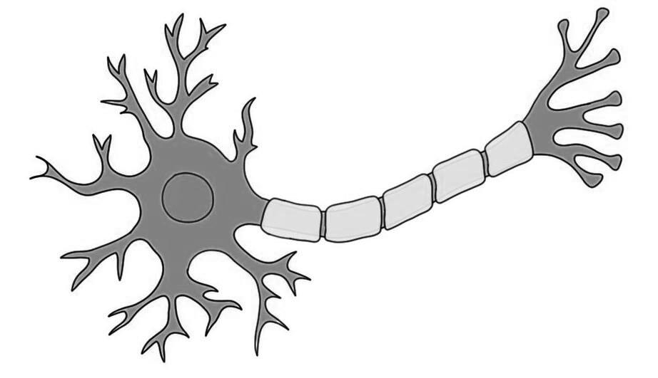
Dendrites
Axon

Slide 5


Slide 6
What did the Computing World Do?
X1
w1
X2
w2
Z
f
Y
X3
w3

Slide 8
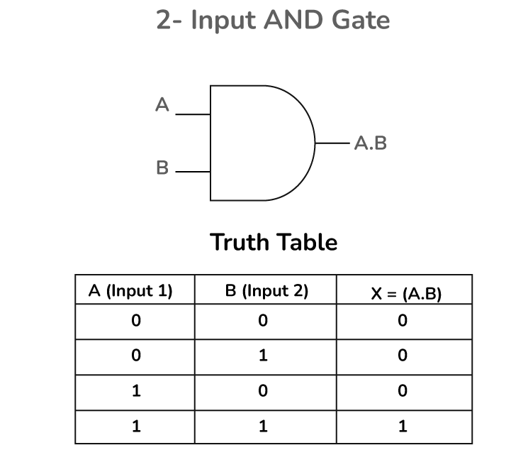
X1
X2
Y

Slide 9
Building the Perceptron
X1 w1
X2 w2
Z = x1 * w1 + x2 * w2 + bias
Bias
Threshold -- > step function
If z >= 0, output 1

Slide 10

Is it a cat?
ear
0.6
0.3
Threshold = 0.9
Z = 1.5
Threshold = 1.0
Z = 1.5
whisker
0.6
0.5
[1, 1]
[1, 1, 1 ]
0.7
0.9
Yes, it is
cat
0.4
fur
Threshold =1.2
0.8
Z = 1.8
Input layer
Hidden layer
Output layer

Slide 11
Understanding Chain Rule
x = 2
w = 3
y = wx
(loss function) z = y²
dz/dw = dz / dy * dy / dw
dz / dy = 2y
dy / dw = x
dz/dw = 2y * x
= 2 (wx) * x
= 2 (6) * 2
= 24
w = w – lr * dl/ dw

Slide 12
Smart Hiring System
Candidate | GPA | Intern (months) | Projects | Comm. Skill (0–10) | Label
A | 8.9 | 6 | 5 | 9 | Strong Fit
B | 7.5 | 3 | 4 | 7 | Maybe
C | 6.2 | 0 | 2 | 5 | Not a Fit
D | 9.1 | 5 | 6 | 8 | Strong Fit
E | 7.0 | 1 | 3 | 6 | Maybe
F | 5.8 | 0 | 1 | 4 | Not a Fit
G | 8.5 | 4 | 5 | 9 | Strong Fit
H | 6.5 | 2 | 3 | 6 | Maybe
I | 5.2 | 0 | 0 | 3 | Not a Fit
J | 7.8 | 3 | 4 | 8 | Maybe

Slide 13
Z = w1x1 + w2x2…. + .. + b
45 89.8 -67 -89 657.4
(r1, r2)
Activation Functions

Slide 14
Load and prepare
Define MLP
Set loss function and optimizer
Train the model
Test the model

