Slide 1
Unveiling the Power of Machine Learning: Sign Language Recognition and its Execution Explained

Slide 2
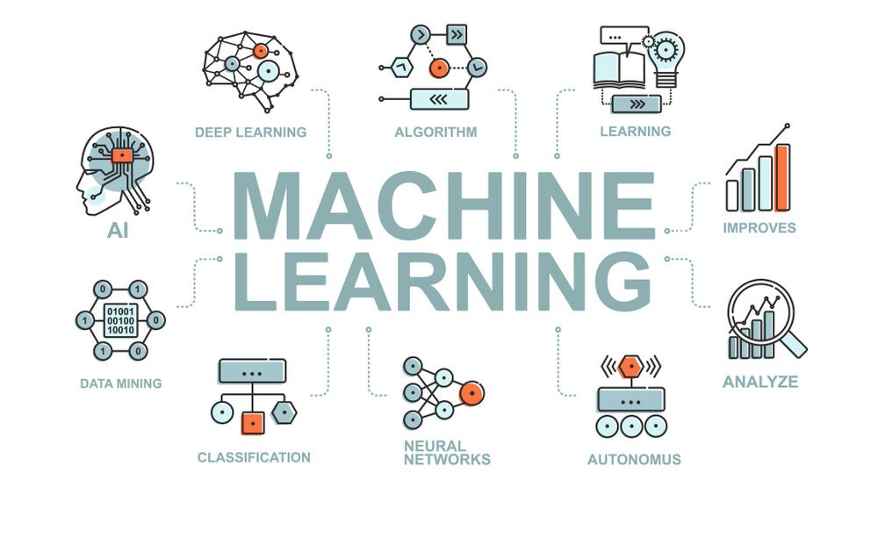
1. Introduction to Machine Learning
Discover the incredible potential of machine learning as we dive into
the world of sign language recognition. Join us as we delve into the intricacies of this groundbreaking technology, exploring its execution and decoding its power in bridging communication barriers. Get ready to witness the future of inclusive and accessible communication.

Slide 3
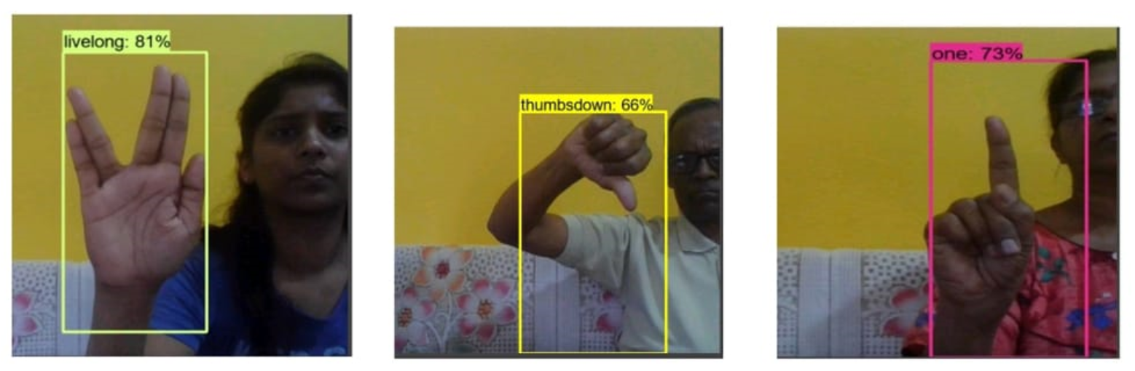
2. Understanding Sign Language Recognition
The Process behind Sign Language Recognition
Machine learning plays a crucial role in sign language recognition. Through a combination of image processing and data analysis techniques, computers can learn to recognize and interpret hand gestures, translating them into written or spoken words. This technology has the potential to revolutionize communication for the deaf and hard of hearing community, creating a more inclusive and accessible society.

Slide 4
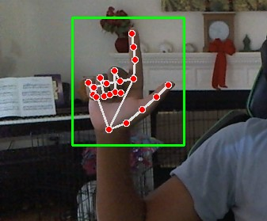
3. Importance of Sign Language Recognition
The Importance of Sign Language Recognition
Sign language recognition has the potential to bridge communication gaps for the deaf and hard of hearing community. It allows for more inclusive interactions, enabling individuals to express themselves freely and participate fully in society. By developing accurate and efficient sign language recognition systems, we can empower individuals with disabilities and promote equality and accessibility for all.

Slide 5
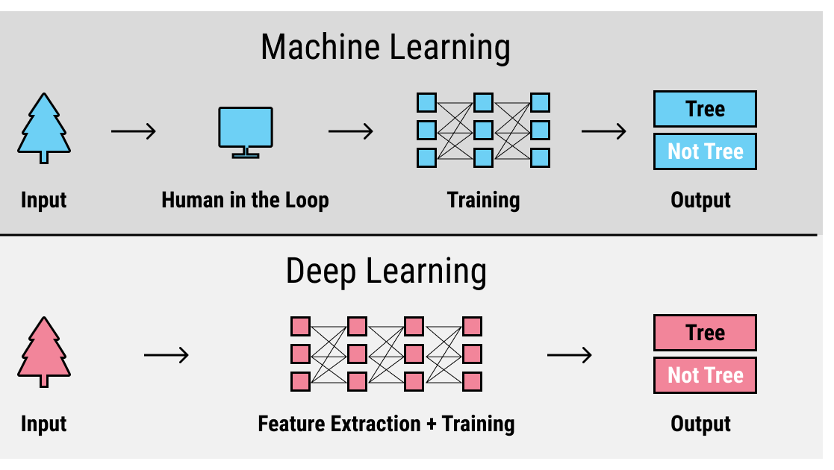
4. Training Data and Feature Extraction
Training data is a crucial component in building an accurate sign
language recognition system. It should consist of diverse and representative sign language samples to ensure optimal performance. Additionally, feature extraction techniques are applied to convert raw sign language data into meaningful representations that can be processed by machine learning algorithms. These steps are essential for achieving high accuracy and reliability in sign language recognition technology.

Slide 6
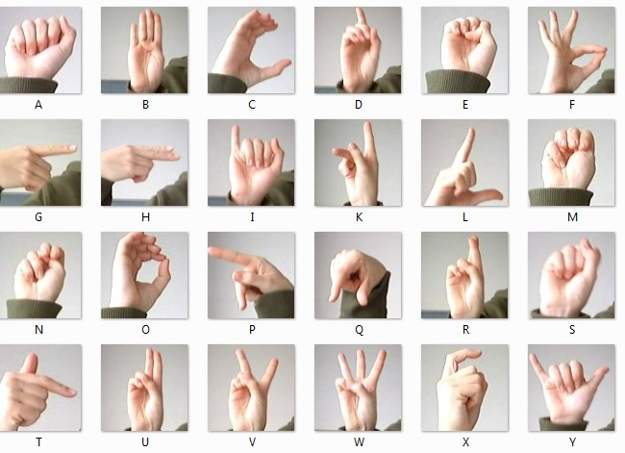
5. Building the Sign Language Recognition Model
To build a sign language recognition model, five key steps are
involved. First, collecting a diverse and representative training dataset of sign language samples. Next, applying feature extraction techniques to convert raw data into meaningful representations.
Then, selecting and implementing appropriate machine learning algorithms. After that, training and fine-tuning the model using the labeled data. Finally, evaluating the model's performance and refining it as needed for optimal accuracy and reliability.

Slide 7

6. Applications of Sign Language Recognition
Sign language recognition has diverse applications, including real-time
translation services, accessibility tools for deaf individuals, and educational platforms. It can also be incorporated into smart home devices, virtual reality systems, and interactive multimedia experiences, opening up new possibilities in communication and inclusion for hearing-impaired individuals.

Slide 8
8. Challenges and Limitations
Developing accurate sign language recognition systems faces several
challenges and limitations. These include variations in signing styles, lighting conditions, occlusions, and the need for large annotated datasets. Additionally, the complexity of hand gestures and the dynamic nature of sign language make it a challenging task to accurately interpret and classify sign gestures in real-time.
Overcoming these challenges will require further research and development in the field of machine learning and computer vision.

Slide 9

9. Conclusion and Future Trends
In conclusion, while sign language recognition systems face
challenges, advancements in machine learning and computer vision offer promising solutions. Future trends include the development of more robust algorithms, improved training datasets, and the integration of sensor technologies. With continued research and collaboration, the power of machine learning can be fully harnessed to accurately recognize and interpret sign language, enhancing communication and inclusivity for the deaf community.

Slide 10
Project By : Pranav Kumar Agrawal

