Slide 1

Session – 1 : Introduction to "Containers"

Slide 2
Agenda
Difference between a VM and a Container
What does working with container really means?
How does docker fit in?
Use Cases
Docker terminology
Demo

Slide 3
Difference between a VM and a Container
Hardware level virtualization vs OS level virtualization

Slide 4
VM – Arch
App - 1
P
Q
App - 3
A VM is essentially an emulation of a real computer, that executes programs like a real computer.
bins/
libs
bins/
libs
bins/
libs
Guest OS
RHEL
Ubuntu
Hypervisor
Host OS (e.g. Windows 7)
Infrastructure

Slide 5
VM
VMs run on top of a physical machine using hypervisor.
The hypervisor, in turn, runs on either a host machine or a "bare metal".
It also carries an entire virtualized hardware stack of its own.
Virtualized network adapters, storage, and CPU.
Which means it has its own full-fledged guest OS.
The take away – VM provides hardware level virtualization.

Slide 6
Container - Arch
The container provides operating system level virtualization by abstracting the User Space.
*(if OS supports containers)
App - 1
App - 2
App - 3
bins/
libs
bins/
libs
bins/
libs
Docker
Host OS
Infrastructure

Slide 7
Containers
Share the host system's kernel with other containers.
Package up just the user space.
Every container has it's own isolated user space. This allows one, to have multiple containers on single host machine.
All the OS level arch. gets shared across containers.
The only components that are created from scratch are the bins and libs.
Hence, containers are extremely light weight.

Slide 8
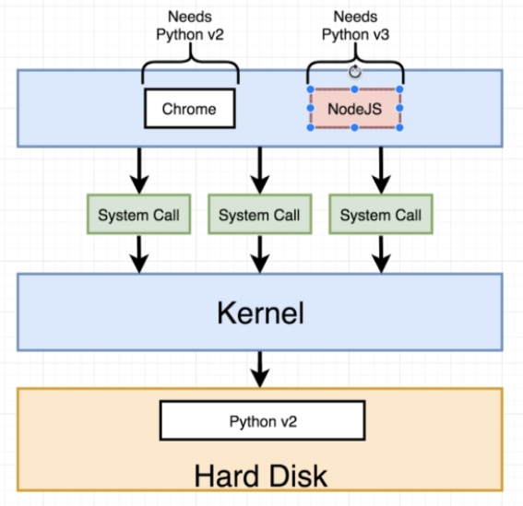
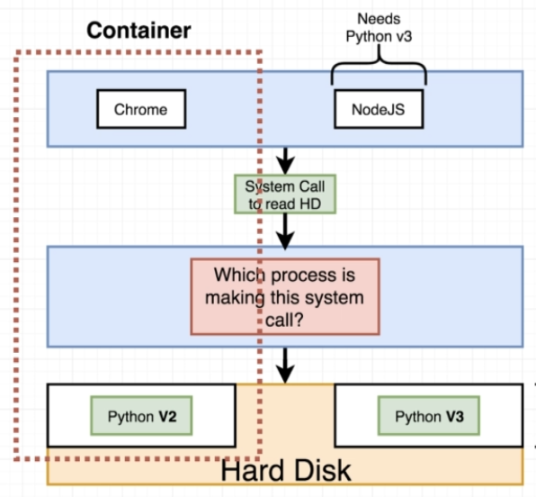
Why do we need containers?

Slide 9
What does working with container really means ?
Isolated Namespaces -
Means providing container with their own view of the underlying Linux System.
Control Groups -
Managing the resource usage of set of processes.
Union File System -
A stackable file system. (We’ll revisit this in sessions to follow)

Slide 10
1. Isolated Namespaces -
Providing personalized view of the underlying system. Limiting what the container can see and access.
Following are some of the different types of namespaces, supported by any Kernel -
NET – Isolated Network stack ( IP address, Routing table, etc.)
PID – Process ID. Isolated view of processes to interact with.
USER – With this one can create different UIDs and GIDs.
And there are many more .. (MNT, UTS, IPC … )

Slide 11
2. Control Groups (cgroups)
Linux kernel feature that manages(isolates, prioritizes and accounts for) the resource usage (CPU, memory, disk I/O, network etc.) of a set of processes.
Hence, cgroups ensures that container only use the resources they need.
One can set up limits upon what resources a container can use.
This way no single container can exhaust one of above resources and bring entire system down.

Slide 12
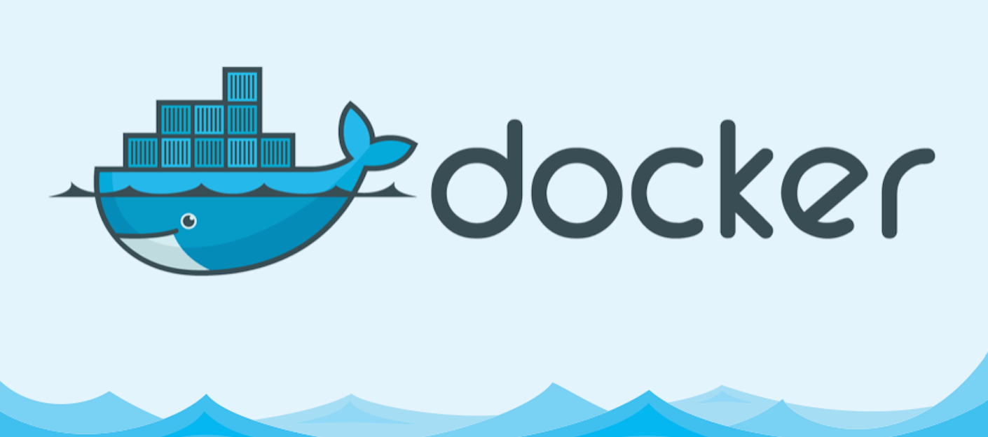
How does docker fit in?

Slide 13
The answer -
Containers aren't a new thing. Google has been using them for years now.
The new thing is the Container Platform – Docker.
Docker is an open source project, based on Linux Containers.
It is a platform for developers and sys-admins to develop, deploy and run applications with containers.
It uses Namespaces and Control Groups to create containers on top of an OS.

Slide 14
Why the sudden steam ?? Because, the mantra is - "Build once, run anywhere!"
Benefits -
Ease of Use – One can package an app on their machine, and it will run as it is on any public cloud platform. *(if it supports containers)
Speed – Containers are light weight and fast to build.
Open Source
Version control capabilities
Modularity and Scalability
Microservices and integrations(APIs)

Slide 15
Use cases
Simplified configuration
Code Pipeline Management
*Consistent environment for the app from dev through production.
App Isolation
Multi-tenancy
React applications with Nginx and Redis
Rapid Deployment

Slide 16
Docker Terminologies
Docker Platform: Docker in a bundle
Docker Engine: Client – Server application.
Docker Client: Cmd line interface to interact with Server.
Docker Daemon: Background service responsible for building and running containers. Provides RestAPIs and Docker CLI.
Docker Registries – Stores Docker images. (Docker Hub/Cloud)
Local and Public
Docker Objects -
Images – Readonly template built by Engine. (using Dockerfile)
Containers – Runnable instances of Image.

Slide 17
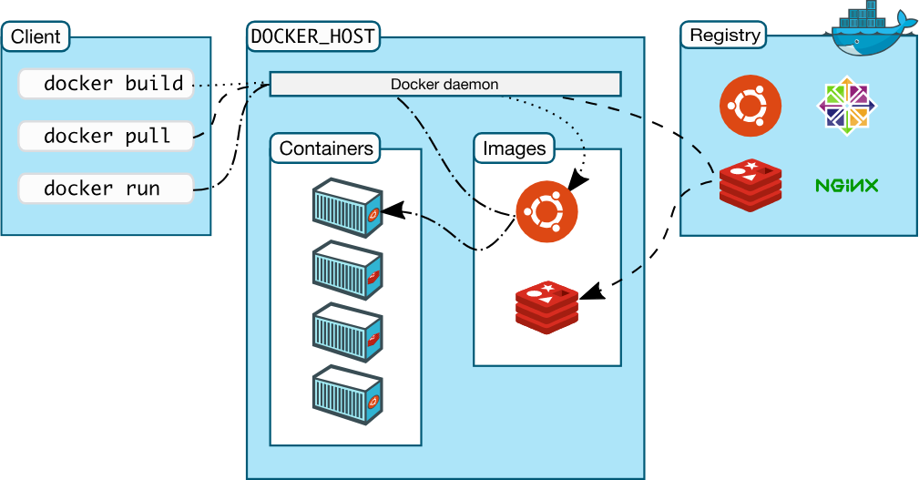
The flow

Slide 18
Demo
1. https://training.play-with-docker.com/ops-s1-hello/
2. https://training.play-with-docker.com/beginner-linux/ (assignment)

Slide 19
Thanks

