Slide 1
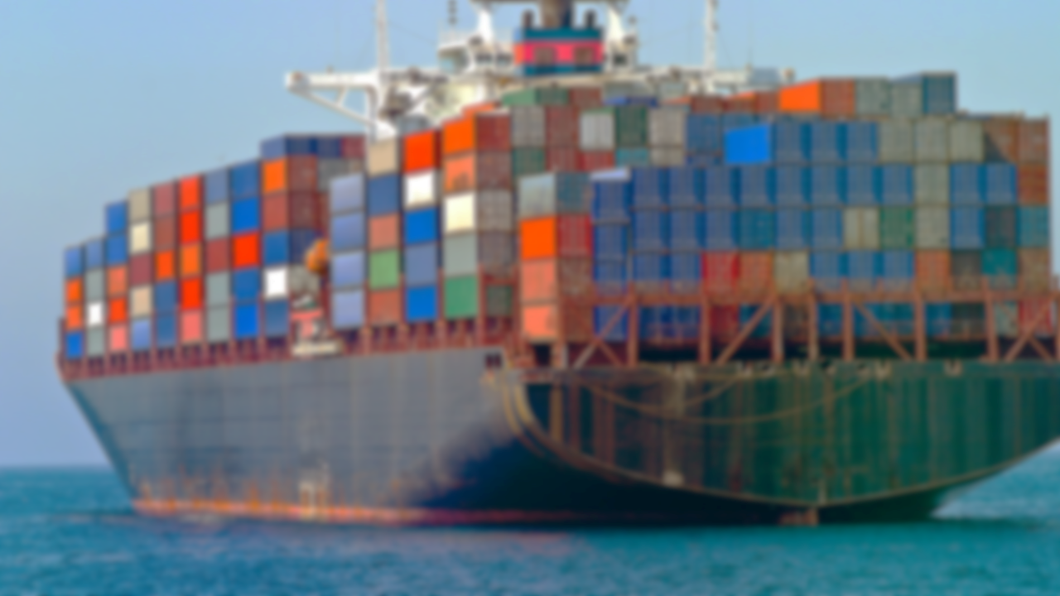
Session – 2 :
Docker Commands
and
Building Custom Images

Slide 2
Agenda
Recap
Docker Basic Commands
Docker Commands – image
Docker Commands – container
Docker Images - a revisit
Dockerfile (Building a custom Docker image)

Slide 3
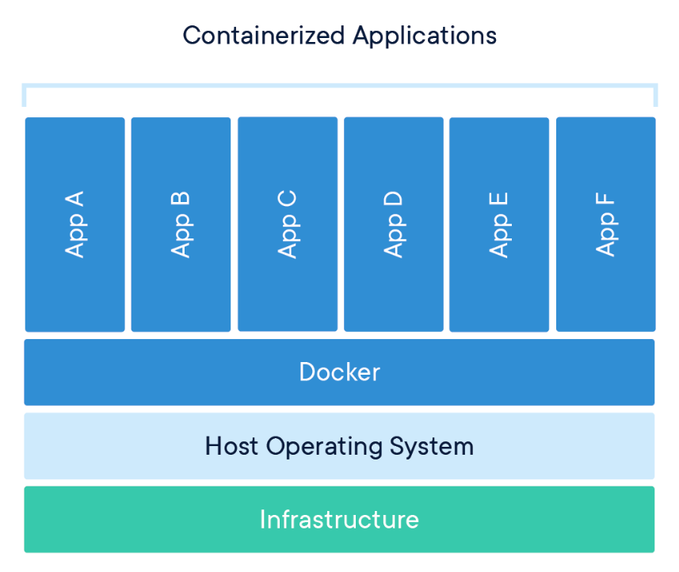
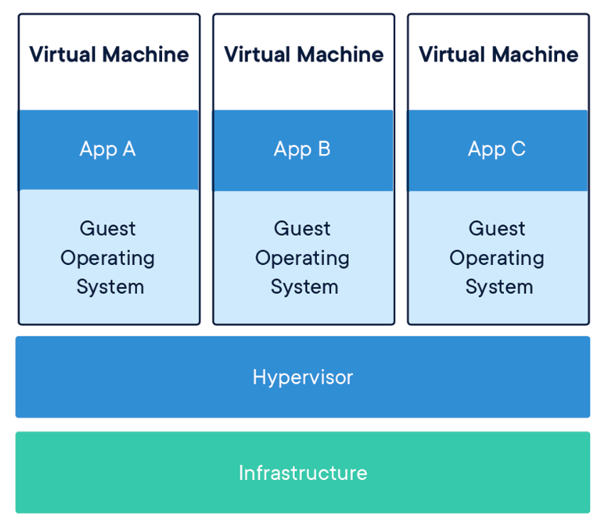
Docker vs VM
A VM is essentially an emulation of a real computer, that executes programs like a real computer.
The container provides operating system level virtualization by abstracting the User Space.

Slide 4
Docker Terminologies
Docker Engine: Client – Server application.
Docker Client: Cmd line interface to interact with Server.
Docker Daemon: Background service responsible for building and running containers. Provides RestAPIs and Docker CLI.
Docker Registries – Stores Docker images. (Docker Hub/Cloud)
Local and Public
Docker Objects -
Images – Read only template built by Engine. (using Dockerfile)
Containers – Runnable instances of Image.

Slide 5
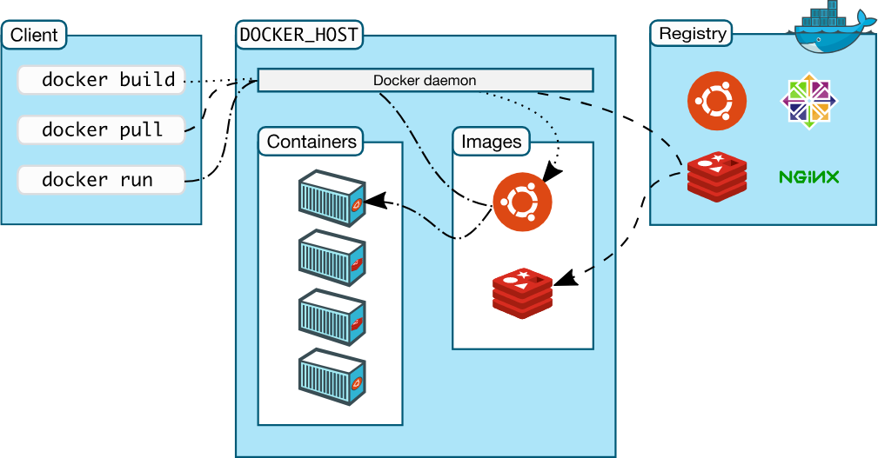
The flow

Slide 6
Docker Basic Commands - CLI
Command | Usage
docker --help | Get help
docker version | Shows docker version information
docker info | Displays the system-wide information
docker ps | Lists the information about running container
docker images | Lists the images present in the local registry
docker search | Search the docker hub for images

Slide 7
Docker Basic Commands
Command | Usage
docker pull | Pull an image from a registry
docker run | Run a command in a new Container
docker start | Start stopped/newly created container(s)
docker exec | Run a command in a running Container
docker stats | Display container(s) resource usage (live)
docker stop | Stop one running container(s)

Slide 8
Docker Commands - Image
Command | Usage
docker image --help | Get help
docker image ls [-a] | List locally available images
docker image pull | Pull an image from a registry (global)
docker image rm | Remove images
docker image prune | Remove unused images
docker image build | Build an image from Dockerfile
docker image tag | Create a tag TARGET that refers to SOURCE_IMG

Slide 9
Docker Commands - Container
Command | Usage
docker container create | Create a container out of an image
docker container ls | List previously used containers
docker container start | Start stopped/newly created container(s)
docker container stop | Stop one running container(s)
docker container prune | Remove all stopped containers
docker container logs | Fetch the logs of a container
docker container top | Display the running processes of a container

Slide 10
Docker Images – a revisit
Public Global Registries
Docker hub
Point to recall: Docker images are immutable!!
- This means, if one has "hello-world" docker image. No matter what you do it's going to print "Hello, World". And you can't make it print some thing else.. (e.g. - "Hello, Earth !")
Hello-World

Slide 11
Overriding default running program (less popular ways)
docker commit
e.g. -
docker commit --change='CMD ["echo", "test for alpine"]' <cID> alpine_echo:1
docker run
e.g. -
docker run --entrypoint "pwd" alpine

Slide 12
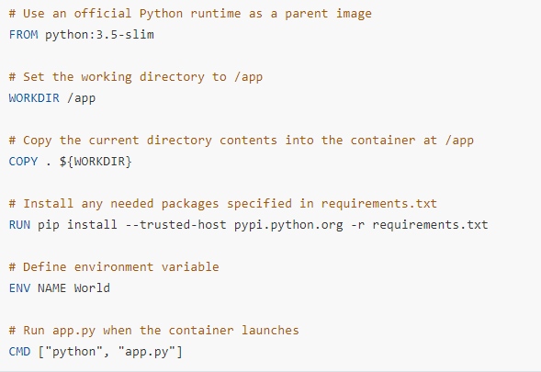
Dockerfile : first look

Slide 13
Dockerfile : Instructions
Instruction | Syntax | Information
FROM | FROM <image>:<tag> | First non-comment instruction in the Dockerfile
WORKDIR | WORKDIR </path/to/workdir> | Sets the working directory inside image file system
COPY | COPY <src> [<src> ...] <dest> | Add files to the destination (host to file system of an image)
RUN | RUN <command> | Run any command passed as an argument
CMD | CMD ["<param1>","<param2>"] | Provide defaults for an executing container
ENV | ENV <key> <value> | Sets the environment variable

Slide 14
Lets Build One (Demo)

Slide 15
Thanks

