Slide 1

Session – 3 :
Communication among "Containers"

Slide 2
Agenda
Recap
Revisiting calculator application (Setting up goal for the day)
Docker Networking
Bridge Networks
Host Networks
Demo

Slide 3
Recap (Commands)
docker --help | docker run
docker ps [-a] | docker container ls | docker exec
docker images | docker image ls | docker build | docker image build
docker search | docker logs | docker container logs
docker pull | docker image pull | docker commit
docker start | docker container start | docker cp
docker stop | docker container stop | docker inspect

Slide 4
Recap (Commands)
Instruction​ | Syntax​ | Information​
FROM​ | FROM <image>:<tag>​ | First non-comment instruction in theDockerfile​
WORKDIR​ | WORKDIR </path/to/workdir>​ | Sets the working directory inside image file system​
COPY​ | COPY <src> [<src> ...] <dest>​ | Add files to the destination (host to file system of an image)​
RUN​ | RUN <command>​ | Run any command passed as an argument​
CMD​ | CMD ["<param1>","<param2>"]​ | Provide defaults for an executing container​
ENV​ | ENV <key> <value>​ | Sets the environment variable ​

Slide 5

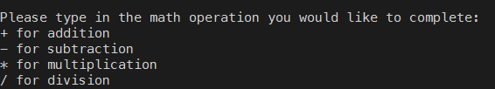
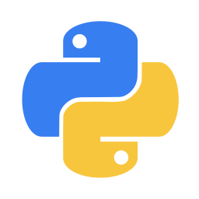

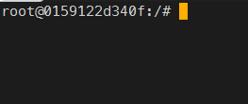
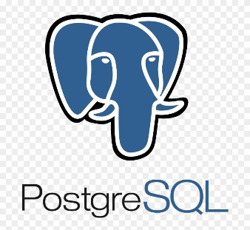
Revisiting Calculator Application
-it
-it

Slide 6
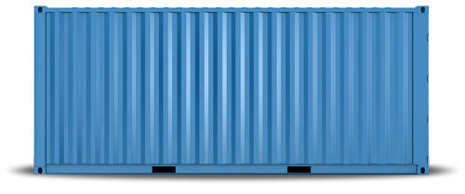
Docker Networking

Slide 7
Docker Networking - Why
Connect multiple Docker containers together, or connect them to non-Docker workloads.
Services/application do not need to be aware that they are on Docker.
Docker can be used to manage the communication between these multiple services in platform–agnostic way(upcomming sessions).
What we are not going to discuss -
Manipulation of IP tables on Linux Platforms
Manipulation of Routing rules on Windows servers
How docker networks work?

Slide 8
Docker Networks - Default
By default docker deamon provides following three networks out of the box -
Bridge :
It is the default network for all the running containers.
If user starts a container without specifying the network, by default it joins the bridge network.
Host :
Reduces the network isolation between container and host.
None :
Disables all networking.

Slide 9
Network Drivers
Docker's networking subsystem is pluggable.
Following are the drivers that are provided by default with docker engine package.
Bridge : This is the default network driver. Using this, user can create a bridge networks. All the running containers by default use networks created with this driver, unless specified otherwise.
Host : User can create a host networds. These are used when user do not want isolated networks for their applications running on the container.
None : Disable all networking. It is used in conjunction with custom dirvers.
Overlay : Used to connect multiple docker daemons.
Macvlan : Assigns a mac address to the container.

Slide 10
Bridge Networks
Uses a software bridge, which allows containers connected to the same bridge network to communicate.
Provides isolation from containers which are not connected to that bridge network.
Bridge driver automatically installs rules in the host machine so that containers on different bridge networks cannot communicate directly with each other.

Slide 11
Bridge Networks – Basic Principles
Bridge networks(driver) only apply to containers running on the same Docker daemon.
In any other case one should use networks suitable for their use case.
When one starts docker, a default bridge network (also called bridge) is created automatically.
One can also create user-defined custom bridge networks (these are superior to the default one).

Slide 12

User-Defined Bridge vs Default Bridge
User-defined bridges provide better isolation and interoperability b/w containerized applications.
Containers expose all ports to each other and no port to outside world.
-it –p 8080:80
Notes:
1) Better isolation – db application e.g

Slide 13
User-Defined Bridge vs Default Bridge
User-define bridges provide automatic DNS resolution between containers.
Containers on the default bridge network can only access each other by IP addresses, unless you use the --link option, which is considered legacy.
Default
User Defined
App1
timeout
ping App2
Success
App2
Notes:
1) Better isolation – db application e.g

Slide 14
User-Defined Bridge vs Default Bridge
Each user-defined network creates a configurable bridge. (docker network create)
If different group of apps need different requirements, one can configure each user-defined bridges separately, as one creates it.
configuring the default bridge network happens outside of Docker itself, and requires a restart of Docker.
Containers can be attached and detached from user-defined networks on the fly.
To remove a container from the default bridge network, you need to stop the container and recreate it with different network options.
Notes:
1) Better isolation – db application e.g

Slide 15
Host Network
If you use host network driver for a container, that means - container’s network stack is not isolated from the Docker host.
host networking driver only works on Linux hosts.
HOST network
hostA:5432 -> PostgresQL
5432
5432

Slide 16
Demo
Container communication with host.
Communication between two containers.
Using default bridge
Using user-defined bridge
Host bridge

Slide 17
Thanks

