Slide 1

Working with Claude Code
How Claude Code operates as a full-stack collaborator on a real production codebase — not autocomplete, a persistent engineering process.

Slide 2
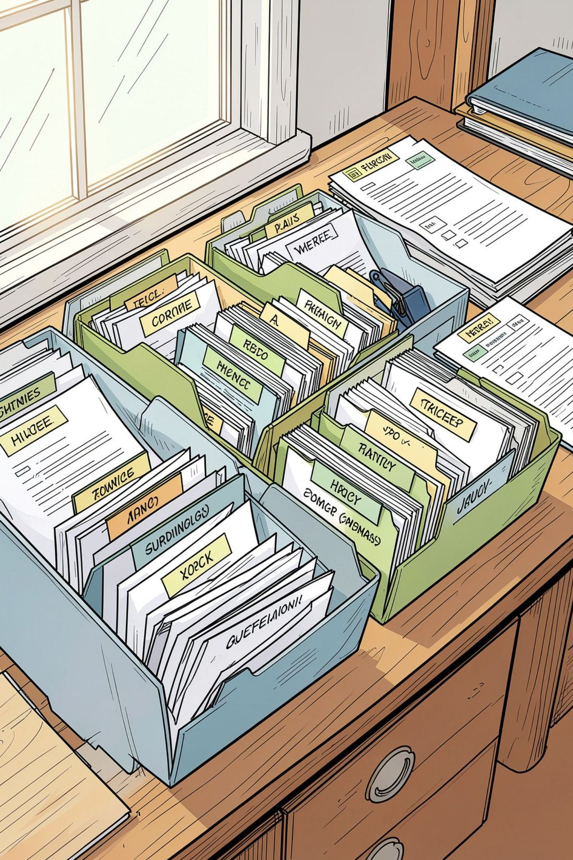


The Setup
Project-Level Files
Claude Code is directed by a set of project-level files checked into the repo, read automatically at the start of every session — not one-off prompting.
What's Included
A root instructions file, a library of vetted reference skills, a running decision trail, and a structured testing and QA process.
The Goal
Every session starts with full context, follows the same rules, and leaves a written trail the next session can pick up from exactly where things left off.

Slide 3
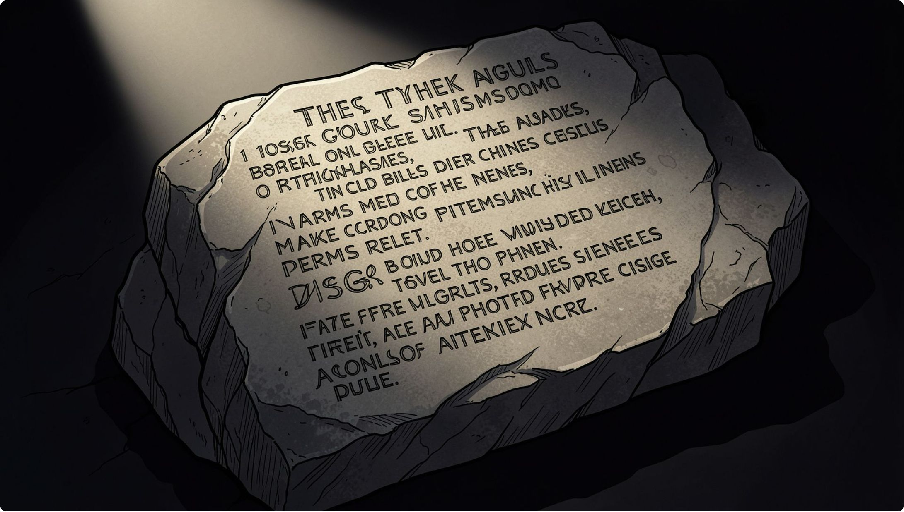
The Constitution File
A single root-level instructions file governs every session — defining the engineer persona Claude acts as, and a set of hard, non-negotiable rules.
Never skip test coverage, never commit red code
Treat security boundaries as boundaries, not filters
Match existing contracts exactly — no inventing new ones
Stop and log genuine ambiguity instead of guessing
Includes documented architecture decisions, known inconsistencies discovered along the way, current priorities as ordered Definition-of-Done-gated slices, and a session resume protocol.

Slide 4
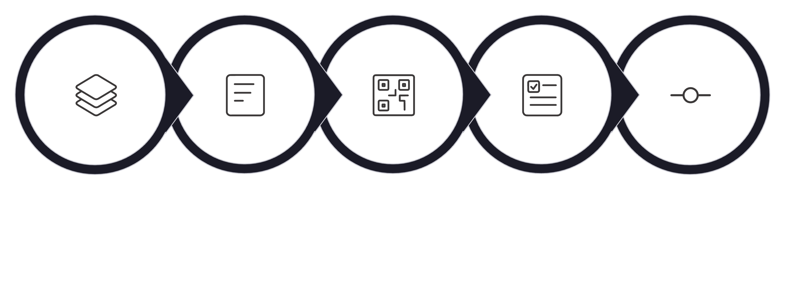
The Development Process
Check Contracts
Lint & Run Suite
Slice Work
Build & Test
Commit Slice
A disciplined, slice-by-slice workflow ensures every unit of work is independently verified before the next begins — no accumulated red code, no skipped gates.

Slide 5
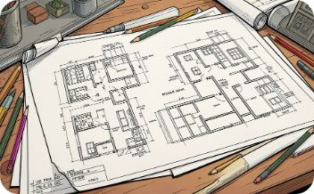


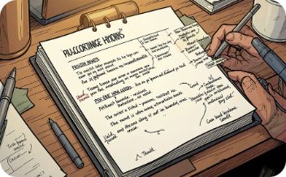
Vetted Reference Skills
Framework & Database Patterns
Security Checklists
Cross-Cutting Discipline
Project-Specific Overrides
Applied to every new endpoint or auth-touching change without exception.
Architecture patterns matched to the actual stack in use — not generic boilerplate.
API design, error handling, secrets management, and code review standards baked in.
Each skill file records where generic guidance does NOT match this project's own conventions.

Slide 6
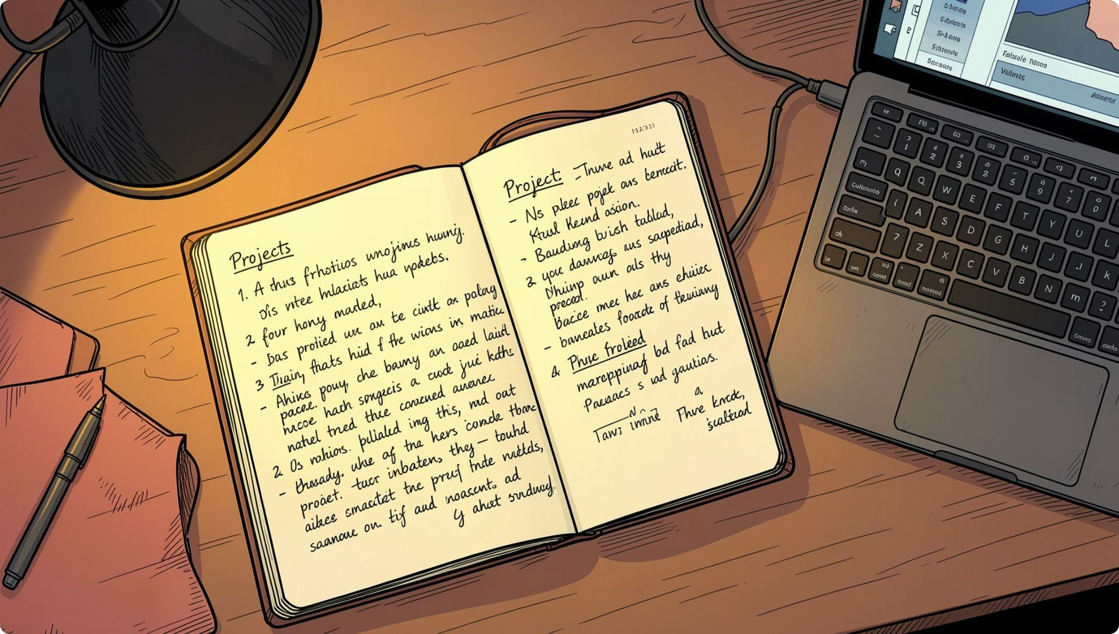

The Planning Trail
A folder of living documents captures every architecture and product decision made during the build, indexed by a single README.
Original requirements and contract analysis
Phased implementation plan
Hard-rules documents per layer of the stack
Full page-by-page and component-by-component frontend audit
An open-questions log records genuinely unresolved ambiguities — Claude never silently guesses an answer.
A new session reads this trail instead of re-deriving decisions from scratch. This is how continuity works.

Slide 7
Testing Documentation: Two Complementary Layers
Manual QA Trail
Formal Test-Case Suite
One matching plan / result / suggestion triad per feature, reused as acceptance criteria instead of re-derived each time. Provides a human-verifiable record alongside automated results.
Every feature area split into Unit / API / End-to-End / Frontend sections, each carrying an explicit role-based access matrix using generic role labels.
Every test case carries a real status — fixed, pre-existing, or still open — not narrative claims of coverage.

Slide 8
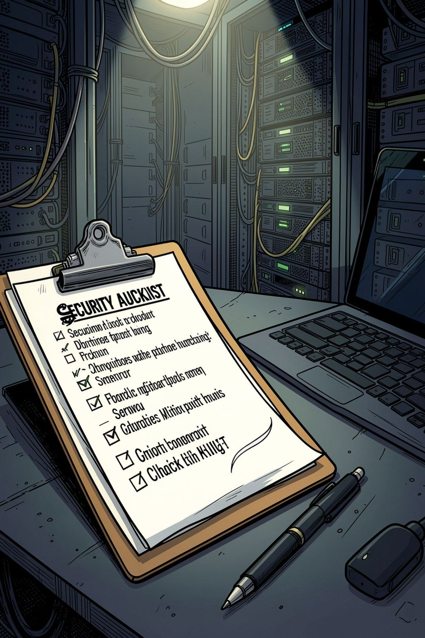
The QA Execution Brief
Explicit Access Matrix
Every role against every operation — write an automated test for every cell. Data isolation is a security boundary, not just a filter.
Hard Gate: Nothing Passes Unrun
A test written but not executed goes in "pending," never "passed." No exceptions.
Live-Browser Verification Required
Log in as each role and confirm denied roles don't just fail an API call — they don't even see the button or route.
Running Findings Log
Every gap already flagged is tracked. Check the log before assuming an area has been audited.

Slide 9
Current Coverage Snapshot
100%
1+
Unit Coverage
Real Issues Found
All built modules, including global auth and access guards
Every area audited has turned up at least one previously-unfixed issue
What Coverage Includes
Happy path, validation failures, and isolation checks per access point
Role-gating verified at every guarded boundary
End-to-end coverage expanding area by area — systematically, not all at once
The process finds problems, not just checks boxes. Every audited area has produced at least one real, previously-unfixed issue.

Slide 10






How Claude Code Is Used Day to Day
Auto-loads Context
Tests Before Done
Reads project instructions and full session context automatically at start — no manual re-briefing.
Writes and runs unit, integration, and end-to-end tests before calling any slice complete.
Commit Discipline
Contract-First Changes
Small, verified, per-slice commits with conventional messages — never bulk uncommitted work.
Cross-checks every change against existing contracts before writing new code.
Logs Ambiguity
Structured QA Pass
Open questions are logged, never silently guessed. Ambiguity is surfaced, not buried.
Runs a full security and QA audit with a written findings log, not informal spot-checks.

Slide 11


Key Takeaways
A Real System, Not a Single Prompt
Claude Code operates against a real constitution, a documented development process, a vetted skill library, a decision trail, and a living QA process with hard gates.
Real Results
Consistent test coverage across every module, a formal access-control test suite, and an audit process that has found and fixed real issues — not checkbox coverage.
A Repeatable Model
This is a repeatable model for running a serious, production-grade build with Claude Code as a full-stack collaborator — structured, verifiable, and built to last.

