Slide 1
COURSERA CAPSTONE PROJECT
IBM APPLIED DATA SCIENCE CAPSTONE PROJECT
PRANAV KARAMCHEDU

Slide 2
NEIGHBOURHOOD SEGMENTATION AND CLUSTERING FOR HYDERABAD, INDIA USING LOCATION DATA THROUGH FOURSQUARE API
SELECTING THE OPTIMUM LOCATION(NEIGHBOUHOOD FOR OPENING A RESTAURANT IN HYDERABAD, INDIA

Slide 3
INTRODUCTION
Hyderabad city: well known for its love for food and drink.
Restaurants are a booming business in such an interesting market.
Success of a newly opened restaurant depends on many factors: geographical, financial, management etc.
Selecting the optimum location to open the restaurant is one of the key factors to kickstart the venture in the right direction

Slide 4
BUSINESS PROBLEM AND TARGET AUDIENCE
OBJECTIVES OF THE PROJECT:
Segment and cluster the different neighbourhoods in the city of Hyderabad.
Select the most optimum location(neighbourhood) to open a restaurant in the city.
TARGET AUDIENCE OF THE PROJECT:
The target audience of this project are investors and chefs looking to open a restaurant in the city of Hyderabad.

Slide 5
DATA AND ITS SOURCES
To tackle this problem, we use the following data to complete the analysis:
List of neighbourhoods in the city of Hyderabad: obtained from the Wikipedia page.
Geospatial data (latitude and longitude coordinates) of the neighbourhoods and venues in the project.
Location data (venues, type of venue etc) from the Foursquare API which helps in the process of clustering the neighbourhoods.

Slide 6
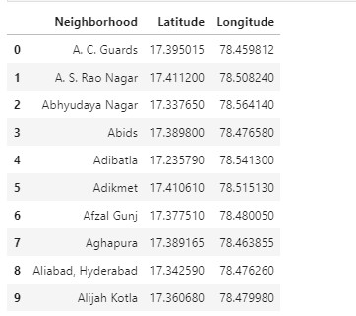
METHODOLOGY
Scraping the Wikipedia page to create a data frame of Hyderabad data using requests, BeautifulSoup and pandas packages in Python

Slide 7
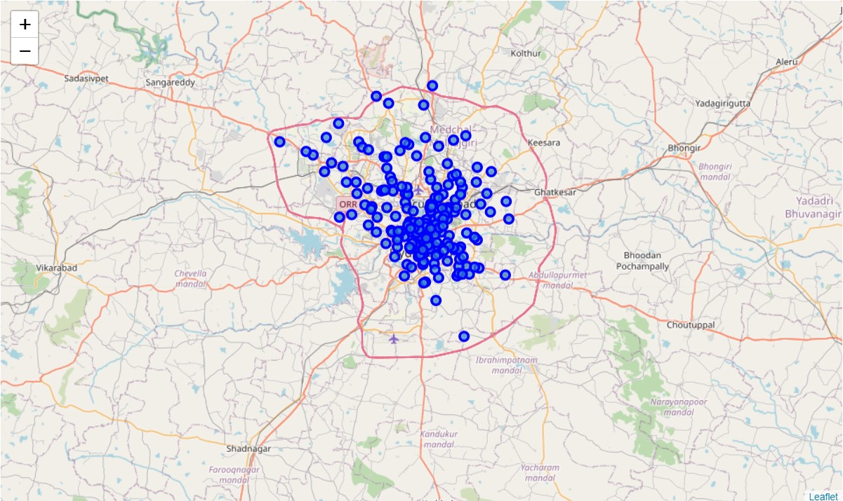
Plotting the map of Hyderabad and it neighbourhoods using Folium Library

Slide 8
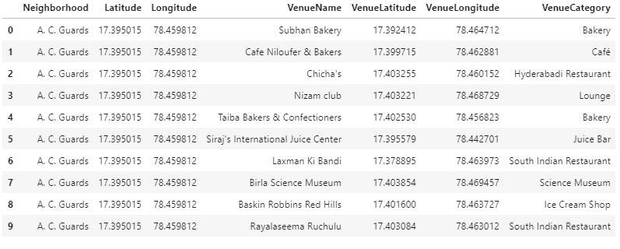
Using the Foursquare Places API to obtain venue and location details for all neighbourhoods.

Slide 9
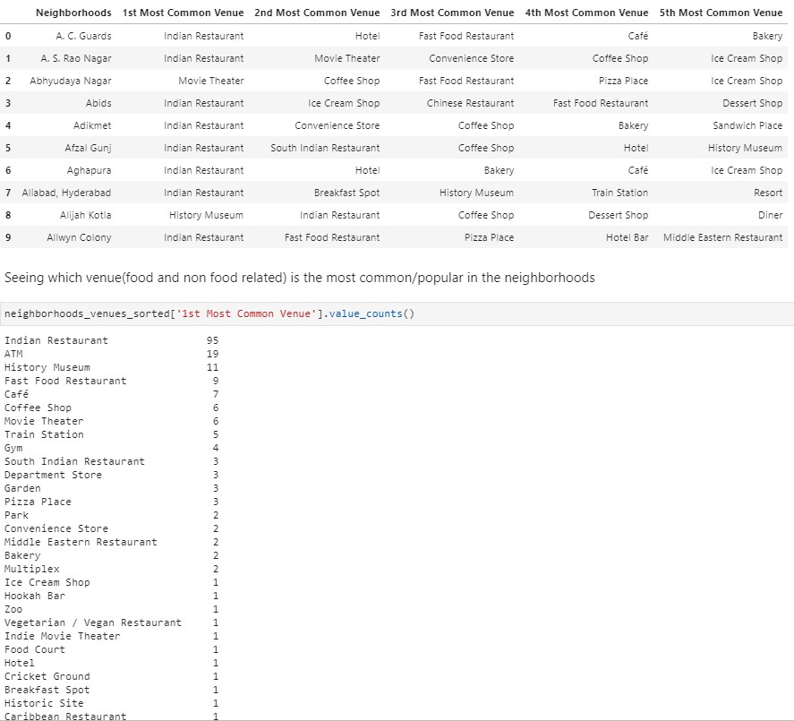
Exploratory analysis shows Indian Restaurants are the most common/popular choice.

Slide 10
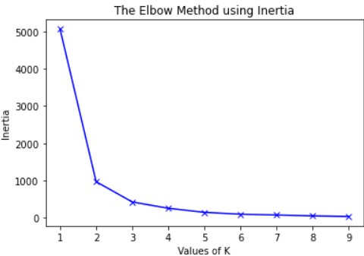
Using the elbow plot method to determine the optimum value of k for the K-Means (Clustering) Algorithm.
K=2 is the ideal value in this case

Slide 11
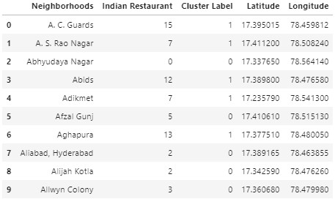
Merged dataset with neighbourhoods and their cluster labels.

Slide 12
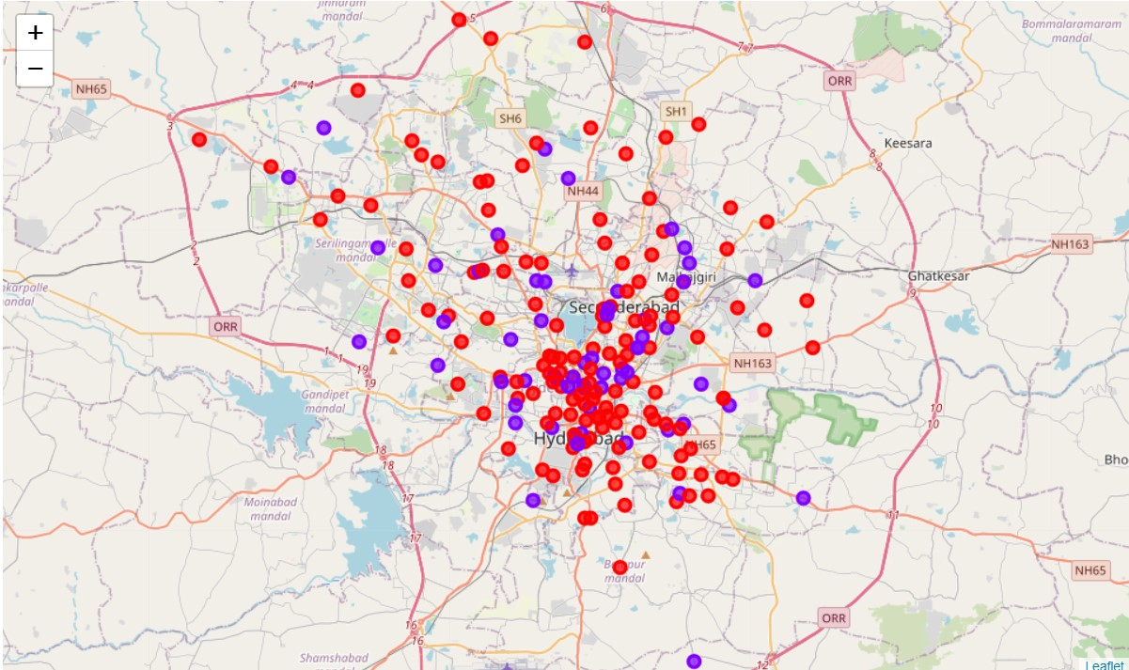
The clustered neighbourhoods plotted using Folium.
Red= cluster 0. Blue = Cluster 1.

Slide 13
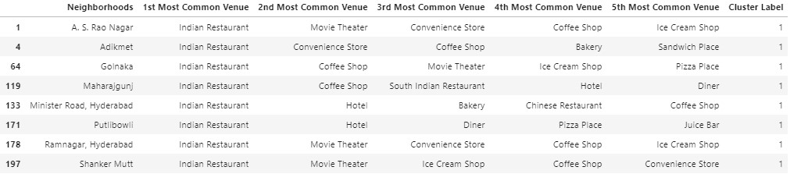
The 7 neighbourhoods which are the result of the analysis as potential choices.

Slide 14
RESULTS AND DISCUSSION
Seven neighbourhoods obtained as potential locations for opening a restaurant.
A.S. Rao Nagar is a major commercial and residential area in the city with few number of Indian restaurants(as seen in analysis).
Analysis can be further improved by improving the exploratory analysis and the overall quality of the dataset before running the ML algorithm.

Slide 15
CONCLUSION
The main purpose of the project was to cluster neighbourhoods in the city of Hyderabad to select an optimum location for the opening of a new restaurant. In the analysis we also looked at which type of restaurant (Indian) would be the most popular choice and the end decision was made considering the clustering results, demographic data, and similarity of neighbourhoods.
To make a thorough decision additional factors like attractiveness of each location (proximity to park or water), levels of noise / proximity to major roads, real estate availability, prices, social and economic dynamics of every neighbourhood etc can also be considered.

