Slide 1
— Computational Machine Learning Assignment 3 Virtual Presentation
Introduction and Goal
The goal is to create a machine-learning system that can categorize images of malignant cells from histopathology. A modified version of the "CRCHistoPhenotypes" dataset is used for this challenge. The 27x27 RGB photographs of cells from 99 different patients make up the dataset, which will be used for two tasks: Cancerous/ not Cancerous and Cancer cell type.
Pranav Karnth Mannur
s3828461

Slide 2
Critical Analysis
Task 1:
Exploratory Data Analysis: Inferences from the EDA are as follows. We merged both the datasets (extra data, main data) to produce a data frame. It was found that there was an imbalance in the classes – Cancerous/ Not Cancerous. (0,1). It was also found that, the data related to a few patients was not distributed evenly
Task 2:
Exploratory Data Analysis: Inferences from the EDA are as follows. We used the dataset - main data to produce a data frame. It was found that there was an imbalance in the classes –cell types. (0,1,2,3). It was also found that, the data related to a few patients was not distributed evenly.

Slide 3
Critical Analysis
Cancerous/ Not Cancerous: Baseline Model: From the results, we can observe that the training accuracy is higher than the validation accuracy, which suggests that the model might be overfitting the training data due to class imbalance, which indicates that it requires regularization techniques or more data to improve its performance. Therefore, the model has a high variance.
Custom Model: From the results, The model performed well in detecting cancerous cells with high accuracy, precision, recall, and specificity. However, the slight difference in performance between the test set and the validation and train sets suggests that the model may have some variance issues and could benefit from further optimization.
After Hyperparameter Tuning – Keras Tuner: From the results, the Keras Tuner model has relatively low bias and variance. This is indicated by the fact that the accuracy, precision, recall, specificity, and F1 score are all consistent across the test, validation, and train datasets, with a relatively small difference between the performance on the train and validation sets.

Slide 4
Critical Analysis
Cancer – cell type: Baseline Model: From the results, the model has a high bias, which means that the model is unable to capture the underlying patterns in the data correctly. Additionally, the variance of the model is relatively low, which suggests that the model is not overfitting on the training data, but it is not generalizing well.
After Hyperparameter Tuning – Keras Tuner: From the results, the bias of the model seems good as indicated by the higher accuracy on the test, training, and validation datasets. The evaluation results indicate that the model's accuracy on the training data is slightly higher compared to the test data and validation data. This suggests a moderately low variance.
VGG 16: From the results, the model has performed reasonably well on the training, validation, and test sets with good accuracy. In this case, since the accuracy on all sets is relatively close, it suggests that the model has generalized well and there is no significant bias or variance issue.

Slide 5
Literature Review
• K. Sirinukunwattana, S. E. A. Raza, Y. Tsang, D. R. J. Snead, I. A. Cree and N. M. Rajpoot, ”Locality Sensitive Deep Learning for Detection and Classification of Nuclei in Routine Colon Cancer Histology Images,” in IEEE Transactions on Medical Imaging, vol. 35, no. 5, pp. 1196-1206, May 2016
• He, K., Zhang, X., Ren, S. and Sun, J., 2016. Deep residual learning for image recognition. In Proceedings of the IEEE Conference on computer vision and Pattern Recognition (pp. 770-778)

Slide 6
Locality Sensitive Deep Learning for Detection and Classification of Nuclei in Routine Colon Cancer Histology Images
The paper introduces novel deep learning approaches for the detection and classification of nuclei in colorectal adenocarcinoma histopathology images stained with H&E. Traditional methods use a sliding window approach, while the proposed approaches incorporate the distance from the center of an object (nucleus) and utilize a weighted ensemble of local predictions for more accurate labeling.
For detection, the authors propose a spatially constrained CNN (SC-CNN) that includes a parameter estimation layer and a spatially constrained layer for spatial regression. SC-CNN predicts the probability of a pixel being the center of a nucleus, and the predicted probabilities are topologically constrained to concentrate high probability values near the nucleus center.
For classification, the authors introduce the neighboring ensemble predictor (NEP) to be used with a standard SoftMax CNN. NEP leverages patch-based predictions in the local neighborhood of the nucleus to be classified, improving the accuracy of classification compared to single-patch-based methods.

Slide 7
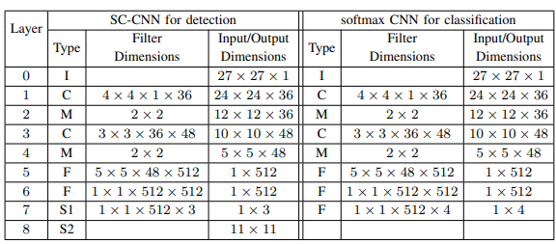
Locality Sensitive Deep Learning for Detection and Classification of Nuclei in Routine Colon Cancer Histology Images
Architecture – for both networks
Data Augmentation: In order to address rotation variance and color distribution variability in histology images – The authors randomly rotated patches (0°, 90°, 180°, 270°) and flipped them horizontally or vertically. To account for color distribution variability, they perturbed the color values in HSV space by multiplying the hue (H), saturation (S), and value (V) variables with random numbers within specific ranges. Additionally, they extracted multiple patches of the same nucleus from different locations to mitigate location variance and handle a class imbalance in the dataset. These augmentation techniques were applied to improve the robustness and generalization of the Softmax CNN used for classification.

Slide 8
Locality Sensitive Deep Learning for Detection and Classification of Nuclei in Routine Colon Cancer Histology Images
Detection
Classification
Combined Classification and Detection
Precision, Recall, and F1 score were used to quantitatively assess the detection performance.
Conclusion: The evaluation of the proposed approaches was performed on a sizable dataset comprising over 20,000 annotated nuclei from various histologic grades. The results demonstrated that the spatially-constrained CNN was superior for nucleus detection, while the Softmax CNN combined with the neighboring ensemble predictor showed better performance for nucleus classification. The combination of these two approaches has the potential to provide a systematic quantitative analysis of tissue morphology and constituents, making it a valuable tool for gaining a deeper understanding of the tumor microenvironment.

Slide 9
Deep Residual Learning for Image Recognition
Abstract:
The authors of this paper propose a framework called residual learning to train deeper neural networks more effectively. They redefine the layers in a way that they learn residual functions with respect to the layer inputs instead of learning unreferenced functions. Empirical evidence shows that these residual networks are easier to optimize and can achieve higher accuracy with increased depth.
The authors evaluate residual networks on the ImageNet dataset, with depths of up to 152 layers, which is 8 times deeper than previous VGG networks but with lower complexity. An ensemble of these residual networks achieves a low error rate of 3.57% on the ImageNet test set, winning first place in the ILSVRC 2015 classification task. They also analyze the performance of these networks on CIFAR-10 with 100 and 1000 layers.
The authors emphasize the importance of depth in representations for visual recognition tasks. Due to the deep representations in their networks, they achieve a significant 28% improvement in the COCO object detection dataset.

Slide 10
Deep Residual Learning for Image Recognition
Plain Network: We first evaluate 18-layer and 34-layer plain nets. The authors suggest that the optimization challenges in deep plain networks are unlikely due to vanishing gradients. The networks employ batch normalization, ensuring non-zero variances in forward signals and healthy norms in backward gradients. Although the 34-layer plain network achieves competitive accuracy, the authors suspect that deep plain networks have very slow convergence rates, hindering the reduction of training error. They plan to investigate the underlying reasons for these difficulties in future research.
Residual Networks: The authors evaluate 18-layer and 34-layer residual networks (ResNets) by adding shortcut connections to the plain network architectures. They observe three key findings. Firstly, the 34-layer ResNet outperforms the 18-layer ResNet, indicating that the degradation problem is addressed, and accuracy gains are achieved with increased depth. Secondly, compared to its plain counterpart, the 34-layer ResNet reduces the top-1 error and successfully lowers the training error, demonstrating the effectiveness of residual learning. Lastly, the 18-layer ResNet achieves comparable accuracy to the plain net but converges faster, suggesting that ResNets facilitate optimization with faster early-stage convergence.

Slide 11
Deep Residual Learning for Image Recognition
Identity VS Projection Shortcuts: (A) parameter-free shortcuts using zero-padding for increasing dimensions, (B) shortcuts with projection for increasing dimensions and identity for others, and (C) shortcuts with projection for all dimensions. Option B, with projection shortcuts for increasing dimensions, performs slightly better than option A. However, the differences among A, B, and C are small, indicating that projection shortcuts are not essential for addressing the degradation problem. Therefore, option C is not used.
Deeper Bottleneck Architectures: The bottleneck architectures in the study consist of 1x1, 3x3, and 1x1 convolutions. The 1x1 layers reduce and then increase dimensions, while the 3x3 layer acts as a bottleneck with smaller input/output dimensions. Both designs have similar time complexity. The parameter-free identity shortcuts are crucial for these bottleneck architectures. If the identity shortcut is replaced with projection, the time complexity and model size would double since the shortcut connects to the two high-dimensional ends. Therefore, identity shortcuts result in more efficient models for the bottleneck designs.

Slide 12
Deep Residual Learning for Image Recognition
50–Layer ResNets: We replace each 2-layer block in the 34-layer net with this 3-layer bottleneck block, resulting in a 50-layer ResNet. We use option B for increasing dimensions. This model has 3.8 billion FLOPs.
101-Layer and 152-Layer ResNets: The authors construct 101-layer and 152-layer ResNets by adding more 3-layer blocks. Surprisingly, even with the increased depth, the 152-layer ResNet has lower complexity than VGG-16/19 nets. The 50/101/152-layer ResNets achieve higher accuracy than the 34-layer ones without experiencing the degradation problem. They observe significant accuracy gains from the increased depth across various evaluation metrics.

Slide 13
Deep Residual Learning for Image Recognition
Comparison:
The baseline 34-layer ResNets achieve highly competitive accuracy. The 152-layer ResNet achieves a single-model top-5 validation error of 4.49%, surpassing all previous ensemble results. An ensemble is formed by combining six models of different depths, including two 152-layer ones at the time of submission. The ensemble achieves a top-5 error of 3.57% on the test set, resulting in a first-place win in the ILSVRC 2015 competition.

Slide 14
Extension:
A typical Histopathology image has a high resolution. For example, the original images in the “CRCHistoPhenotypes” data set have a resolution of 500x500. However, an individual cell in that image is relatively small (fits within a rectangle of 27x27). If a model is developed to process the high-resolution images (or a down-sampled version of it), then the fine-scale information of the cells will be lost and the classifier would not be good. To solve this problem, individual cells were detected in the original histopathology images and, were extracted into individual images of 27x27.
How can automated detection and extraction of individual cells from high-resolution histopathology images be achieved? Discuss the applicable machine learning techniques and problem formulation needed for an end-to-end system.

Slide 15
References for Extension:
Yu, Y.; Wang, C.; Fu, Q.; Kou, R.; Huang, F.; Yang, B.; Yang, T.; Gao, M. Techniques and Challenges of Image Segmentation: A Review. Electronics 2023, 12, 1199. https://doi.org/10.3390/electronics12051199
Jung, S.; Heo, H.; Park, S.; Jung, S.-U.; Lee, K. Benchmarking Deep Learning Models for Instance Segmentation. Appl. Sci. 2022, 12, 8856. https://doi.org/10.3390/app12178856
Liu, H.; Ma, X.; Yu, Y.; Wang, L.; Hao, L. Application of Deep Learning-Based Object Detection Techniques in Fish Aquaculture: A Review. J. Mar. Sci. Eng. 2023, 11, 867. https://doi.org/10.3390/jmse11040867

Slide 16
Extension:
Object Detection:
Object detection algorithms, such as Faster R-CNN, YOLO, or SSD, can be adapted to detect and localize individual cells within high-resolution histopathology images. By formulating the problem as a bounding box regression task, the aim is to predict the bounding boxes around each cell in the image.
Faster R-CNN: Faster R-CNN is a popular object detection algorithm that consists of two main components: a region proposal network (RPN) and a classification network. The RPN generates potential bounding box proposals, and the network classifies these proposals into different classes, including the presence of individual cells.
YOLO: YOLO is a real-time object detection algorithm that takes a different approach compared to Faster R-CNN. It divides the input image into a grid and predicts bounding boxes and class probabilities directly from the grid cells.
SSD: is another single-shot object detection algorithm that performs detection and classification in a single pass. It uses a series of convolutional layers with different scales to detect objects of various sizes.

Slide 17
Extension:
Semantic Segmentation:
By giving each pixel a unique label, semantic segmentation algorithms like U-Net or Mask R-CNN can be utilized to segment individual cells. With this method, cells can be accurately identified down to the pixel level. Assigning the appropriate label to each pixel in order to identify cells from the background is the goal of the problem, which may be stated as a pixel-wise classification challenge.
Prior to the application of deep learning to the field of image segmentation, semantic segmentation classifiers were often built using random forest and semantic texton forests approaches. Deep learning algorithms have been used more and more in segmentation tasks over the last few years, and both the segmentation effect and performance have greatly increased. The original method uses small regions of the image to train a neural network, which then categorizes the pixels. The fully linked layers of the neural network require fixed-size images, hence this patch classification algorithm has been used.

Slide 18
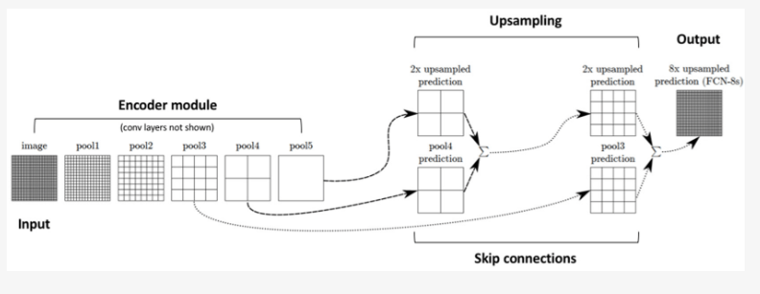
Extension:
Semantic Segmentation:
FCNs prove that neural networks can perform end-to-end semantic segmentation training, laying a foundation for deep neural networks in semantic segmentation.

Slide 19
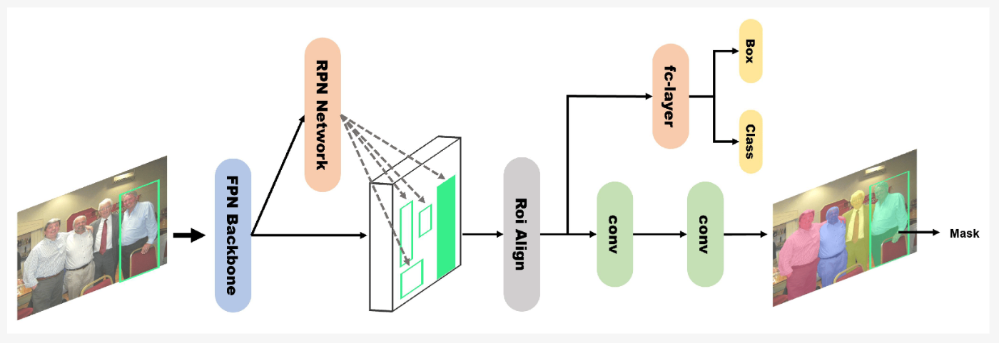
Extension:
Instance Segmentation:
Individual instances inside an image can be located and segmented using instance segmentation techniques as Mask R-CNN. By isolating each cell instance in the image, this strategy goes beyond semantic segmentation and enables distinct identification and extraction. It is possible to formulate the issue as an instance-level segmentation task, with the goal being to identify, classify, and distinguish each cell instance in the image.

Slide 20
Extension:
Formulating the problem involves preparing labeled training data for the machine learning model. This typically requires annotations that indicate the bounding boxes or pixel masks for individual cells in the high-resolution histopathology images. The labeled data would serve as the ground truth for training the model.
Once the problem is formulated and the data is prepared, the machine learning model can be trained using the appropriate technique, such as object detection, semantic segmentation, or instance segmentation. The trained model can then be used to automatically detect and extract individual cells from the original histopathology images with 500x500 resolution, providing a complete end-to-end system.
By applying suitable machine learning techniques and formulating the problem effectively, it becomes possible to automate the detection and extraction of individual cells from high-resolution histopathology images, thus preserving the fine-scale information needed for accurate classification and analysis.

Slide 21
— Thank you very much Have a good one, cheers!

