Slide 1

GOVERNMENT COLLEGE OF ENGINEERING. CHANDRAPUR
DEPARTMENT OF ELECTRONICS AND TELECOMMUNICATION ENGINEERING
Project Name : Low Cost Self-Activating Touchless Hand Sanitizer Dispensing with Battery Imposed System
Team Members:
Shivani N. Kodurwar
Shubham P. Kajale
Pranav B. Khatale
Guided by:
Prof H. M. Raza

Slide 2
CONTENTS
INTRODUCTION
AIM OF THE PROJECT
BLOCK DIAGRAM
CIRCUIT IMPLEMENTATION
SOFTWARE & PROGRAMMING
ADVANTAGES
DISADVANTAGES
APPLICATIONS
CONCLUSION

Slide 3



INTRODUCTION
The main intention of this project is to give a touchless automated Hand Sanitizer Dispensing solution for everyone.
It is really impossible for aged persons to press the foot operated hand sanitizer dispensers.
Low cost, easily deployable & fast operating dispensing solution is required in public places.
Provide an good alternative to expensive foot operated mechanical sanitizer dispensers

Slide 4




AIM OF THE PROJECT
Low cost affordable solution
Reduction of high cost hardware in implementation
Touchless fast operating solution
Easily deployable battery operated solution
Rapid Manufacturing

Slide 5
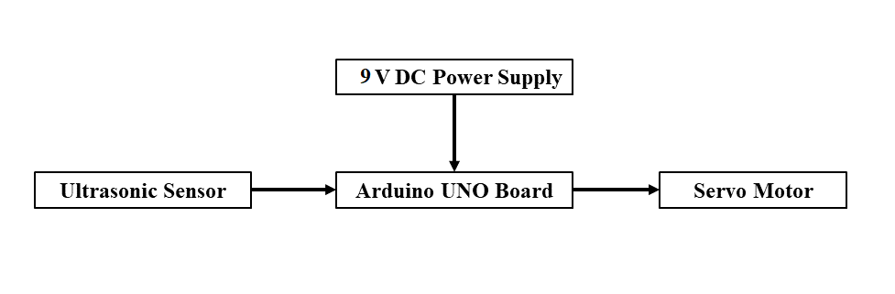
BLOCK DIAGRAM

Slide 6
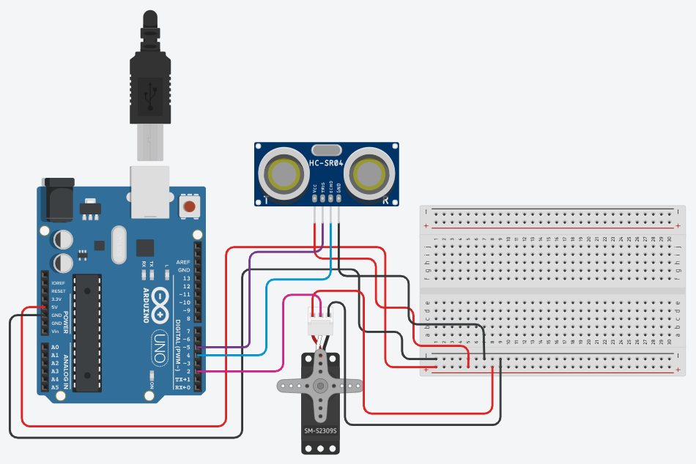
CIRCUIT IMPLEMENTATION

Slide 7
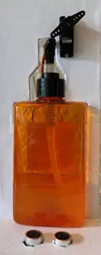
Servo Motor Horn
Servo Motor
Sanitizer Bottle
Ultrasonic Sensor
Sanitizer Dispensing Nozzle

Slide 8
BLOCK DIAGRAM
Start
Measure Distance
If distance < 40 cm
False
Servo Stops
True
Servo Motor Rotates

Slide 9


SOFTWARE & PROGRAMMING
Arduino
IDE
Arduino C & C++

Slide 10



ADVANTAGES
Hands-free usage
User friendly & Cost efficient
Low amount of strength of operation required
Appropriate amount of dispensing

Slide 11



Fabricated from industrial waste like hard cardboards & cheap electronic components
Portable
Works without A.C. mains power supply
Wall mountable

Slide 12


DISADVANTAGES
Requires battery
Not show remaining sanitizer level in bottle

Slide 13





APPLICATIONS
Hospitals
Restaurants
Offices
Schools/Colleges
Religious Places
Industries

Slide 14
CONCLUSION
Implementing of Contactless Automatic Hand Wash Dispenser for Sanitation is efficient and the cost price is minimized. It works like the normal contactless automatic machine. The human gets the limited sanitizer liquid for sanitation in hand, to sanitize the hands and to protect themselves from the Covid-19. This system can be utilized in malls, high populated areas.

Slide 15
Thank You.
https://github.com/pranavkhatale/Low-Cost-Self-Activating-Touchless-Hand-Sanitizer-Dispensing-with-Battery-Imposed-System

