Slide 1

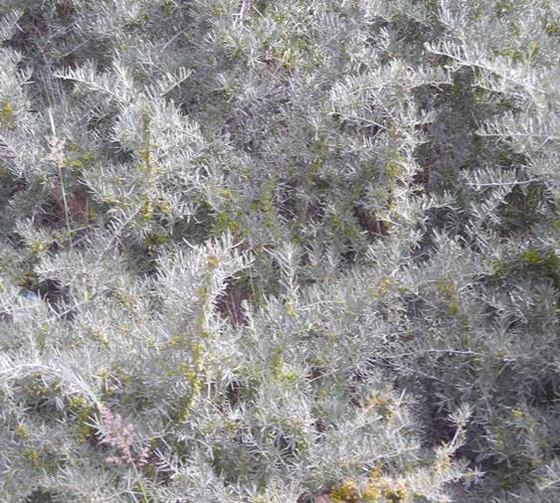
SeaBuckThornMiSatDB
UNIVERSITY SCHOOL OF BIOTECHNOLOGY
GURU GOBIND SINGH INDRAPRASTHA UNIVERSITY
Home Intro Blast Search Contact us
SeaBuckThornMiSatDB: A Comprehensive Database of Genic Microsatellite Loci of Seabuckthorn (Hippophae rhamnoides L.)
Advent of sequencing technology has resulted in rapid development of genome resources. It has offered an opportunity to develop huge data set for even the least studied plants in a single run. Seabuckthorn (Hippophae L.; 2n=24), a member of family Elaegnaceae, is an inhabitant of high mountain ranges and also an ecologically viable and ethnobotanically sustainable food crop (Verma 1998). Seabuckthorn is one such least studied plant for which limited genomic resources were available until last decade but increasing interest of consumers as well as researcher in its medicinal led to certain significant development in its available genomic resources. Whole transcriptome sequencing of seabuckthorn (Ghangal et al., 2013) led to development of one of the major sequence resource in seabuckthorn. This sequence data was further exploited. to study the microsatellite distribution in the whole transcriptome (Jain et al., 2014). Development of A user friendly web interface for microsatellite data has wide application for breeders and researchers for better characterization of seabuckthorn. Apart from it as the microsatellite are from the genic region markers cited here might reflect a direct impact on function characteristic of the plant. The database has wide applications in genome mapping and understanding microsatellite distribution and occurrence in eukaryotic genomes. Database is certain to enrich the limited marker resources available to seabuckthorn community.
SSR Type: Genic SSR
Simple: 8037
Compound: 714
Citation: XXXXXX, SeaBuckThornMiSatDB: A comprehensive resource for genic microsatellite development in seabuckthorn (Hippophae rhamnoides L.).
Acknowledgement: We are thankful to DBT, DRDO for their respective funding to out projects>>>>>>>>>>. We are further thankful to GGS Indraprastha University for providing the computational support to us.

Slide 2
SeaBuckThornMiSatDB
UNIVERSITY SCHOOL OF BIOTECHNOLOGY
GURU GOBIND SINGH INDRAPRASTHA UNIVERSITY
Home Intro Blast Search Contact us
Complete Structure of the database as per developer

Slide 3
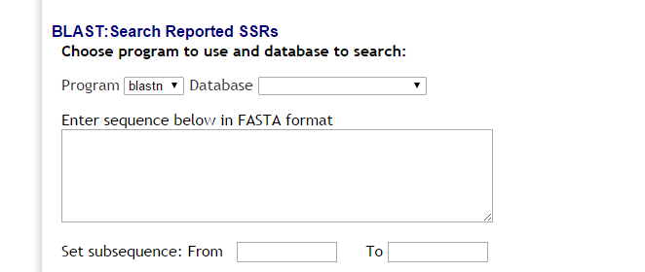
SeaBuckThornMiSatDB
UNIVERSITY SCHOOL OF BIOTECHNOLOGY
GURU GOBIND SINGH INDRAPRASTHA UNIVERSITY
Home Intro Blast Search Contact us

Slide 4
SeaBuckThornMiSatDB
UNIVERSITY SCHOOL OF BIOTECHNOLOGY
GURU GOBIND SINGH INDRAPRASTHA UNIVERSITY
Home Intro Blast Search Contact us
Search SSR by complexity
SSR Type
Submit
Search SSR by custom motif sequence
SSR Motif
Submit
Search SSR by Var score
Score
Submit

Slide 5
SeaBuckThornMiSatDB
UNIVERSITY SCHOOL OF BIOTECHNOLOGY
GURU GOBIND SINGH INDRAPRASTHA UNIVERSITY
Home Intro Blast Search Contact us
Unigenes ID | Motif | Length | Start | End | Forward | Reverse | Tm | Estimated amplicon size

Slide 6
SeaBuckThornMiSatDB
UNIVERSITY SCHOOL OF BIOTECHNOLOGY
GURU GOBIND SINGH INDRAPRASTHA UNIVERSITY
Home Intro Blast Search Contact us
Professor P. C. Sharma University School of Biotechnology
Director Research and Consultancy Guru Gobind Singh Indraprastha University Sector 16C, Dwarka, New Delhi - 110078, INDIA e-mail: pro.pcsharma@gmail.com
Tel. +91-11-25302303;06 (Off); 25302123 Mobile: +91-9899088818

