Slide 1


Online Examination System
P.E.S. Modern College of Engineering
Group Members:
39044 Pranav Konde
39031 Rutik Gugale
39029 Aryan Gandhi
39071 Shivam Singh

Slide 2


Introduction
ONLINE EXAMINATION SYSTEM is a web-based examination system where examinations are given online. either through the internet or intranet using computer system. The main goal of this online examination system is to effectively evaluate the student thoroughly through a totally automated system that not only reduce the required time but also obtain fast and accurate results.

Slide 3


Abstract
ONLINE EXAMINATION SYSTEM is an online test simulator is to take online examination, test in an efficient manner and no time wasting for manually checking of the test paper. The main objective of this web based online examination system is to efficiently evaluate the student thoroughly through a fully automated system that not only saves lot of time but also gives fast and accurate results. For students they give papers according to their convenience from any location by using internet and time and there is no need of using extra thing like paper, pen etc.

Slide 4


Functional Specification:
Registering new Student.
Getting the student and staff info and storing it to databases. 3.Getting the type of question paper.
4.Generating result after the exam.

Slide 5
Schema DIAGRAM

Slide 6

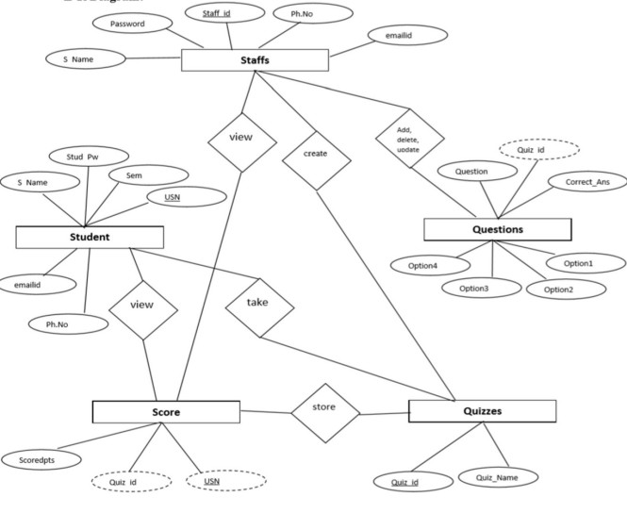


E-R DIAGRAM

Slide 7

SOFTWARE REQUIREMENTS:
Programming language : PHP, MYSQL. Operating system : ANY OS (Recommended: Windows8,Windows Vista, Windows XP).
Application required : Apache Neatbeans IDE application & Xampp.
Coding language : PHP,HTML,CSS,Javascript.

Slide 8

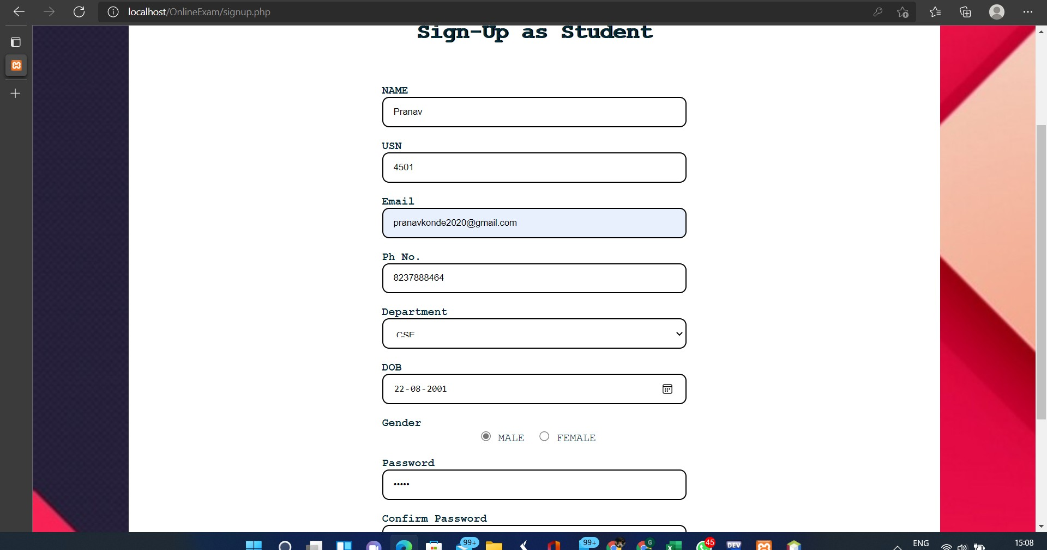
Sign-Up Page

Slide 9

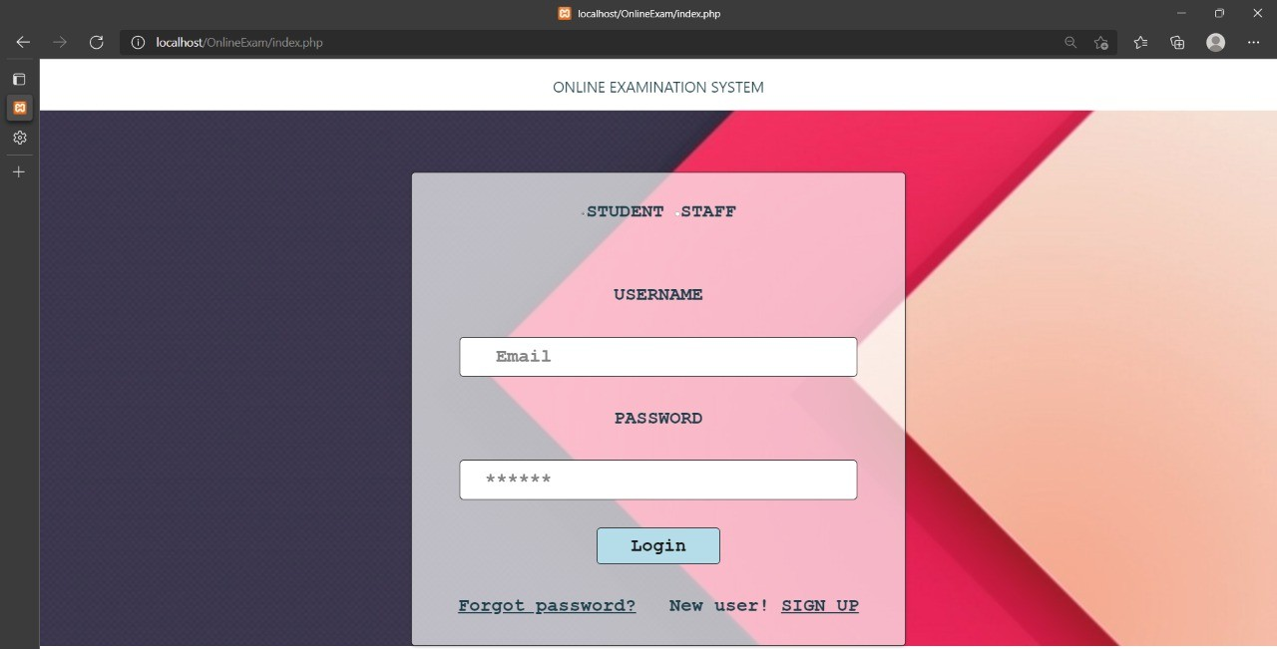
Sign-In Page

Slide 10
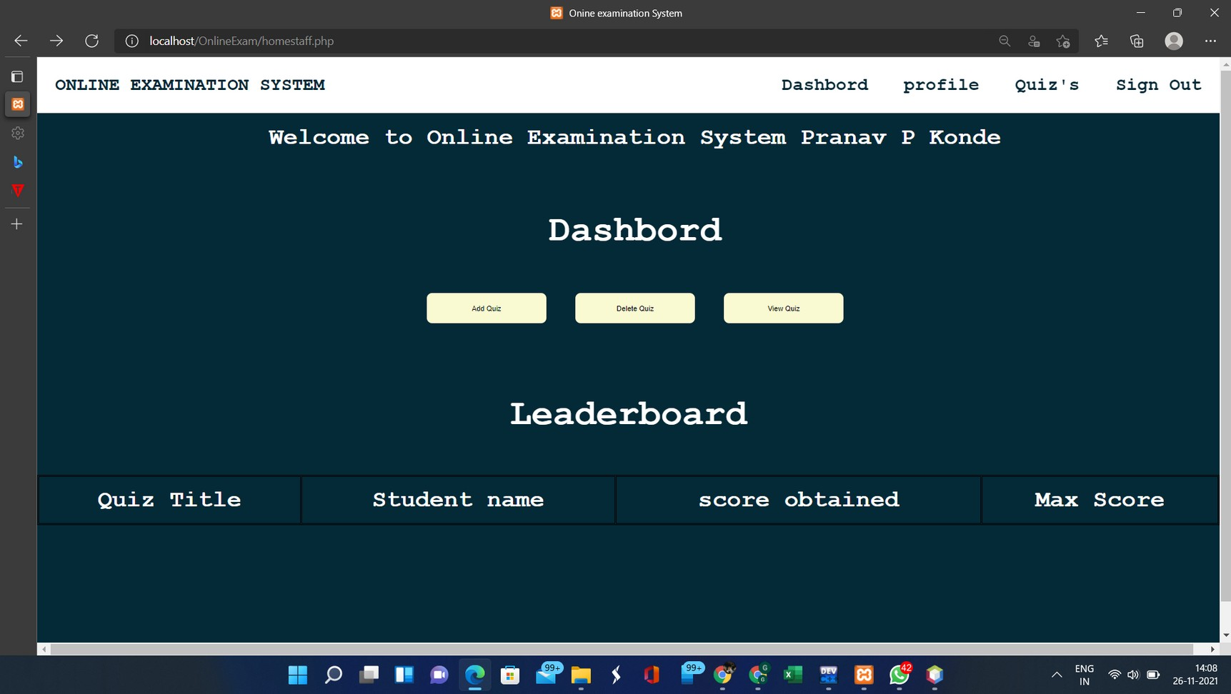
Staff Login

Slide 11
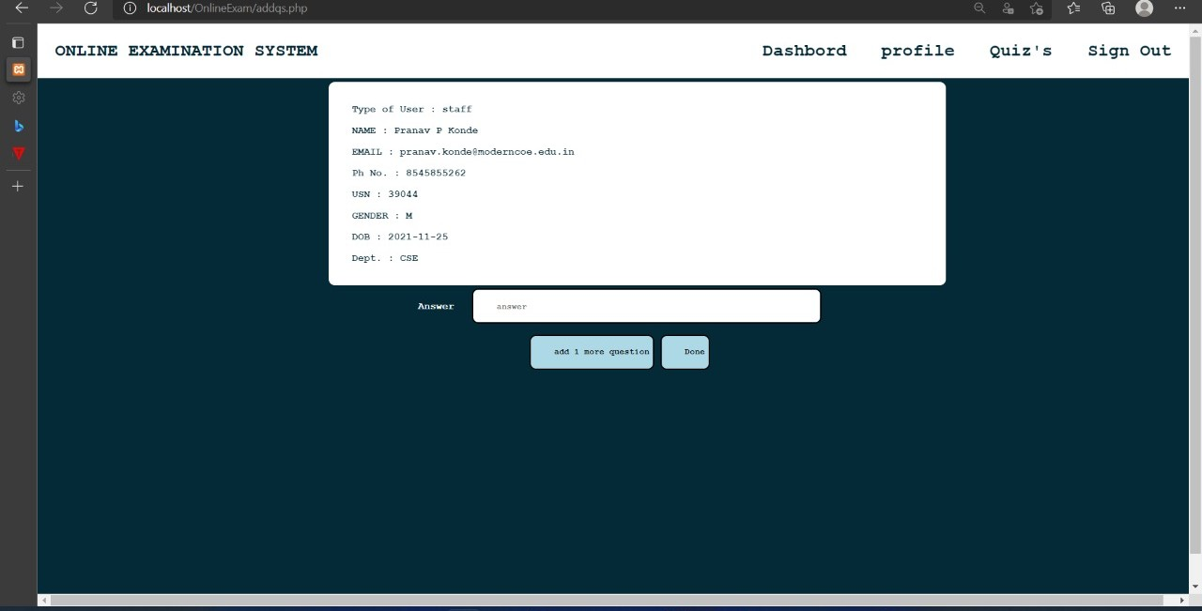
Staff Profile

Slide 12

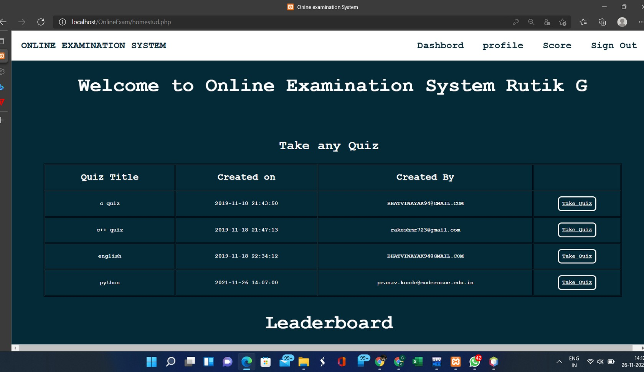
Student login

Slide 13
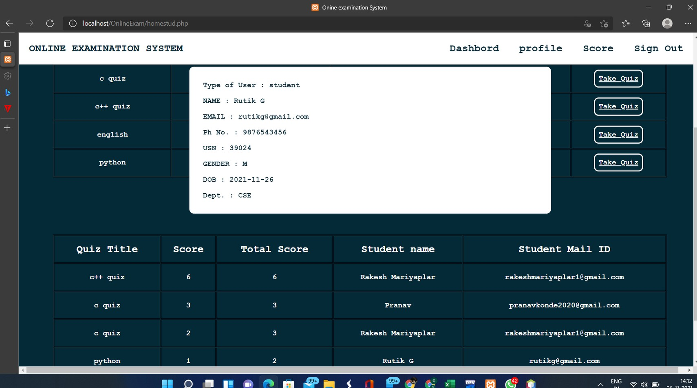
Student Profile

Slide 14
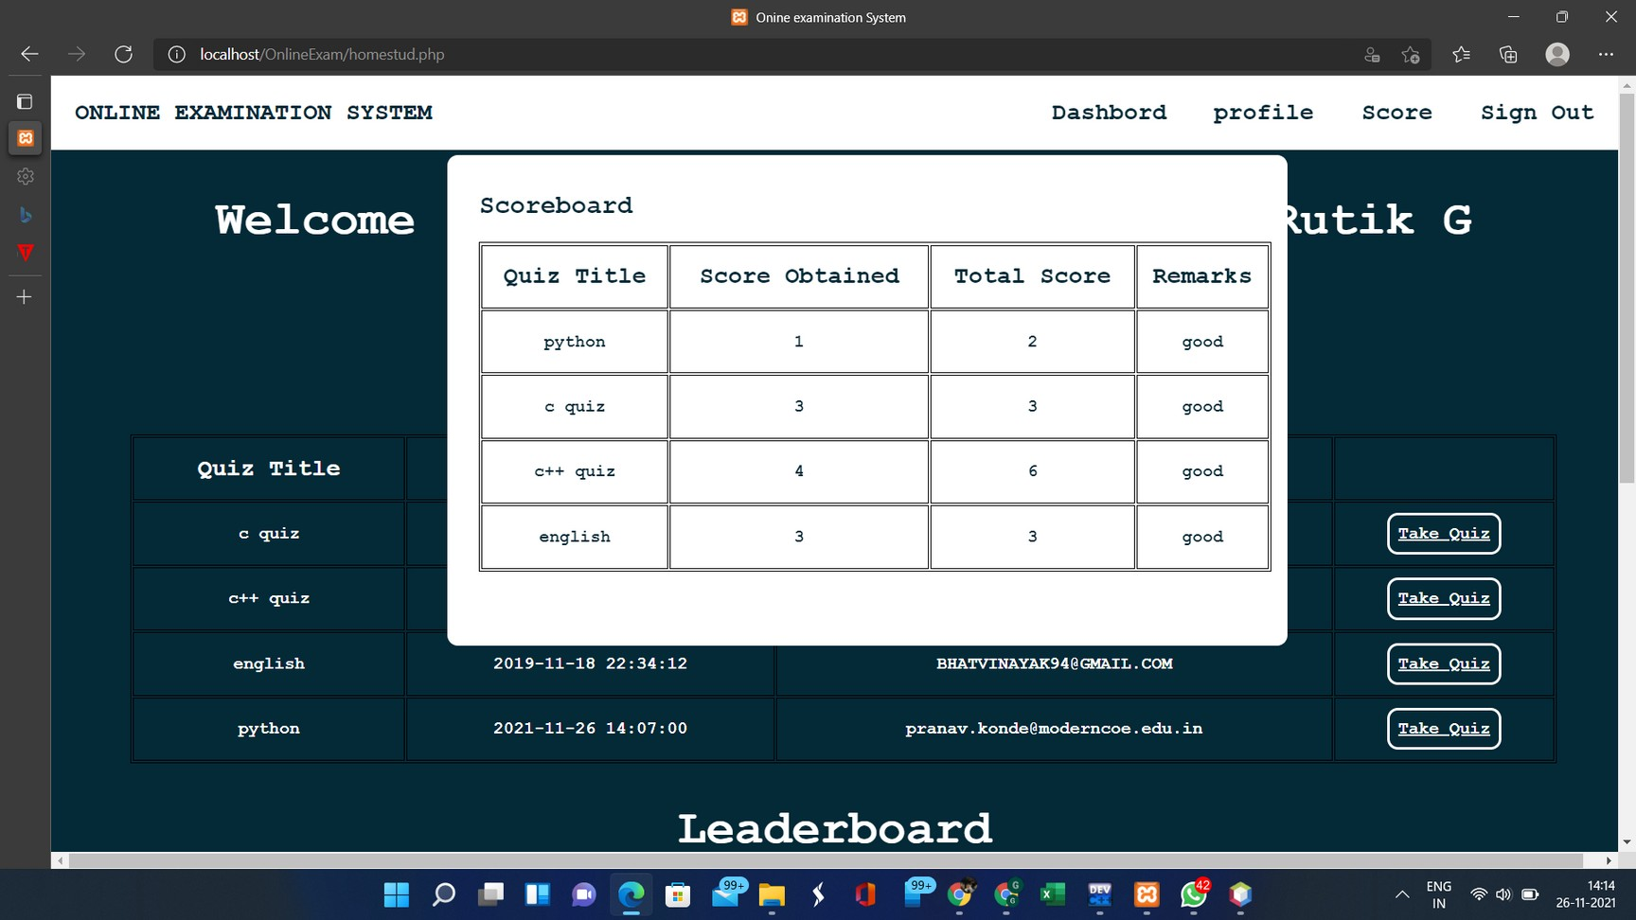
Student Dashboard

Slide 15
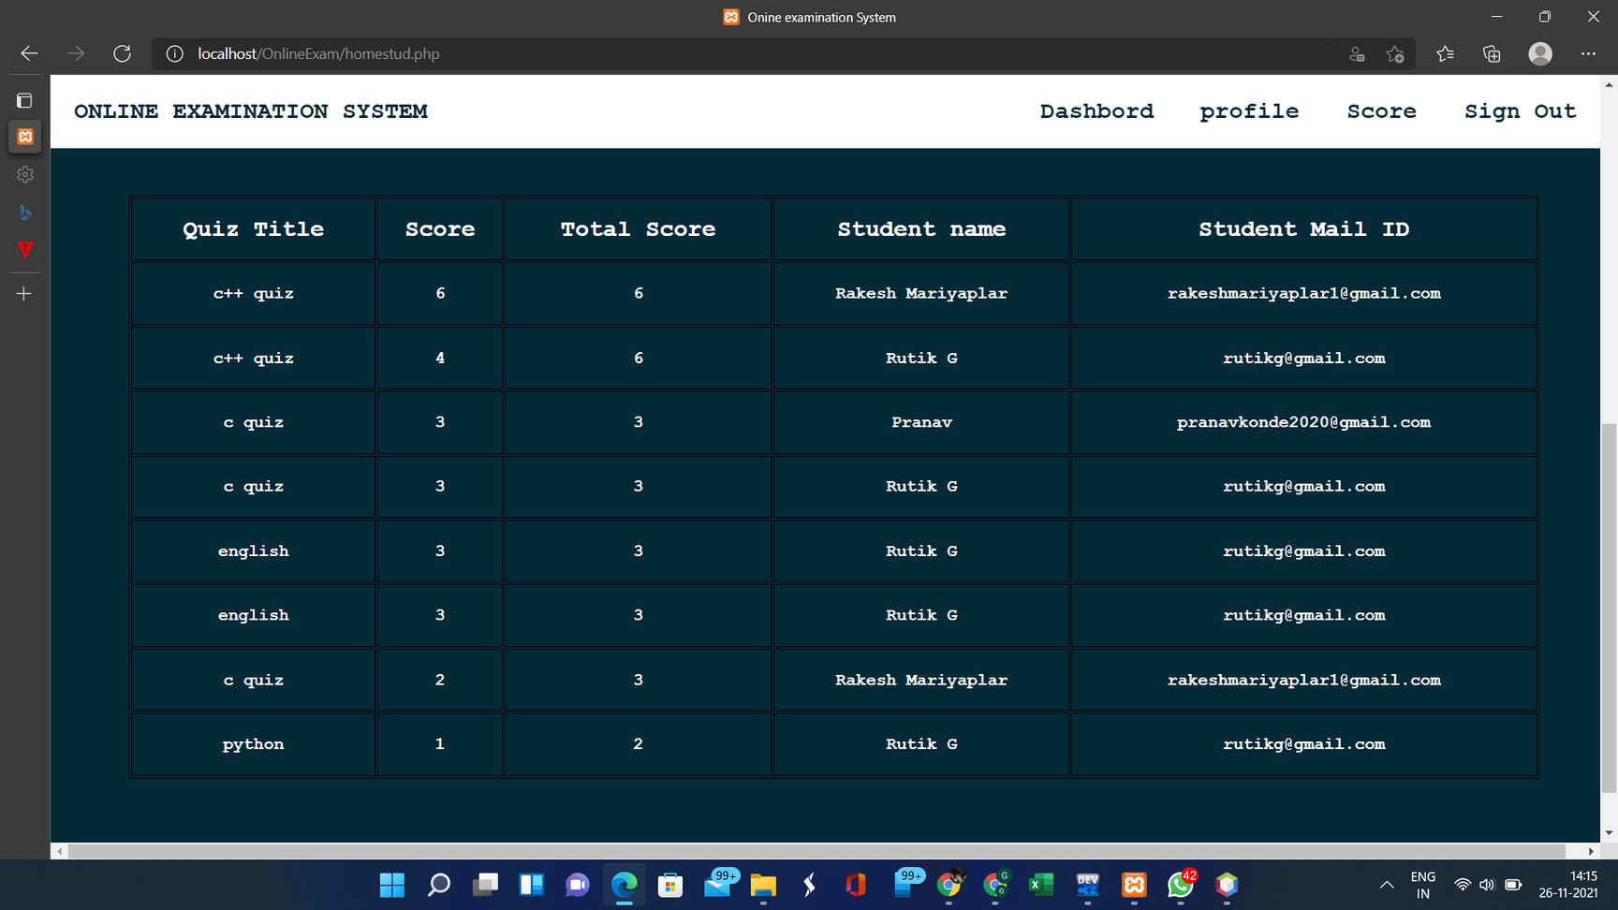
Entire Student Dashboard

Slide 16

CONCLUSION
The online examination system provides better functionality for an examination to be more efficient and reduce manual paperwork in order to automate all possible tasks. For implementing this system, PHP, HTML, CSS, JavaScript and MySql are used.
The system comprises of following features: Management of quiz.
Automated grading.
Adding/deleting quizzes and questions.

Slide 17


FUTURE SCOPE
There are also few features which can be integrated with the system to make it more flexible.
Below list shows the future points to be considered:
Implementing the timer for the quiz.
Sending mails on sign up and when student takes the quiz. Supporting all type of questions including MCQ’s.
Including Programming Questiond where user can compile or interpret on site only.

Slide 18


www.stackoverflow.com
www.youtube.com
https://www.php.net www.google.com https://www.w3schools.com
References

Slide 19



Thank you!

