Slide 1

IIT Delhi
Helping Build Specialized Large Language Models in Construction Materials & Civil Engineering.
Pranav Khetarpal
2021CE10480
Department of Civil Engineering
Indian Institute of Technology Delhi
Hauz Khas, New Delhi, India 110016
B.Tech project - I

Slide 2
Outline
Introduction
Motivation
Gaps
Objectives
Methodology
Preliminary Results
Future work

Slide 3


Introduction
“We’ll soon be able to work with AI that helps us accomplish much more than we ever could without AI; eventually we can each have a personal AI team, full of virtual experts in different areas, working together to create almost anything we can imagine.” – Sam Altman
Large Language Models like GPT-4, Gemini, etc. excel in many human language tasks but often falter in highly specialized domains.
Where is my Virtual Expert in Civil Engineering?

Slide 4
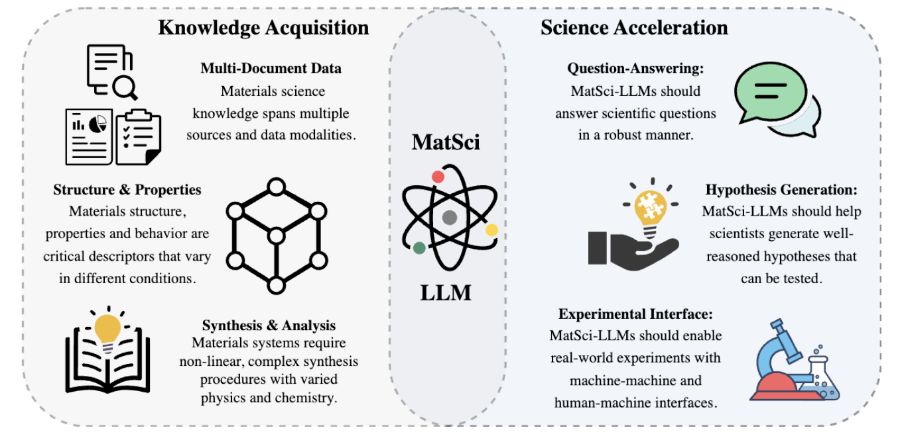
Motivation
To build models ready for Real-World Discoveries in Construction Materials and Civil Engineering.
Build our Virtual Expert in Construction materials with high domain knowledge and accuracy.
Are LLMs Ready for Real-World Materials Discovery? (Miret & Krishnan, 2024)

Slide 5
Gaps
How do you evaluate the current performance levels of the State of the Art Models?
Improve the scientific accuracy and minimize hallucinations of these AI models.
Knowledge extraction and its limitations.

Slide 6
Objectives
Build a Multimodal (w/ Images) Benchmarking Dataset and Evaluation framework for Language Models in Construction Materials and Material Science.
Help with the Knowledge extraction process to create accurate Large Datasets in Civil Engineering and Materials specifically.
Build a Knowledge Graph to ground these Language models on.

Slide 7
Methodology
Multi-modal Benchmark in Const. Materials
What is a Benchmark?
Why do we even need a Benchmark?
How did we create it?
Manually or in a semi-automated fashion.
Tip: Do NOT Scrape the internet.

Slide 8
It encompasses tasks across three key areas: fundamental scientific understanding, data extraction from visual information, and practical laboratory, plot interpretation and experimentation knowledge, totaling to more than a 1000 questions.
Various visual inputs: laboratory images, band structure diagrams, crystal structures, tables, atomic force microscopy images, real images from scientific patents and hand-written molecular structures.

Slide 9
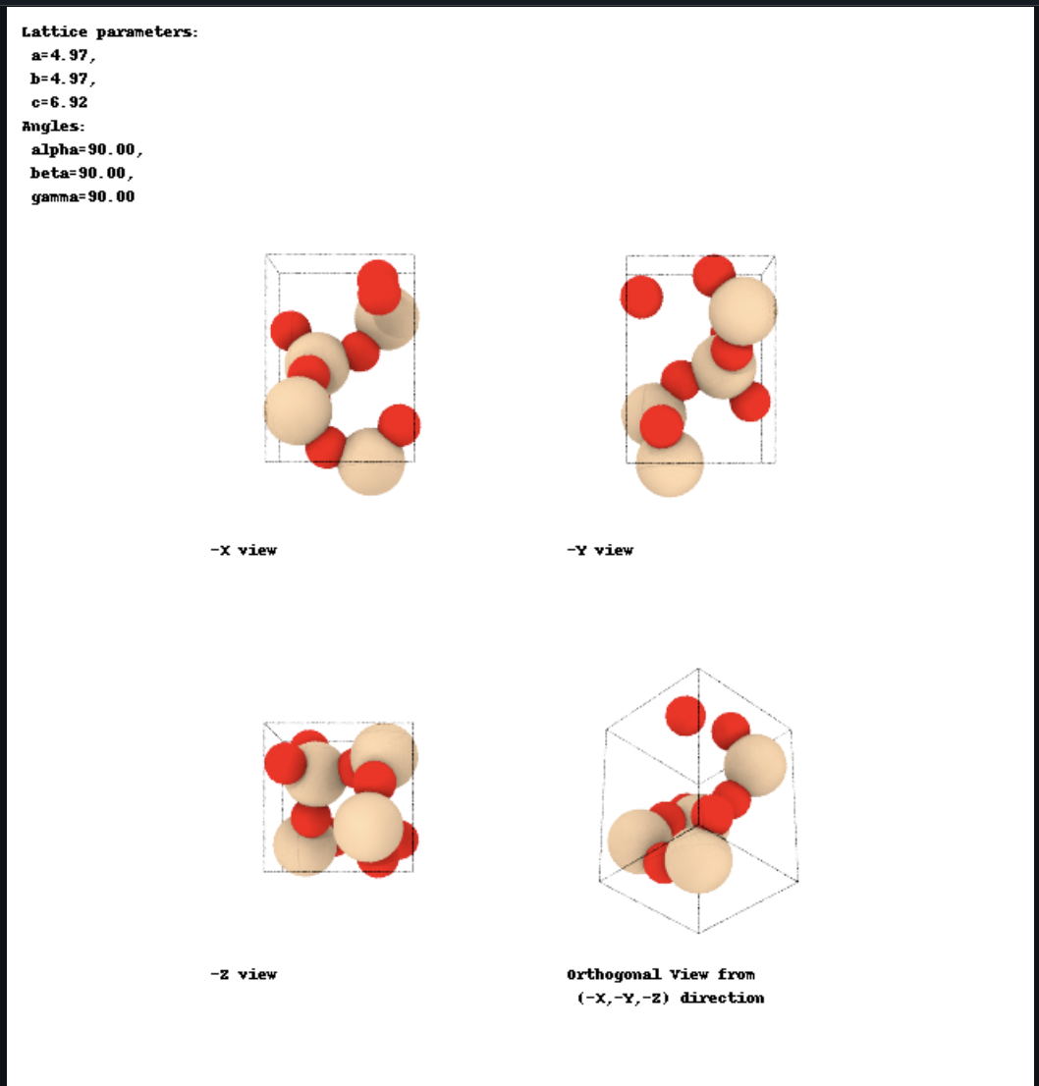
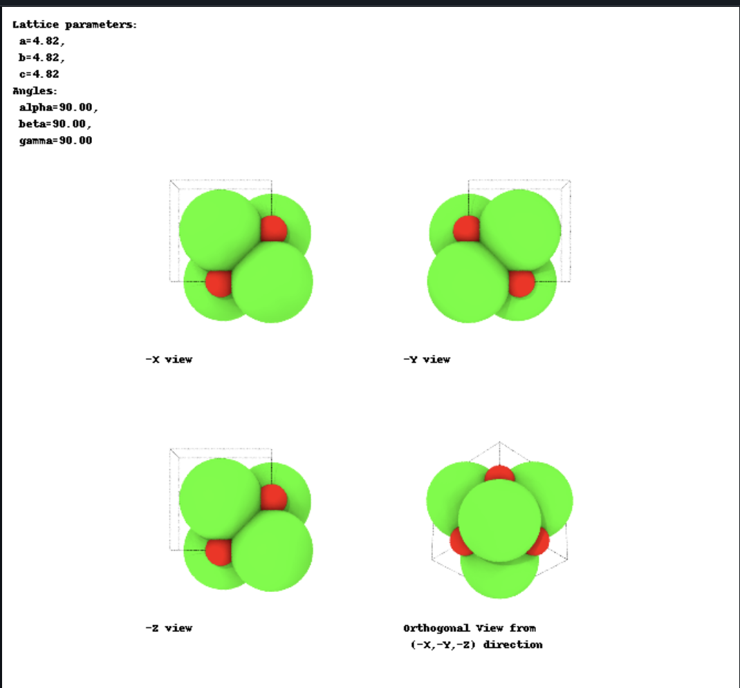
Some example crystals part of the Dataset
Cristobalite Lime
Hematite, Magnetite, Calcium Catapleiite, Anatase, Barium, Aluminum, etc.

Slide 10
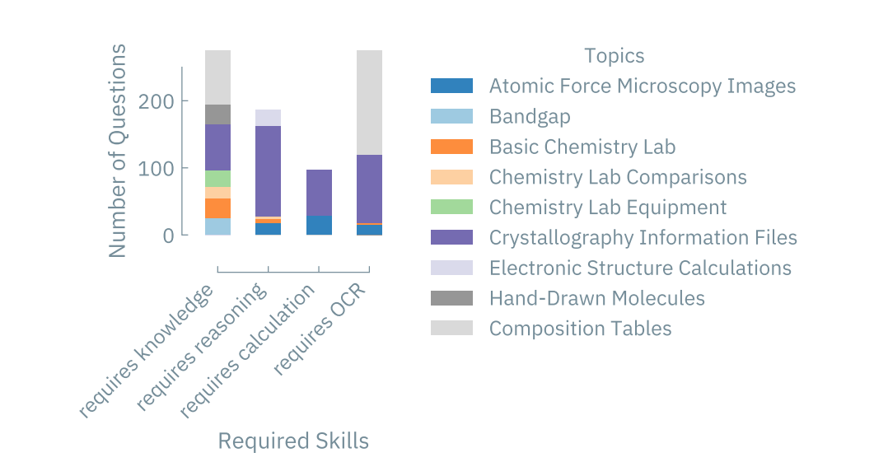
Benchmark Corpus – older version

Slide 11
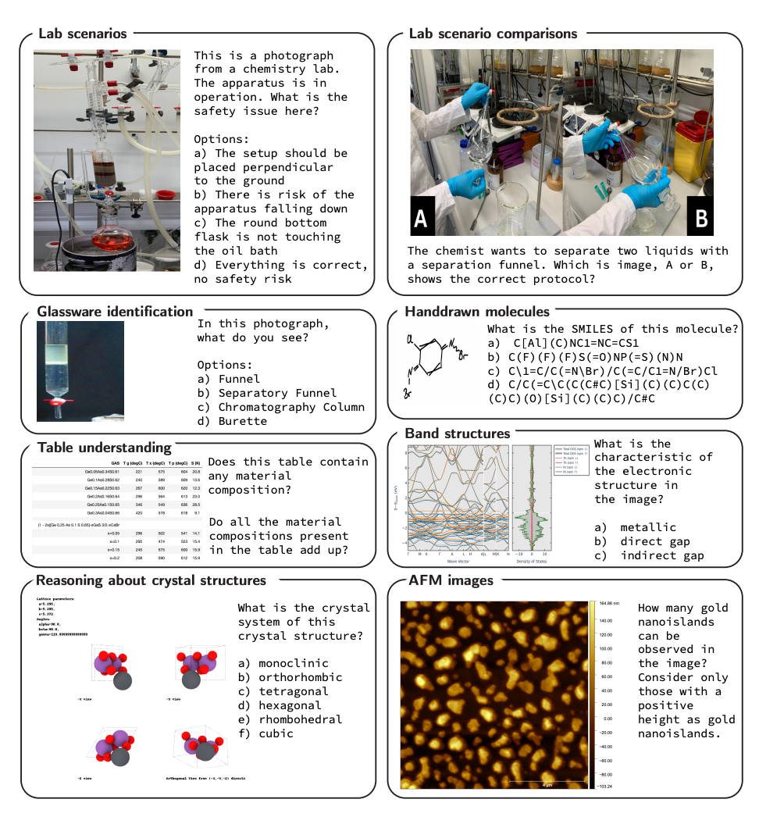

Slide 12
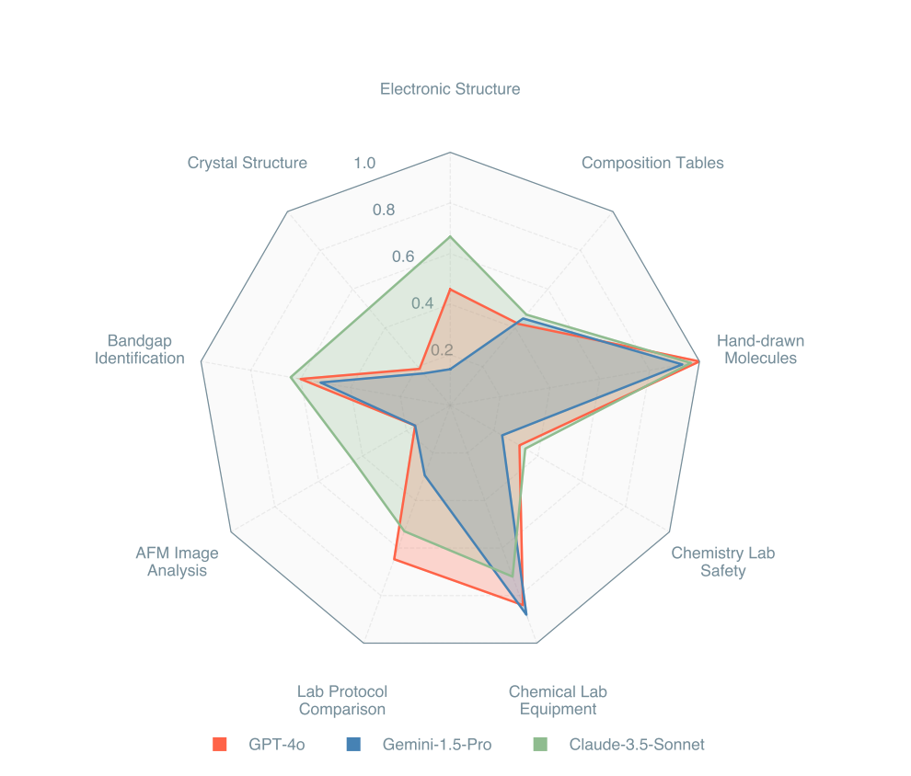
Preliminary Results

Slide 13
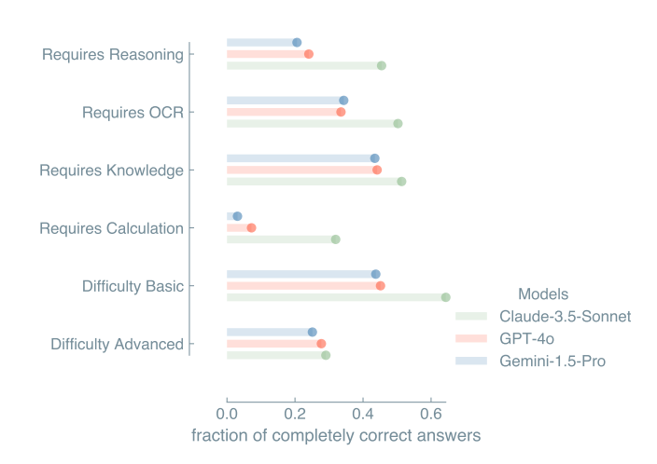
Preliminary Results

Slide 14
What’s Next?
We are done with the Dataset creation. Next one week will go into final reviews.
Evaluations of the models will start by end of next week.
Then rest of October – Analyze the results and Writing the paper.

Slide 15
Methodology
Knowledge extraction process to create accurate Large Datasets in Civil Engineering and Materials specifically.
A crucial component in the curation of KB for a scientific domain is information extraction from tables in the domain’s published research articles
To facilitate research in this direction, we define a novel NLP task of extracting compositions of materials (e.g., cement, glass) from tables in materials science papers.
DisCoMat, Krishnan et.al. , Jan, 2024

Slide 16
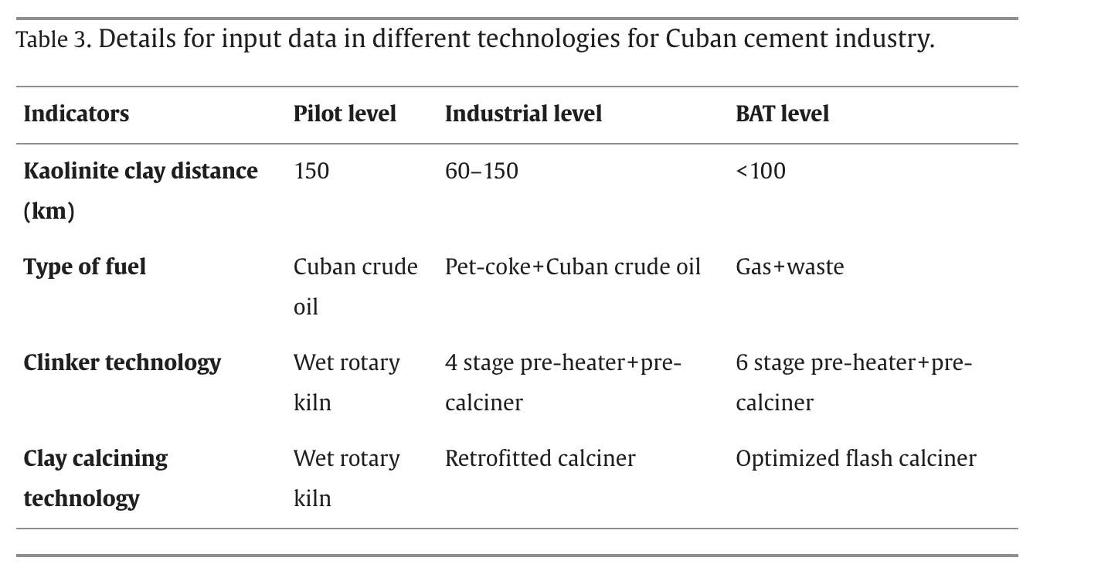
Tables – the thorn in every research paper.
LC3 Cement – Bishnoi et.al. 2018

Slide 17
Expected Work
Extract compositions of materials reported in text and connect them with the properties reported in tables.
In some papers which we have processed, we have the properties but not composition, I will extract the composition from text and connect them to the corresponding properties.

Slide 18
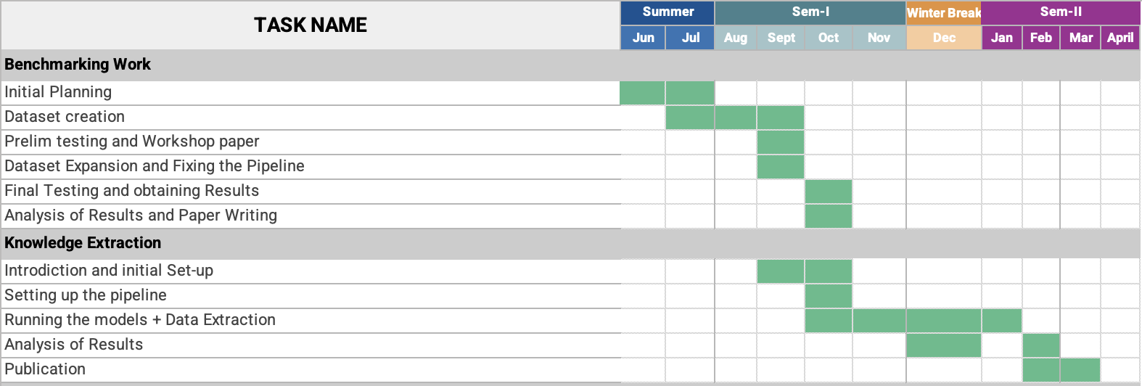
Timeline of my Work.

Slide 19
Thank You

