Slide 1

Vivekanand Ramakrishnan
Pranav Kulkarni

Slide 2

What is ELK Stack?
Collection of 3 (really 4) open-source products
Elasticsearch – No SQL database
Logstash – Log collection and transformation
Kibana – Data visualizer for Elasticsearch
Beats - Data shippers
Notes:
The ELK Stack is a collection of three open-source products —
Elasticsearch, Logstash, and Kibana — from Elastic.
a highly scalable open-source full-text search and analytics engine.
server-side data processing pipeline that centralizes, transforms and stashes data
a window into the Elastic Stack, enables visual exploration and real-time analysis of data in Elasticsearch

Slide 3

Why ELK?
Usecases
Centralized Log Analysis
Business intelligence
Security and compliance
Monitoring
Web Analytics
Notes:
Why is Log Analysis Becoming More Important? As more and more IT infrastructures move to public clouds such as Amazon Web Services and Microsoft Azure, public cloud security tools and log analytics platforms are both becoming more and more critical.In cloud-based infrastructures, performance isolation is extremely difficult to reach — particularly whenever systems are heavily loaded. The performance of virtual machines in the cloud can greatly fluctuate based on the specific loads, infrastructure servers, environments, and number of active users. As a result, reliability and node failures can become significant problems. Log management platforms can monitor all of these infrastructure issues as well as process operating system logs, NGINX and IIS server logs for technical SEO and web traffic analysis, application logs, and ELB and S3 logs on AWS.In all of these contexts, DevOps engineers, system administrators, site reliability engineers, and developers can all use logs to make better decisions that are data-informed (and not, as Facebook’s Adam Mosseri says, data-driven). After all, what is being called “big data analytics” is increasingly important for a number of reasons — particularly when it comes to the cloud.
Problem statement:
You have different applications feeding into each other. Debugging an issue requires logging into each individual box to look at the logs. With small number of apps/boxes it's not an issue, but it quickly becomes tedious as the number of apps/boxes increase!
Solution:
It would be awesome to have all of your logs aggregated into one place so you can see the process flow and perform queries against the logs from all applications from one place.

Slide 4
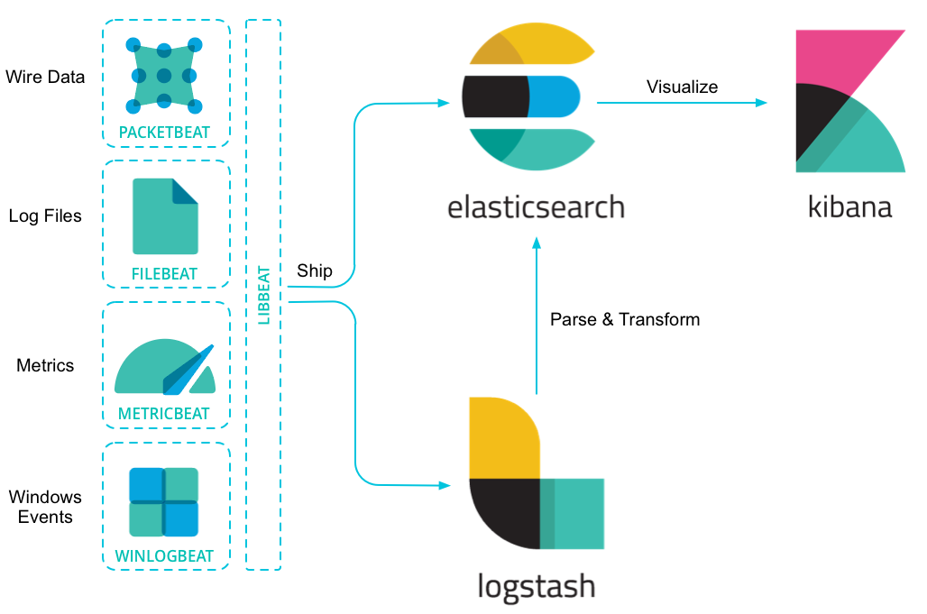
ELK Architecture
Notes:
FileBeat - when you have tens, hundreds, or even thousands of servers, virtual machines, and containers generating logs, Filebeat helps you keep the simple things simple by offering a lightweight way to forward and centralize logs and files.
MetricBeat - Collect metrics from your systems and services. From CPU to memory, Redis to Nginx, and much more, Metricbeat is a lightweight way to send system and service statistics.
Packetbeat is a lightweight network packet analyzer that sends data to Logstash or Elasticsearch.
Winlogbeat live streams Windows event logs to Elasticsearch and Logstash in a lightweight way.

Slide 5
Demo (aka Crash n Burn Time)

