Slide 1

InfraRed Bot
Team: ATeamNoPlanB
Vivekanand Ramakrishnan
Anand Varma
Sekharan Natarajan
Namit Sharma
Pranav Kulkarni

Slide 2


Software Engineering Problem: Setting Up Cloud Infrastructure
Command-line drudgery
Time Consuming
Dynamic Pricing
Tracking resources across cloud providers
Secure storage of Tokens

Slide 3



Pain Points
Developer
Data-Scientist
Project Manager
Dev/Test VMs
Time consuming
Repetitive
Deploy Clusters
One-click Setup
Zeppelin Interface
Resource tracking
Cost-Efficiency

Slide 4

InfraRed Bot to the rescue!

Slide 5
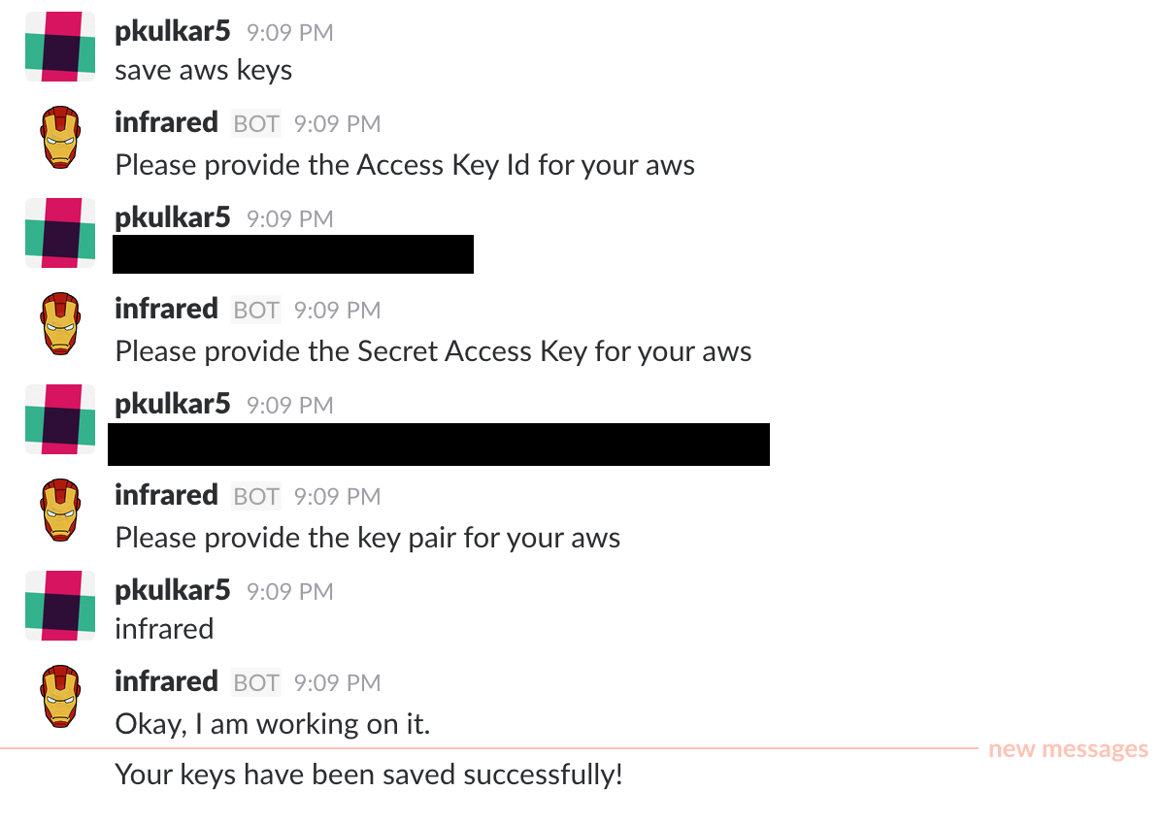
Bot in Action: Setup Credentials

Slide 6
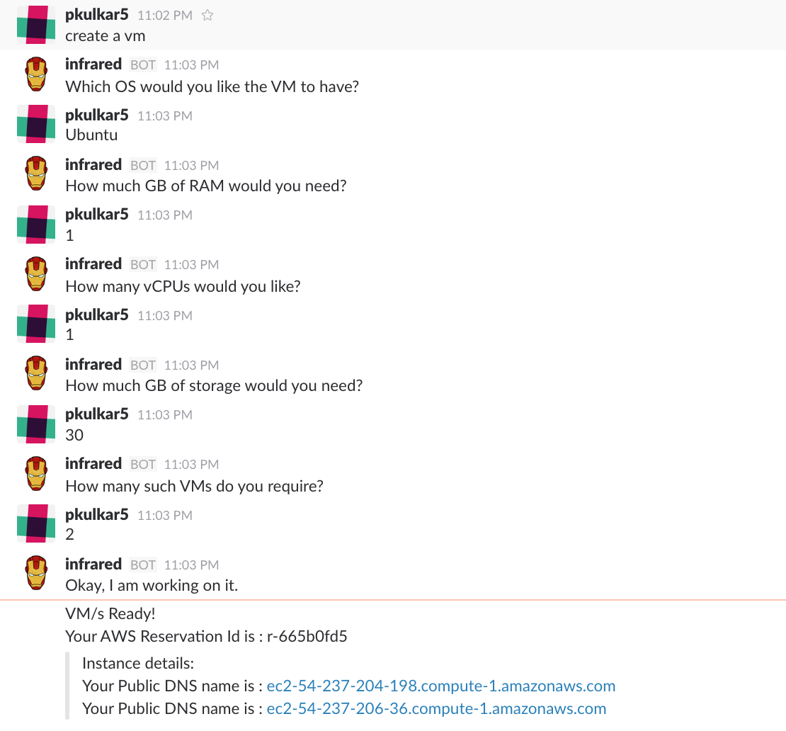
Bot in Action: Create VMs

Slide 7
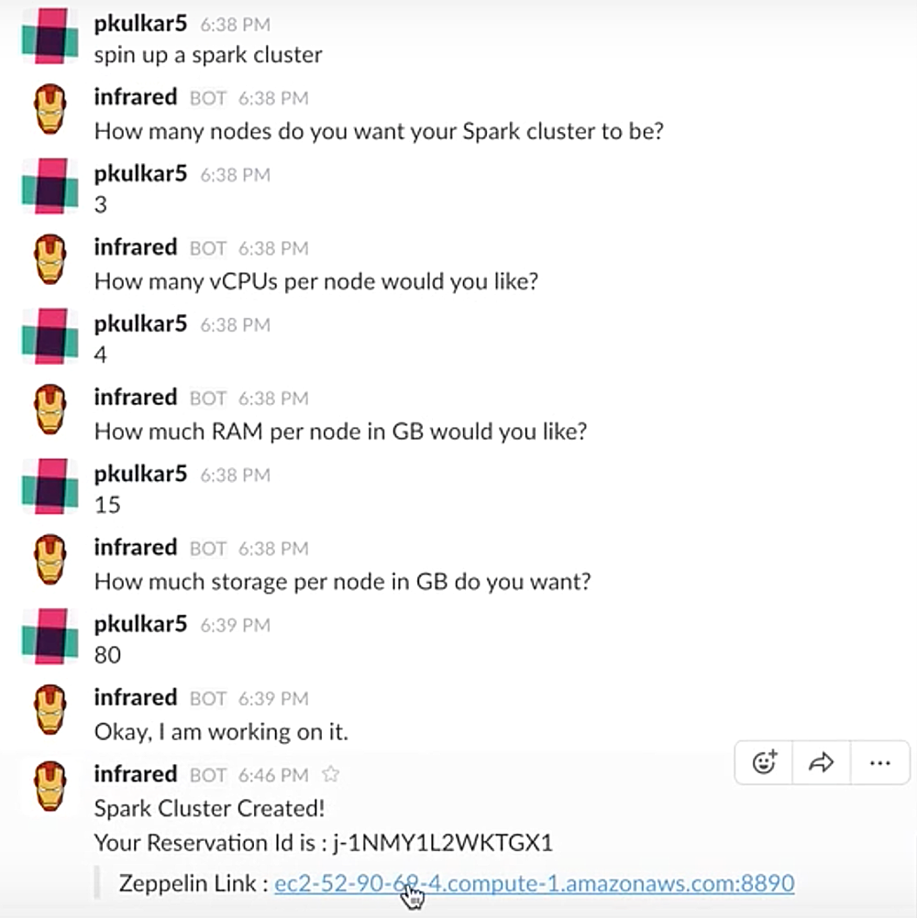
Bot in Action: Spin-up Spark Cluster

Slide 8
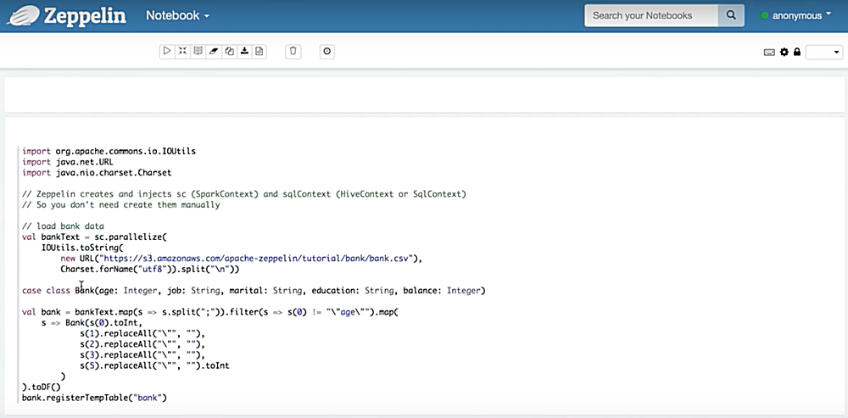
Bot in Action: Zeppelin Interface

Slide 9
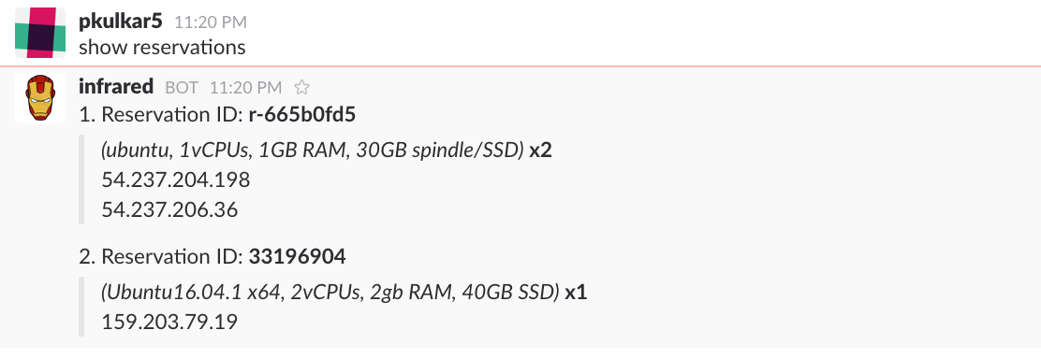
Bot in Action: Show Reservations

Slide 10
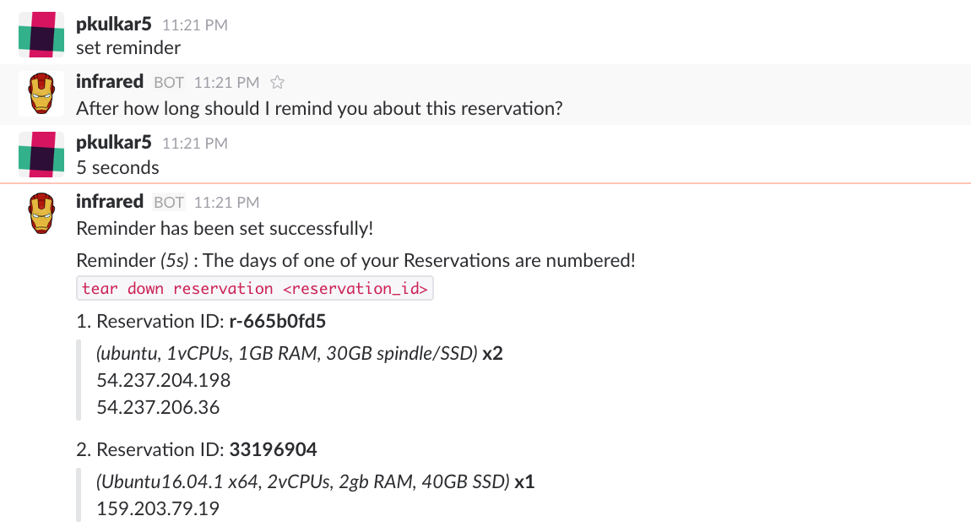
Bot in Action: Set Reminders

Slide 11
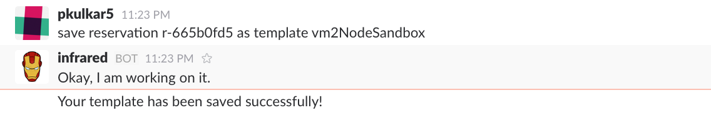
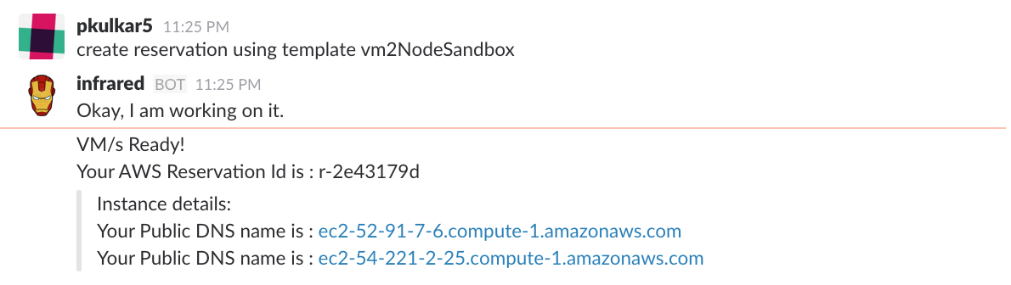
Bot in Action: Templates

Slide 12
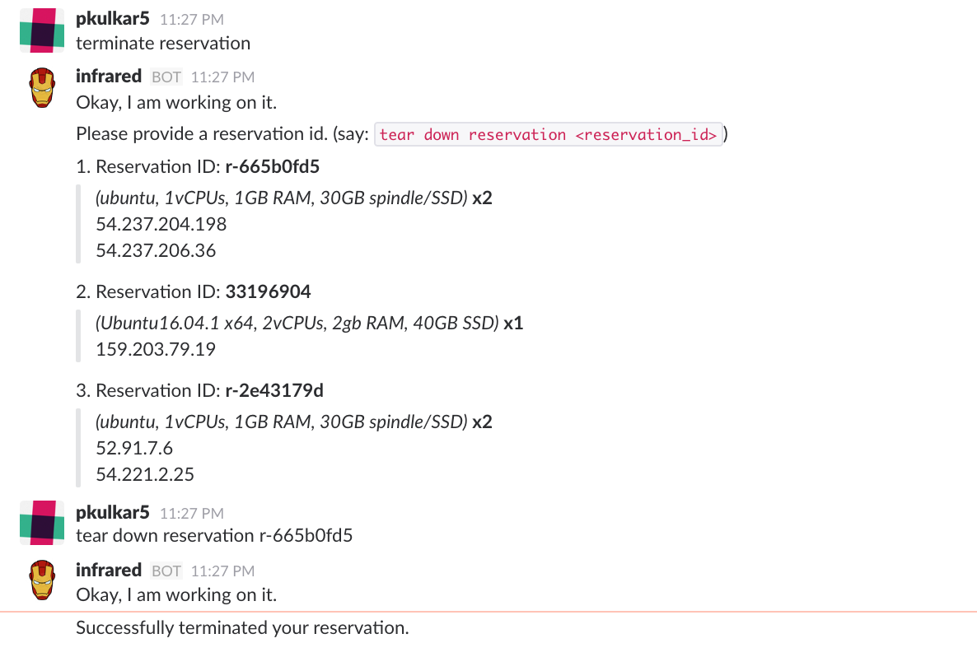
Bot in Action: Terminate Reservation

Slide 13
Impact
Selects the cheapest cloud provider. Saves my $$$ and prevents idling.
Automatic spin-up and setup of clusters lets me squeeze in a game of foosball.
Lets me focus on my work rather than raising tickets and managing my VMs everyday.
Developer
Data-Scientist
Project Manager

Slide 14
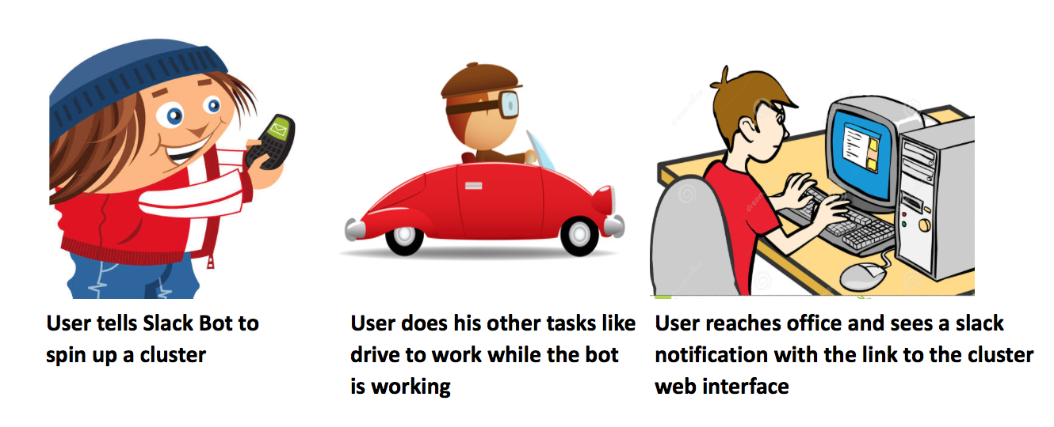
Impact

Slide 15
Architecture

Slide 16
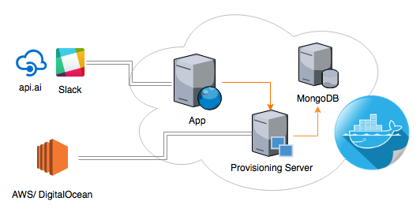
Deployment

Slide 17
Thank You
Special Thanks to Dr. Christopher Parnin

