Slide 1

Department of Computer Science & Engineering (DS)
Project Title: Provenance-Grounded Drug Repurposing via Agentic Evidence Adjudication
Section: CSD A
Team No : 14
Roll No Student Name
23BD1A6722 J Pranav Kumar
23BD1A6758 V Sri Teja
23BD1A6751 Shishir Gella
23BD1A6710 C Girish

Slide 2
Contents
Index
1. Project Title Selection
2. Introduction
3. Problem Statement
4. Project Objectives
5. Literature Survey
6. Existing System and Its Limitations
7. Proposed Solution
8. Proposed Methodology
9. References

Slide 3
1. Project Title Selection
▸ Domain: Artificial Intelligence & Machine Learning — Agentic Systems, Graph Learning, Biomedical Informatics
▸ Drug repurposing offers a faster, cheaper route to treatment than de-novo drug discovery, reusing an already-approved drug's known safety and pharmacokinetic profile
▸ Chosen title reframes repurposing from a single drug-disease lookup into ranked, in-silico triage over the entire approved-drug space
▸ Selected to build a system that is simultaneously computationally efficient and rigorously auditable — confidence must be earned, never asserted

Slide 4
2. Introduction
▸ Drug repurposing = finding new therapeutic uses for drugs already approved for another indication
– Faster and cheaper than de-novo discovery — safety, dosing and manufacturing data already exist
▸ Evidence needed to assess a candidate is fragmented across three very different kinds of sources
– Mechanistic knowledge graphs (drug → target → pathway → disease)
– Curated association repositories (chemical–gene–disease records)
– Primary literature (PubMed abstracts)
▸ Manual triage across these sources is slow, inconsistent, and cannot scale to the entire approved-drug space (~3,000 compounds)
▸ Multi-agent LLM frameworks (e.g. PharmaSwarm) show agents can be orchestrated for biomedical reasoning — but target novel discovery, use proprietary/omics-scale data, and defer validation to future work
▸ This project targets a narrower, tractable, evaluable problem instead: rank the full approved-drug space and return a small, audited, source-traceable shortlist

Slide 5
3. Problem Statement
▸ No existing system can, for a given disease: screen the full ~3,000-drug approved space cheaply, narrow it with transparent mechanism-aware rules, and reserve expensive reasoning only for the shortlist
▸ Existing agentic approaches either:
– reason over one drug–disease pair at a time, with no ranking or search over candidates, or
– generate hypotheses without enforcing that every claim traces back to a real source
▸ Independent, per-candidate adjudication has a hidden failure mode: biomedical evidence is heavily shared across candidates, so correlated support gets double-counted and rankings become systematically over-confident
▸ A trustworthy system must also be able to say “no good candidate” — an empty result is a valid, honest answer

Slide 6
4. Project Objectives
▸ Design a precision–recall cascade that screens the entire approved-drug space for a disease and narrows it to a small, audited shortlist
▸ Train a relational Graph Neural Network (R-GCN) on a public biomedical knowledge graph for millisecond-scale, exhaustive drug–disease scoring
▸ Design deterministic structured filters that prune, annotate, and flag degenerate (similarity-driven rather than mechanism-driven) candidates
▸ Build a LangGraph-orchestrated adversarial adjudication layer (Proponent / Falsifier / Referee) producing auditable, source-traceable briefs
▸ Design a cross-candidate arbitration mechanism that detects and corrects for evidence shared across the shortlist
▸ Fit a calibrator that converts evidence features into a reliability-checked confidence score, instead of an asserted one
▸ Evaluate against a gold-standard dataset containing true clinical negatives, so the system can be shown to return an empty result when appropriate

Slide 7
5. Literature Survey
▸ PharmaSwarm — multi-agent LLM framework for drug-discovery hypothesis generation; targets novel discovery, relies on proprietary/omics-scale resources, defers rigorous validation to future work
▸ TxGNN — graph foundation model for zero-shot drug repurposing across 17,080 diseases; state-of-the-art ranking baseline (~49% improvement in zero-shot indication prediction), used here as a pluggable scorer rather than a competitor
▸ Hetionet (Rephetio project) — heterogeneous biomedical knowledge graph purpose-built for repurposing; published gold standard of disease-modifying indications with metapath semantics linking graph structure to pharmacological mechanism
▸ PrimeKG — large-scale precision-medicine knowledge graph (~130,000 entities) integrating 20+ biomedical resources
▸ repoDB — benchmark of approved AND failed drug-indication pairs, providing the true clinical negatives essential for honest evaluation
▸ Retrieval-augmented generation & natural-language-inference (NLI) claim verification — grounding LLM-generated claims against cited literature rather than trusting free-form generation

Slide 8
6. Existing System and Its Limitations
▸ Typical designs fan out several LLM “agents” in parallel and use one Evaluator to aggregate their outputs into a brief
– No agent's output changes another's behaviour — effectively one prompt with several tools, not a genuinely multi-agent system
▸ A single model asked to “weigh evidence” is systematically over-optimistic, since generation and criticism share the same prior
▸ Evaluating against well-known repurposing pairs (e.g. metformin–cancer) is unfalsifiable — the LLM already knows the answer from pretraining, so a confident brief does not prove the pipeline retrieved or reasoned about anything
▸ No mechanism exists to detect that many “independent” findings secretly rest on the same shared — and possibly weak — evidence
▸ Confidence scores are typically self-reported by the LLM rather than calibrated against any ground truth
▸ Fixed-cost designs apply the same expensive reasoning to every candidate instead of allocating cost where it is warranted

Slide 9
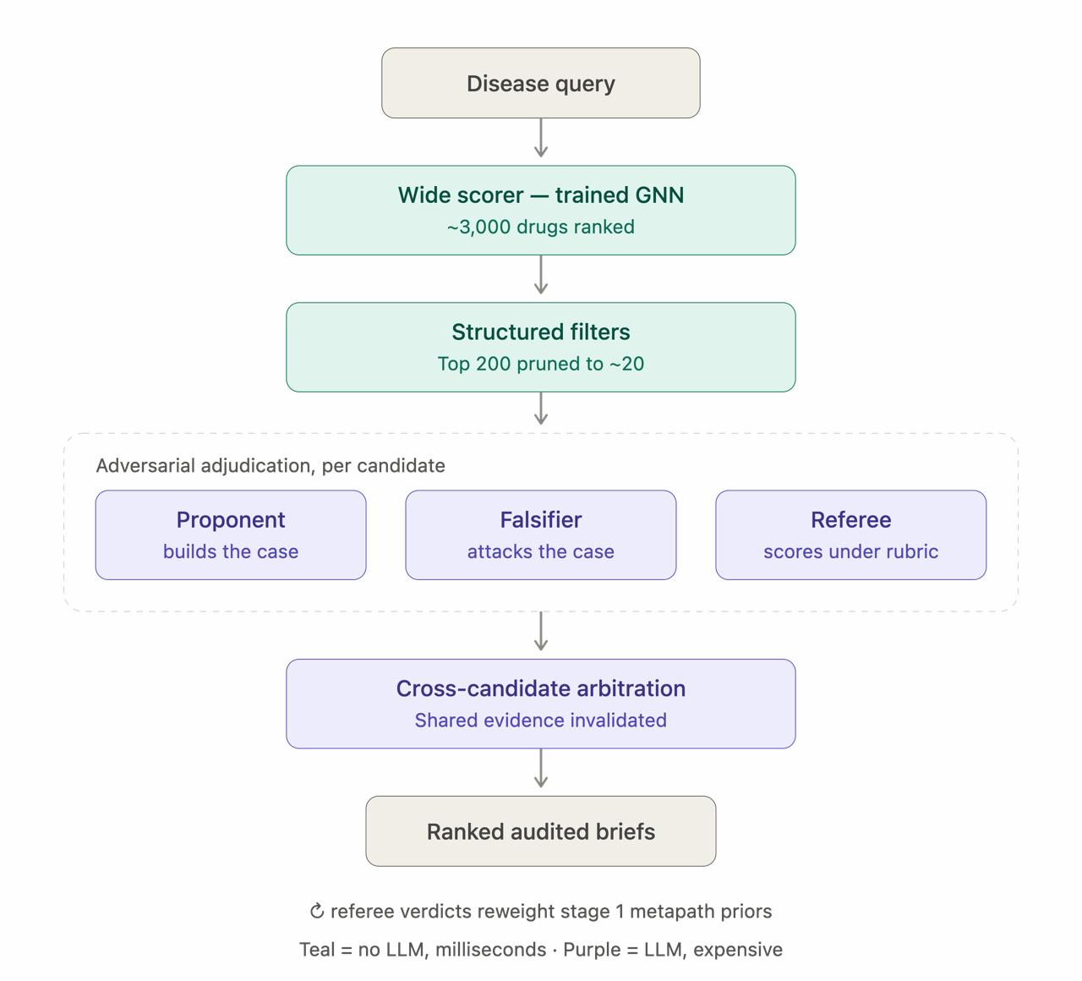
7. Proposed Solution
▸ A cost-tiered precision–recall cascade: computational cost rises only as the candidate set narrows
▸ Cheap stages (no LLM) optimise for recall; the expensive agentic stage optimises for precision
▸ Disease query → GNN scores all ~3,000 drugs → rule-based filters narrow to ~20 → adversarial agents adjudicate each → cross-candidate arbitration corrects shared-evidence over-confidence
▸ Output: ranked, tiered, fully-sourced briefs — and an empty list when nothing clears threshold

Slide 10
8. Proposed Methodology — Stage 1 & 2:
Wide Scoring and Structured Filtering
▸ Knowledge base: built entirely on public, redistributable resources — Hetionet/PrimeKG, CTD, Reactome, ChEMBL, repoDB, DrugCentral, PubMed
▸ Stage 1 — Wide Scorer (no LLM, milliseconds)
– Relational Graph Neural Network trained on the knowledge graph under time-split link prediction (train on edges before a cutoff year, test on edges added after — prevents leakage)
– Scores every approved drug against the query disease exhaustively, not via retrieval — the first stage incurs no retrieval loss
– ~3,000 candidates → top ~200
▸ Stage 2 — Structured Filters (deterministic rules, milliseconds)
– Prune drugs already indicated for the disease and hard safety exclusions
– Annotate survivors with metapath profile, target/pathway data, and trial history
– Flag degeneracy — candidates whose score comes mostly from chemical similarity to an existing treatment rather than a real mechanistic path
– ~200 candidates → top ~20

Slide 11
9. Proposed Methodology — Stage 3:
Adversarial Adjudication
▸ The only genuinely agentic layer in the system — LangGraph-orchestrated, run per candidate
▸ Proponent agent — builds the strongest evidence-backed case for the candidate (PubMed retrieval, knowledge-graph path tracing); cannot state anything it cannot cite
▸ Falsifier agent — builds the strongest case against, under a separate retrieval budget: confounding, failed trials, non-transferable mechanisms, publication bias; must cite disconfirming evidence, not just express doubt
▸ Referee — adjudicates using a fixed rubric and introduces no biological claims of its own; every sentence in its verdict traces back to a Proponent/Falsifier citation
▸ Natural-Language-Inference (NLI) verifier gates every individual claim against its cited source (supports / contradicts / neutral) before it is allowed into a brief
– Converts “no hallucinated claims” from a prompt instruction into an enforced, measurable system property

Slide 12
10. Proposed Methodology — Stage 4:
Cross-Candidate Arbitration & Calibration
▸ Problem addressed: biomedical evidence is heavily shared across candidates, so independent adjudication over-counts correlated support and produces over-confident rankings
▸ Shared evidence ledger: every claim gets an ID; when the Falsifier invalidates a source for one candidate, the invalidation propagates to every other candidate that depends on it, and affected briefs are rescored
▸ Effective independent support: candidates are scored by their number of non-overlapping evidence chains, not raw evidence count
▸ Calibration: a lightweight model (logistic regression / gradient boosting) fitted on structured evidence features — independent support, contradiction count, metapath type, NLI pass rate, stage-1 score — over approved AND failed indications (repoDB)
– Reported via reliability diagrams / ECE / Brier score, rather than an asserted confidence number
▸ Evaluation: Recall@K / MAP / nDCG against repoDB & DrugCentral with time-split gold standard containing true clinical negatives; system can output an empty recommendation set

Slide 13
11. References
▸ Himmelstein et al., “Systematic integration of biomedical knowledge prioritizes drugs for repurposing” (Hetionet / Rephetio), eLife, 2017
▸ Chandak, Huang, Zitnik, “Building a knowledge graph to enable precision medicine” (PrimeKG), Scientific Data, 2023
▸ Huang et al., “A foundation model for clinician-centered drug repurposing” (TxGNN), Nature Medicine, 2024
▸ Brown, Patel et al., “repoDB: a database of successful and failed drug repositioning trials”, Scientific Data, 2017
▸ Comparative Toxicogenomics Database (CTD); Reactome Pathway Knowledgebase; ChEMBL Database; DrugCentral
▸ PubMed / National Library of Medicine
▸ LangGraph documentation — multi-agent orchestration framework
▸ PharmaSwarm — multi-agent LLM framework for drug-discovery hypothesis generation (project motivation)

Slide 14
THANK YOU!

Slide 15
Any Queries?

