Slide 1

Department of Computer Science & Engineering (DS)
Project Title: Provenance-Grounded Drug Repurposing via Agentic Evidence Adjudication
Section: CSD A
Team No : 14
Roll No Student Name
23BD1A6722 J Pranav Kumar
23BD1A6758 V Sri Teja
23BD1A6751 Shishir Gella
23BD1A6710 C Girish
Stage-1 Review-2 | 14 Sep - 19 Sep 2026

Slide 2
Contents
Review-2 Agenda
i. Updated Literature Survey
ii. Research Gap Identification
iii. Proposed Methodology
iv. System Architecture
v. Module Design
vi. Dataset & Technology Stack
vii. Gantt Chart / Project Timeline

Slide 3
i. Updated Literature Survey
▸ PharmaSwarm — multi-agent LLM framework for drug-discovery hypothesis generation; targets novel discovery, relies on proprietary/omics-scale resources, defers rigorous validation to future work
▸ TxGNN — graph foundation model for zero-shot drug repurposing across 17,080 diseases; state-of-the-art ranking baseline (~49% improvement in zero-shot indication prediction); treated here as a pluggable scorer, not a competitor
▸ Hetionet (Rephetio project) — heterogeneous biomedical knowledge graph purpose-built for repurposing; published gold standard of disease-modifying indications with metapath semantics linking graph structure to pharmacological mechanism
▸ PrimeKG — large-scale precision-medicine knowledge graph (~130,000 entities) integrating 20+ biomedical resources
▸ repoDB — benchmark of approved AND failed drug-indication pairs; the true clinical negatives essential for honest evaluation
▸ Relational Graph Neural Networks (R-GCN) — typed message passing for heterogeneous knowledge-graph link prediction; standard approach for exhaustive, millisecond-scale candidate scoring
▸ Retrieval-augmented generation & natural-language-inference (NLI) claim verification — grounding LLM-generated claims against cited literature instead of trusting free-form generation
▸ Multi-agent LLM debate (adversarial role separation) — literature shows splitting generation and criticism into separate roles reduces over-optimistic, single-model evidence weighing

Slide 4
ii. Research Gap Identification
▸ Gap 1 — No evaluable, reproducible triage system: agentic frameworks (PharmaSwarm) target novel discovery on proprietary/omics data and defer validation; nothing screens the full approved-drug space with a falsifiable evaluation
▸ Gap 2 — Ranking without provenance: scoring-only models (TxGNN, KGE baselines) rank candidates but give no human-readable, source-traceable justification a reviewer or clinician can audit
▸ Gap 3 — Fan-out agents are not genuinely multi-agent: single-Evaluator-over-parallel-agents designs are systematically over-optimistic, since generation and criticism share the same prior
▸ Gap 4 — Correlated evidence is unhandled: no existing system detects that many “independent” candidate briefs secretly rest on the same shared, possibly weak, evidence — causing systematic over-confidence
▸ Gap 5 — Confidence is asserted, not calibrated: most systems report LLM self-reported confidence with no reliability diagram, ECE, or Brier score behind it
▸ Gap 6 — No evaluation against true clinical negatives: repurposing systems are rarely tested on failed-trial pairs, so false enthusiasm goes undetected

Slide 5
iii. Proposed Methodology — Overview
▸ A cost-tiered precision–recall cascade: computational cost rises only as the candidate set narrows
▸ Given a disease query, the pipeline runs four stages of increasing cost and decreasing candidate count:
– Stage 1 — Wide Scorer: a trained GNN scores ~3,000 approved drugs in milliseconds (no LLM)
– Stage 2 — Structured Filters: deterministic rules narrow ~200 candidates to an audited top ~20
– Stage 3 — Adversarial Adjudication: LangGraph agents (Proponent / Falsifier / Referee) build and test the case for each of the ~20 candidates
– Stage 4 — Cross-Candidate Arbitration & Calibration: a shared evidence ledger corrects for correlated evidence and a fitted calibrator produces a reliability-checked confidence score
▸ Output: ranked, tiered, fully-sourced briefs — and an empty list when nothing clears threshold

Slide 6
iii. Proposed Methodology — Stage Details
▸ Stage 1 (no LLM, ms): R-GCN trained under time-split link prediction; scores every approved drug exhaustively against the query disease — no retrieval loss
▸ Stage 2 (rules, ms): prunes drugs already indicated / unsafe; annotates survivors with metapath profile, target/pathway data, trial history; flags degeneracy (similarity-driven rather than mechanism-driven scores)
▸ Stage 3 (agentic, minutes): Proponent builds the cited case for; Falsifier builds the cited case against under a separate retrieval budget; Referee adjudicates with a fixed rubric and adds no claims of its own; an NLI verifier gates every claim against its source
▸ Stage 4 (hybrid): a shared evidence ledger propagates invalidations across the shortlist; candidates are rescored by effective independent support; a calibrator (logistic regression / GBM) converts evidence features into a confidence estimate, reported via reliability diagrams

Slide 7
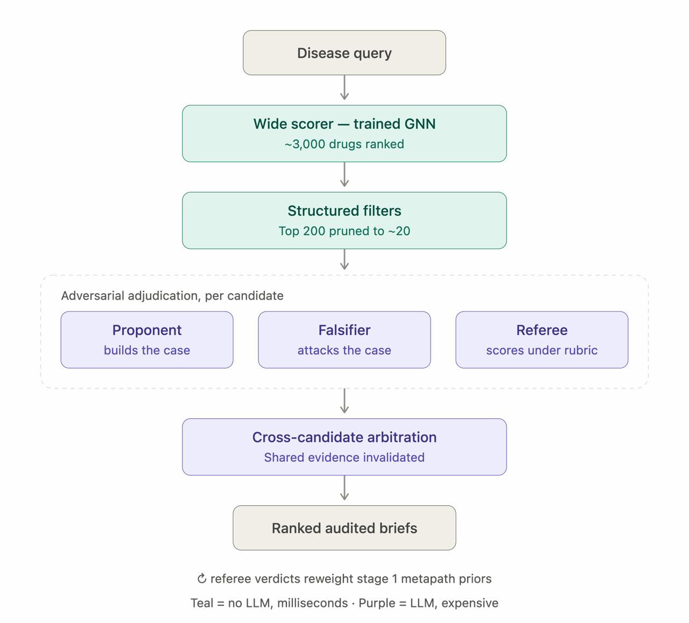
iv. System Architecture
▸ Disease query enters the cascade at the top
▸ Teal stages: no LLM, millisecond latency, deterministic
▸ Purple stages: LLM-driven, expensive, run only on the narrowed shortlist
▸ Referee verdicts feed back to reweight Stage-1 metapath priors over time
▸ Output is a ranked list of audited briefs, not a single verdict

Slide 8
v. Module Design
▸ M1 — KG Construction & Preprocessing: as built, ingests Hetionet v1.0 + PharmacotherapyDB into a versioned typed graph (47k nodes, 2.25M edges); PrimeKG / repoDB / DrugCentral + ID crosswalks are planned
▸ M2 — Wide Scorer (Stage 1): inductive R-GCN ensembled with popularity + gene-overlap priors (weights fit on validation); disease-holdout link prediction (true time-split supported); outputs top-200
▸ M3 — Structured Filter (Stage 2): deterministic rule engine — pruning, metapath annotation, degeneracy flagging; outputs top-20
▸ M4 — Adversarial Adjudication (Stage 3): LangGraph orchestrator running Proponent/Falsifier/Referee with tool access (PubMed, KG path query, FAERS/trials) and an NLI claim-verification gate
▸ M5 — Arbitration & Calibration (Stage 4): shared evidence ledger, invalidation propagation, effective-independent-support scoring, fitted calibrator
▸ M6 — Evaluation Harness: repoDB/DrugCentral benchmark runner; ablation ladder; Recall@K, MAP, nDCG, ECE, Brier
▸ M7 — Serving & Audit UI: FastAPI backend + React frontend exposing ranked briefs, full provenance trace, and invalidation history

Slide 9
vi. Dataset & Technology Stack
▸ Datasets: Hetionet / PrimeKG (base knowledge graph); CTD, Reactome, ChEMBL (mechanistic & pathway annotation); repoDB (approved + failed indications — gold standard with true negatives); DrugCentral (drug/safety metadata); PubMed (literature retrieval); OpenFDA FAERS (adverse-event signal)
▸ Modelling: Python, PyTorch + PyTorch Geometric / DGL (R-GCN link prediction)
▸ Agentic layer: LangGraph (multi-agent orchestration); an LLM API (Claude/GPT-class model) for Proponent / Falsifier / Referee
▸ Verification & calibration: HuggingFace Transformers (off-the-shelf NLI checkpoint, e.g. SciFact/HealthVer-trained DeBERTa); scikit-learn (calibrator, metrics)
▸ Serving: FastAPI backend, React audit-UI frontend
▸ Tooling: Git/GitHub for version control; Docker for reproducible environments
▸ All datasets are public and redistributable — no proprietary or licensing-restricted resources (DrugBank, KEGG) are used

Slide 10
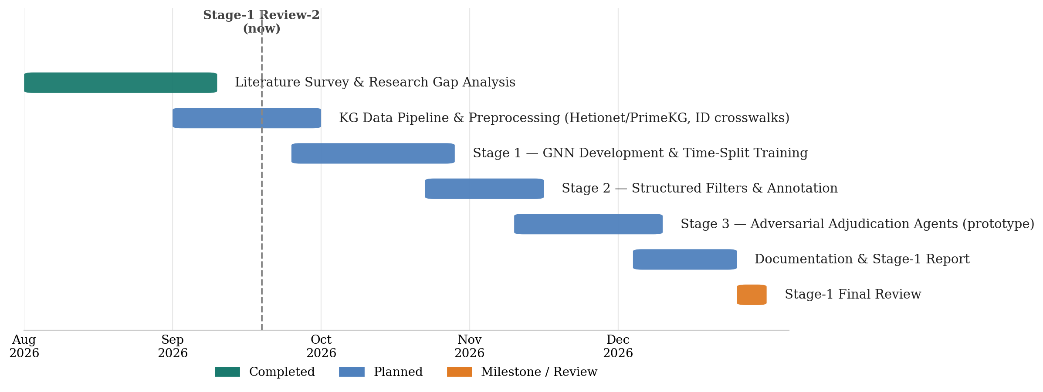
vii. Gantt Chart / Project Timeline
▸ Timeline for the remainder of Stage 1 (through December 2026); literature survey and research-gap analysis are already complete

Slide 11
Results (as built) — real Hetionet
Method (15 zero-shot test diseases) | MAP | recall@10 | ECE
Popularity baseline | 0.127 | 0.172 | —
Stage 1 — ensemble | 0.126 | 0.176 | —
Stage 2 — + filters & audit | 0.225 | 0.360 | —
Stage 4 — full system | 0.231 | 0.418 | 0.063
Full Hetionet (2.25M edges), disease-holdout: every test disease has all known drugs hidden in training.
• Full system beats the best baseline; recall@10 more than doubles (0.42 vs 0.17).
• Confidence is calibrated — ECE drops from 0.67 (raw) to 0.063 after Stage 4.
• Rheumatoid arthritis: 8 of top 10 are real known treatments. Migraine: topiramate, valproate recovered.
• Caveat: Stage 3 agents ran on an offline stand-in, not a live LLM — L3/L4 measure the pipeline, not LLM reasoning.

Slide 12
THANK YOU!

Slide 13
Any Queries?

