Slide 1






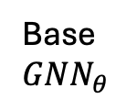


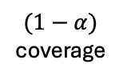



$C\left(x_{n+1}\right)$= {1, 2, 4}
x
$$\hat{q}$$
Base
$$GNN_{θ}$$
$$\hat{π}$$
x
Conformal
$$GNN_{ν}$$
$$GNN_{ν}$$
$$GNN_{θ}$$
$$GNN_{ν}$$
$(1−α)$
coverage
No label
$$GNN_{θ}$$
Calibration
Development
$$L_{efficiency}$$
Test
Base model training
Topology aware CF-GNN training
Conformal Prediction

