Slide 1
Model for learning language

Slide 2
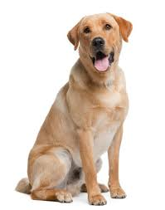
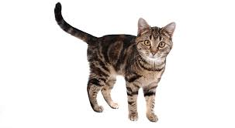
Overview of the implementation
Image 1
Image 2
Convolutional Network
Image activations
Sender
(Sender Network)
Receiver
(Receiver Network)
Word symbol
Feedback (+1 for match,
-1 for mismatch)
Target selection by receiver
Reinforcement Learning Environment

Slide 3
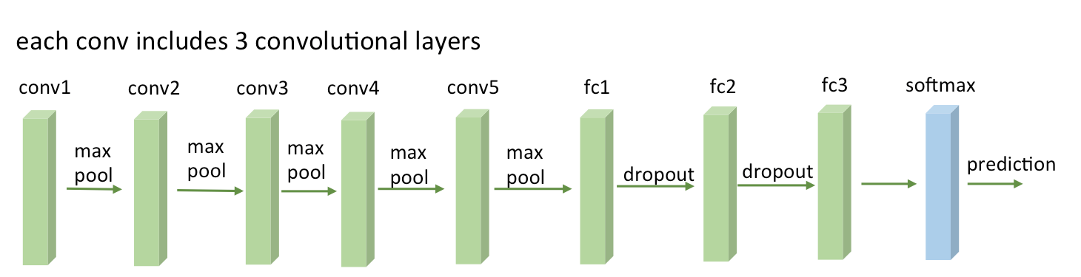
VGG ConvNet architecture

Slide 4
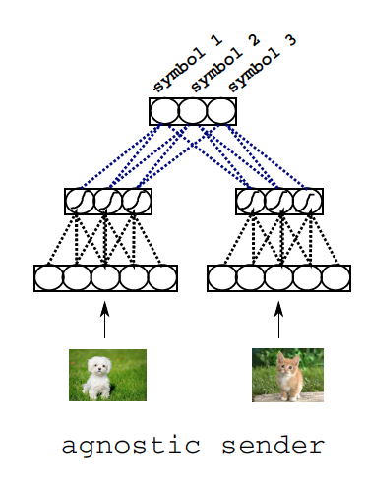
Model Structure: Sender Network

Slide 5
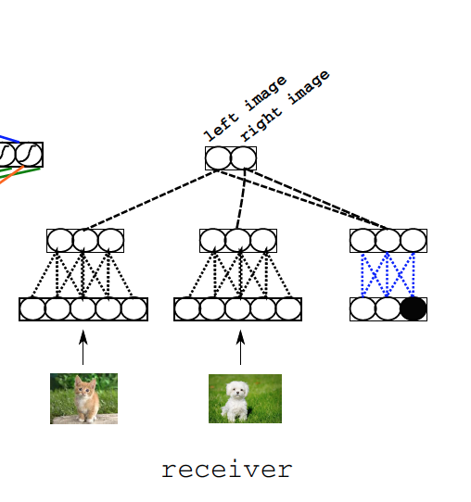
Model Structure: Receiver

