Slide 1



SSET’s, S.G.Balekundri Institute of Technology, Belagavi,
Department of Computer Science & Business Systems
Blockchain-Based Secure Medical Record System
Group no: 2
Rakesh Patil : 2BU23CB059
Pranav Murkibhavi : 2BU23CB057
Manu Nandihalli : 2BU23CB047
Abhishek Mallgoudnavar : 2BU23CB001
Guide : Ms. Afziya Garag
Project Phase II (BCB786)
VII Semester,
Department of Computer Science & Business Systems,
S. G. Balekundri Institute of Technology, Belagavi

Slide 2
SSET’s, S.G.Balekundri Institute of Technology, Belagavi,
Department of Computer Science & Business Systems
Introduction
The Blockchain-Based Secure Medical Record System is designed to give patients verifiable ownership of their health data. Medical files are encrypted inside the patient's own browser using AES-256-GCM, stored off-chain on IPFS, and anchored to the Ethereum blockchain by a cryptographic hash. The complete medical file is never written to the blockchain.
Access is governed by a smart contract rather than by a server administrator. A doctor must request permission, and only the patient can approve, reject or revoke it. Every such decision is recorded permanently as a blockchain event, producing an audit trail that no hospital, developer or administrator can alter or delete.

Slide 3
SSET’s, S.G.Balekundri Institute of Technology, Belagavi,
Department of Computer Science & Business Systems
Literature Survey:
SI No. | Author & Year | Title | Methodology | Dataset | Result
1 | A. Azaria, A. Ekblaw, T. Vieira, A. Lippman (2016) | MedRec: Using Blockchain for Medical Data Access and Permission Management | Ethereum smart contracts managing authorization and pointers to provider databases | Provider EMR databases (pointers only) | Decentralized permission management; established on-chain permissions with off-chain data
2 | Q. Xia, E. B. Sifah, K. O. Asamoah, et al. (2017) | MeDShare: Trust-less Medical Data Sharing Among Cloud Service Providers | Smart contracts with provenance tracking and automatic revocation on misuse | Cloud-hosted medical datasets | Auditable data sharing between untrusted providers with automated revocation
3 | G. Zyskind, O. Nathan, A. Pentland (2015) | Decentralizing Privacy: Using Blockchain to Protect Personal Data | Blockchain as an automated access-control manager storing pointers and permissions | Personal data stored off-chain | Removed need to trust a third party for access control enforcement

Slide 4
SSET’s, S.G.Balekundri Institute of Technology, Belagavi,
Department of Computer Science & Business Systems
Literature Survey:
SI No. | Author & Year | Title | Methodology | Dataset | Result
4 | A. Dubovitskaya, Z. Xu, S. Ryu, M. Schumacher, F. Wang (2017) | Secure and Trustable Electronic Medical Records Sharing Using Blockchain | Permissioned blockchain among known hospitals with cloud storage | Oncology patient records | Improved sharing within a regulated consortium of accountable institutions
5 | T. T. Kuo, H. E. Kim, L. Ohno-Machado (2017) | Blockchain Distributed Ledger Technologies for Biomedical and Health Care Applications | Comparative survey of distributed ledger designs for biomedical use | Review of existing biomedical systems | Identified immutability and auditability as key benefits; flagged scalability limits
6 | J. Benet (2014) | IPFS: Content Addressed, Versioned, Peer-to-Peer File System | Content-addressed distributed storage where the identifier derives from file contents | Distributed file storage network | Enables off-chain storage whose integrity is verifiable from the identifier alone

Slide 5
SSET’s, S.G.Balekundri Institute of Technology, Belagavi,
Department of Computer Science & Business Systems
Problem Statement
Existing medical record systems store sensitive patient data in centralized databases, which creates three structural weaknesses.
Confidentiality: a single intrusion exposes every record at once, making healthcare one of the most frequently breached sectors.
Integrity: when one organization holds both the records and the access log, that log is only as trustworthy as the organization. Alterations leave no evidence a patient can verify.
Control: patients cannot technically grant or withdraw access. Consent is a policy promise rather than an enforced constraint, and patients cannot see who has read their data.

Slide 6
SSET’s, S.G.Balekundri Institute of Technology, Belagavi,
Department of Computer Science & Business Systems
Objectives
To encrypt every medical record in the browser before it leaves the patient's device.
To store encrypted records off-chain on IPFS and anchor only the hash on the blockchain.
To guarantee data integrity so that any tampering is immediately detectable.
To enforce patient-controlled access through smart contracts rather than server policy.
To allow patients to grant, reject and revoke doctor access at any time.
To maintain an immutable audit trail of every access request, approval and denial.
To ensure that neither the server nor an administrator can decrypt any medical record.
To deploy the system as a public website usable from any browser with MetaMask.

Slide 7
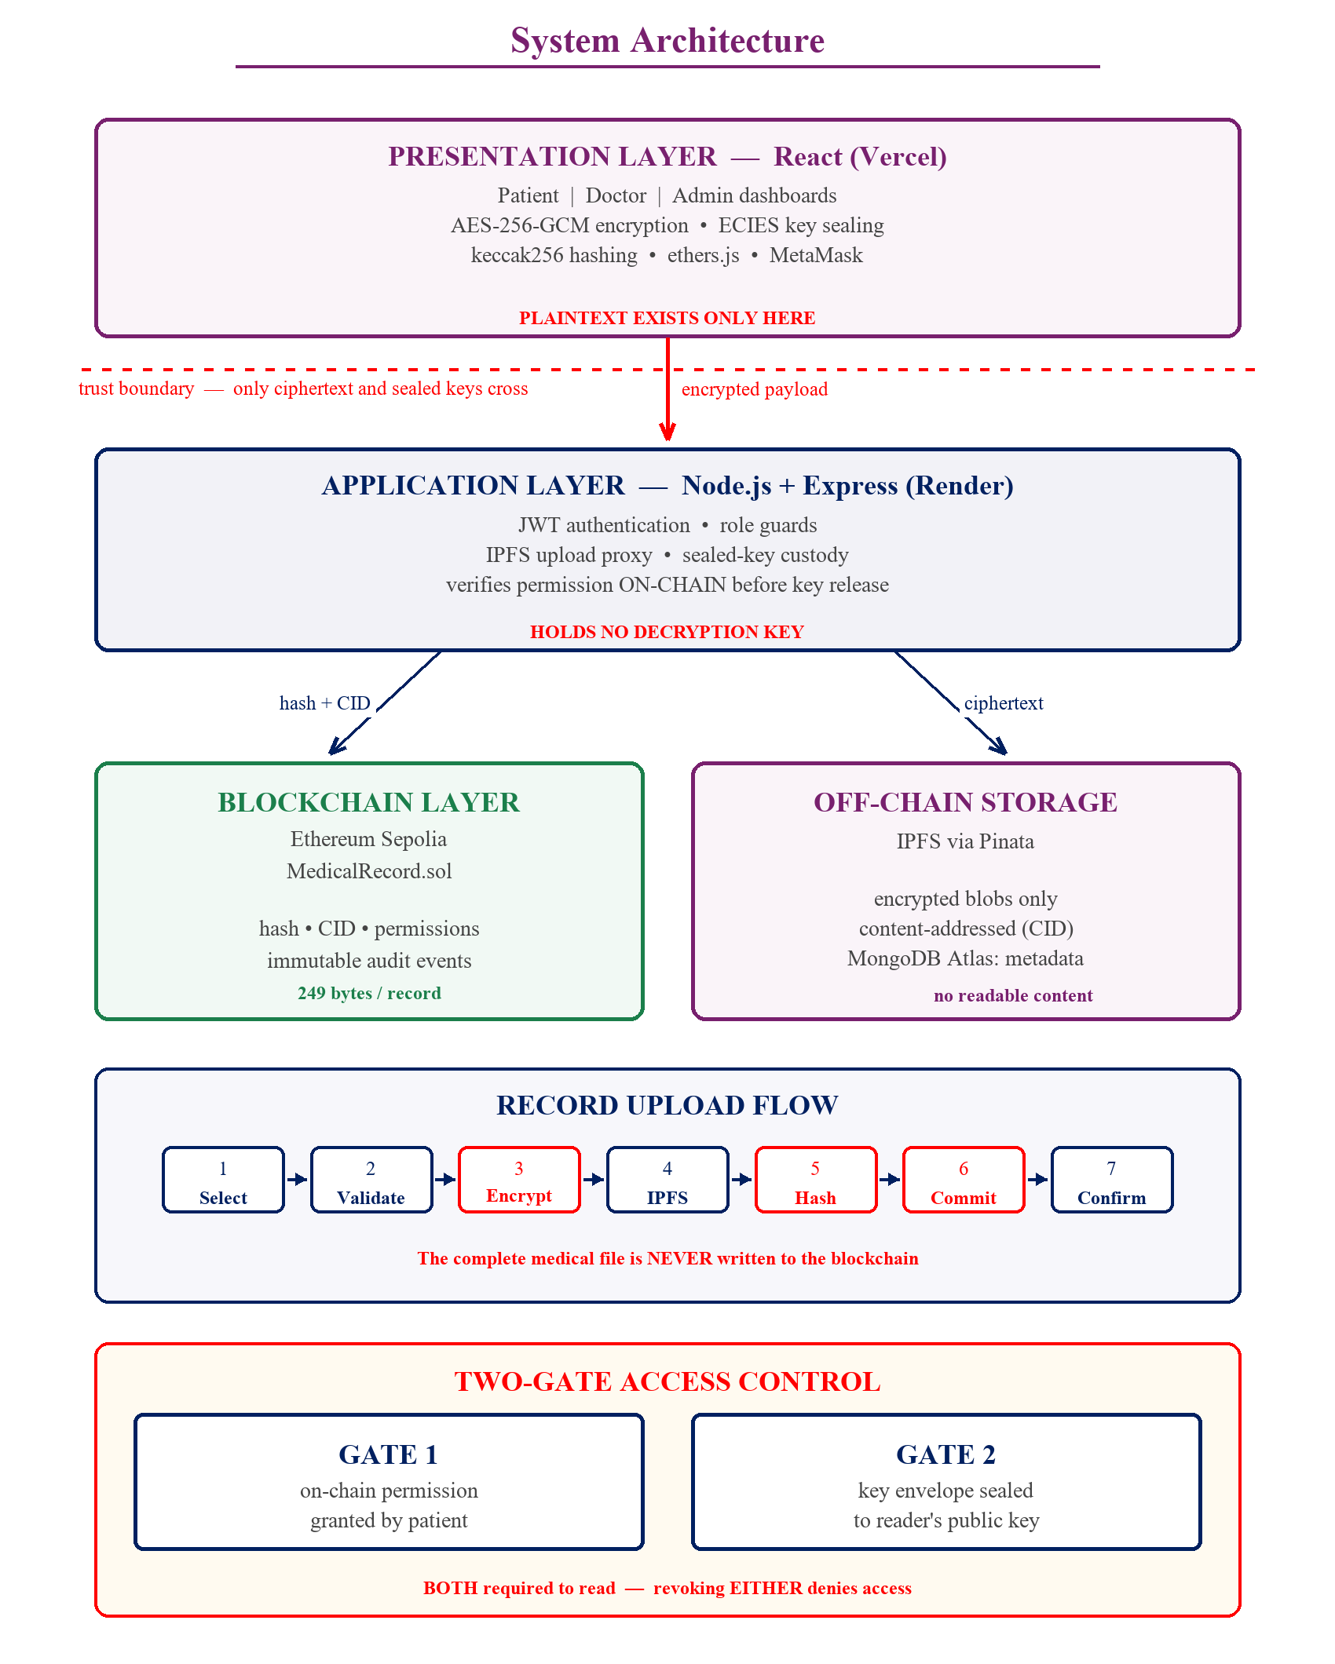
SSET’s, S.G.Balekundri Institute of Technology, Belagavi,
Department of Computer Science & Business Systems
System Architecture

Slide 8
SSET’s, S.G.Balekundri Institute of Technology, Belagavi,
Department of Computer Science & Business Systems
Methodology
Step 1 Patient selects a medical file in the browser.
Step 2 File type and size are validated before processing.
Step 3 A fresh 256-bit key encrypts the file using AES-256-GCM.
Step 4 The ciphertext is uploaded to IPFS, which returns a Content Identifier (CID).
Step 5 keccak256 of the ciphertext is computed as the integrity proof.
Step 6 Hash, CID and metadata are committed on-chain in one signed transaction.
Step 7 On confirmation, the data key is sealed to the patient's own public key.
8. The hash is taken over the ciphertext, so integrity can be verified by anyone holding the file, even without a decryption key.

Slide 9
SSET’s, S.G.Balekundri Institute of Technology, Belagavi,
Department of Computer Science & Business Systems
Technology Stack
Frontend: React 18, Vite, Tailwind CSS, ethers.js v6
Backend: Node.js, Express, JWT authentication
Blockchain: Solidity 0.8.24, Hardhat, Ethereum Sepolia testnet
Wallet: MetaMask for identity and transaction signing
Off-chain storage: IPFS through the Pinata pinning service
Database: MongoDB Atlas for metadata and sealed key envelopes
Cryptography: Web Crypto API (AES-GCM), @noble/secp256k1 (ECIES)
Deployment: Vercel (frontend), Render (backend), Sepolia (contract)

Slide 10
SSET’s, S.G.Balekundri Institute of Technology, Belagavi,
Department of Computer Science & Business Systems
Smart contract design
MedicalRecord.sol stores identities, record metadata, permissions and audit events.
Core functions: registerPatient, registerDoctor, uploadRecord, requestAccess, approveRequest, rejectRequest, grantAccess, revokeAccess, hasAccess.
Security modifiers: onlyPatient, onlyDoctor, onlyRecordOwner, onlyAdmin, validAddress.
Audit events: RecordUploaded, AccessRequested, AccessGranted, AccessRejected, AccessRevoked, AccessDenied, RecordViewed.
Records are never deleted. deactivateRecord flags them inactive so history stays verifiable.

Slide 11
SSET’s, S.G.Balekundri Institute of Technology, Belagavi,
Department of Computer Science & Business Systems
Security & Key Management
Wallet-derived encryption key: MetaMask refuses to export a private key, so the system derives one. The user signs a fixed message; because wallet ECDSA is deterministic (RFC 6979), that signature is stable, and hashing it yields a reproducible secp256k1 keypair. The private key exists only in memory; the server learns only the public half.
Per-record keys: each record is encrypted under its own random AES-256 key, which is sealed to a recipient using ECIES (ephemeral ECDH, HKDF-SHA256, AES-GCM).
Two-gate access: reading a record requires both an on-chain permission and a key envelope sealed to the reader. Revoking either gate alone is sufficient to deny access.

Slide 12
SSET’s, S.G.Balekundri Institute of Technology, Belagavi,
Department of Computer Science & Business Systems
Implementation & Deployment
The system is deployed publicly and is reachable from any laptop with a browser and MetaMask.
Website: medchain-records.vercel.app
Backend API: medchain-api-j6hv.onrender.com
Smart contract: 0xAE246FCcad4F7aF88C1c6B3d17FaF2105D345824 (Ethereum Sepolia)
Verification: 29 smart contract unit tests and 56 full-stack integration assertions all pass. Deployed bytecode is 17,046 bytes, within the 24,576-byte EIP-170 limit.

Slide 13
SSET’s, S.G.Balekundri Institute of Technology, Belagavi,
Department of Computer Science & Business Systems
Result
The system was implemented, deployed and tested end to end on a public Ethereum testnet.
Patients successfully uploaded records that were encrypted in the browser, pinned to IPFS and anchored on-chain. Integrity verification confirmed that every retrieved file hashed to exactly the value recorded on the blockchain.
Access control behaved as designed under adversarial testing. An unauthorised doctor was refused by the smart contract and by the API independently, and the attempt was logged on-chain as an AccessDenied event. After the patient approved the request the same doctor could decrypt the record, and after revocation access was denied immediately.
Administrators could view record metadata and system activity but could not decrypt any medical content, confirming that confidentiality does not depend on administrator trust.

Slide 14
SSET’s, S.G.Balekundri Institute of Technology, Belagavi,
Department of Computer Science & Business Systems
Performance Analysis: Gas Cost
SI No. | Contract Operation | Gas Used | Cost (ETH) | Cost (USD) | Frequency
1 | Contract deployment | 3,780,959 | 0.075619 | 226.86 | One time
2 | registerPatient | 186,023 | 0.003720 | 11.16 | Per patient
3 | registerDoctor | 230,839 | 0.004617 | 13.85 | Per doctor
4 | uploadRecord | 367,574 | 0.007351 | 22.05 | Per record
5 | requestAccess | 279,970 | 0.005599 | 16.80 | Per request
6 | approveRequest | 149,465 | 0.002989 | 8.97 | Per approval
7 | revokeAccess | 46,148 | 0.000923 | 2.77 | Per revocation
8 | logRecordAccess | 30,732 | 0.000615 | 1.84 | Per record read

Slide 15
SSET’s, S.G.Balekundri Institute of Technology, Belagavi,
Department of Computer Science & Business Systems
Performance Analysis: Encryption
File Size | AES Encrypt (ms) | AES Speed (MB/s) | keccak256 (ms) | Hash Speed (MB/s) | Total (ms)
100 KB | 0.3 | 293 | 8.5 | 11 | 10.2
500 KB | 0.6 | 777 | 39.3 | 12 | 41.6
1 MB | 1.6 | 643 | 95.3 | 10 | 100.2
5 MB | 9.1 | 550 | 554.9 | 9 | 525.0
10 MB | 13.9 | 721 | 1049.8 | 10 | 1195.1

Slide 16
SSET’s, S.G.Balekundri Institute of Technology, Belagavi,
Department of Computer Science & Business Systems
Conclusion & Future Scope
The system demonstrates that blockchain and client-side encryption together can deliver medical records that are confidential, tamper-evident and genuinely patient-controlled.
Storing only a hash on-chain keeps the cost constant at 249 bytes per record regardless of file size, making the design scalable for real clinical data.
Future Scope:
Key recovery through social recovery or threshold secret sharing.
Reducing on-chain metadata leakage using zero-knowledge proofs.
Controlled emergency access for unconscious patients.
Integration with hospital information systems and a progressive web app for mobile.

Slide 17
Thank You

