Slide 1





ALGoRITHM mAchine LearninG to deteRmIne THe Materials behaviour
-Pranav A. Nerurkar
A project launched by :

Slide 2
Contents
Background –
Nissan
Odor project
Data Description
Data visualization
Experimental results
Future works

Slide 3
1. Background

Slide 4


Background to our work
Aim:
Given the input ingredients and their quantities, predict the performance targets
Ingredients
Performance targets
X f(x) y
Projects:

Slide 5
2. Data description

Slide 6
Data description: Ingredients
Table 1: List of ingredients used for synthesizing elastomers
Ingredient Exact Trade Name
Polymer 1
Polymer 2
Polymer 3
Polymer 4
Polymer 5
Polymer 6
Carbon Black 1
Carbon Black 2
Carbon Black 3
Carbon Black 4
Carbon Black 5
Carbon Black 6
Carbon Black 7
Filler 1
Filler 2
Filler 3
Filler 4
Filler 5
Filler 6
Filler 7
Filler 8
Ingredient Exact Trade Name
Plasticizer 1
Plasticizer 2
Plasticizer 3
Processing Aids 1
Processing Aids 2
Processing Aids 3
Dessiccant 1
Metal oxide 1
Metal oxide 2
Antidegradant 1
Antidegradant 2
Antidegradant 3
Antidegradant 4
Curing Agent 1
Curing Agent 2
Curing Agent 3
Curing Agent 4
Curing Agent 5

Slide 7
Data description: Elastomers
Using the ingredients in Table 1, Total 98 elastomers are made
Locations where elastomers were made:
a. North America – 30
b. European Union – 68
c. Total – 98

Slide 8
Data description: Performance targets
Table 2: List of Performance targets
Property Category | Property Name |  | Standard | Unit [SI] | Directionality | Priority
Viscosity | ML(1+4)@121°C |  |  | MU | Trend | Ignore
 | Complex vscosity |  |  | Pa.s | Trend | Ignore
MDR Curing time at 180°C, 7%, 1,67 Hz, 10min isothermal | S' max |  |  | dNm | Trend | Ignore
 | S' min |  |  | dNm | Trend | Ignore
 | T10 |  |  | s | Trend | Ignore
 | T50 |  |  | s | Trend | Ignore
 | T90 |  |  | s | Trend | Ignore
Density | Specific gravity | +-0,03 | NES M 0516 | g.cm-3 | Trend | Medium
recalculated TGA | Volatiles | +-2% |  | % | Trend | Medium
 | Elastomer | +-2% |  | % | Trend | Medium
 | Carbon black | +-2% |  | % | Trend | Medium
 | Calcium carbonate | +-2% |  | % | Trend | Medium
 | Residues | +-2% |  | % | Trend | Medium
As received properties | log (Troughput resistivity) | 10 | DIN IEC 60093 | Ω.cm | Maximize | Low
 | Hardness | +-3 | ISO 48 | IRDH | Trend | Low
 | M30 |  | ISO 37 | Mpa | Trend | Ignore
 | Stress at break | +-10% | ISO 37 | Mpa | Maximize | Low
 | Elongation at break | +-20% | ISO 37 | % | Maximize | Low
 | Tear resistance | +-10% | ISO 34.1 | N/cm | Maximize | Low
 | Tear resistance | +-10% | ISO 34.2 | N/cm | Maximize | Low
 | Compression set 168hrs at 135°C | +-15% | NES M 0517 | % | Minimize | Low
 | Compression set 168hrs at 150°C | +-15% | NES M 0517 | % | Minimize | Low
 | Compression set 22hrs at -20°C |  | NES M 0517 | % | Minimize | Low
 | Cold flexibility | +-3°C | Internal DSC | °C | Minimize | Low
 | Ozone resistance |  | NES M 0507 | - | Minimize | Ignore

Slide 9
Dataset description: Performance targets
Table 3: List of Performance targets
Property Category | Property Name |  | Standard | Unit [SI] | Directionality | Priority
Ageing in air 168hrs at 135°C | Change of Hardness | +-3 | ISO 48 | IRDH | Trend | Low
 | Change of stress at break | +-10% | ISO 37 | % | Trend | Low
 | Change of elongation at break | +-20% | ISO 37 | % | Trend | Low
 | Ozone resistance |  | NES M 0507 | - | Minimize | Ignore
Ageing in air 168hrs at 150°C | Change of Hardness | +-3 | ISO 48 | IRDH | Trend | Low
 | Change of stress at break | +-10% | ISO 37 | % | Trend | Low
 | Change of elongation at break | +-20% | ISO 37 | % | Trend | Low
 | Ozone resistance |  | NES M 0507 | - | Minimize | Ignore
Ageing in 10-90% DW - coolant mixture 240hrs at 115°C | Change of Hardness | +-3 | ISO 48 | IRDH | Trend | Low
 | Change of stress at break | +-10% | ISO 37 | % | Trend | Low
 | Change of elongation at break | +-20% | ISO 37 | % | Trend | Low
 | Change of volume |  | NES M 0516 | % | Trend | Low
 | Extraction by coolant |  | D5806 | g | Minimize | Low
Ageing in oil 72hrs at 100°C | Change of volume | +-10% | NES M 0516 | % | Minimize | Low
Ageing in oil 72hrs at 150°C | Change of volume | +-10% | NES M 0516 | % | Minimize | Low

Slide 10
Data description
Inputs have no missing values
Outputs have missing values:
a. ML(1+4)@121°C - 11
b. Complex viscosity - 11
c. Cold flexibility - 11
d. Ozone resistance - 98
e. Ageing in air 168hrs at 135C Ozone resistance - 98
f. Ageing in air 168hrs at 150C Ozone resistance - 98
Illegal characters:
a. NOK – 17 rows
Data entry errors
a. Elastomer 53 has 52118,9 in Complex viscosity
5. Following ingredients have never been used and can be removed:
a. Carbon black 7
b. Anti-degradant 4
c. Curing agent 4

Slide 11
3. Data visualization

Slide 12
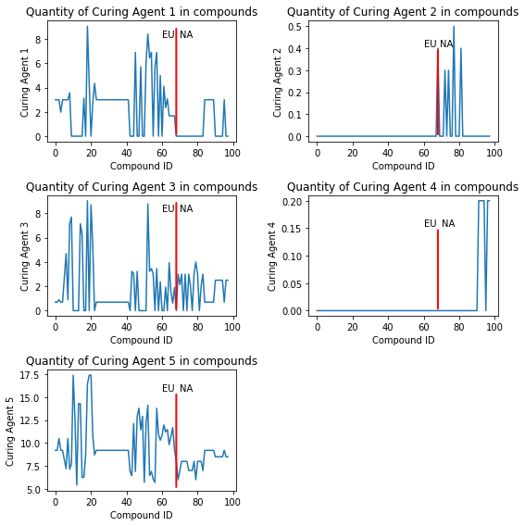
Use of Curing Agents
Figure 1: Use of Curing Agents

Slide 13
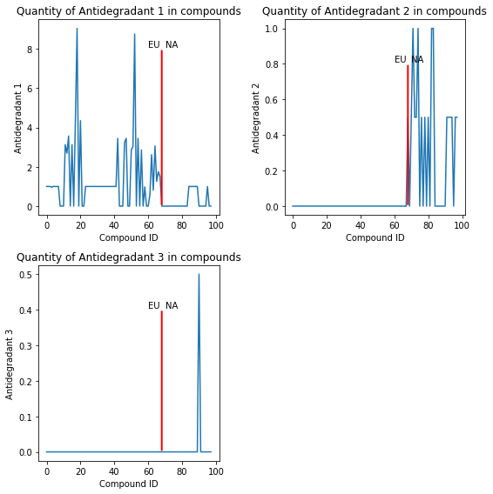
Use of Anti-degradant
Figure 2: Use of Anti-degradant

Slide 14
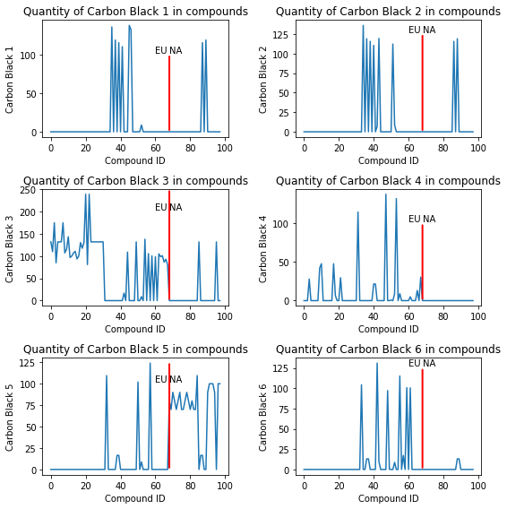
Use of Carbon black
Figure 3: Use of Carbon black

Slide 15
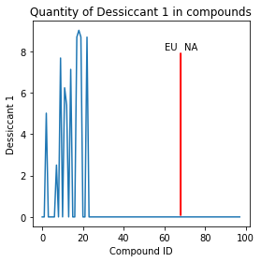
Use of Dessicant
Figure 4: Use of Dessicant 1

Slide 16
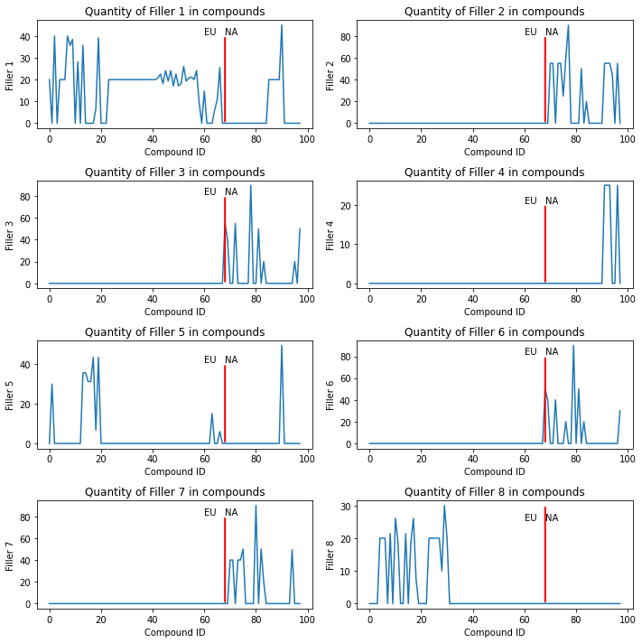
Use of Fillers
Figure 5: Use of Filler

Slide 17
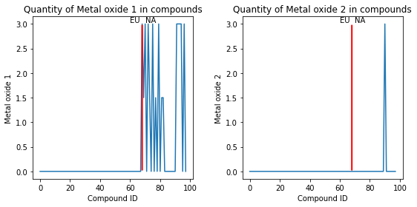
Use of Metal oxide
Figure 5: Use of Metal oxide

Slide 18
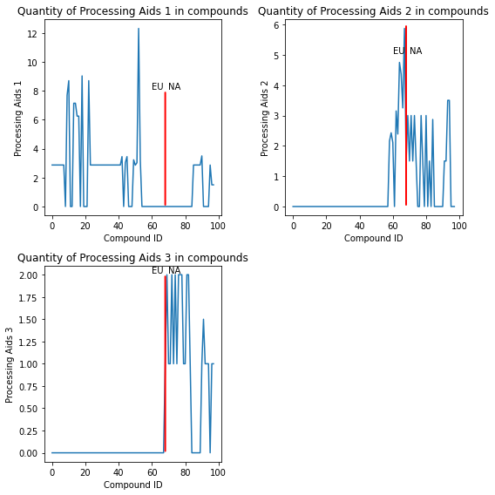
Use of Processing Aids
Figure 6: Use of Processing Aids

Slide 19
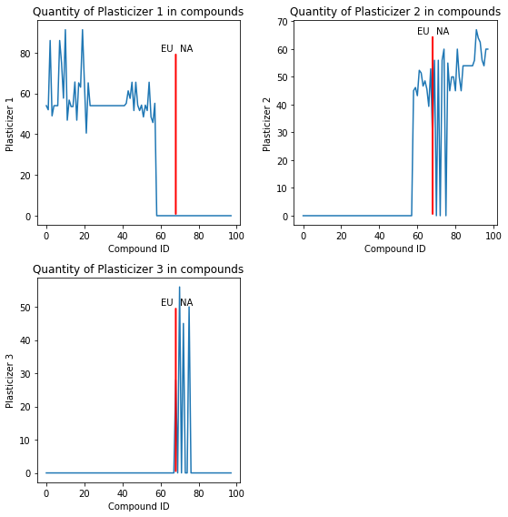
Use of Plasticizers
Figure 7: Use of Plasticizers

Slide 20
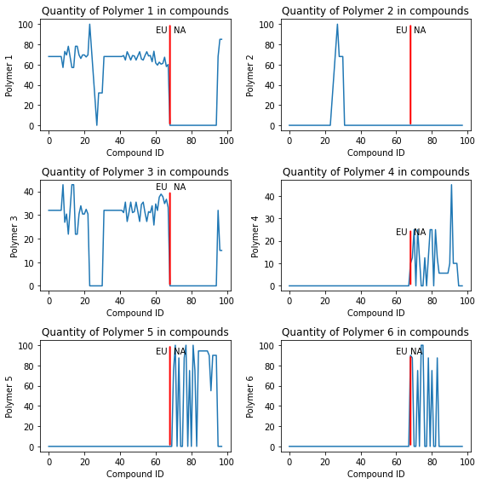
Use of Polymers
Figure 7: Use of Polymers

Slide 21
4. Experimental Results

Slide 22
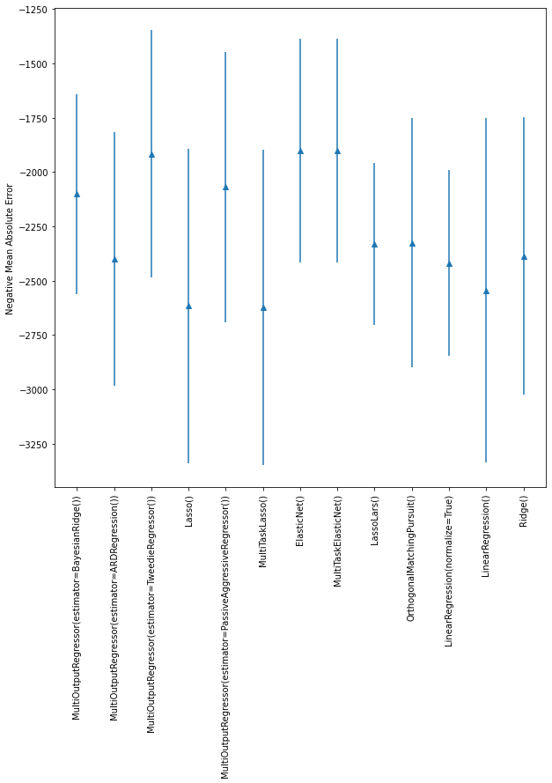
Mean absolute error on test set
Figure 8: Performance of Linear models

Slide 23
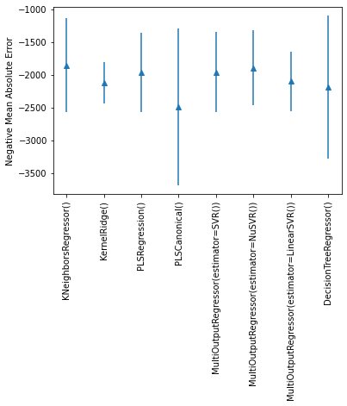
Mean absolute error on test set
Figure 9: Performance of Non-linear models

Slide 24
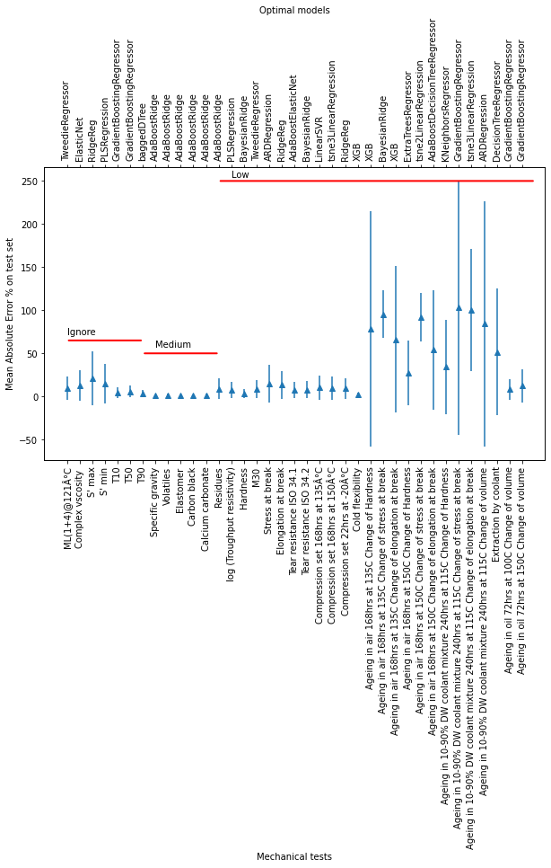
Mean absolute error percentage on test set
Figure 10: Best model for each performance target

Slide 25
Summary of Outcomes and Lessons Learnt
A single model to predict all performance targets had lower accuracy then multiple models.
A simple formula to understand which ingredient has impact of the performance target
Confidence of our predictions
Tests | Priority | Models | Mean_MAE_% | Stddev_MAE_%
ML(1+4)@121Ã‚Â°C | Ignore | TweedieRegressor | 9.427497 | 13.39514
Complex vscosity | Ignore | ElasticNet | 12.96506 | 17.90196
S' max | Ignore | RidgeReg | 20.78166 | 31.37592
S' min | Ignore | PLSRegression | 15.21905 | 22.87749
T10 | Ignore | GradientBoostingRegressor | 4.405956 | 6.325531
T50 | Ignore | GradientBoostingRegressor | 5.797389 | 6.62025
T90 | Ignore | baggedDTree | 3.353349 | 4.214014

Slide 26
Summary of Outcomes and Lessons Learnt
Tests | Priority | Models | Mean_MAE_% | Stddev_MAE_%
Specific gravity | Medium | AdaBoostRidge | 1.103252 | 1.423295
Volatiles | Medium | AdaBoostRidge | 1.406106 | 2.024292
Elastomer | Medium | AdaBoostRidge | 0.772048 | 1.190107
Carbon black | Medium | AdaBoostRidge | 0.96534 | 1.625891
Calcium carbonate | Medium | AdaBoostRidge | 1.255442 | 2.450146
Residues | Medium | AdaBoostRidge | 8.907841 | 11.96839
log (Troughput resistivity) | Low | PLSRegression | 7.733561 | 9.402155
Hardness | Low | BayesianRidge | 3.383795 | 4.852995
M30 | Ignore | TweedieRegressor | 8.254001 | 10.50354
Stress at break | Low | ARDRegression | 14.46953 | 21.80333
Elongation at break | Low | RidgeReg | 13.4632 | 16.44931

Slide 27
Summary of Outcomes and Lessons Learnt
Tests | Priority | Models | Mean_MAE_% | Stddev_MAE_%
Tear resistance ISO 34.1 | Low | AdaBoostElasticNet | 7.328024 | 9.525831
Tear resistance ISO 34.2 | Low | BayesianRidge | 7.916047 | 10.26493
Compression set 168hrs at 135Ã‚Â°C | Low | LinearSVR | 10.19896 | 13.92175
Compression set 168hrs at 150Ã‚Â°C | Low | tsne3LinearRegression | 9.720428 | 13.32882
Compression set 22hrs at -20Ã‚Â°C | Low | RidgeReg | 9.266888 | 11.69419
Cold flexibility | Low | XGB | 1.864593 | 2.380878
Ageing in air 168hrs at 135C Change of Hardness | Low | LinReg_Ind | 59.21897 | 94.8328
Ageing in air 168hrs at 135C Change of stress at break | Low | BayesianRidge | 95.36933 | 27.47139
Ageing in air 168hrs at 135C Change of elongation at break | Low | XGB | 66.22553 | 84.90135
Ageing in air 168hrs at 150C Change of Hardness | Low | ExtraTreesRegressor | 27.20412 | 37.40239

Slide 28
Summary of Outcomes and Lessons Learnt
Tests | Priority | Models | Mean_MAE_% | Stddev_MAE_%
Ageing in air 168hrs at 150C Change of stress at break | Low | tsne2LinearRegression | 92.04042 | 28.15645
Ageing in air 168hrs at 150C Change of elongation at break | Low | AdaBoostDecisionTreeRegressor | 54.08215 | 69.33101
Ageing in 10-90% DW coolant mixture 240hrs at 115C Change of Hardness | Low | KNeighborsRegressor | 34.51986 | 54.64367
Ageing in 10-90% DW coolant mixture 240hrs at 115C Change of stress at break | Low | GradientBoostingRegressor | 103.2144 | 147.4875
Ageing in 10-90% DW coolant mixture 240hrs at 115C Change of elongation at break | Low | tsne3LinearRegression | 100.0301 | 70.77282
Ageing in 10-90% DW coolant mixture 240hrs at 115C Change of volume | Low | ARDRegression | 84.32137 | 142.428
Extraction by coolant | Low | DecisionTreeRegressor | 51.74107 | 73.76162
Ageing in oil 72hrs at 100C Change of volume | Low | GradientBoostingRegressor | 8.438752 | 11.94158
Ageing in oil 72hrs at 150C Change of volume | Low | LinReg_2000 | 11.90596 | 20.70381

Slide 29
5. Data description

Slide 30
Data description: Ingredients
Accelerator | 50
Polymer | 43
Additive | 18
Carbon Black | 17
White Filler | 17
Activator | 14
Plasticizer | 12
Sulfur | 8
Blowing Agent | 7
Process Aid | 6
Retarder | 6
Desiccant | 4
Antidegradant | 1
Resin | 1
Grand Total | 204

Slide 31
Data description: Performance targets
Hardness | 13
Tensile strength | 9
Elongation at break | 9
Compression Set | 8
Modulus | 6
Tear resistance | 6
Specific gravity | 5
Odor | 4
Tension set | 3
VOC | 2
ML (S'min) | 1
Water absorption | 1
Garvey die | 1
Ts2 | 1
VVOC | 1
Mooney Viscosity | 1
MH (S'max) | 1
T90 | 1
T50 | 1
Scorch T5 | 1
Grand Total | 75

Slide 32
Data description
Total observations : 602
Groups: dense60, dense70, dense75, dense85, sponge, microdense
Missing values
Performance target | % of missing values
Scorch T5: Uncured, 121Â°C | 72.4
Mooney Viscosity: Uncured, 121Â°C | 71.8
Blooming: TL 52 704, 90Â°C, Audi, 22hours | 71.4
Compression Set | 70.9
Tensile strength | 57.6
Elongation at break | 57.6
Hardness: Shore A | 47.7
VVOC: VDA 278 | 46.2
T90: Uncured, MDR, 3minutes, 180Â°C | 38.7
VOC: VDA 278 | 29.2
Odor: VDA 270, Dry, 2hours, 80Â°C | 20.1

Slide 33
6. Preliminary Work

Slide 34
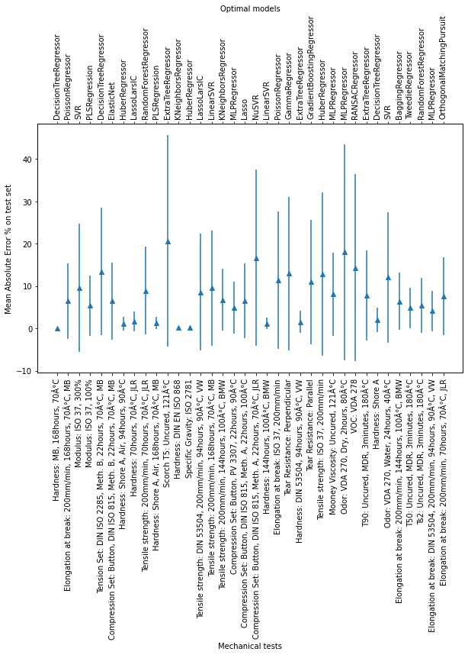
Mean absolute error on Dense60 test set
Figure 11: Performance on Dense60

Slide 35
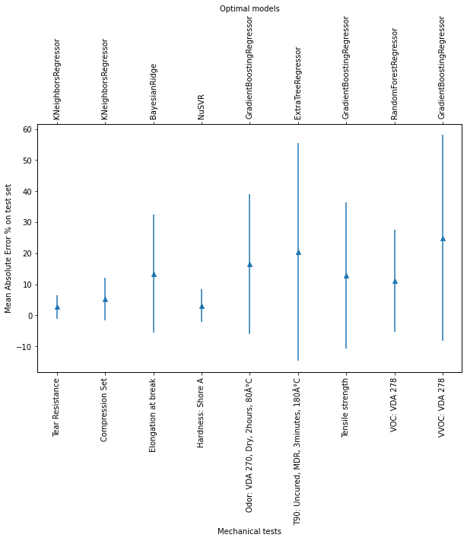
Mean absolute error on Dense70 test set
Figure 12: Performance on Dense70

Slide 36
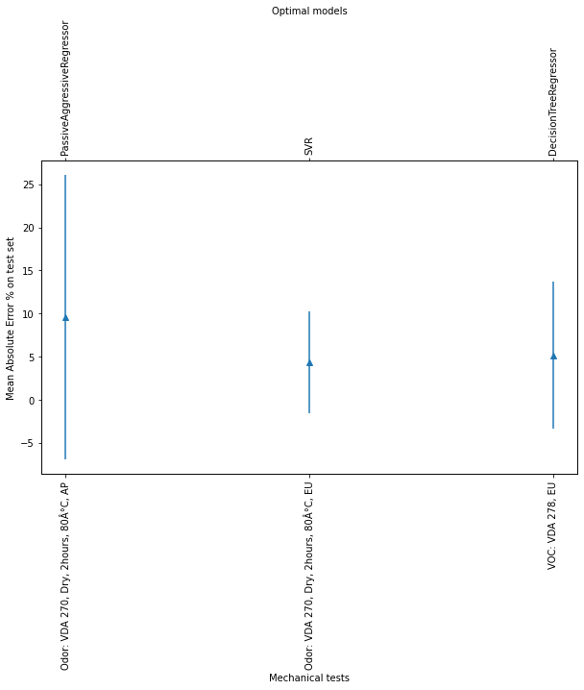
Mean absolute error on Dense75 test set
Figure 12: Performance on Dense75

Slide 37
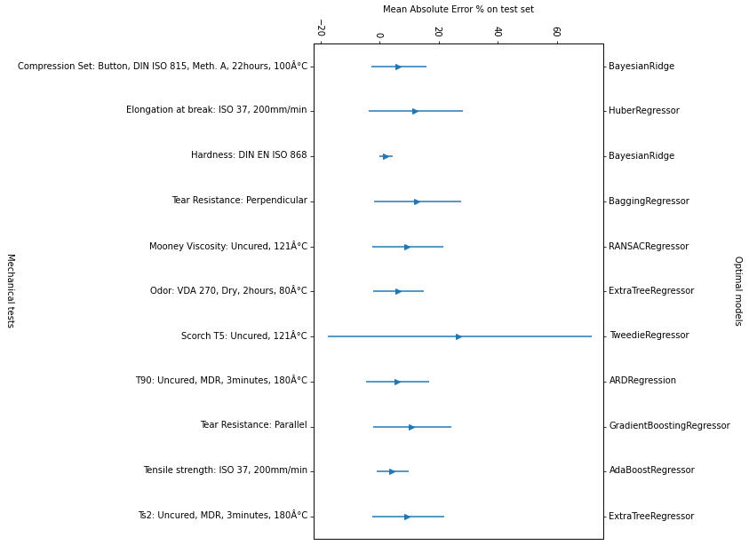
Mean absolute error on Dense85 test set
Figure 12: Performance on Dense85

Slide 38
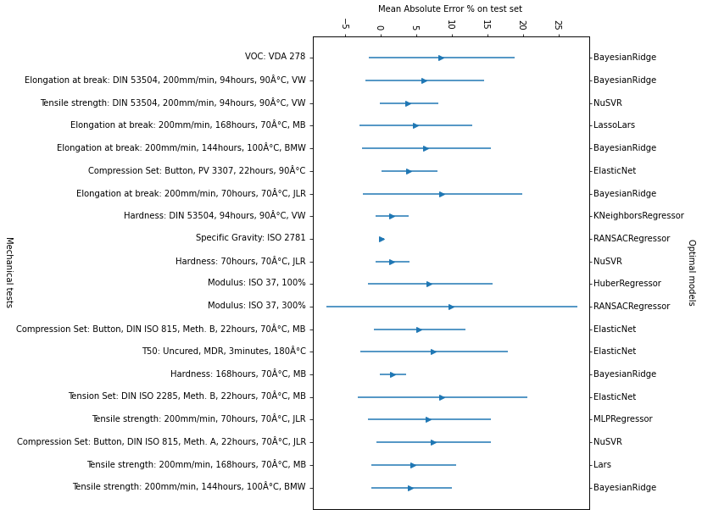
Mean absolute error on Dense85 test set
Figure 12: Performance on Dense85

Slide 39
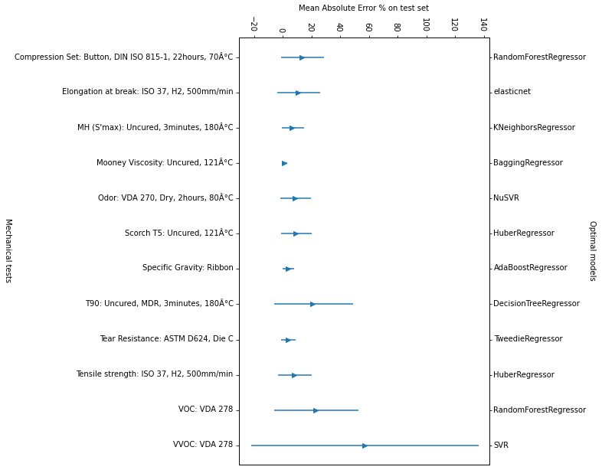
Mean absolute error on Sponge test set
Figure 12: Performance on Sponge

Slide 40
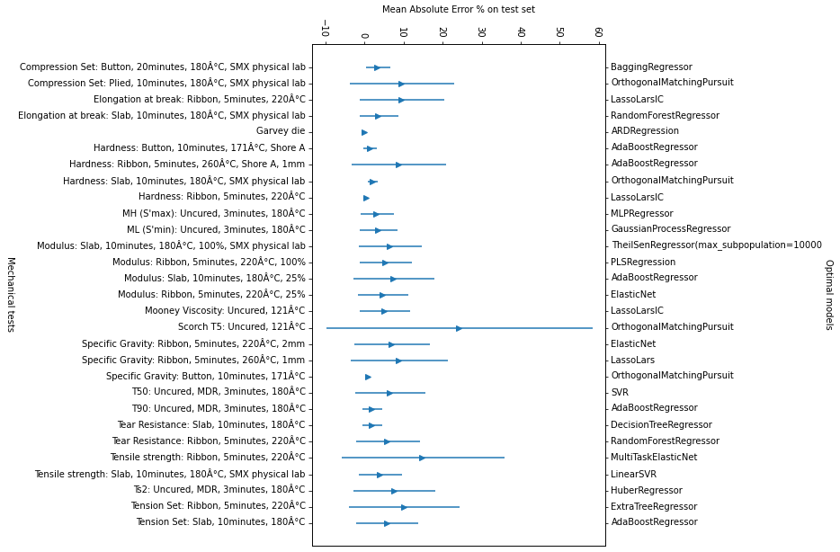
Mean absolute error on Microdense test set
Figure 12: Performance on Microdense

Slide 41
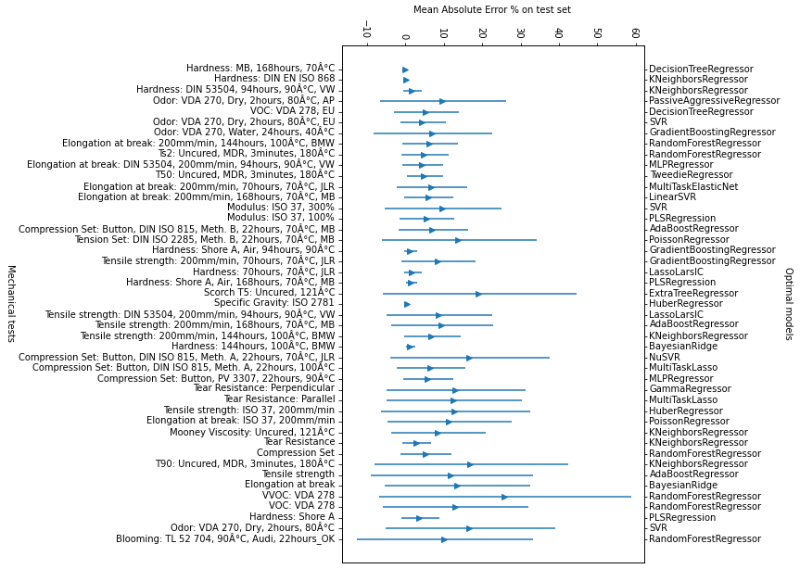
Mean absolute error on Dense 60-70-75 test set
Figure 12: Performance on Dense 60-70-75

Slide 42
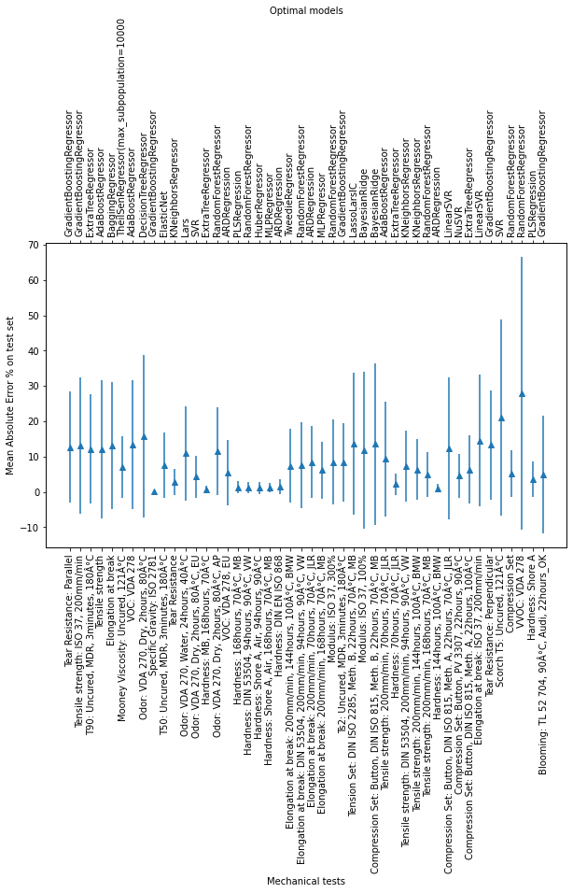
Mean absolute error on Dense 60-70-75-85 test set
Figure 12: Performance on Dense 60-70-75-85

Slide 43
Mean absolute error on Microdense test set
Figure 12: Performance on Microdense

Slide 44
Our next steps
For Nissan: We can generate performance targets given the input recipes.
For Nissan: We can understand if we reduce ingredients what performance targets we can get.
For Odor: Find best models for performance targets
For Odor: Get simple mathematical relation to explain how ingredients lead to performance targets

Slide 45


Thank you!
-Pranav NERURKAR

