Slide 1
Customer Segmentation Project and Purchase Behavior Analysis
Project Code – CDACL002
Name : Pranav a naik

Slide 2
Project Objective
Analyze customer data to identify trends, segments, and marketing strategies.

Slide 3
Problem Statement
Identify product categories where discounts should be applied.
Analyze card spending across age groups.
Study seasonal and location-based shopping behavior.
Perform customer clustering for targeted marketing.

Slide 4
Dataset Overview
3900 customer records.
Attributes include Age, Gender, Category, Purchase Amount, Season, Location, Discount Applied, Payment Method.
Used for understanding customer behavior patterns.

Slide 5
Tools & Technologies
Power BI – Visualization & Dashboard
Orange – Customer Clustering
Excel – Data cleaning
MySQL – To store the data, Retrieve the required data from the mysql by using sql queries.

Slide 6
Data Preprocessing
Removed null values.
Converted categorical values to numeric.
Normalized numerical columns.
Prepared data for clustering.

Slide 7
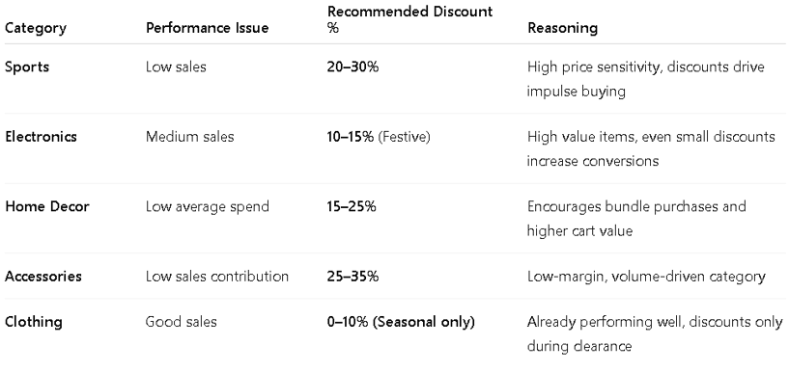
Objective 1: Discount Analysis
Identified categories with high discount dependency.
Electronics, Sports & Home Decor showed higher discount impact.
These categories attract customers through offers.

Slide 8
Objective 2: Card spending by Age Group
Age group 46-60 shows highest card spend based on all seasons.
Age 36-45 shows highest spending based on average purchased amount.
Younger customers prefer online payments.
Older customers show stable purchasing behavior.

Slide 9
Season & Location Analysis
Higher sales are observed during the festive season among the 46–60 age group.
Season-wise, the highest sales occur in the spring season, whereas summer records the lowest sales.
Clear seasonal demand patterns are observed.
Chicago records higher sales compared to other locations, whereas Houston shows the lowest sales.
Location-wise, the highest sales are from the 46–60 age group in Chicago, whereas New York records the lowest sales.

Slide 10
Customer Clustering
K-Means clustering used.
Based on purchase behavior and spending patterns.
4 customer segments identified.

Slide 11
Cluster 1: High Value Customers
Key Characteristics:-
Highest purchase amount among all clusters.
Frequent shoppers with regular purchase behavior.
Low dependency on discounts or promotional offers.
High brand loyalty and repeat purchase rate.
Behavioral Insights:-
Customers in this cluster prefer quality over price.
They are willing to pay more for better products or services.
Purchasing decisions are less influenced by discounts.
Represent the most profitable segment of the customer base.

Slide 12
Business Interpretation:-
This cluster represents premium and loyal customers who contribute significantly to overall revenue. Retaining this group is more cost-effective than acquiring new customers.
Recommended Business Strategies:-
Offer exclusive access to new products or premium services.
Introduce loyalty reward programs.
Provide personalized offers instead of heavy discounts.
Focus on relationship-based marketing.

Slide 13
Cluster 2: Discount Seekers
Key Characteristics:-
Highly sensitive to discounts and promotions.
Purchase mainly during sales or when offers are available.
Moderate purchase frequency.
Lower average purchase value compared to premium customers.
Behavioral Insights:-
Promotions strongly influence their buying decisions.
They are likely to abandon purchases without discounts.

Slide 14
Business Interpretation:-
This group is price-conscious and motivated by discounts rather than brand loyalty.
Recommended Strategies:-
Flash sales and limited-time offers.
Coupon-based marketing campaigns.
Push notifications and deal alerts.

Slide 15
Cluster 3: Occasional Buyers
Key Characteristics:-
Low purchase frequency.
Infrequent shopping behavior.
Moderate purchase frequency.
Behavioral Insights:-
They represent a growth opportunity.
Potential to be converted into loyal customers.

Slide 16
Business Interpretation:-
These customers shop occasionally and are not strongly engaged with the brand.
Recommended Strategies:-
Personalized recommendations.
Loyalty points for repeat purchases.
Re-engagement emails and reminders.

Slide 17
Cluster 4: Seasonal Buyers
Key Characteristics:-
High spending during specific seasons or festivals.
Minimal activity outside peak seasons.
Strong seasonal purchasing pattern.
Behavioral Insights:-
Strong contributors during festive periods.
Important for seasonal revenue spikes.

Slide 18
Business Interpretation:-
Their purchasing behavior is event-driven rather than consistent.
Recommended Strategies:-
Festival-based promotions (Diwali, Christmas, etc.)
Limited-time seasonal bundles.
Advance marketing before festive periods.

Slide 19
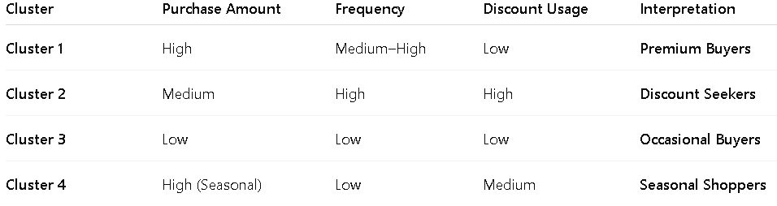
Summary of each Cluster

Slide 20
Business Recommendations
Personalized offers based on cluster.
Seasonal marketing campaigns.
Loyalty programs for repeat customers.
Optimize discounts for profitability.

Slide 21
Conclusion
Data-driven segmentation improves decision making.
Helps increase revenue and customer satisfaction.
Supports targeted marketing strategies.

Slide 22
Thank You

