Slide 1
Product team operating model
T+IL Playbook
See file name for date and time of last update (e.g., 20190601 Product team operating model – T+IL playbook – v1230)

Slide 2
Playbook context – product team operating model
This chapter
Chapter
Description
File name
T+IL in a nutshell
An overview of the Lab’s scope, guiding principles, and purpose
[Date] T+IL nutshell - T+IL playbook - v[Time]
Lab operations
A high-level view of the Lab’s structure, governance, and operating model
[Date] Lab operations - T+IL playbook - v[Time]
Product Lifecycle guide
Walkthrough of the Lab’s Product Lifecycle (PLC) governance, with detailed guidance for each review
[Date] PLC guidebook - T+IL playbook – v[Time]
Product team operating model
Overview of how product teams operate, including structure and ceremonies
[Date] Product team operating model - T+IL playbook – v[Time]
T+IL talent guide
An overview of all things talent for the Lab, including recruiting, capability-building, and performance management
[Date] T+IL talent guide - T+IL playbook - v[Time]
Onboarding playbook
A guide for people joining the Lab
[Date] Onboarding playbook - T+IL playbook - v[Time]

Slide 3
Product teams’ agile operations are paramount to the success of the Lab
The Technology + Innovation Lab will operate under Agile methodologies focused on product deployments, sprints, and user stories
Agile development teams will be centered around the roles of product owner, scum master, and the development team
Product teams will consist of co-located business-facing product owners, multidisciplinary development teams, and agile resources (e.g., scrum masters, agile coaches)
Product development teams will work in rapid sprints following key agile ceremonies for governance and productivity

Slide 4
The Lab will follow Agile methodologies focused on product deployments, sprints, and user stories
From today’s processes…
… to new Agile methodologies
Who
Current project-oriented talent mix
New-age user and product-oriented talent mix
Project-oriented teams is a mix of dedicated individuals and individuals supporting the project on a part-time basis
Multi-functional, agile, product-based
Distinct positions grouped under separate functional/organizational units
Consistent execution of agile methodologies: Product owners, scrum masters, and delivery teams
How
Agile principles, with waterfall deployment cycles
Agile, iterative, and collaborative methodologies
Agile methods but linear project-based work
Iterative, 10-12-week product-based deployment cycles
Plan-analyze-design-develop-test-deploy
Continuous improvement through user story oriented sprints
Silo’ed and specialized groups functionally aligned rather than product or user aligned
Cross-functional groups collaborating across org. boundaries to deliver integrated solutions
Where
Distributed, decentralized workforce
Unified and streamlined delivery teams
Large distributed teams across multiple locations relying primarily on asynchronous communications
Smaller, focuses co-located squads to target faster delivery and collaboration

Slide 5
Agile development teams are typically comprised of three key groups, each performing critical roles…
Product owner (PO)
Development Team
Represents the business
Ensures value delivery
Acts as voice of the user
Delivers potentially shippable product at every sprint
Staffed with cross-functional team members
Is self-organizing and empowered
Includes a Technology Head, who drives the technical direction of the project and coaches the team
Build the right thing
(PO)
Build the thing right
(Dev Team)
Scrum master (SM)
Oversees the Scrum process and coaches the team
Facilitates the removal of impediments to increase progress
Enables cooperation across all roles and functions
Enable the team to build the thing fast (SM)
Following true agile principles
Technology + Innovation Lab able to transcend org. silos and fully integrated with business
Team is dynamic, flexible, and includes business and technical roles
12 weeks in total, with 2 week sprints. Daily stand-up/check-in to highlight milestones/roadblocks and steering committee every 2-4 weeks

Slide 6
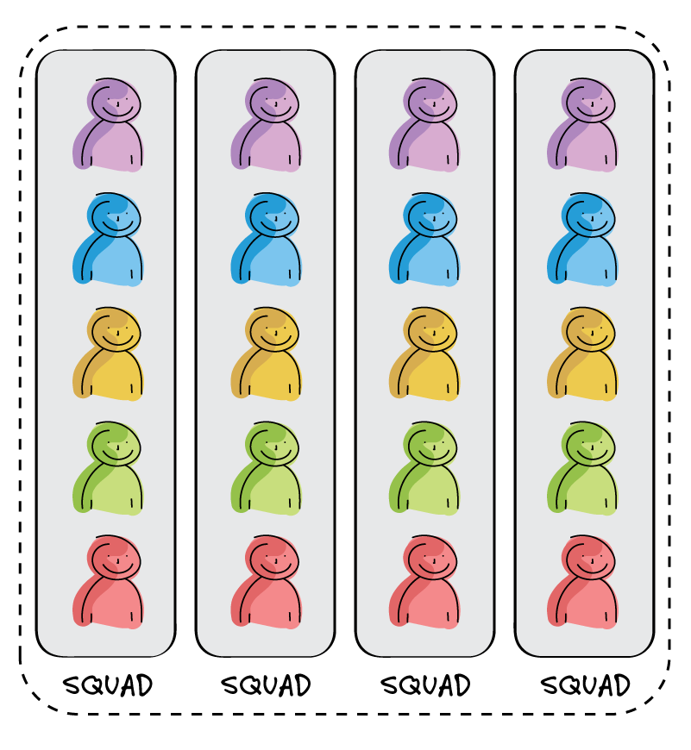

Product teams may sit in a broader ecosystem of similar products that interact through communities
Product Teams
Multidisciplinary teams that sit together focused around product features.
Three key product team members:
Agile teams create nimbleness, increased productivity, and greater employee engagement
Communities foster sharing of best practices and knowledge
Key enablers are co-locating and integrating business and technical resources
Product owner (PO)
Scrum master (SM)
Development Team
Communities
Communities cut across product teams, consisting of same-role employees sharing best practices and expertise

Slide 7
Product teams will also require detailed engagement from key external stakeholders
Stakeholder role
Description
3 – 6 Users
Users to provide input on overall experience and feedback on application design and interaction model throughout Delivery
1 – 3 SMEs
Subject matter experts that can provide valuable input throughout Discovery and Delivery
Business Product Sponsor and
IT Product Sponsor
Senior leader committed to effort’s success, helping team clear roadblocks and obstacles. Provides strategic and problem solving input throughout the process

Slide 8

These teams work in sprints to take ideas from business-backed backlog elements to deploy products
Product Owner
Scrum Master
Dev team
Product Backlog
User focused prioritized product features
Backlog refinement
Features for a Sprint
Estimated by team
Team commitment
Sprint Retrospective
Done after each sprint
Aims to improve the process for next sprint
II
V
Time-boxed Test/Develop
(No changes)
Working code ready for deployment
Product Backlog
Sprint Backlog
Dev team
Dev team
Dev team
Sprint Planning
Review product backlog
Estimate sprint backlog
Commit
Daily Stand up
Progress since last stand up
Plan for today
Roadblocks/Impediments?
Sprint Review
Demo features to all
Retrospective on improving the next sprint
I
III
IV
Time-boxed “Sprint” Cycles
Agile allows teams of people to develop complex products in environment of uncertainty and change
Agile is a simple but powerful framework for teams and users to inspect and adapt as product is produced
Agile provides a high degree of clarity and transparency to everyone involved: team, users, users, stakeholders
Agile rapidly surfaces dysfunction and enables teams and organizations to continuously improve their effectiveness

Slide 9
Each element of the process is supported by a ceremony
PO = Product Owner SM = Scrum Master
Ceremony
Inputs
Activities
Outputs
Sprint Planning
Team capacity (SM)
Planning velocity (SM)
Prioritized Product Backlog (PO)
Sprint goal (Team)
Sprint backlog (Team)
Review prioritized backlog (Team)
Elaborate stories (PO)
Create sprint goal (Team)
Estimate tasks based on DoD / Development best practices (Team)
Consider high-level design (Team)
Sprint goal
Sprint backlog
Sprint plan (Team)
I
Backlog grooming
Up to date feedback from sprint review
Feedback from users
Discuss new stories for the backlog
Review stories and acceptance criteria with the team
Estimate stories
Updated and prioritized product backlog (PO)
Technical spikes (team)
Business spikes (PO)
II
Daily Stand-Up
Deployment board (Team)
Answer the following questions:
What I did yesterday
What I will do today
What impediments I have
Updated deployment board (Team)
List of impediments to resolve (SM)
III
Sprint Review
Potentially shippable increment of software
Metrics from the sprint
Updated MVP delivery plan
Demonstrate the stories developed in the sprint (Team)
Discuss feedback (All)
Create new stories (PO)
Update on deployment progress
Signed off stories (PO)
Improvements (PO)
New stories (PO)
IV
Sprint Retro-spective
Sprint metrics (SM)
Discuss sprint (Team)
Present sprint metric (SM)
Identify good and bad parts of the sprint (Team)
Identify actions for improvement (Team)
Actions for improvement (SM)
V

Slide 10
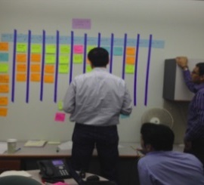
Sprint Planning
I
The Sprint Planning meeting is used for the team to plan what can be accomplished during the next sprint
Product Owner
Assesses progress made against the deployment goals and changes based on sprint feedback
Presents sprint priorities to be considered in form of stories
Elaborates detailed acceptance criteria for each story
The Scrum Process
Daily Huddle
24 hours
Potentially shippable product increment
Product backlog
2 weeks
The Team
Creates the sprint goals
Reviews prioritized backlog
Assesses stories they can commit to base on DoD and development best practices
Considers high-level design
This side up
Sprint backlog
Guidelines
Held at the end of each Sprint
Typically 2-3 hrs for a 2 week sprint
Deployment wall or digital backlog is used to facilitate the discussion
Who are the attendees?
Product Owner
Scrum Master
Full dev team
SMEs
SOURCE: McKinsey

Slide 11
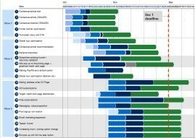
Backlog refinement
II
The backlog refinement meeting is used to refine the backlog: define stories, acceptance criteria, details and priority such that highest priority stories ready for work.
Product Owner
Discusses feedback from sprint review
Shares user feedback
Updates and prioritizes user stories
Reviews stories and acceptance criteria in collaboration with the team
The Scrum Process
Daily stand up
24 hours
Potentially shippable product increment
Product backlog
2 weeks
The Team
Identifies technical or business spikes
Gains functional clarity from Product Owner on new/updated stories
Discusses implementation options
Estimates stories
Influences priority based on technical dependencies
This side up
Sprint planning
Sprint backlog
Guidelines
1 – 2 times during the sprint
Can happen anytime during the sprint
Product Owner prepares and runs the meeting
Who are the attendees?
Product Owner
Scrum Master
IT Architect + team (not mandatory for all team members)

Slide 12

Daily stand-up
III
Goal of the daily huddle is for the team to understand its status each day in order to do a daily “inspect and adapt cycle”. The team reports to itself for 15 minutes regarding 3 questions
Three questions
What did I do yesterday?
What do I plan to do today?
What impediments do I have?
Kudos and Admin
The Scrum Process
Daily huddle
24 hours
2 weeks
Parameters
Daily
15-minutes
Stand-up
Not for problem solving
Team members and stakeholders are invited. Only those committed share updates
Helps avoid other unnecessary meetings
This side up
Team impediments
Impediments identified during daily Scrum are added to the team impediments list

Slide 13
Sprint Review
IV
The Sprint Review is used to demonstrate what was accomplished during the Sprint. The team
Presents stories committed to and completed
Demonstrates new features
Seeks feedback from leadership and stakeholders
Assesses progress made against the deployment goals
Reviews critical actions and KPIs
Reviews updates or changes to backlog
Is THIS what you asked for?
Who are the attendees?
Tribe Leadership
Key stakeholders
Members of dev team
External teams (e.g., support)
Invite the WORLD?
Demonstrate the Product
Review the deployment Progress
Guidelines
Held at the end of each Sprint
Typically 30 minutes of dry run / preparation time for the meeting
Demo software and share progress preferably with minimal slides

Slide 14
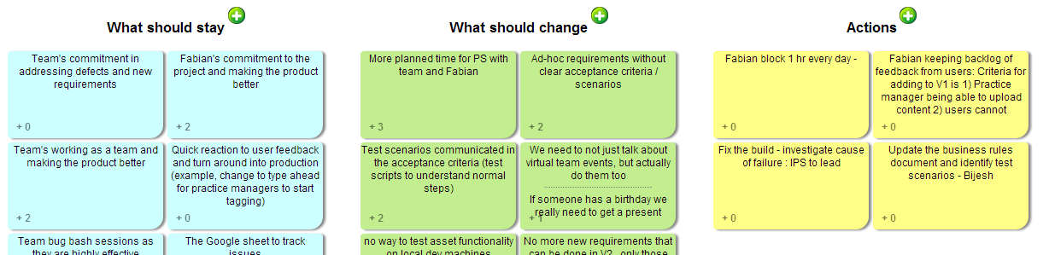
Sprint Retrospective
V
The Sprint Retrospective is a regular review of the team and its process. Focuses on "how" the team is building software and identifies how to get better for the next sprint
Team gets together to answer 3 questions
What is working well (should stay)?
What is not working well (should change)?
What do we need to do to get better (start)?
The Scrum Process
Daily huddle
24 hours
Potentially shippable product increment
Parameters
End of each sprint
Approximately 30 minutes to 1 hour
Facilitated by a Scrum Master
Attended by all team members
Product backlog
2 weeks
This side up
Outcome
Team prioritizes 2-3 areas of focus and assigns ownership
Team devises solution to most vexing problems
Sprint backlog
Sprint Retrospective
Retrospective creates an “inspect and adapt” cycle for how a team works together and alters their practices to improve productivity
Adapt
Inspect
Sprint Retrospective
Act

