Slide 1
Steps to Scrape & Query Transfermarkt Data for the BCsg round 2 data engineer project
Pranav Natarajan

Slide 2
Why Transfermarkt?
Website tailored to obtain & maintain player valuation data for football across leagues.
Quantitative approach to valuation, backed by a qualitative discussion from the `Transfermarkt Community`^{1,2}.
Contains all the data we need for this project-both for teams and players!

Slide 3
Project Steps
Step 1: Understand the Website Layout
Step 2: Scrape & Format Club data table as a pandas dataframe
Upon inspecting the HTML code for the Transfermarkt.us website(s) for LaLiga Clubs and players for 22/23, I noticed that all the data required for this project were in tables. I specifically decided to use the compact player data tables for each club in the 22/23 season as it had all the data required to complete the project, and thus would result in minimal data storage.
This, along with the specifications meant that I could use the requests, bs4, pandas & sqlite3 modules on python to complete this project.
I then scraped the data from the LaLiga Clubs Page on Transfermarkt.us, storing the Name, Squad Size, Avg. Squad Age, No. of Foreigners, Avg. Market Value ($) for a player on the team, and the Total Market Value ($) for the team as a pandas dataframe.
I then used pandas apply functions to reformat the market values from string to float, and changing Squad, Avg. Squad Age & Foreigners to a numeric data type.

Slide 4
Project steps
Step 3: Scrape & Format compact player data tables as a pandas dataframe
Step 4: Create the Position Map pandas dataframe
I then scraped the data from the respective Teams’ pages on Transfermarkt.us, reformatting a list of lists to store the Name, Position, Age, Contract End date, Market Value ($), and the Team (as a foreign key reference to the Clubs table) as a pandas dataframe.
I then used pandas apply functions to reformat the market value from string to float, and changed Age to a numeric data type.
I then created a pandas dataframe, with each Position being a primary key, while the more general positions (Goalkeepers, Defenders, Midfielders, Attackers) were the attribute.
The general positions were created using an apply function.

Slide 5
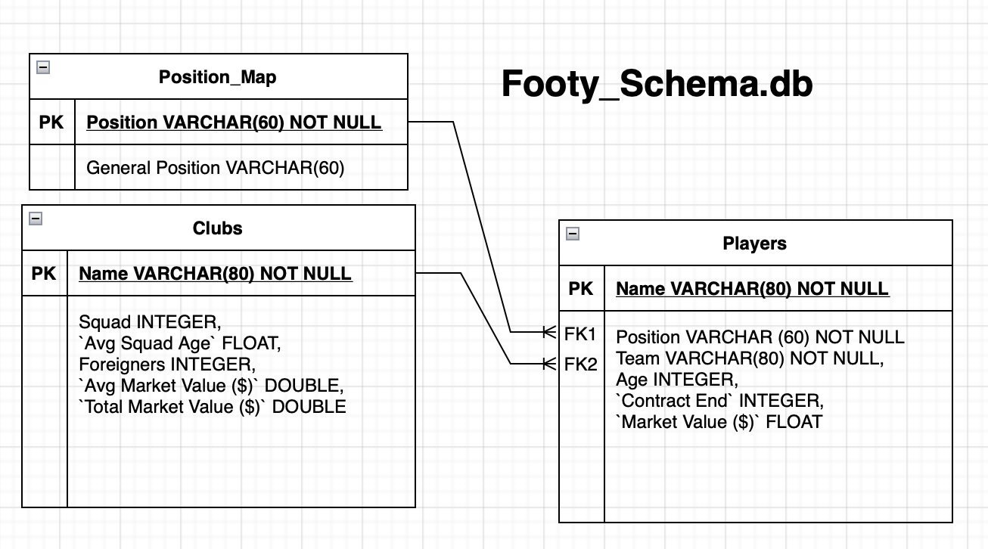
Step 5: Create the tables on the schema Footy_schema.db on sqlite
I used 3 tables, keeping in mind the normalization of data. Data was bulk inserted using INSERT INTO after converting their pandas dataframes to a list of row tuples using list(pd.itertuples())

Slide 6
Project steps
Step 6: Write the query to get the total market value for each team by general position
Step 7: Create pure code file from ipynb notebook, and push relevant files to `BCSG_DataEngineerR2` repo on github
I used sqlite3 to write the query above, getting a 80 x 3 table. I then proceeded to save the results on the database and as a csv file called ”query_results.csv”.
I created a .py file of all the code for this project from the notebook I completed this project in, and pushed the code files, footy_schema.db, query_results.csv, and this powerpoint presentation onto the repo.

