Slide 1

Meeting Bot
Schedule meetings in easy and effective way
Team Members:
Ajay Chandra Pendyala
Gautam Verma
Sohan Kunkerkar
Pranav Firake
Sunil Narasimhamurthy

Slide 2
Problem: Attendance problem in frequent meetings (e.g. sprints in agile)
Solution: Azra finds optimal timing for these meetings
And schedules those meetings too.

Slide 3
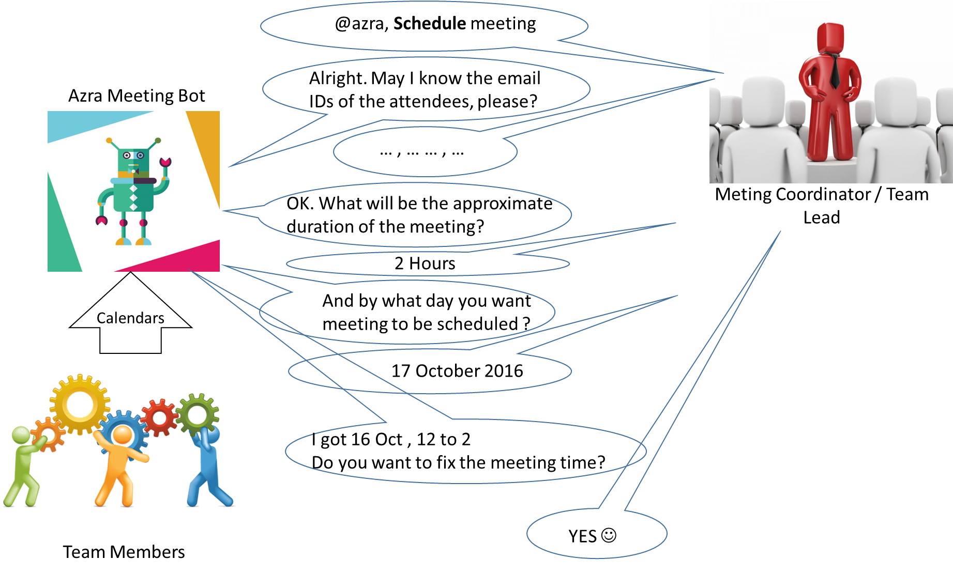
Milestone 1: Design

Slide 4
Milestone 2: BOT
Bot implementation using Mock data
Mock.json : to store calendars of users (Calendar Mocking)
Use case 1: Create A meeting with optimal timing
https://www.youtube.com/watch?v=_aRoP7qXVPE
Use case 2: Add a member to existing meeting
https://www.youtube.com/watch?v=jg6YaqR_Pyw
Use case 3: Create A meeting
https://www.youtube.com/watch?v=mP6HtTPp6lU

Slide 5
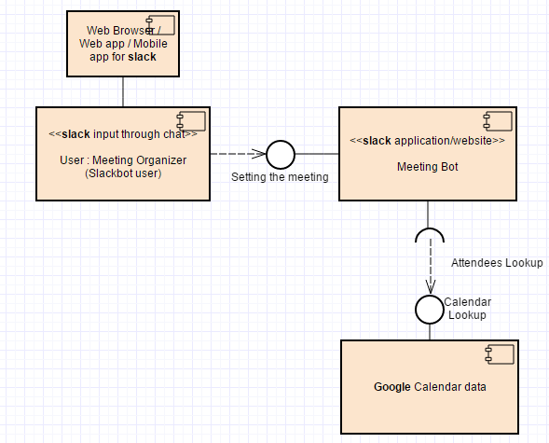
Milestone 3: Service

Slide 6
Milestone 3: Service
Used Google Oauth 2.0 to get access to google calendars of users.
Slack users would authorize their calendar access to Azra bot by @azra Auth / @azra Authorize
Bot can access the calendars of these users and can find optimal timing.
Bot can also manage their meetings i.e. Add members to existing meeting / Cancel meeting.

Slide 7
Milestone 4: Deploy
Made a server instance on Amazon EC2.
Set up the deployment tools with ansible, npm and other required modules.
Bot is now running on server using forever.

Slide 8
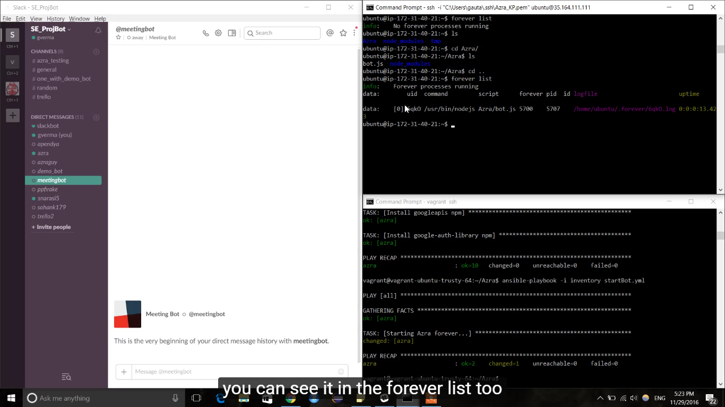
Milestone 4: Deploy

Slide 9

Implementation

Slide 10
Limitations and Future scope
Here we have considered all users have google accounts, Future scope of this bot will be to handle other calendars of users too. E.g. outlook calendar.
Elimination of @azra Auth instruction so that users will be authorized while signing up to the slack team.

