Slide 1
Analysis of the Adult Dataset

Slide 2
About the dataset:
The dataset is extracted from the 1994 Census database.
The dataset contains a total of 32560 rows and 15 columns.
It contains a total of 6 integer columns and 9 columns with categorical
variables.

Slide 3
Python Libraries Used
NumPy: To perform mathematical operations on arrays.
Pandas: Used for analyzing, cleaning, exploring, and manipulating data.
Matplotlib and Seaborn: Used for creating plots and visualization for our data.

Slide 4
Attributes of the dataset:
age: The age of the person (Integer).
work_class: The sector the person is employed in (Categorical).
fnlwgt: The final weight, this is the number of people the census believes the entry represents (Integer).
education: Educational qualification of the employee (Categorical).
education_number: A unique number assigned to each education level (Integer).
marital_status: The marital status of the employee (Categorical).
occupation : The occupation of the employee (Categorical).

Slide 5
relationship: The relationship status of the employee (Categorical).
race: The ethnicity of the employee (Categorical).
sex: Gender of the employee (Binary)
capital_gain: Capital gain of the employee other than the income (Integer).
capital_loss: Loss from the investments (Integer).
hours_per_week: The number of hours each employee works per week (Integer).
native_country: The employee's country (Categorical).
income: Whether the employee makes greater than 50K or less than 50K (Binary).

Slide 6
Data Preprocessing:
Dropping the columns fnlwgt and education_number, as they do not offer us any insights on statistical analysis.
By examining the dataset it is found that the missing values in the dataset are denoted by '?', instead of the standard NA value. From the code snippet below we see that there are 4262 rows that contain '?’
work_class: Has 1836 rows that contain "?".
occupation: Has 1843 rows that contain "?".
native_country: Has 583 rows that contain "?".

Slide 7
Limiting Categorization:
Education column:
All education levels lower than 'High School Grad' are classified as 'Dropout'.
Education levels other than 'High School Grad', ‘Bachelors', ‘Masters', and 'Doctorate' are collectively classified as 'Community College’.
Marital_status column:
People with the marital status 'Married-AF-spouse' and 'Married-civ-spouse' are classified as Married.
People with the marital status ‘Separated' and 'Married-spouse-absent' are classified as Divorced.
People with the marital status 'Never-married' are classified as Single.

Slide 8
How are the countries distributed in terms of percentage, in the given data frame?
The United States represents the majority of entries in the dataset, accounting for 91%, followed by Mexico with a smaller portion of 2%.
Given that 91% of the entries in the dataset originate from the United States, we can confidently exclude all other countries, as they constitute only a minor proportion of the data.
Therefore, we will keep only the data from the United States and exclude all entries related to other countries in the dataset, as the statistical relevance of those countries is limited.

Slide 9
What is the age distribution of the workforce in the given dataset?
The average age of the workforce in the given dataset is 39.
The minimum age of the workforce in the given dataset is 17.
The maximum age of the workforce in the given dataset is 90.
Inference :
It is intriguing to observe that individuals continue working until the age of 90, surpassing the official retirement age in the United States, which is typically 65. To gain deeper insights, let us further investigate the factors that motivate people to work beyond the age of 65.

Slide 10
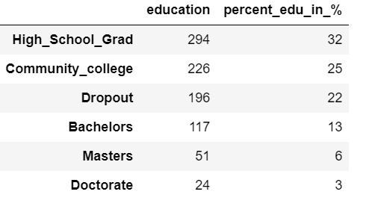
Calculating the percentage distribution of people in each educational category within the age range of 65 to 90.
Based on the data from the provided Data Frame, a notable trend emerges among individuals who continue working after reaching the retirement age of 65. A significant majority of these individuals possess lower levels of education, namely those who have either not completed their education, attended community college, or attained a high school diploma. In fact, approximately 79% of the entire group falls within these categories.

Slide 11
On the other hand, individuals with higher education levels, including Bachelor's, Master's, or Doctorate degrees, constitute only a relatively small portion, making up approximately 22% of the total population working past the age of 65. This suggests that a considerable proportion of people who continue working beyond retirement may do so to address essential financial needs rather than for career advancement or higher-skilled roles.

Slide 12
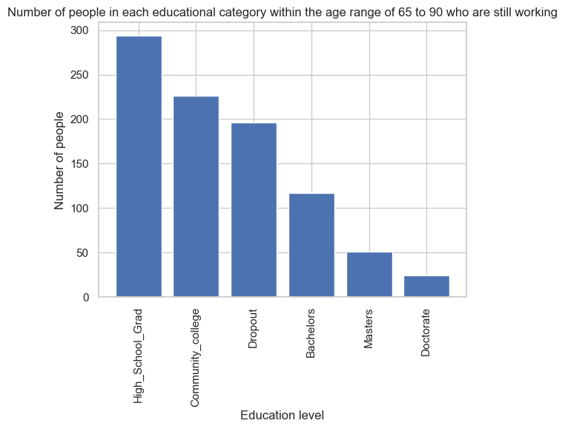
Visualizing a bar chart from the old education dataset to see the correlation?
Based on the bar chart, we can deduce a negative correlation between the education level of individuals and the number of people working beyond the age of 65. As education level increases, the probability of individuals working beyond 65 decreases significantly.

Slide 13
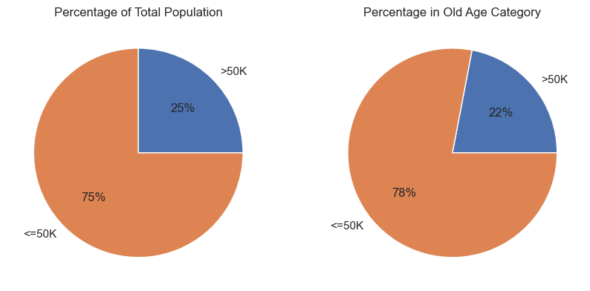
How age affects the income level, visualized using Pie chart
The pie chart reveals an interesting trend: individuals who work past the retirement age are more likely to earn less than $50K compared to the general population in the dataset. In the general population, 25% of people make over 50K, while in the age group of 65 - 90, the percentage drops to 22%, which is 3% lower. This difference could be attributed to the fact that individuals working beyond 65 are likely to have lower educational levels, which may result in lower income levels.

Slide 14
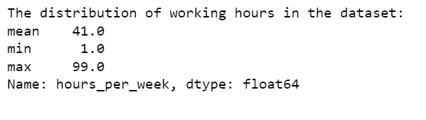
What is the average, minimum, and maximum time people work per week in the given dataset?
Currently, the average working hours in the United States is reported to be 39 hours per week. However, intriguingly, the average working hours obtained from the dataset show 41 hours per week, which is 2 hours higher. Moreover, the maximum recorded working hours in the dataset are 99 hours, which seems unusually high. To gain deeper insights, we should delve further into the data to understand which demographic groups tend to overwork.

Slide 15
To gain a better understanding of the data, we can categorize the "hours per week" numerical column into bins and create a new column based on these bin values and visualize it with the help of a histogram. This will allow us to analyze the data in a more meaningful way and identify patterns or trends related to working hours.
0 - 25 hours: Low Working hours
25 - 40 hours: Average working hours
40 - 60 hours: High Working hours
60 - 100 hours: Extremely high working hours

Slide 16
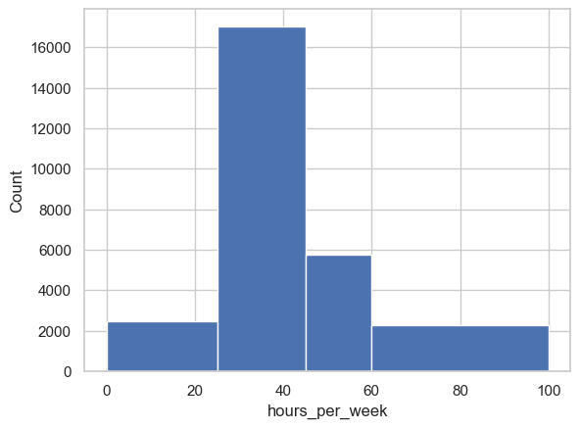
The histogram provides valuable insights into the working hours distribution in the given dataset. The majority of individuals fall into the "Average working hours" category, represented by the interval of 25 to 45 hours per week. Following this, the next prominent group is the "High working hours" category, encompassing the range of 45 to 60 hours per week.

Slide 17
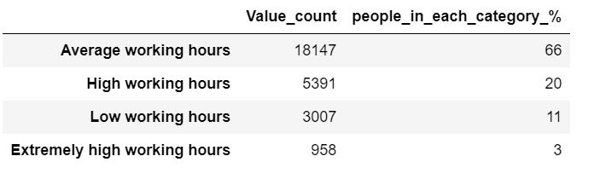
What is the percentage distribution of people in each of the working hour categories?
As deduced from the histogram, a substantial proportion of employees (66%) in the dataset have average working hours.
Following that, 20% have high working hours, 11% have low working hours, and 3% have extremely high working hours.

Slide 18
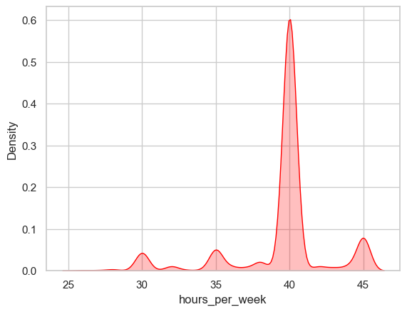
How does the distribution in the Average working hour group range?
The KDE plot is employed to visualize the distribution of data points within the "Average working hours" category. The plot highlights that a significant portion of individuals work approximately 40 hours per week, which aligns with the mean value. Additionally, there are minor spikes in the plot observed around 30, 35, and 45 hours, indicating some clustering of data points at these hour intervals.

Slide 19
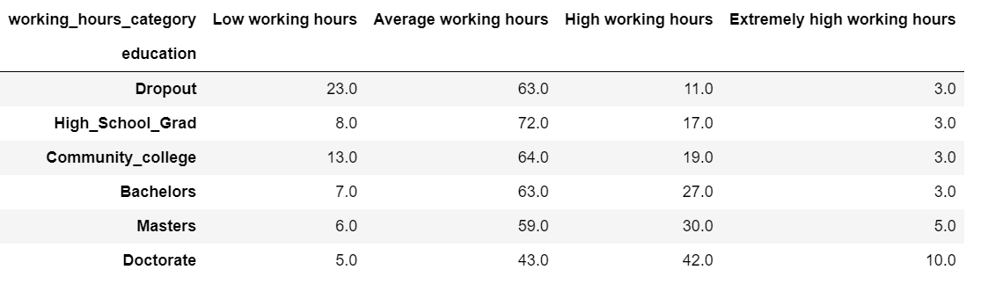
How does the education level of the employee correspond to their weekly working hours?

Slide 20
The pivot table with 'education' as the index and 'working_hours_category' as columns, using the value counts as the aggregate function, reveals interesting insights about the working hours of different education categories.
The working hours trend shows that individuals with higher education tend to spend more time working, while those with lower education spend the least amount of time working.
The categories 'Dropout', 'High School Grad’, and 'Community College' have the lowest working hours, whereas 'Bachelors’, 'Masters', and 'Doctorate' categories show a gradual increase in working hours.
Surprisingly, a significant proportion of people with a 'Doctorate' degree have high working hours, indicating that they might be more engaged in their professions or research work.
People with a 'Doctorate' have the highest proportion (10%) of individuals in the 'Extremely high working hours' category, followed by 'Masters' degree holders at 5%.
In contrast, for the categories 'Dropout', 'High School Grad', 'Community college' and 'Bachelors', more than 70% of the people have either 'Average working hours' or below, suggesting a lower dedication to work in these categories.

Slide 21
In summary, the working hours distribution across different education categories highlights how educational attainment can influence the time individuals spend on their jobs, with higher education generally associated with more working hours.

Slide 22
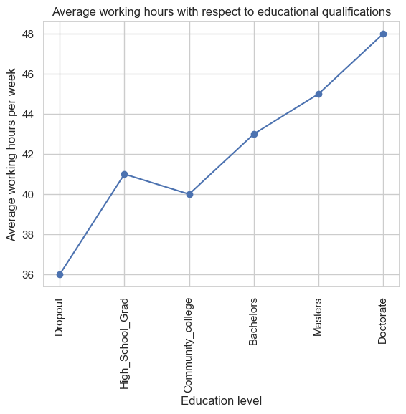
How is the education qualification of an employee correlate with the hours of work per week?
The plot clearly indicates a direct relationship between an individual's educational qualification and the average amount of working time per week. As the level of education increases, the average working hours also tend to rise proportionally. Except, for people who went to community college, which drops below the 'high school grad'. Overall, there appears to be a positive correlation.

Slide 23
What is the income distribution for people working in the category, Low working hours?
There are 94% of people who make less than $50,000 in the given dataset and only 6% of people make more than $50,000.
Analyzing the dataset reveals a notable trend: individuals working 'Low working hours' are more inclined to earn less than 50K. In the overall dataset, the probability of making over 50K is 25%. However, for the 'Low working hours' category, this probability drops significantly to 6%, indicating a substantial 19% decline.

Slide 24
What is the income distribution for people working in the category, High Working hours?
In the category of extremely high working hours, 62% of people make less than $50,000, while 38% make more than $50,000.
Conversely, individuals working 'Extremely high working hours' are more prone to earning over 50K. The probability of this group making over 50K is 38%, representing a 13% increase compared to the general dataset's probability.

Slide 25
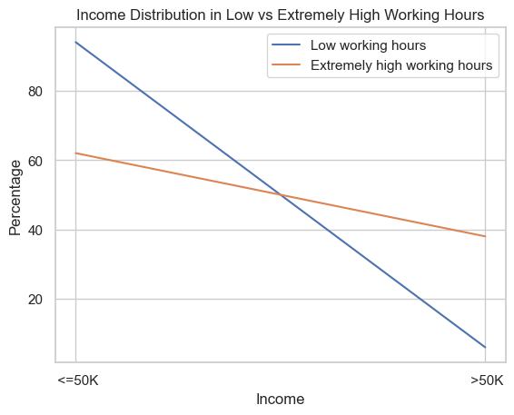
Is there a correlation between income and working hours, specifically within the categories of 'Low working hours' and 'Extremely high working hours'?
The plotted data reveals a significant decline in the proportion of individuals earning above 50K within the 'Low working hours' category, as opposed to the 'Extremely high working hours' category where the decline is less steep. This suggests that those with low working hours might have lower educational qualifications or could be engaged in part-time employment, which could contribute to their lower income.

Slide 26
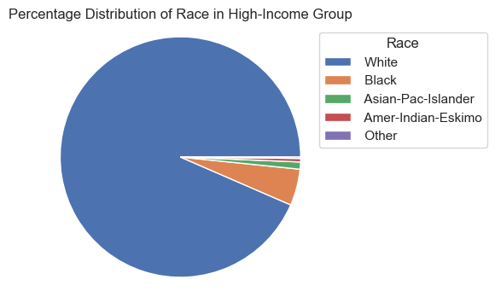
How is race associated with high-income group, people who make over 50K?
The analysis reveals that the majority of individuals in the dataset (approximately 93%) who earn more than $50,000 per year are of White ethnicity. The Black race represents the second largest group, comprising around 5% of the high-income category. In contrast, the combined percentage of individuals from other racial backgrounds (Asian-Pac-Islander, Amer-Indian-Eskimo, and other groups) is only about 2% in the high-earning income category.

Slide 27
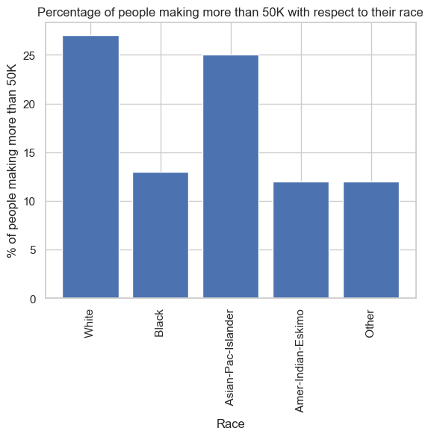
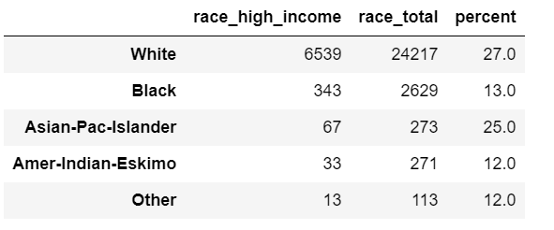
What is the percentage breakdown of people in each ethnicity with respect to their income level?

Slide 28
Upon closer examination of the graph, it initially appeared that individuals of White ethnicity were financially better off compared to other ethnicities. However, after calculating the percentage of high-income earners relative to the total population size of each race, we find that the probability of making over $50,000 for people of White and Asian-Pacific Islander descent is 27% and 25% respectively. On the other hand, the other three ethnicities have similar probabilities around 12%.
In conclusion, individuals of White or Asian-Pacific Islander descent are approximately twice as likely to earn over $50,000 compared to individuals of other races.

Slide 29
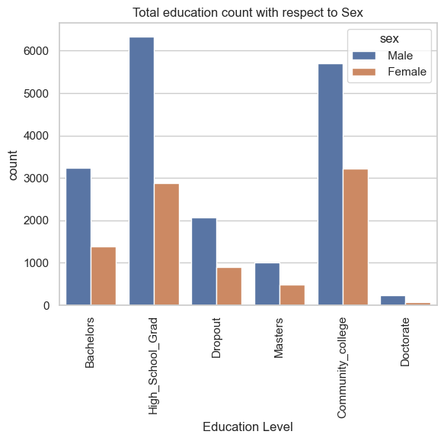
What is the total educational count with respect to gender?
The count plot with 'sex' as the hue reveals that there is a higher number of males in each educational category. However, to gain a comprehensive understanding, we need to ascertain the percentage of individuals within each educational level based on their respective genders.

Slide 30
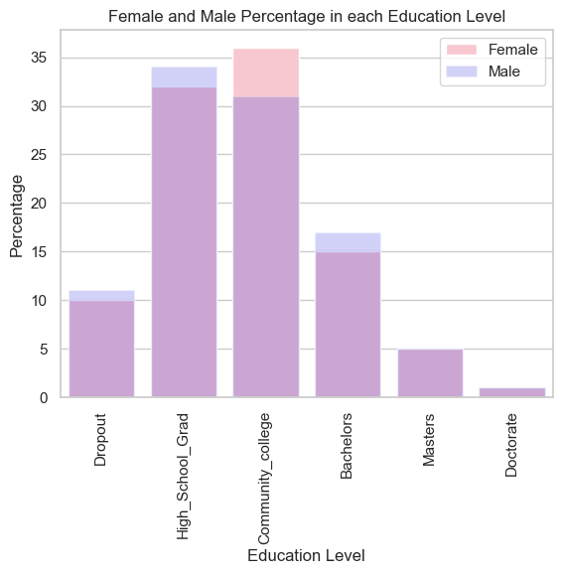
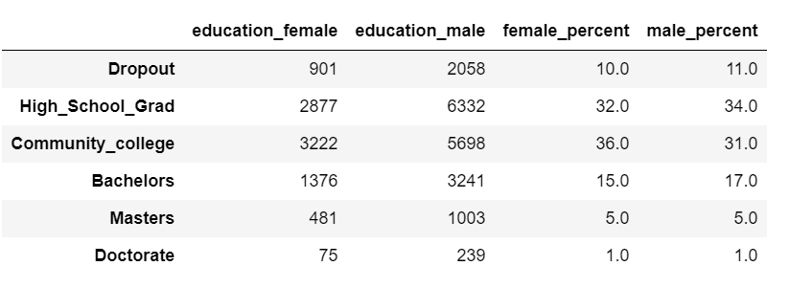
Are both male and female equally educationally qualified?

Slide 31
The analysis of both the data and the visualizations reveals that the percentage distribution of genders is comparable for the 'Masters' and 'Doctorate' categories, both accounting for 5% and 1% respectively.
In the 'High School Grad' category, females comprise 32% of the total, while males make up 34%. Similarly, within the 'Community College' category, females represent 36%, and males account for 31%. For individuals with a 'Bachelors' degree, the distribution is 15% for females and 17% for males. Consequently, it can be inferred that genders exhibit relatively similar levels of educational attainment across most sectors.

Slide 32
Which gender earns more income?
The percentage of men who are in the high-income category is 32%.
The percentage of women who are in the high-income category is 11%.
This uncovers a surprising revelation – despite both genders having similar levels of education, males significantly outnumber females in the higher income bracket, surpassing them by a considerable margin. While 32% of men fall into the high-income category, only 11% of females achieve the same, signifying a substantial 21% disparity.

Slide 33
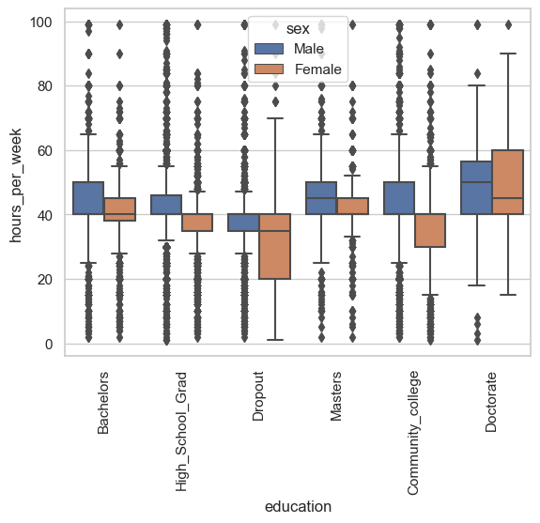
What is the average time spent working per week by gender?
This boxplot provides insight into the significant income disparity based on gender. The boxplot indicates that, despite having similar education levels, women tend to work fewer hours than men in all educational categories except for Doctorate. This discrepancy in working hours might contribute to the lower percentage of women in the high-income category compared to their male counterparts.

Slide 34
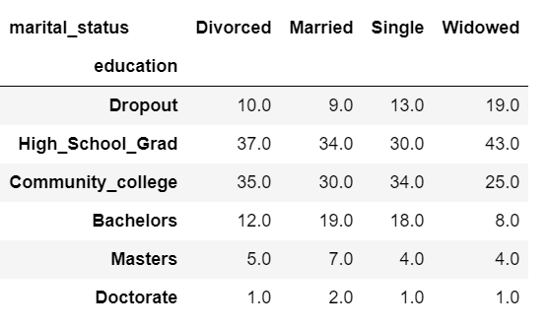
How is educational qualification linked with marital status?
The insights from the pivot table reveal distinct educational trends based on marital status. Individuals classified as "Married" are more inclined to have advanced degrees compared to those with other marital statuses. Conversely, people categorized as "Divorced" or "Widowed" tend to have educational backgrounds comprising Dropout, High School Grad, or Community College levels.

Slide 35
Furthermore, individuals in the "Married" or "Single" marital statuses exhibit a greater likelihood of pursuing higher degrees compared to those in the "Divorced" or "Widowed" categories.

Slide 36
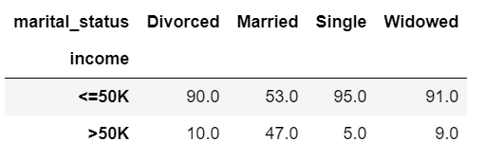
Does the marital status have any influence on the income?
Examining the pivot table, it's apparent that individuals classified as "Married" or "Single" tend to achieve higher educational qualifications. Notably, the largest group making over 50K (47%) falls under the "Married" marital status, followed by "Divorced" and "Widowed" categories, each comprising around 10% of high earners. A noteworthy observation is that despite the similar educational attainment of "Married" and "Single" individuals, the proportion of "Single" individuals making over 50K is significantly lower compared to other marital status groups.

Slide 37
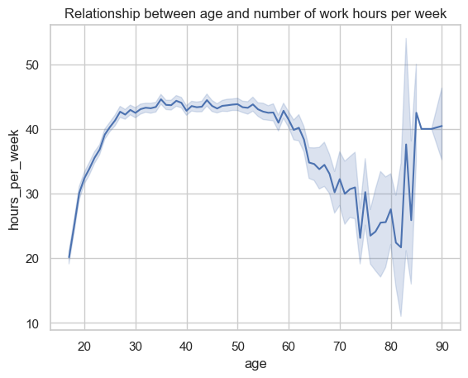
Is there a correlation between a person's age and the number of hours they work per week?
The line plot illustrates that with increasing age, the weekly working hours of employees generally rise. This trend remains relatively stable between the ages of 30 and 60. After reaching around 50 years of age, there is a significant decline in working hours, likely due to retirement, with an average of slightly over 20 hours per week. Interestingly, there is a notable surge in working hours for individuals aged approximately 84 to 90 years.

Slide 38
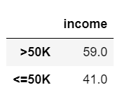
Is the capital gain and capital loss related to income in some way?
Based on the net income column, it is evident that approximately 59% of individuals are earning more than $50,000. This observation aligns with common sense, as individuals typically aim to surpass the minimum income threshold necessary for basic living expenses, allowing them to allocate funds toward investments. This rationale may explain why a majority (59%) of individuals in the dataset earn over $50,000, likely reflecting their intention to invest.

Slide 39
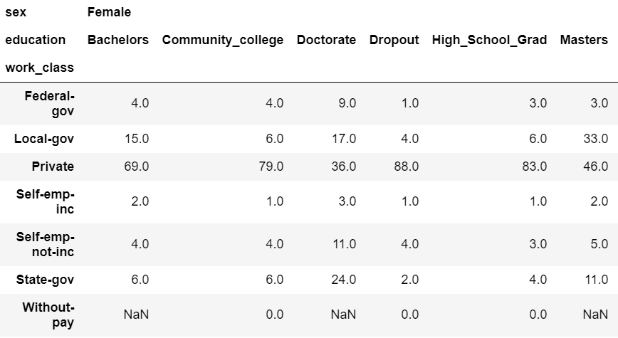
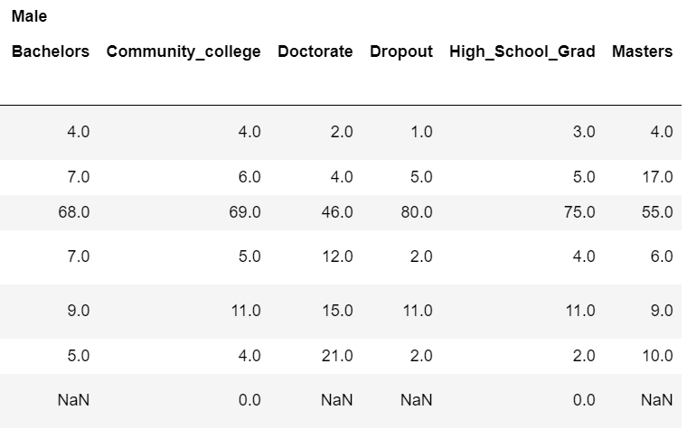
Can you derive any insights from the column work_class using pivot table?

Slide 40
The following insights can be drawn from the pivot table:
1. Across both genders (Male and Female), a substantial proportion of individuals (approximately 70%) in the Dropout, High School Grad, and Bachelor's educational categories are employed in the private sector. However, for individuals with Master's and Doctorate degrees, this percentage drops to less than 50% for both genders.
2. The data table also reveals that women are more inclined to work for local government institutions, in contrast to their male counterparts. Conversely, men are more prone to being self-employed compared to women.

Slide 41
Conclusion:
Dominant Demographics: This dataset primarily comprises entries from the United States (91%).
Extended Workforce: Many individuals work beyond the retirement age of 65, often driven by financial needs. Around 79% of those continuing to work have lower educational levels.
Education’s impact: Higher education levels (Bachelor’s, Master’s, and Doctorate) are less common among individuals over 65, comprising approximately 22% of this group.
Working Hours and Income: People who work a high number of hours are more likely to earn over $50,000.
Gender-Education Dynamics: It can be inferred that genders exhibit relatively similar levels of educational attainment across most sectors.

Slide 42
Gender Income Gap: Despite similar educational levels, males significantly outnumber females in the higher income bracket, with a 21% difference.
Education-Marital Link: Marital status correlates with education, with married individuals tending to have higher educational qualifications.
Racial Impact: Individuals of White or Asian-Pacific Islander descendants are more likely to make over $50,000.
Economic Aspiration: People who make more than $50,000 are more likely to have an investment income.

