Slide 1
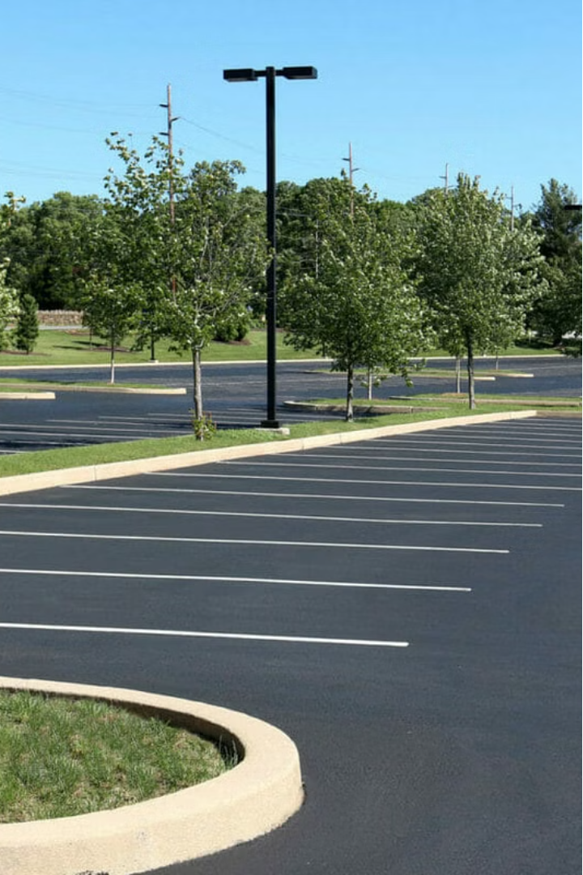
Introduction to Parking Management System
Parking management systems play a crucial role in optimizing urban mobility and enhancing the driver's experience. These innovative solutions leverage technology to streamline parking operations, improve efficiency, and provide a seamless experience for both parking operators and users.

Slide 2
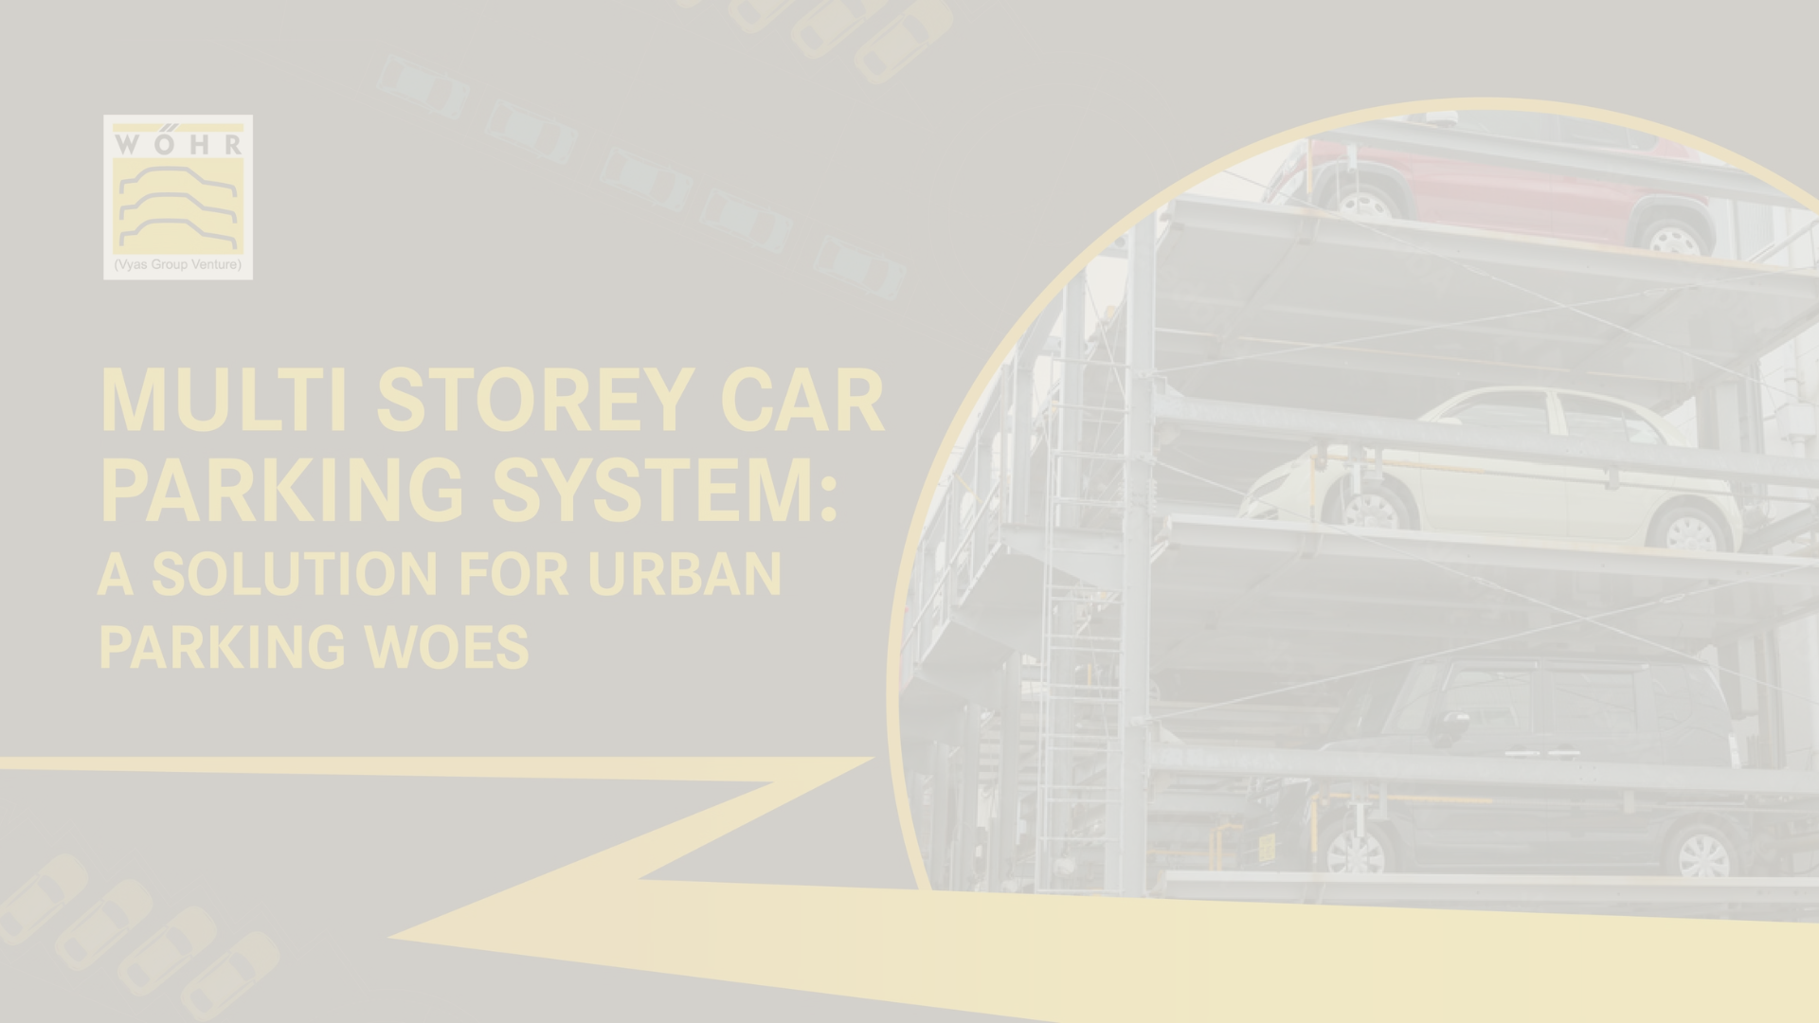
Problem Statement and Objectives
1
Inefficient Parking Utilization
2
Difficult Parking Navigation
3
Inconsistent Billing and Revenue
Lack of real-time data on parking availability leads to drivers circling endlessly, contributing to traffic congestion and pollution.
Drivers often struggle to find available parking spots, wasting time and resources.
Manual parking payment processes result in revenue leakage and user dissatisfaction.

Slide 3
System Architecture and Components
User friendly interface
Integrated Payment System
Data Analytics and Reporting
A user friendly interface is in the project while user can work easily and availability in real-time.
A seamless payment platform that allows users to pay for parking conveniently using various methods.
Sophisticated data analysis tools to provide insights on parking utilization, trends, and revenue generation.

Slide 4
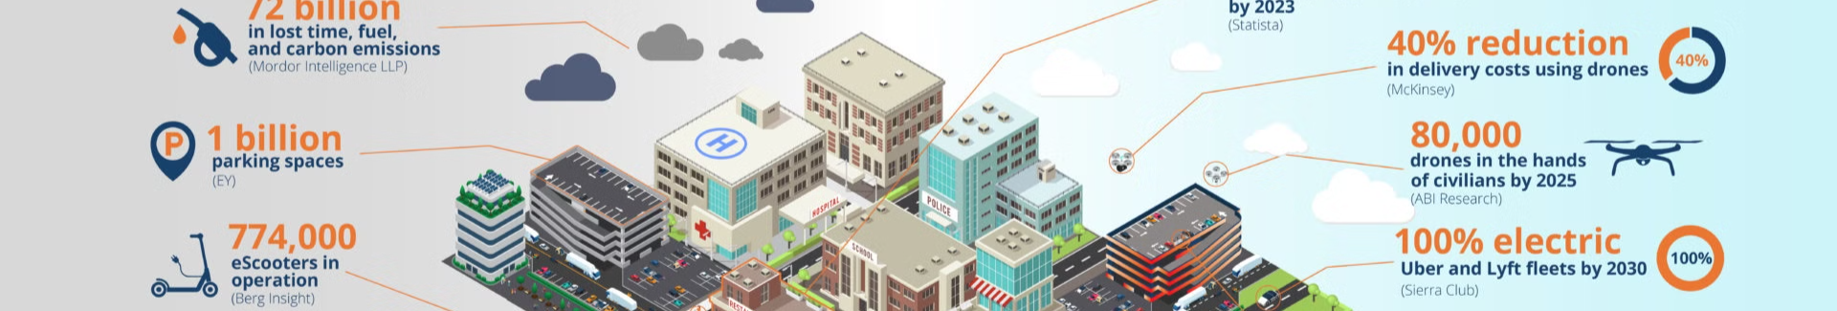
Billing Process and Functionality
Entry and Occupancy Detection
1
Sensors detect vehicle entry and monitor parking duration to accurately track parking time.
2
Dynamic Pricing Calculation
Intelligent algorithms adjust parking rates based on demand, time of day, and other factors.
Automatic Billing and Payment
3
Users can pay for parking using mobile apps, or on-site payment , ensuring seamless transactions.

Slide 5



User Interface and Interaction
Parking Availability Map
Mobile Payment
Parking Guidance
Interactive maps showing real-time parking occupancy and availability across the system.
mobile app or web-based interface for users to easily find, reserve, and pay for parking.
Turn-by-turn navigation and guidance to direct drivers to the nearest available parking spot.

Slide 6
Data Management and Storage
Real-time Data Collection
Secure Data Storage
Advanced Analytics
Robust data storage and management infrastructure to ensure the integrity, confidentiality, and availability of parking-related information.
Sophisticated data analysis tools to generate insights, identify trends, and support informed decision-making for parking management.
Continuous data gathering from sensors, payment systems, and user interactions to provide a comprehensive view of parking activities.

Slide 7
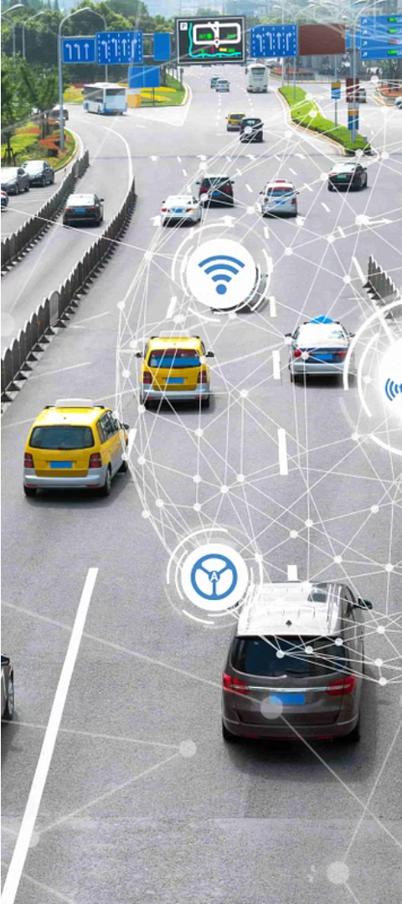



Conclusion and Future Enhancements
Increased Automation
Leveraging advanced technologies like AI and machine learning to optimize parking operations and decision-making.
Integrated Mobility Solutions
Seamless integration with other transportation modes, such as public transit and ride-sharing, to provide a comprehensive mobility ecosystem.
Sustainable Parking
Incorporating eco-friendly features, such as electric vehicle charging stations and renewable energy sources, to support a greener future.

