Slide 1

BlindSight
Assistance On Demand
PC Hacks 2019
Siddharth Garg, Pranav Panchal, Neet Shah & Liz Jaluague

Slide 2



What is BlindSight?
BlindSight
Live remote assistance for the visually impaired
Information
Navigation
Errands

Slide 3






Core Tools
BlindSight

Slide 4


Main Challenges
BlindSight
Detection Accuracy
Server Connection

Slide 5
Live Demo
BlindSight

Slide 6





What’s Next?
BlindSight
Reward System
Android App
Emotion Detection
Voice Commands
Location Pairing

Slide 7
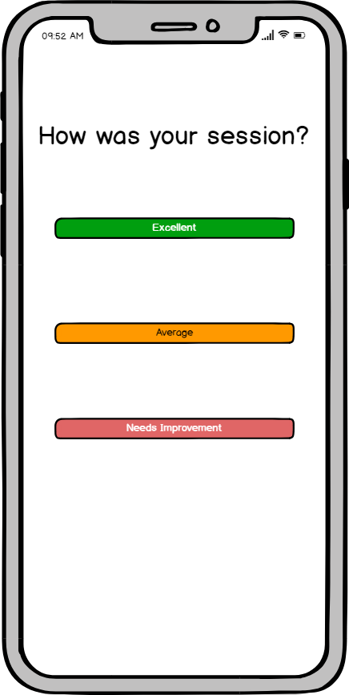
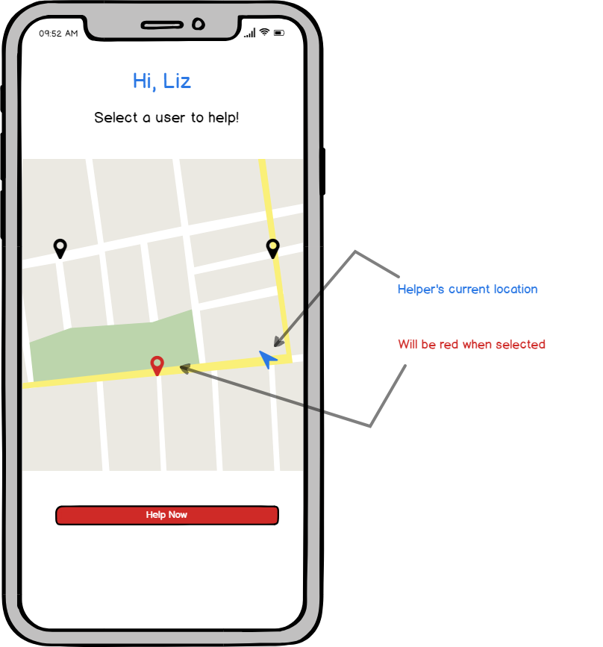
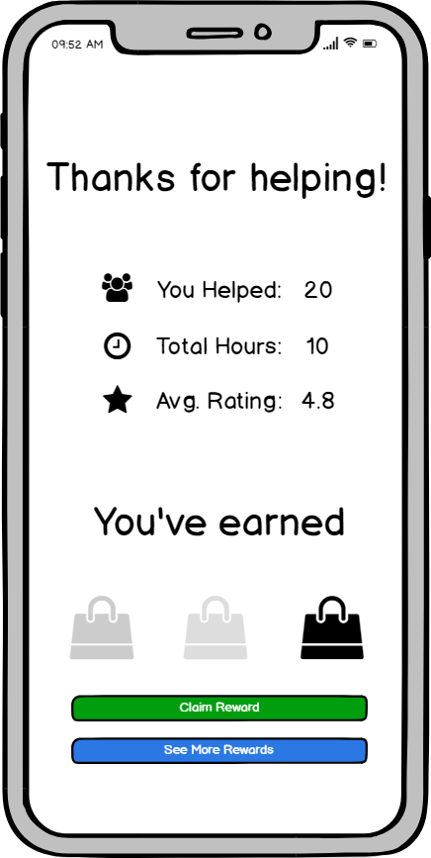
Under Development
BlindSight

Slide 8
Thank You!

