Slide 1

NEMESIS
AI CIVIC OPERATIONS AGENT
Networked Enforcement & Municipal Evidence System for Infrastructure & Service Accountability
Prove, don't log.
PROTOTYPE WALKTHROUGH

Slide 2
THE PROBLEM
A pothole gets reported. The app says “In Progress”. Weeks pass.
No one knows who did the work, what it cost, or why it failed. So the next complaint never gets filed.
That silence isn't apathy. It's the sound of a system that broke its promise once too often.

Slide 3
THE PREMISE
A civic system earns trust by producing evidence, not status updates.
Every figure NEMESIS publishes is computed from an append-only event log. Every claim it makes about itself carries a status label. Nothing is edited by hand.
What follows is the running product, photographed against a seeded deployment of a demo city — not a mockup, and not a rendering of one.

Slide 4
01
The landing film
Nine acts over a 3D clay model of the city, scroll-driven. The model's light is that city's local time; its rain is that city's real weather.
10 SCREENS

Slide 5
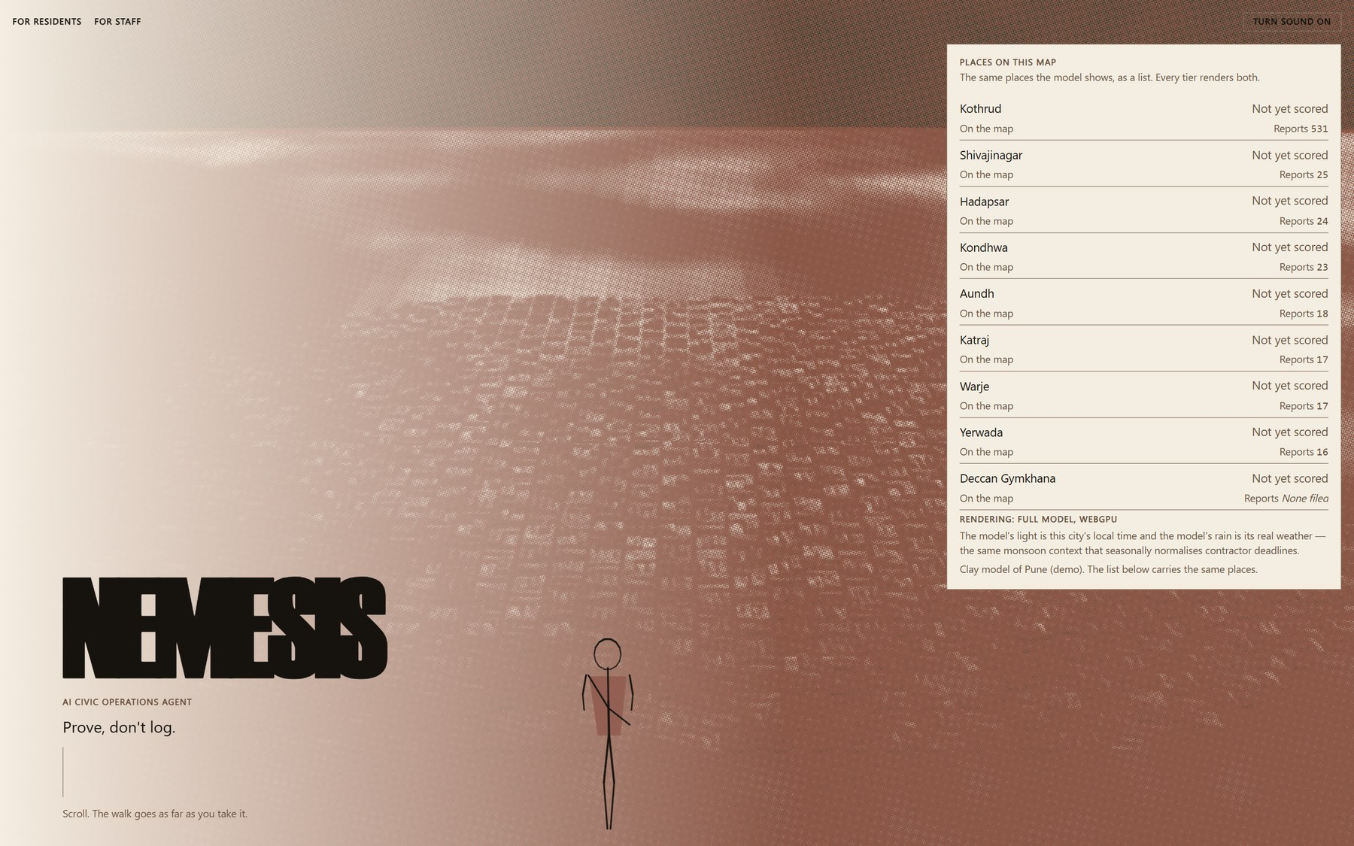
THE LANDING FILM
Landing — cold open
The wordmark over a clay model of the city, lit by that city's real local time and its real weather.
LIVE · REAL DATA
/
01 / 38

Slide 6
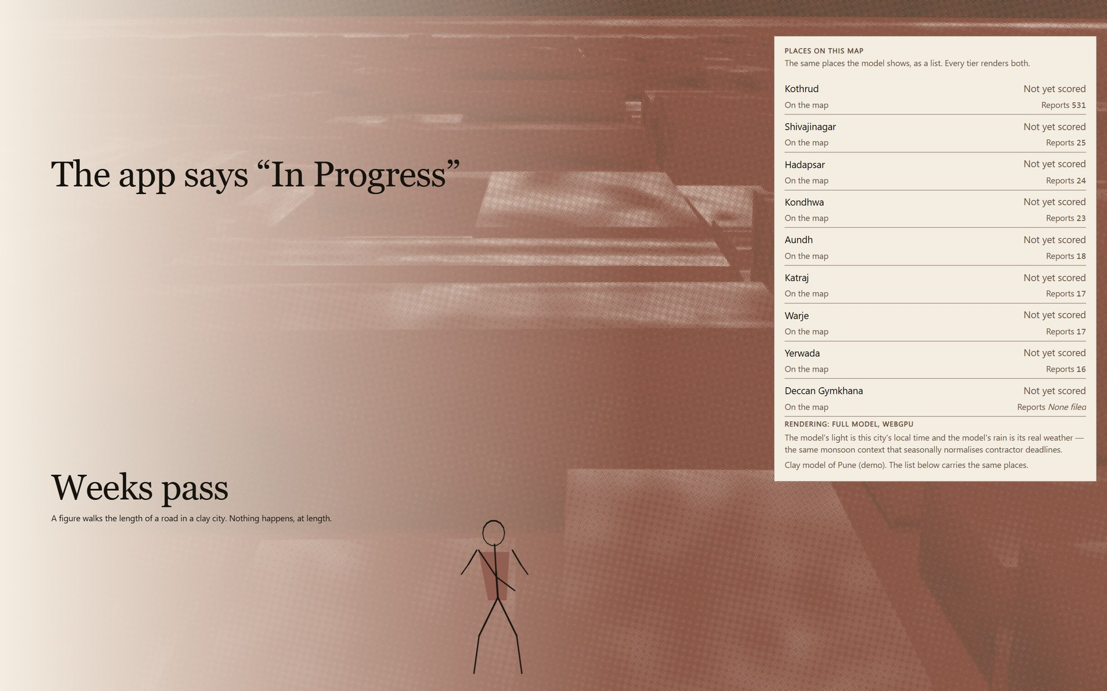
THE LANDING FILM
Act 1 — the walk
A pothole gets reported. The app says “In Progress”. Weeks pass.
LIVE · REAL DATA
/
02 / 38

Slide 7
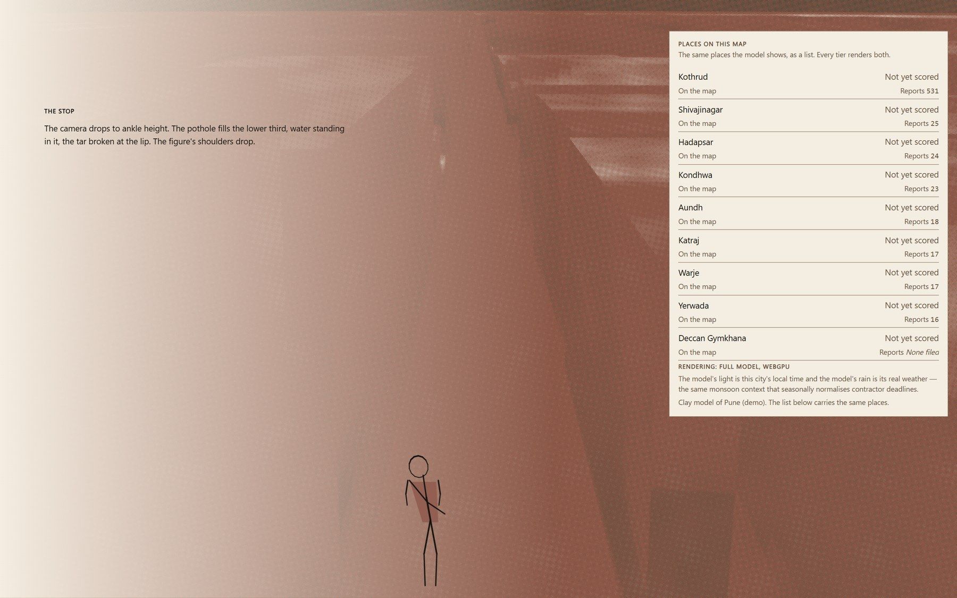
THE LANDING FILM
Act 2 — the stop
The camera drops to ankle height and the problem fills the lower third.
LIVE · REAL DATA
/
03 / 38

Slide 8
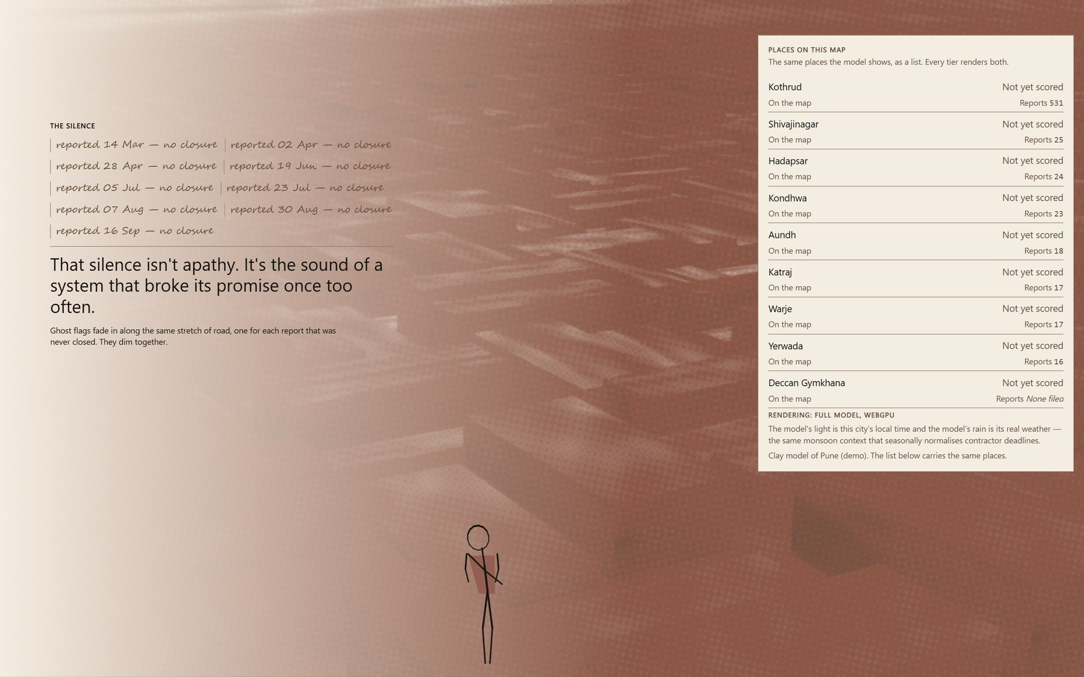
THE LANDING FILM
Act 3 — the silence
One ghost flag for every report that was never closed. They dim together.
LIVE · REAL DATA
/
04 / 38

Slide 9
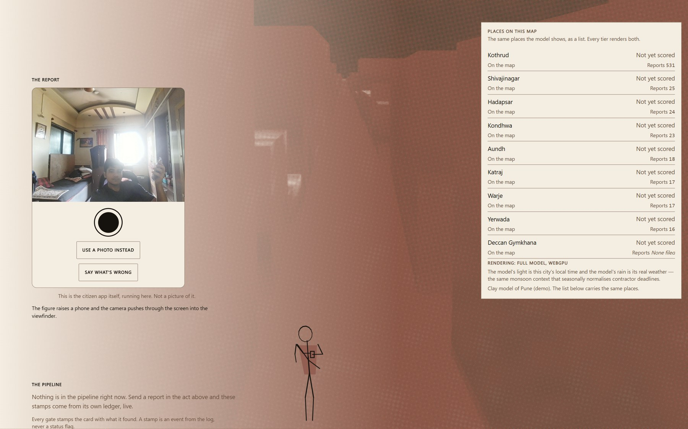
THE LANDING FILM
Act 4 — the report
The camera pushes through the phone into the real citizen app, running in the page.
LIVE · REAL DATA
/
05 / 38

Slide 10
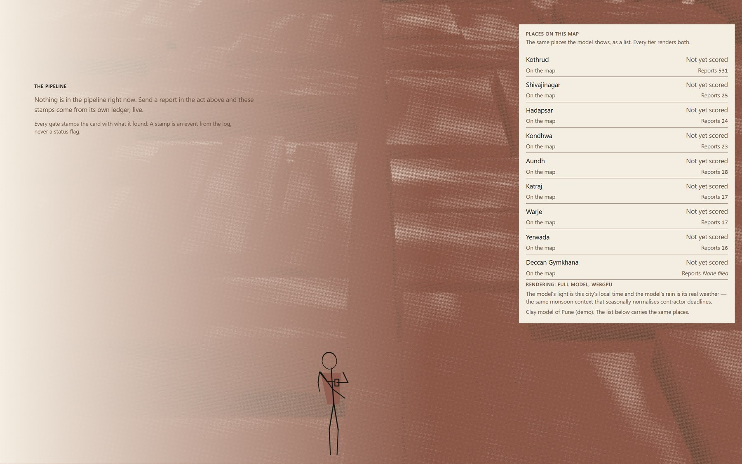
THE LANDING FILM
Act 5 — the pipeline
Every gate stamps the card with what it found. A stamp is an event from the log, never a status flag.
LIVE · REAL DATA
/
06 / 38

Slide 11
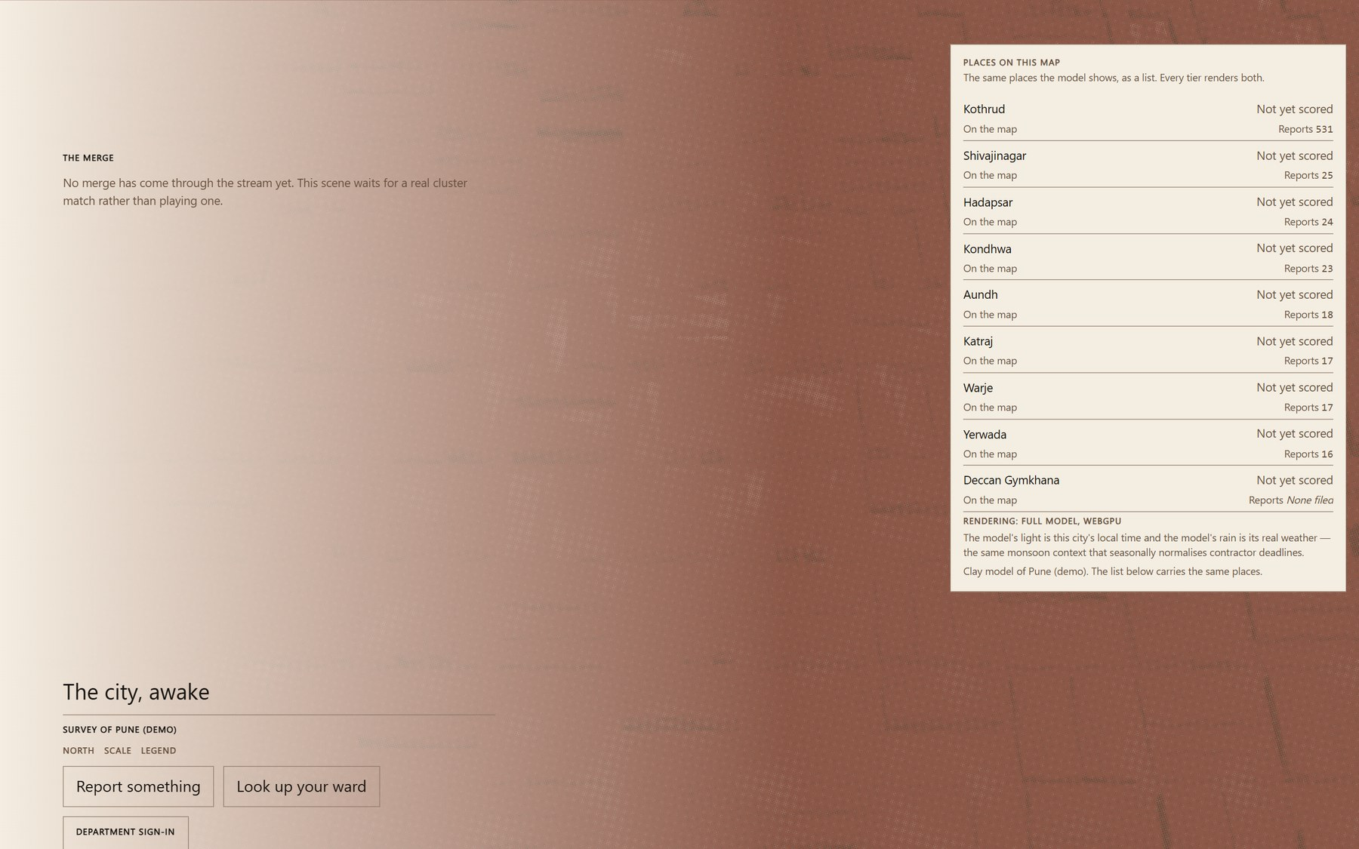
THE LANDING FILM
Act 6 — the merge
Duplicate reports fuse into one cluster — and the scene waits for a real match rather than playing one.
LIVE · REAL DATA
/
07 / 38

Slide 12
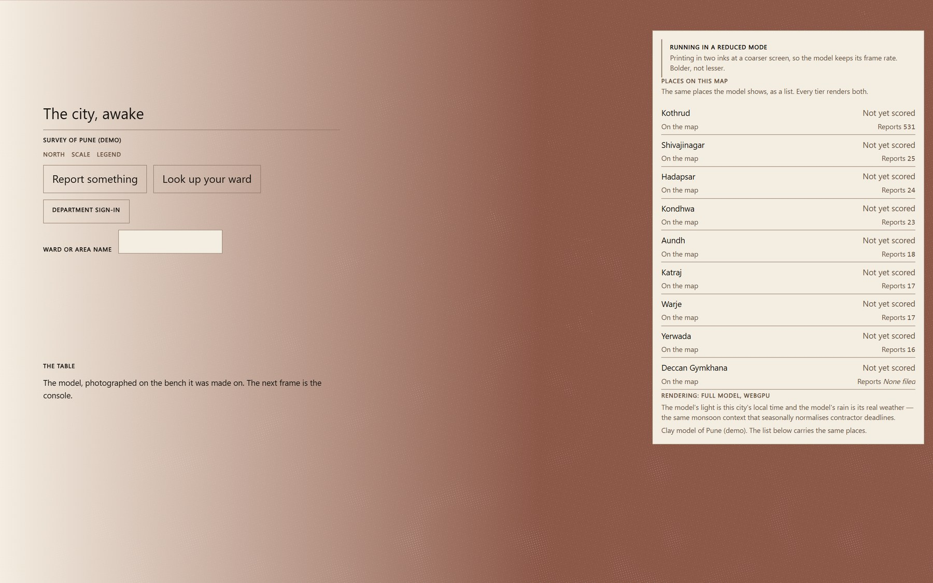
THE LANDING FILM
Act 7 — the city, awake
The survey: every ward this deployment publishes, drawn from the live open-data API.
LIVE · REAL DATA
/
08 / 38

Slide 13
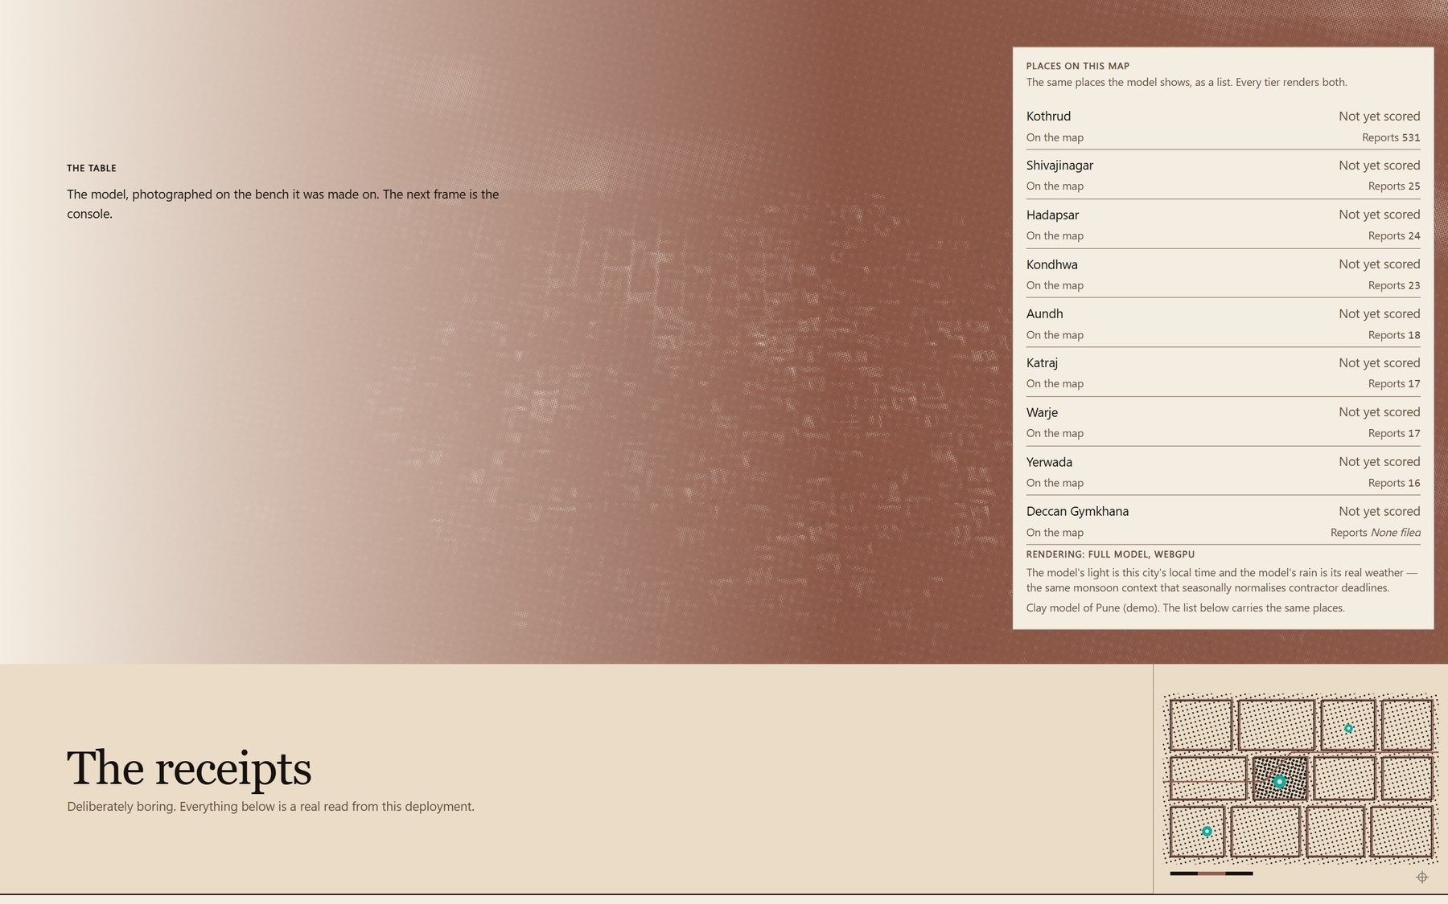
THE LANDING FILM
Act 8 — the table
The model, photographed on the bench it was made on. The next frame is the console.
LIVE · REAL DATA
/
09 / 38

Slide 14
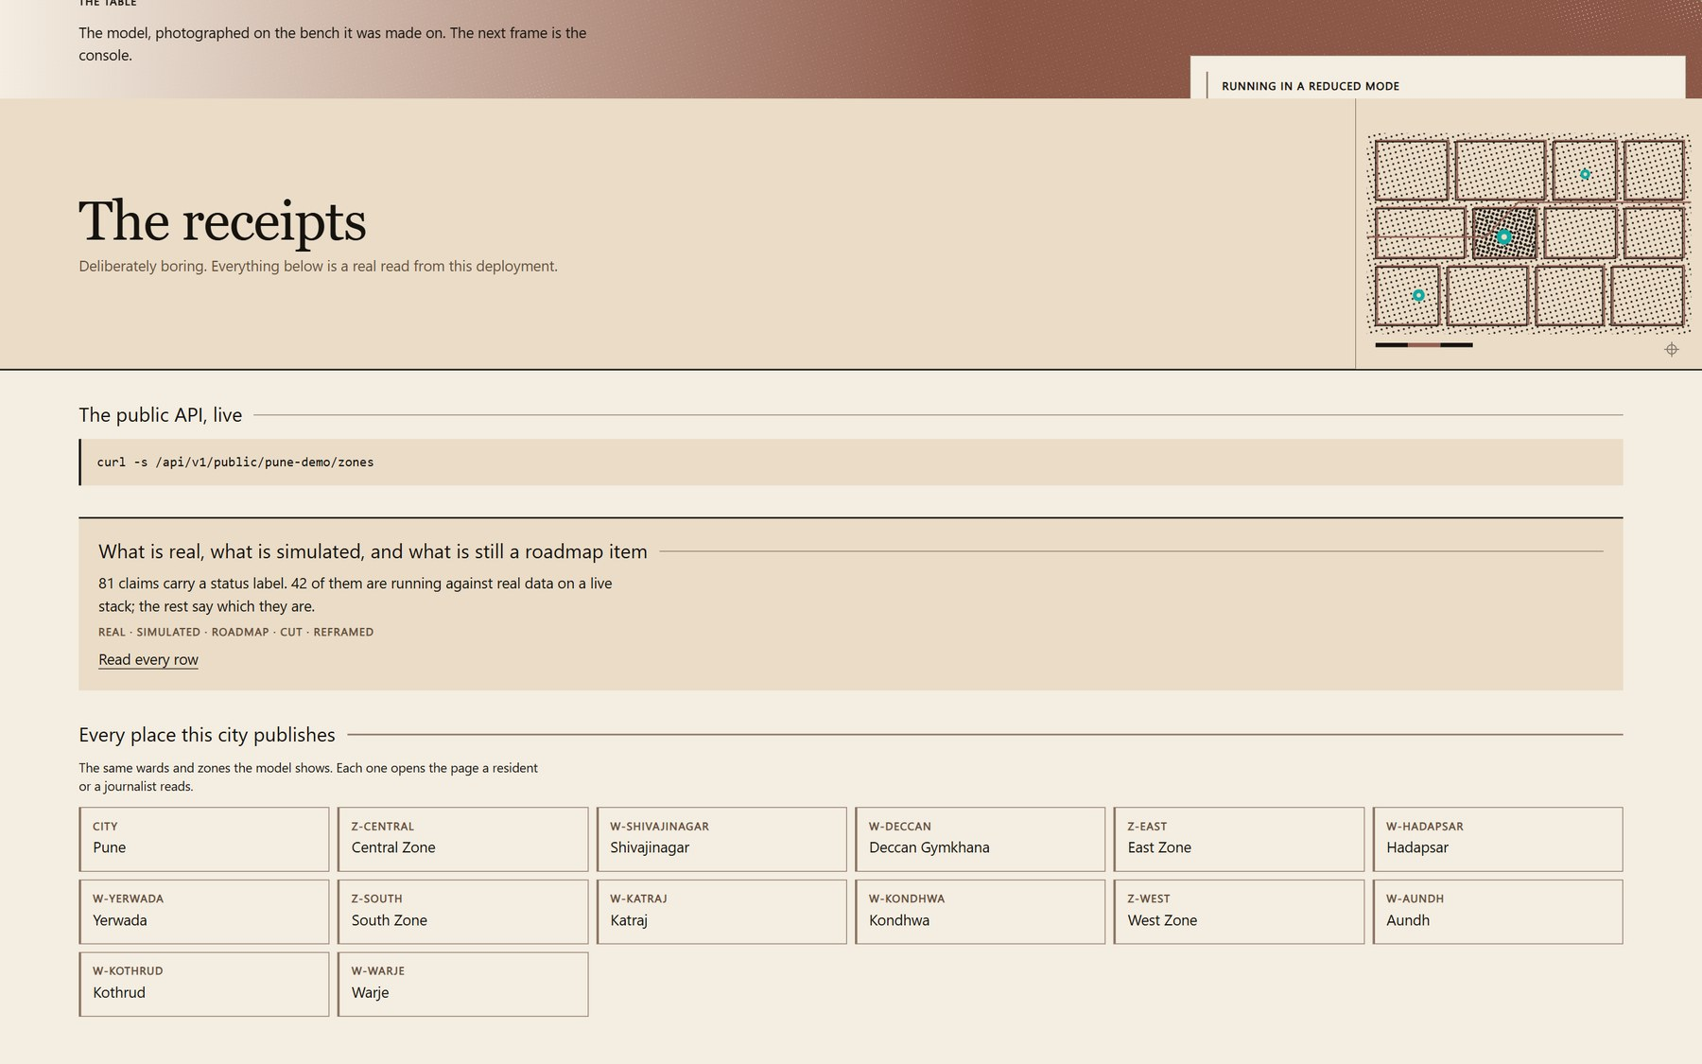
THE LANDING FILM
Act 9 — the receipts
Deliberately boring: a live curl against the public API, and every claim carrying a status label.
LIVE · REAL DATA
/
10 / 38

Slide 15
02
The resident
Photograph it, say where, send. Then a receipt whose claim is a hash, and an evidence trail nobody can look up by your name.
6 SCREENS

Slide 16
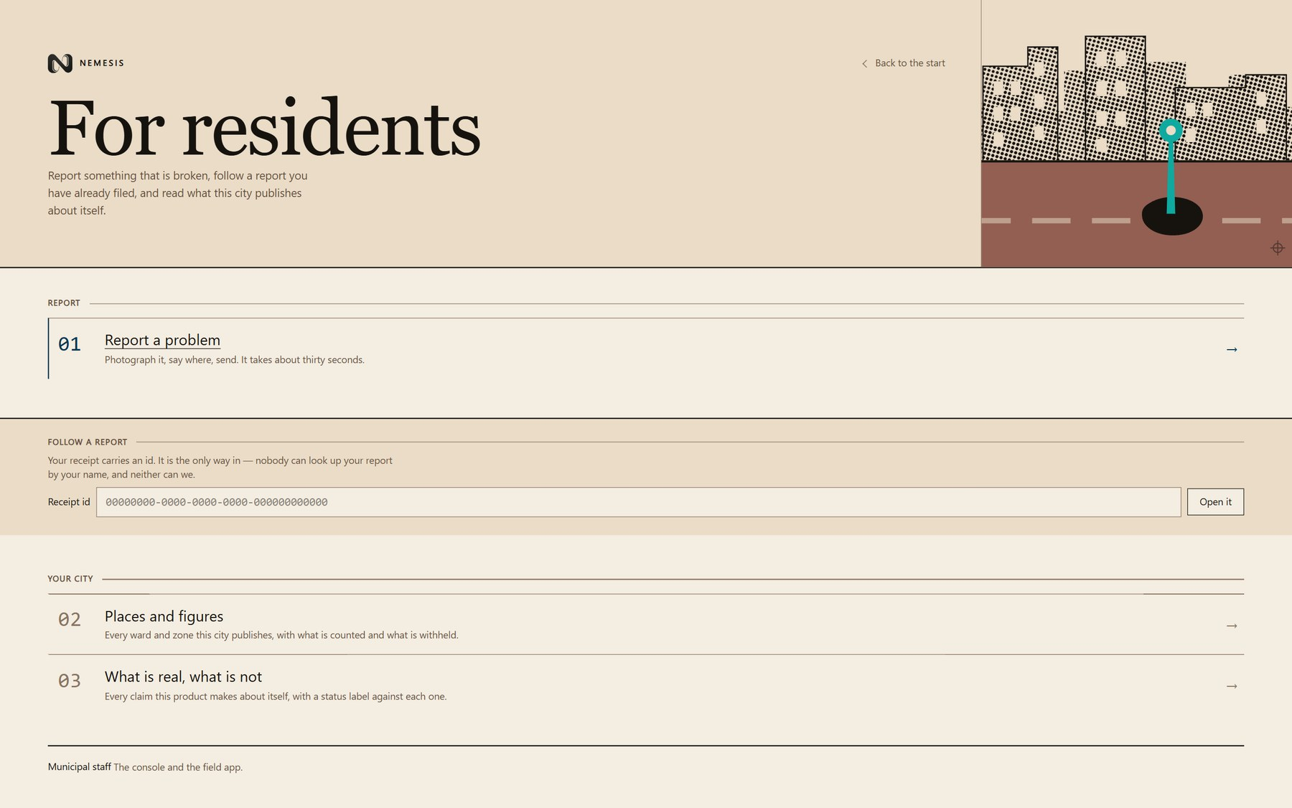
THE RESIDENT
Resident — the three doors
Report a problem, follow a report by its receipt id, or read what the city publishes about itself.
LIVE · REAL DATA
/citizen
11 / 38

Slide 17
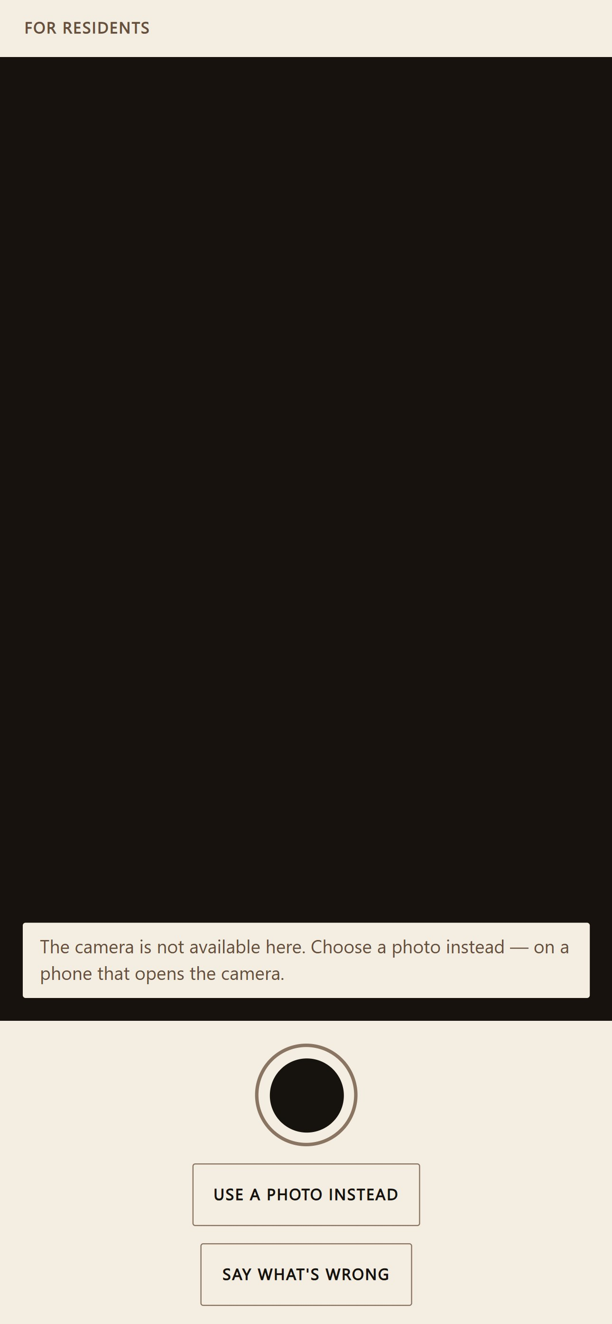
THE RESIDENT
Resident — step 1, capture
Photograph it, say where, send. About thirty seconds, and the viewfinder is the first screen.
LIVE · REAL DATA
/report
12 / 38

Slide 18
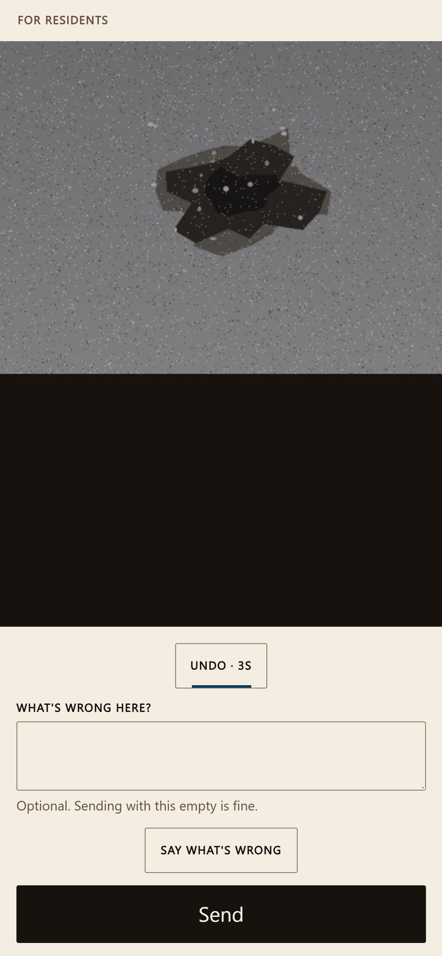
THE RESIDENT
Resident — step 1, in your own words
A four-second undo on the photograph, and one optional line. The flow completes if it is left empty.
LIVE · REAL DATA
/report
13 / 38

Slide 19

THE RESIDENT
Resident — step 2, where
A card, not a picker. The ward resolves against the city's own zone tree — never a third-party geocoder.
LIVE · REAL DATA
/report
14 / 38

Slide 20
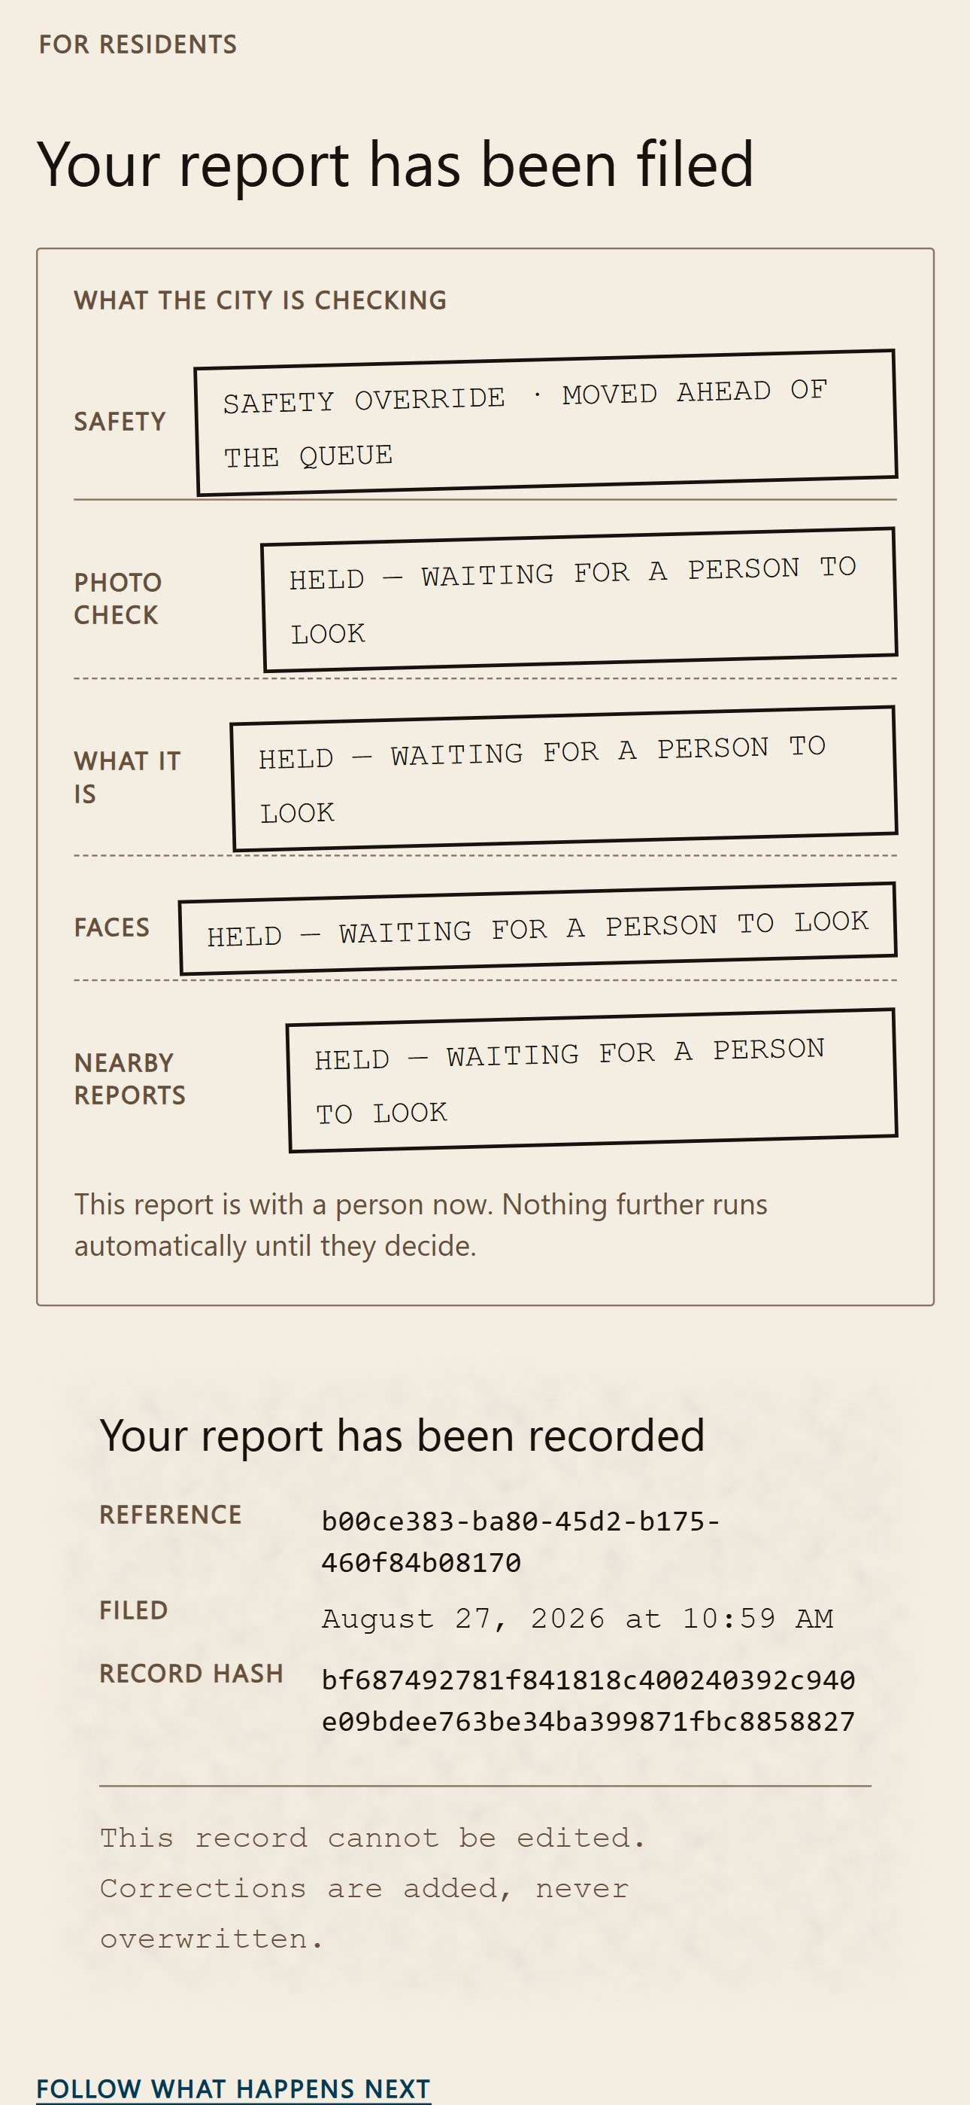
THE RESIDENT
Resident — step 3, the receipt
Filed. The receipt is a document, and its claim is a SHA-256 of the event the log actually wrote.
LIVE · REAL DATA
/report
15 / 38

Slide 21
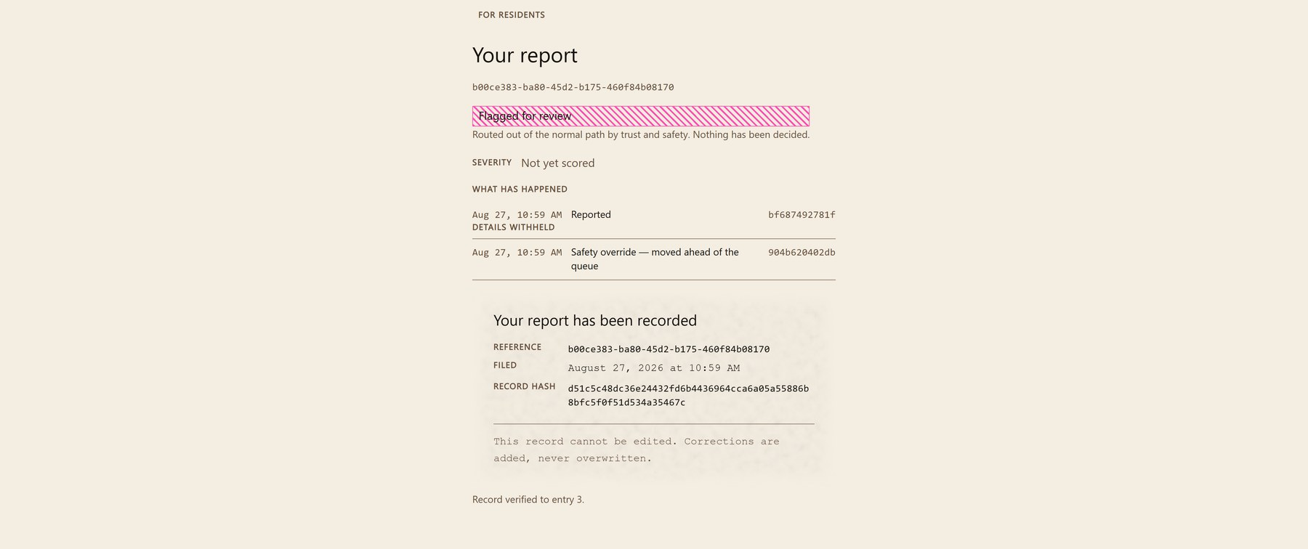
THE RESIDENT
Resident — the evidence trail
The receipt id is the only way in — nobody can look the report up by name. Each gate it passed is an event, not a status.
LIVE · REAL DATA
/t/b00ce383-ba80-45d2-b175-460f84b08170
16 / 38

Slide 22
03
What the city publishes
The open-data surfaces — wards, money, contractors — and the page that says which of this product's claims are real.
5 SCREENS

Slide 23
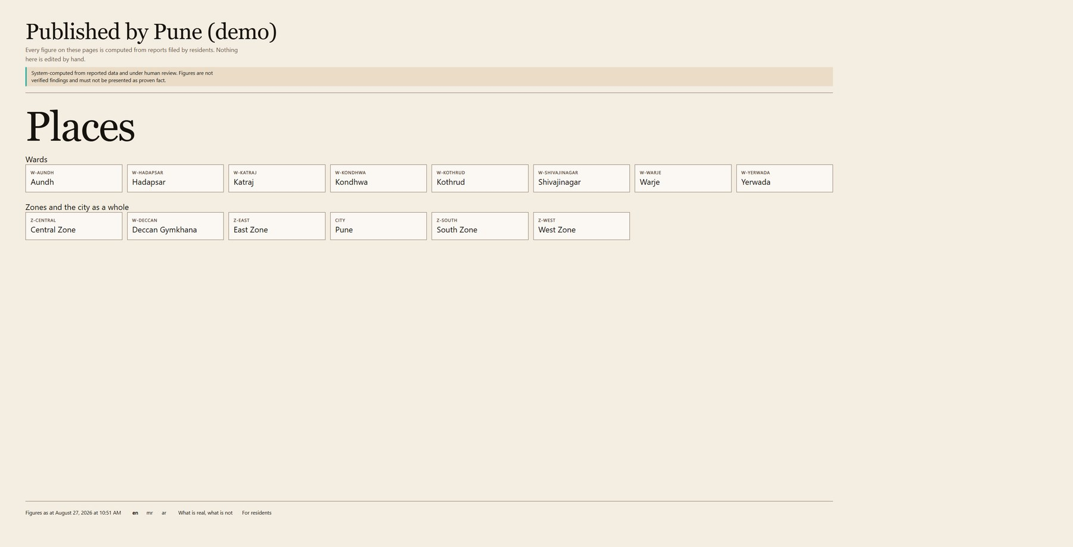
WHAT THE CITY PUBLISHES
Public — the city
The open-data portal: every zone and ward, with what is counted and what is withheld.
LIVE · REAL DATA
/pune-demo
17 / 38

Slide 24
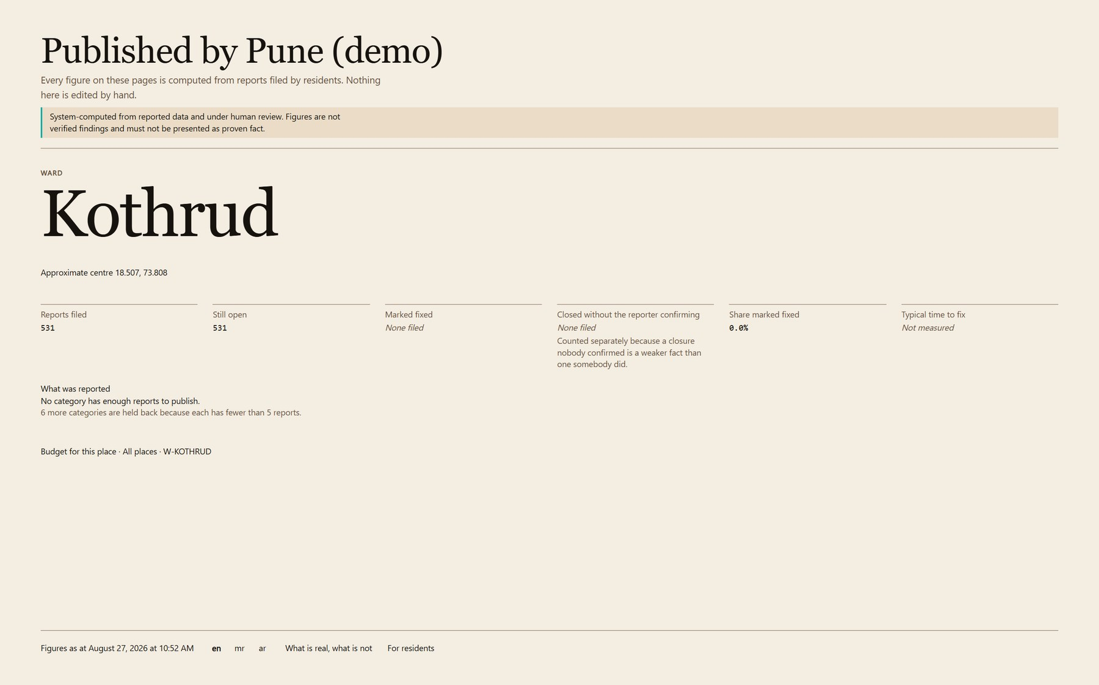
WHAT THE CITY PUBLISHES
Public — one ward
Kothrud, by category, with the suppression threshold stated rather than implied.
LIVE · REAL DATA
/pune-demo/ward/W-KOTHRUD
18 / 38

Slide 25
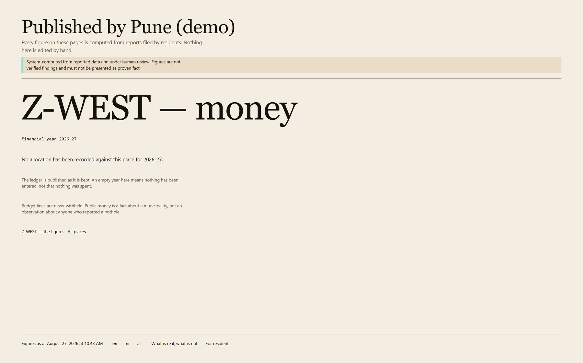
WHAT THE CITY PUBLISHES
Public — the money
Allocated against spent for a zone, in a fiscal year a resident can name.
LIVE · REAL DATA
/pune-demo/budget/Z-WEST?fiscal_year=2026
19 / 38

Slide 26
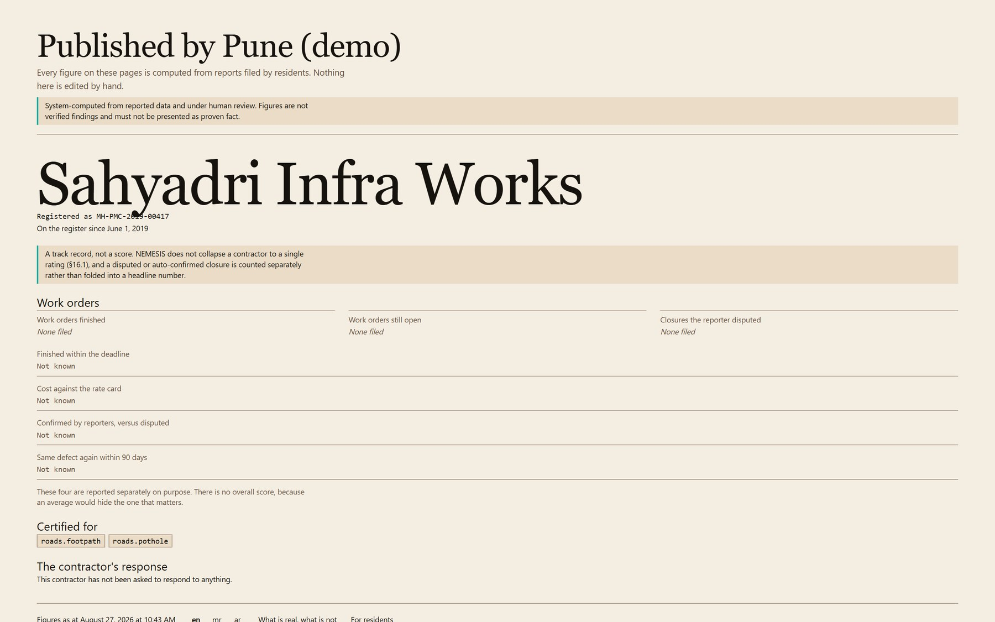
WHAT THE CITY PUBLISHES
Public — the contractor ledger
Four independent metrics, published side by side. There is no overall score, because an average would hide the one that matters.
LIVE · REAL DATA
/pune-demo/contractor/f5e3e2fb-82de-4b1d-93e5-344f2d82ffe9
20 / 38

Slide 27
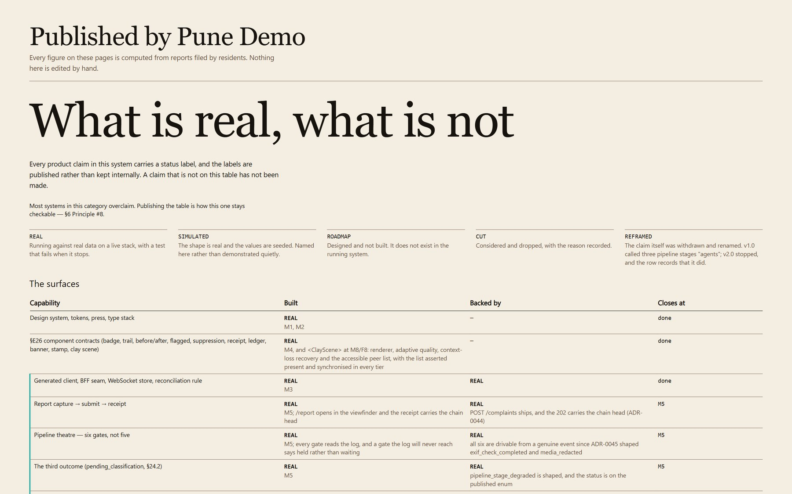
WHAT THE CITY PUBLISHES
Public — what is real
Every claim the product makes about itself, labelled REAL, SIMULATED, ROADMAP, CUT or REFRAMED.
LIVE · REAL DATA
/pune-demo/honesty
21 / 38

Slide 28
04
The staff
The console: what breaches first, the reports the pipeline would not decide alone, and the administrative plane underneath them.
8 SCREENS

Slide 29
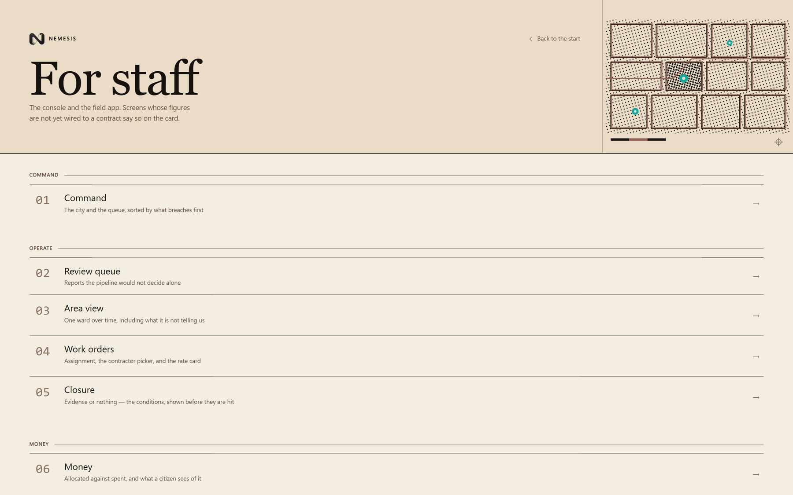
THE STAFF
Staff — the thirteen surfaces
The whole operating surface, with the ones that are not wired yet saying so on the tile.
LIVE · REAL DATA
/staff
22 / 38

Slide 30
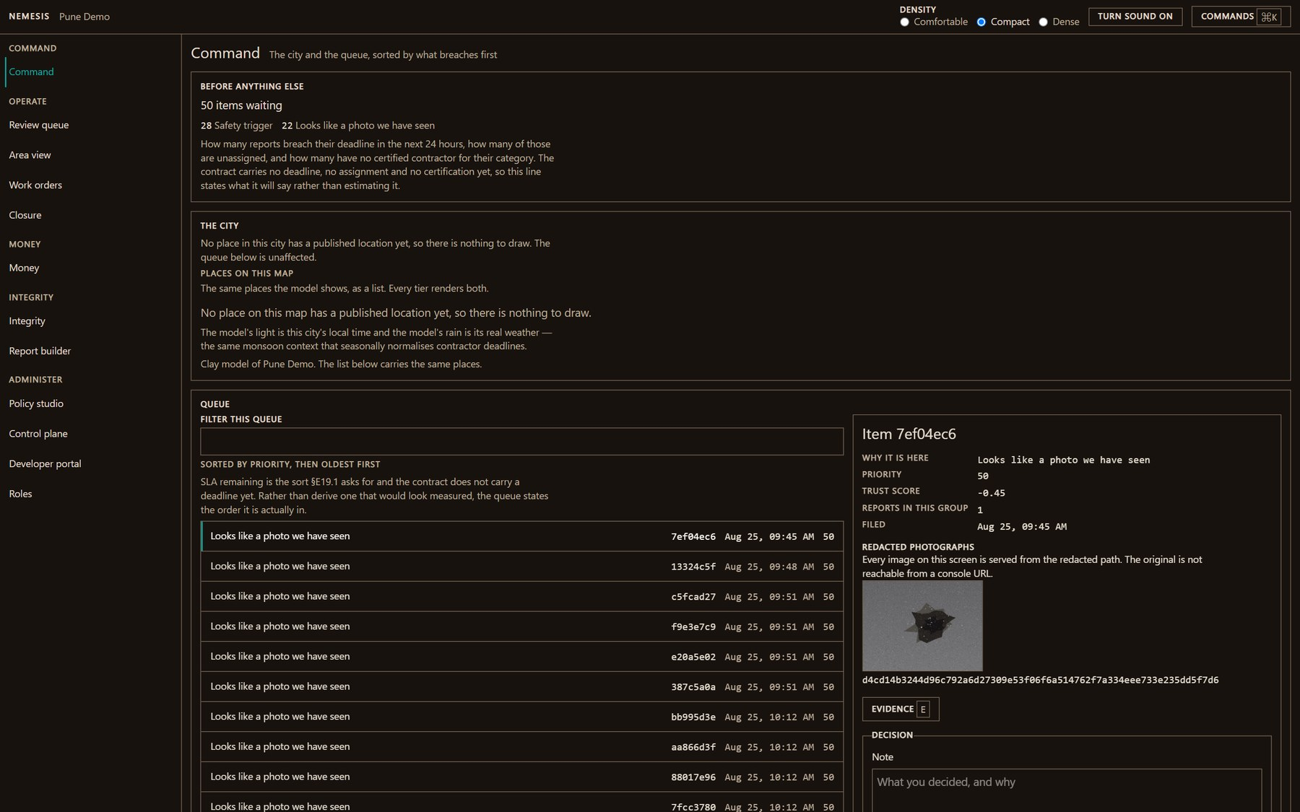
THE STAFF
Console — command
What breaches first, the city as a clay model, and the queue underneath it.
LIVE · REAL DATA
/console
23 / 38

Slide 31
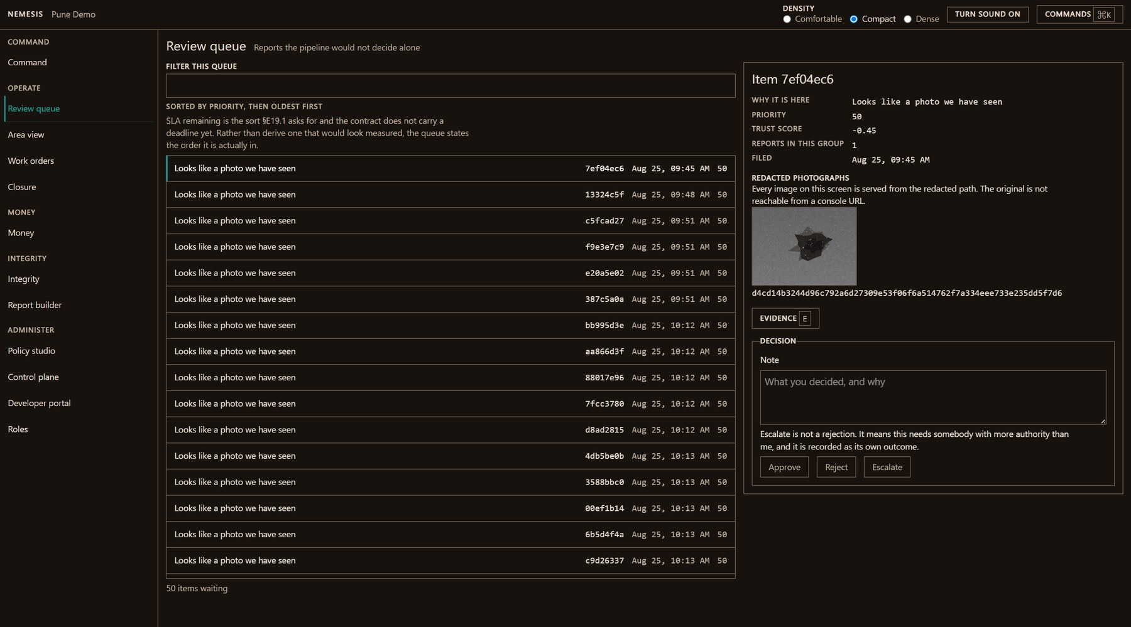
THE STAFF
Console — the review queue
The reports the pipeline would not decide alone, ordered by priority then oldest first.
LIVE · REAL DATA
/console/review
24 / 38

Slide 32
THE STAFF
Console — one decision
Why the gate stopped, the redacted photograph, the evidence, and the decisions a reviewer may take.
LIVE · REAL DATA
/console/review
25 / 38

Slide 33
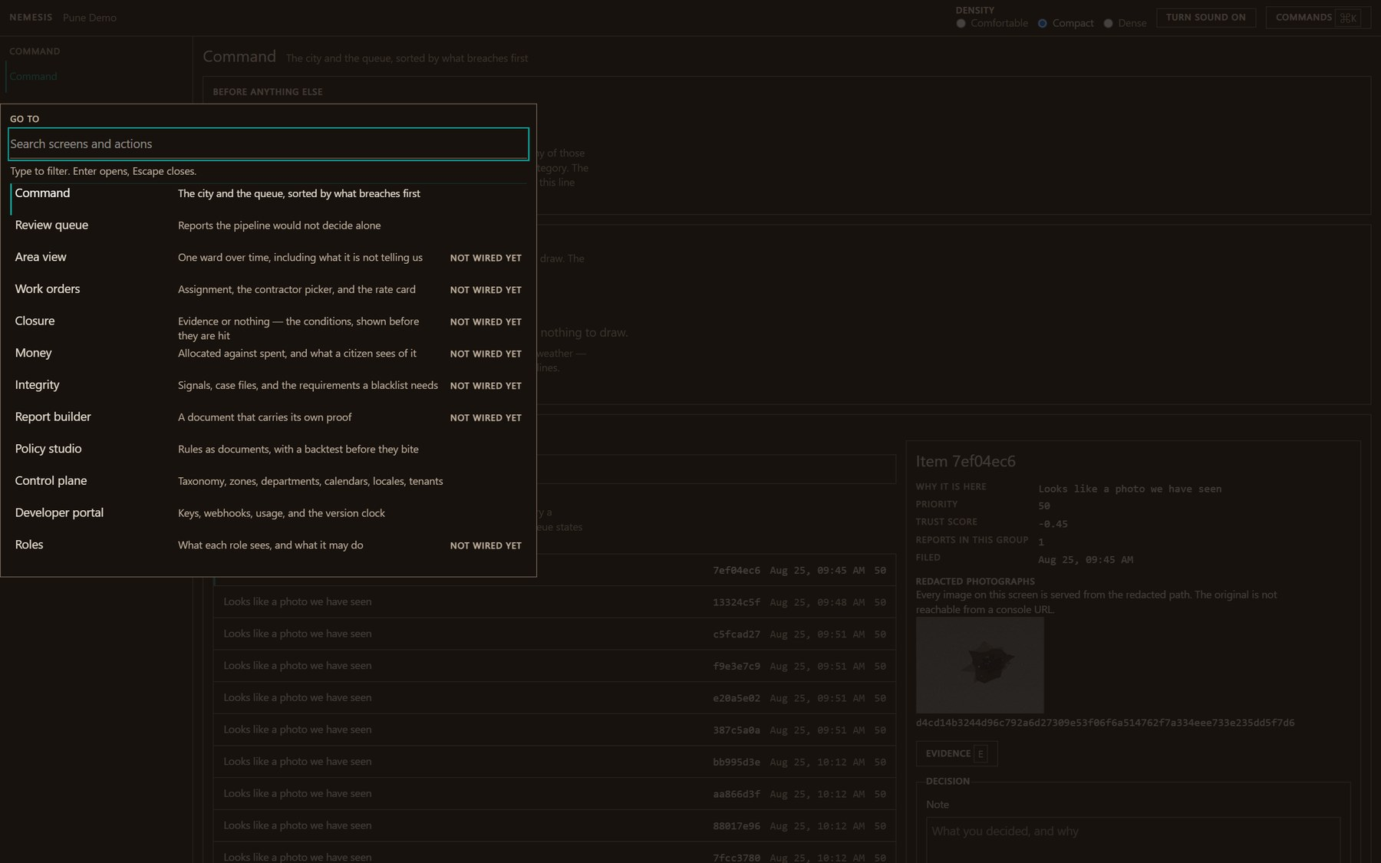
THE STAFF
Console — the command palette
Every screen one keystroke away. The console is a keyboard surface first.
LIVE · REAL DATA
/console
26 / 38

Slide 34
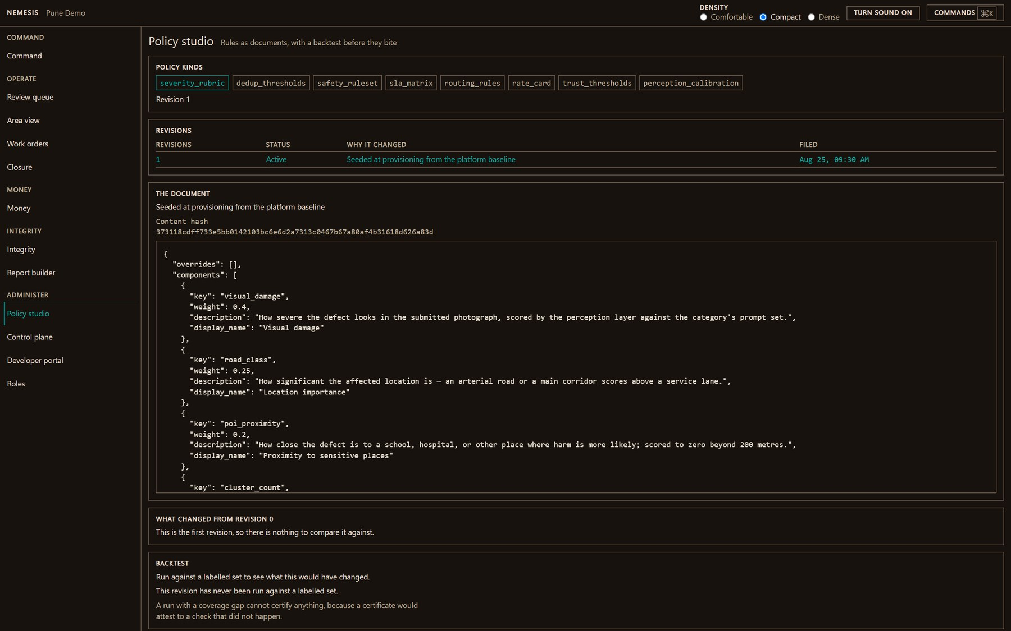
THE STAFF
Console — the policy studio
Rules as documents, with a backtest before they bite.
LIVE · REAL DATA
/console/policy
27 / 38

Slide 35
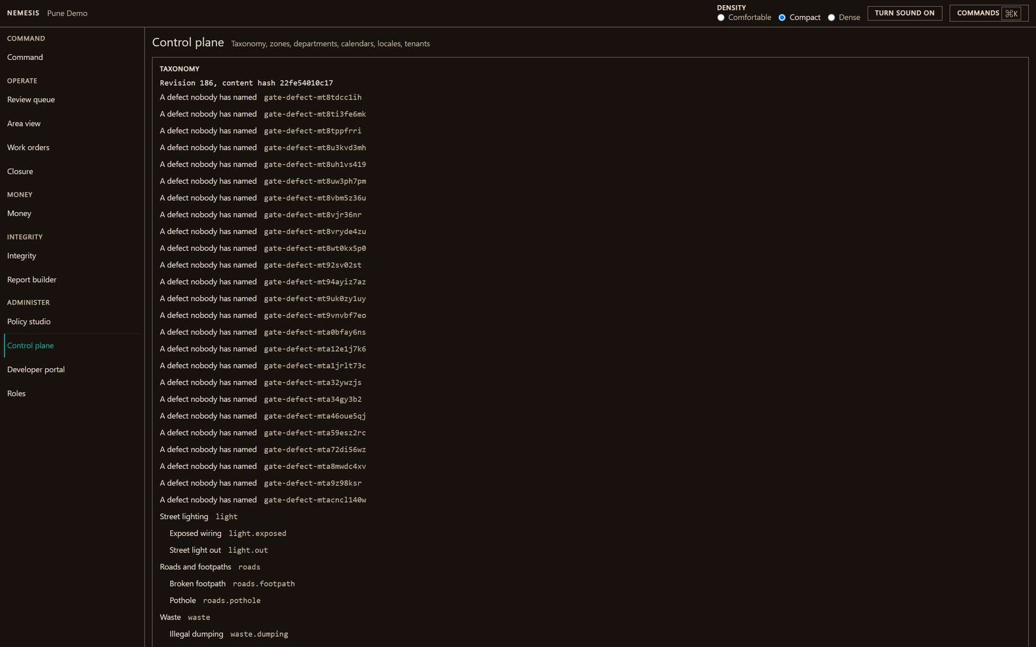
THE STAFF
Console — the control plane
Taxonomy, zones, departments, calendars, locales and tenants.
LIVE · REAL DATA
/console/control
28 / 38

Slide 36
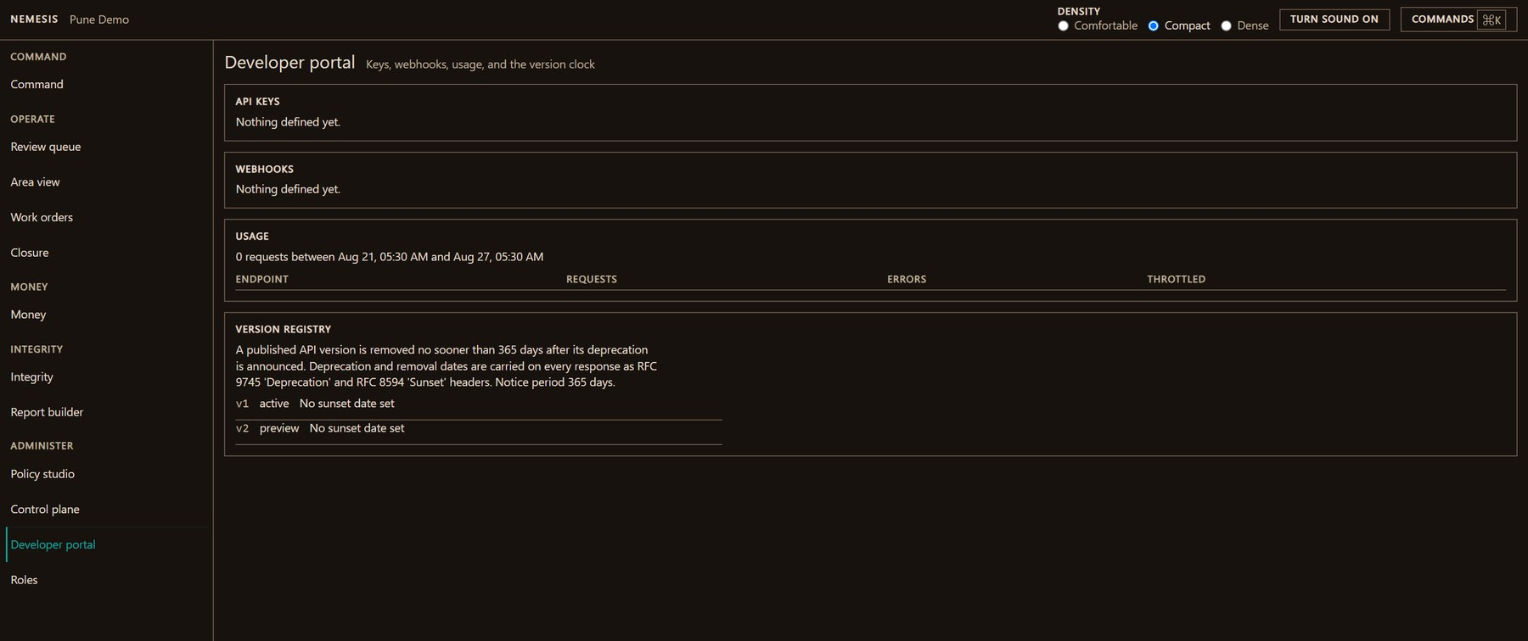
THE STAFF
Console — the developer portal
Keys, webhooks, usage and the version clock.
LIVE · REAL DATA
/console/developers
29 / 38

Slide 37
05
What is not wired yet
Seven screens whose contracts still return nulls. A production build routes every one of them to a 404 — they are designed, and they say so.
7 SCREENS

Slide 38
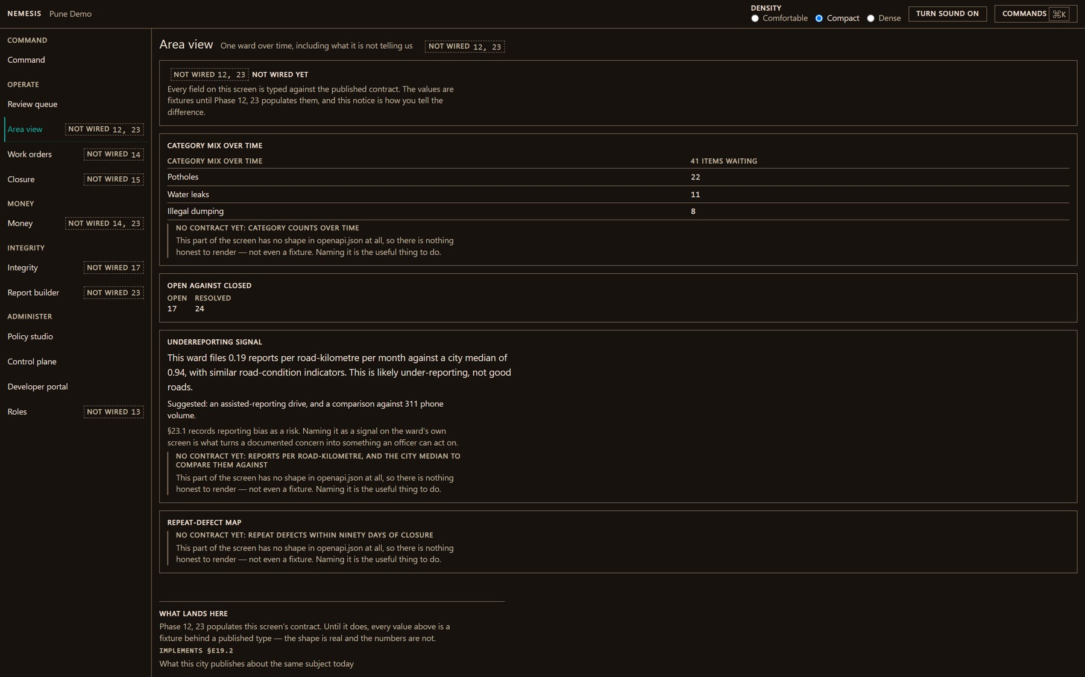
WHAT IS NOT WIRED YET
Console — area view
One ward over time, including what it is not telling us.
ROADMAP · DEV ONLY
/console/area
30 / 38

Slide 39
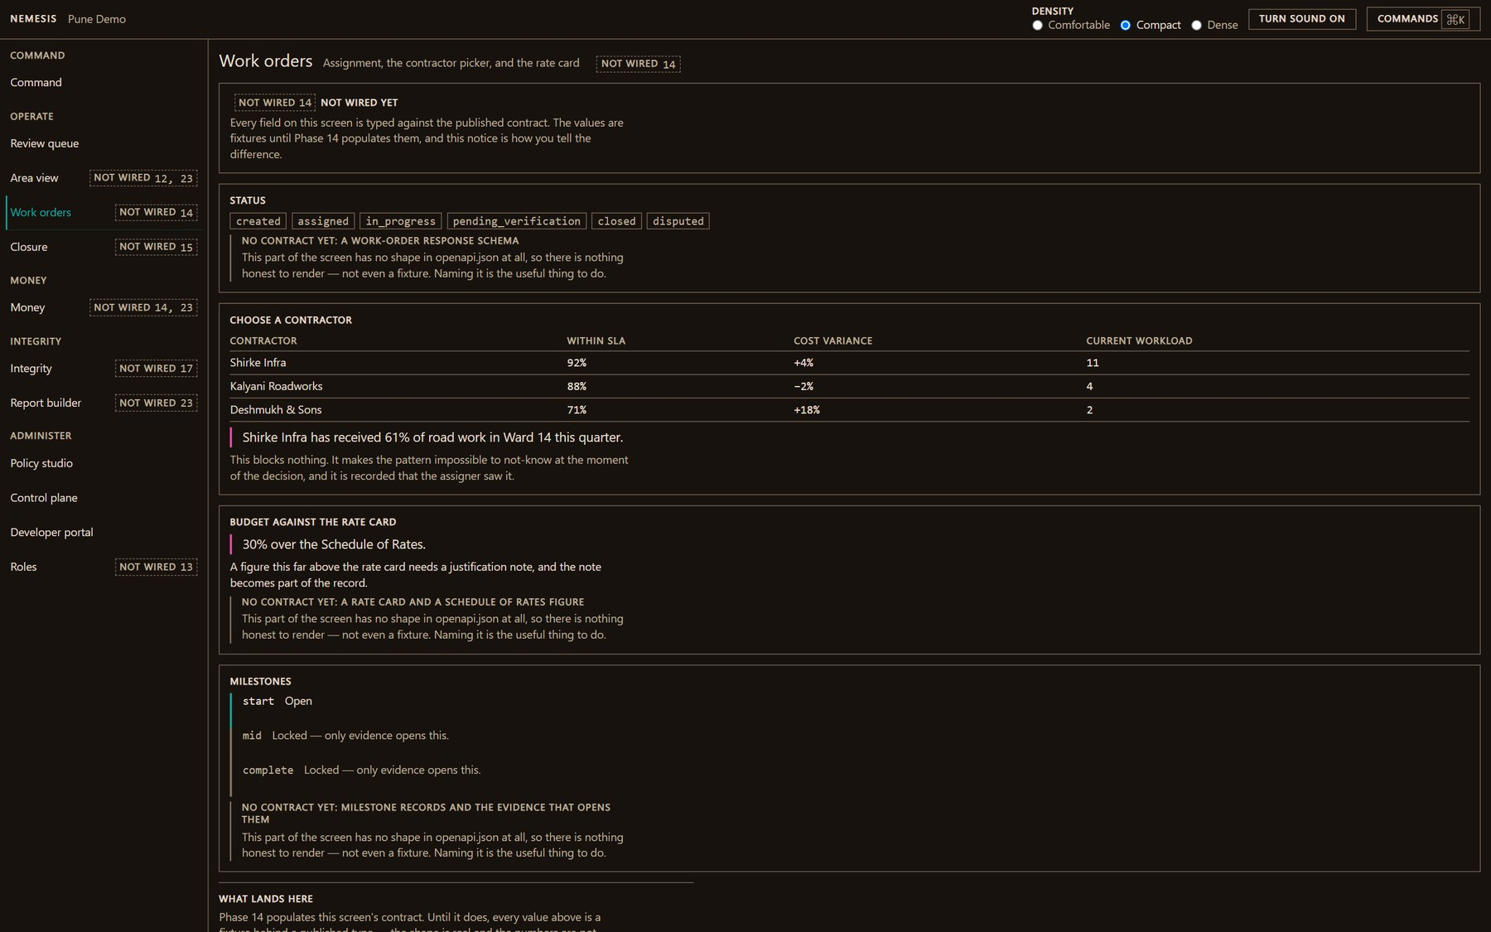
WHAT IS NOT WIRED YET
Console — work orders
Assignment, the contractor picker and the rate card.
ROADMAP · DEV ONLY
/console/work
31 / 38

Slide 40
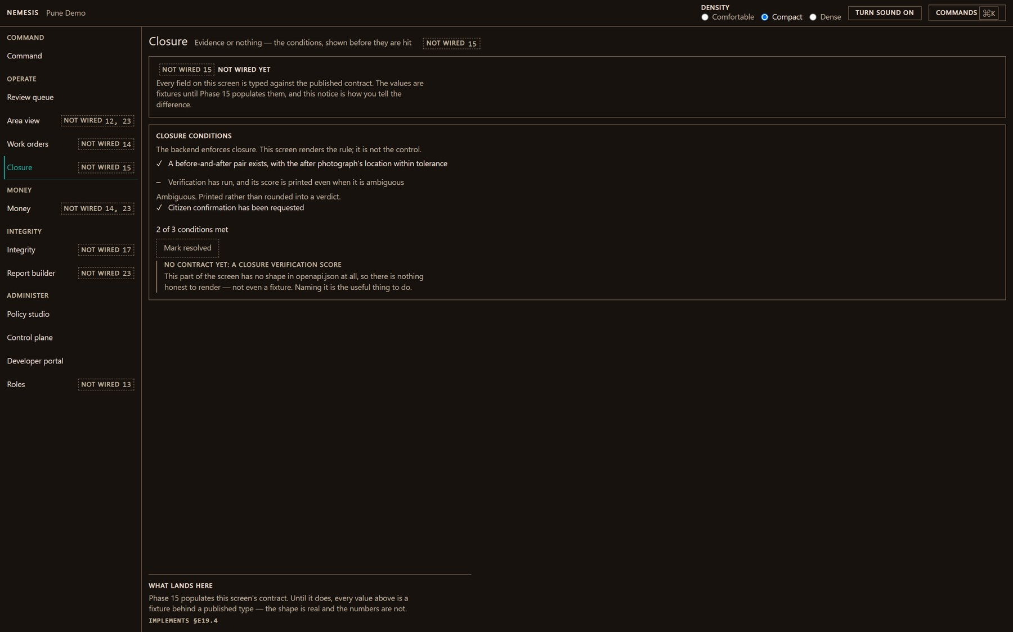
WHAT IS NOT WIRED YET
Console — closure
Evidence or nothing. The conditions for closing a job are shown before they are hit.
ROADMAP · DEV ONLY
/console/closure
32 / 38

Slide 41
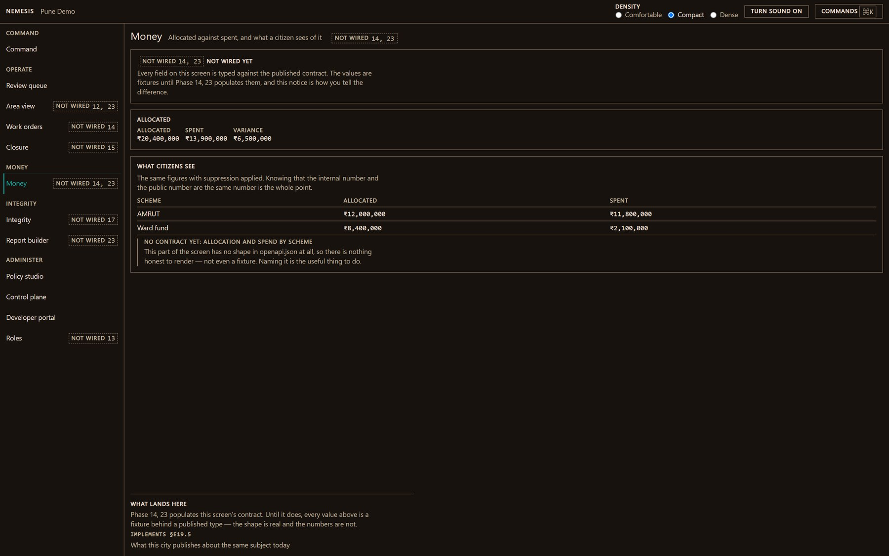
WHAT IS NOT WIRED YET
Console — money
Allocated against spent, and what a citizen sees of it.
ROADMAP · DEV ONLY
/console/money
33 / 38

Slide 42
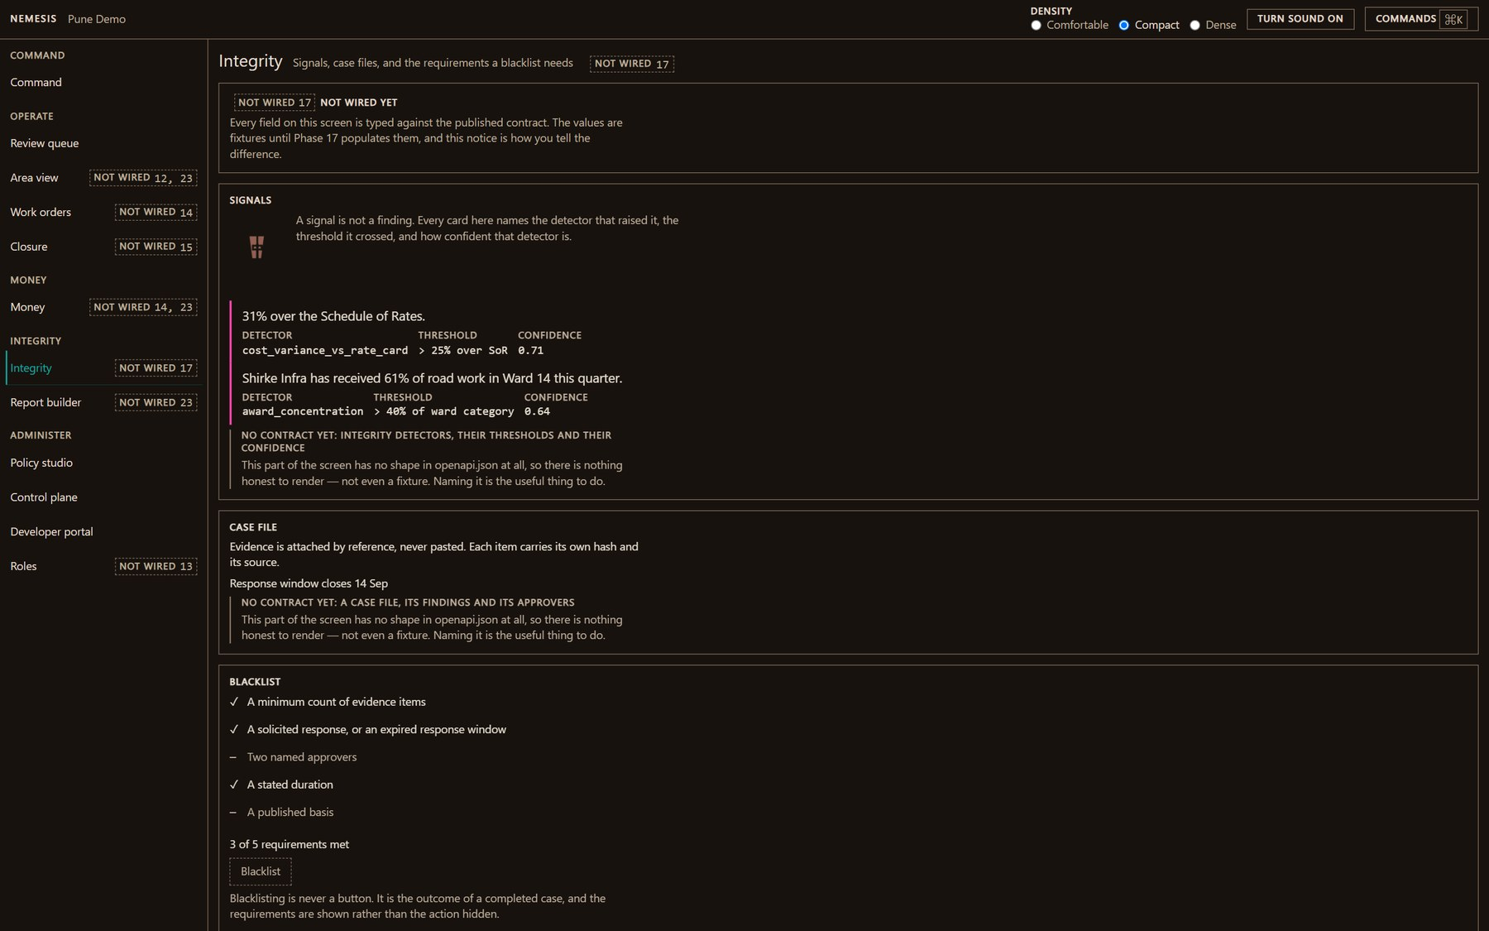
WHAT IS NOT WIRED YET
Console — integrity
Signals, case files, and the requirements a blacklist has to meet before it is one.
ROADMAP · DEV ONLY
/console/integrity
34 / 38

Slide 43
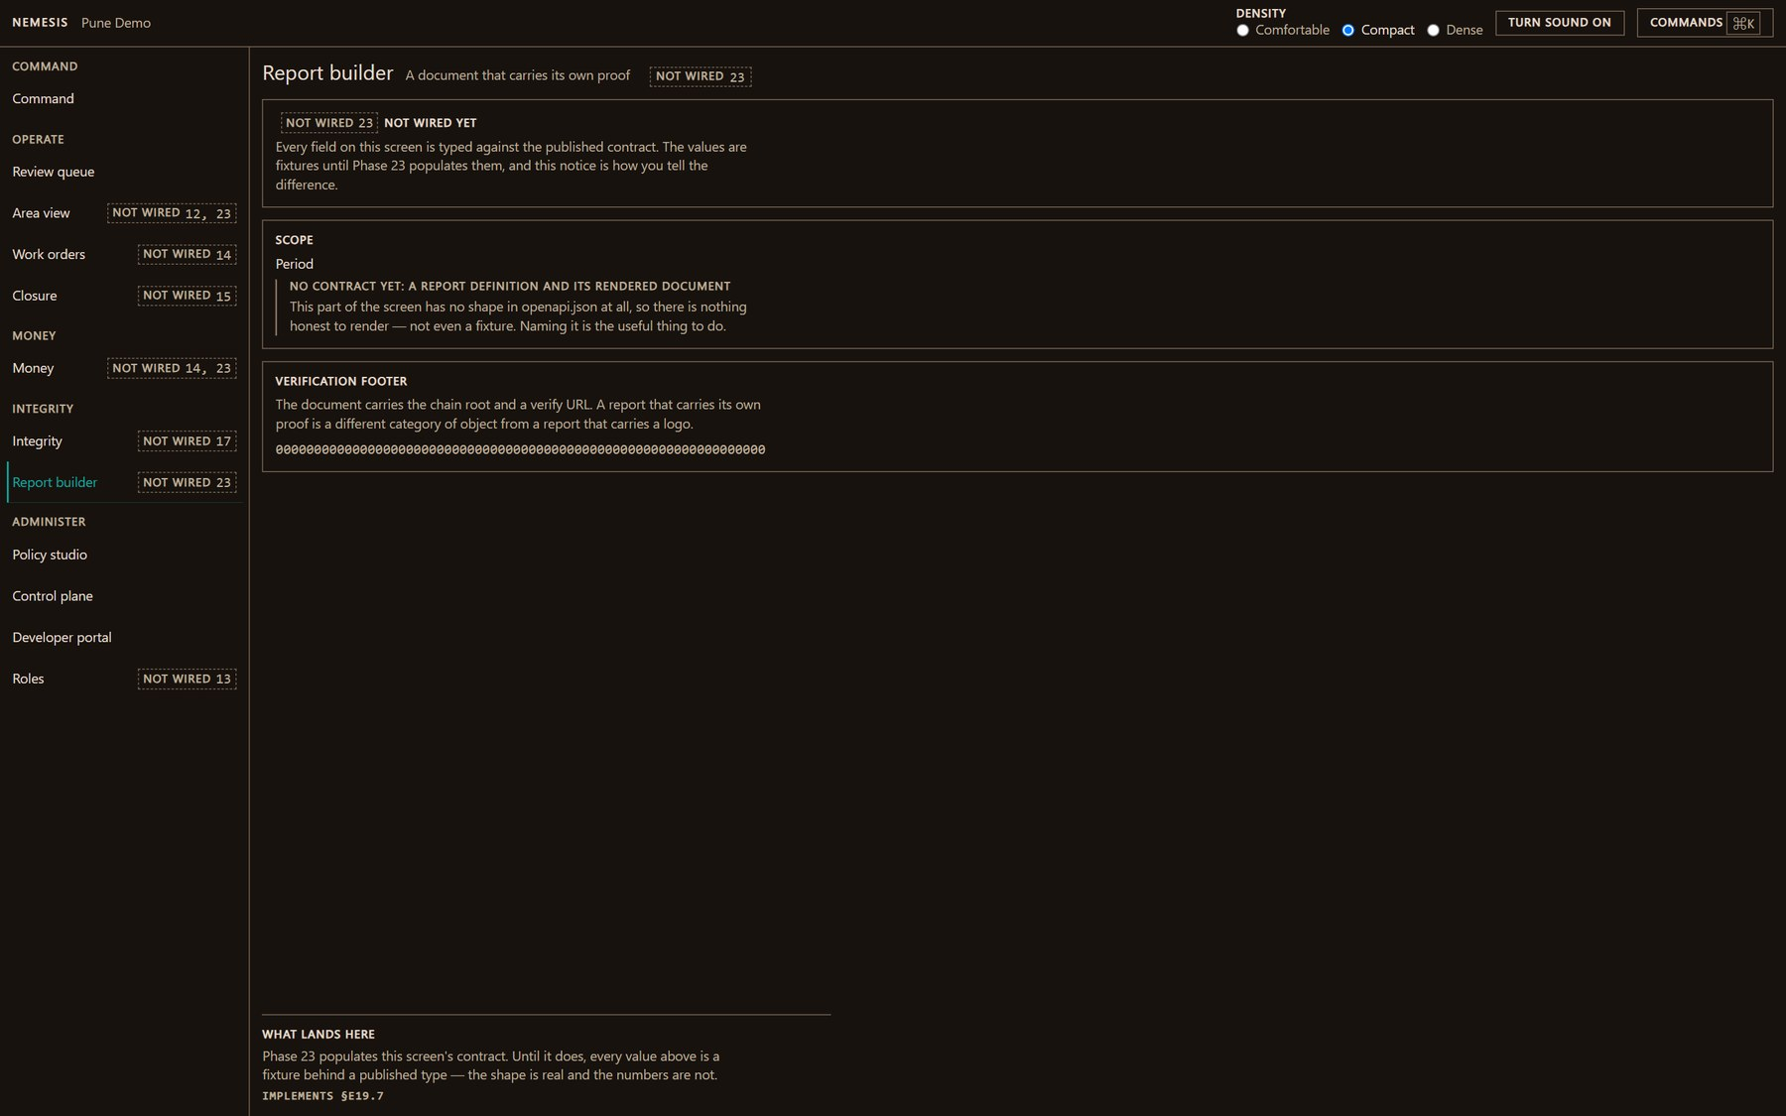
WHAT IS NOT WIRED YET
Console — the report builder
A document that carries its own proof.
ROADMAP · DEV ONLY
/console/reports
35 / 38

Slide 44
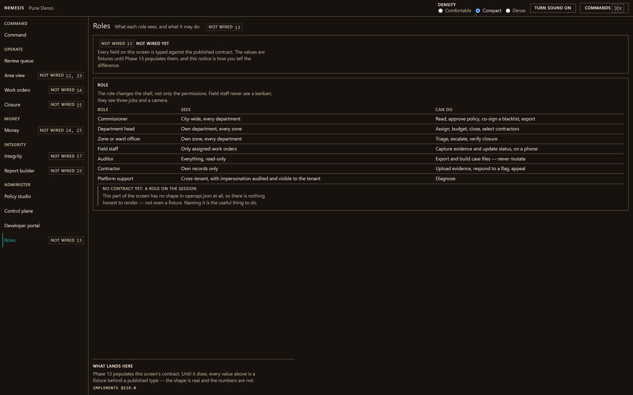
WHAT IS NOT WIRED YET
Console — roles
What each role sees, and what it may do.
ROADMAP · DEV ONLY
/console/roles
36 / 38

Slide 45
06
Outdoors, and under the hood
The crew's phone, offline and in sunlight — and the proof routes each rendering pipeline is photographed through.
2 SCREENS

Slide 46
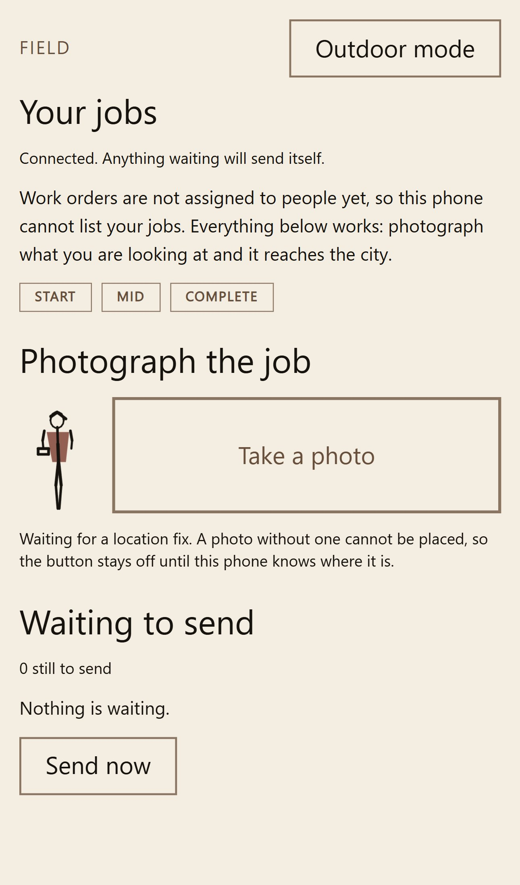
OUTDOORS, AND UNDER THE HOOD
Field — the crew's phone
Capture and close jobs outdoors and offline. Installs to a phone; built for sunlight and gloves.
LIVE · REAL DATA
/field
37 / 38

Slide 47
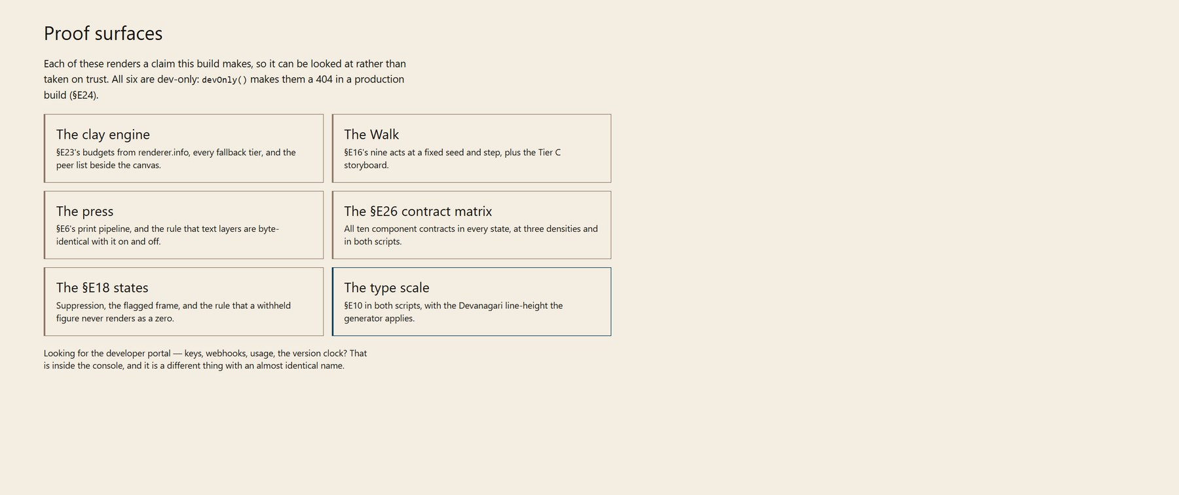
OUTDOORS, AND UNDER THE HOOD
Developers — the proof surfaces
The routes each rendering pipeline is photographed through, and the contracts it holds.
LIVE · REAL DATA
/developers
38 / 38

Slide 48
HOW A REPORT MOVES
Every stage appends events. Nothing mutates a row.
ingest
safety
trust
classify
dedup
severity
routing · SLA
investigation
SOLID — shipped and gated DASHED — designed, not built
· The safety fail-safe runs on its own queue, served by a container that has never imported torch. A saturated ML queue cannot delay a gas-leak report.
· Degradation is recorded, not swallowed. Every external call has a timeout, a retry budget, a fallback, and its own event — DEGRADED is not FAILED.
· Deduplication is reversible. A merge is undone by a compensating event, never a delete.

Slide 49
Every figure on every one of these screens
is computed from an append-only log.
31
7
0
screens photographed live,
against a seeded deployment
designed and honestly
routed to a 404 in production
figures typed by hand
anywhere in this deck
Prove, don't log.

