Slide 1
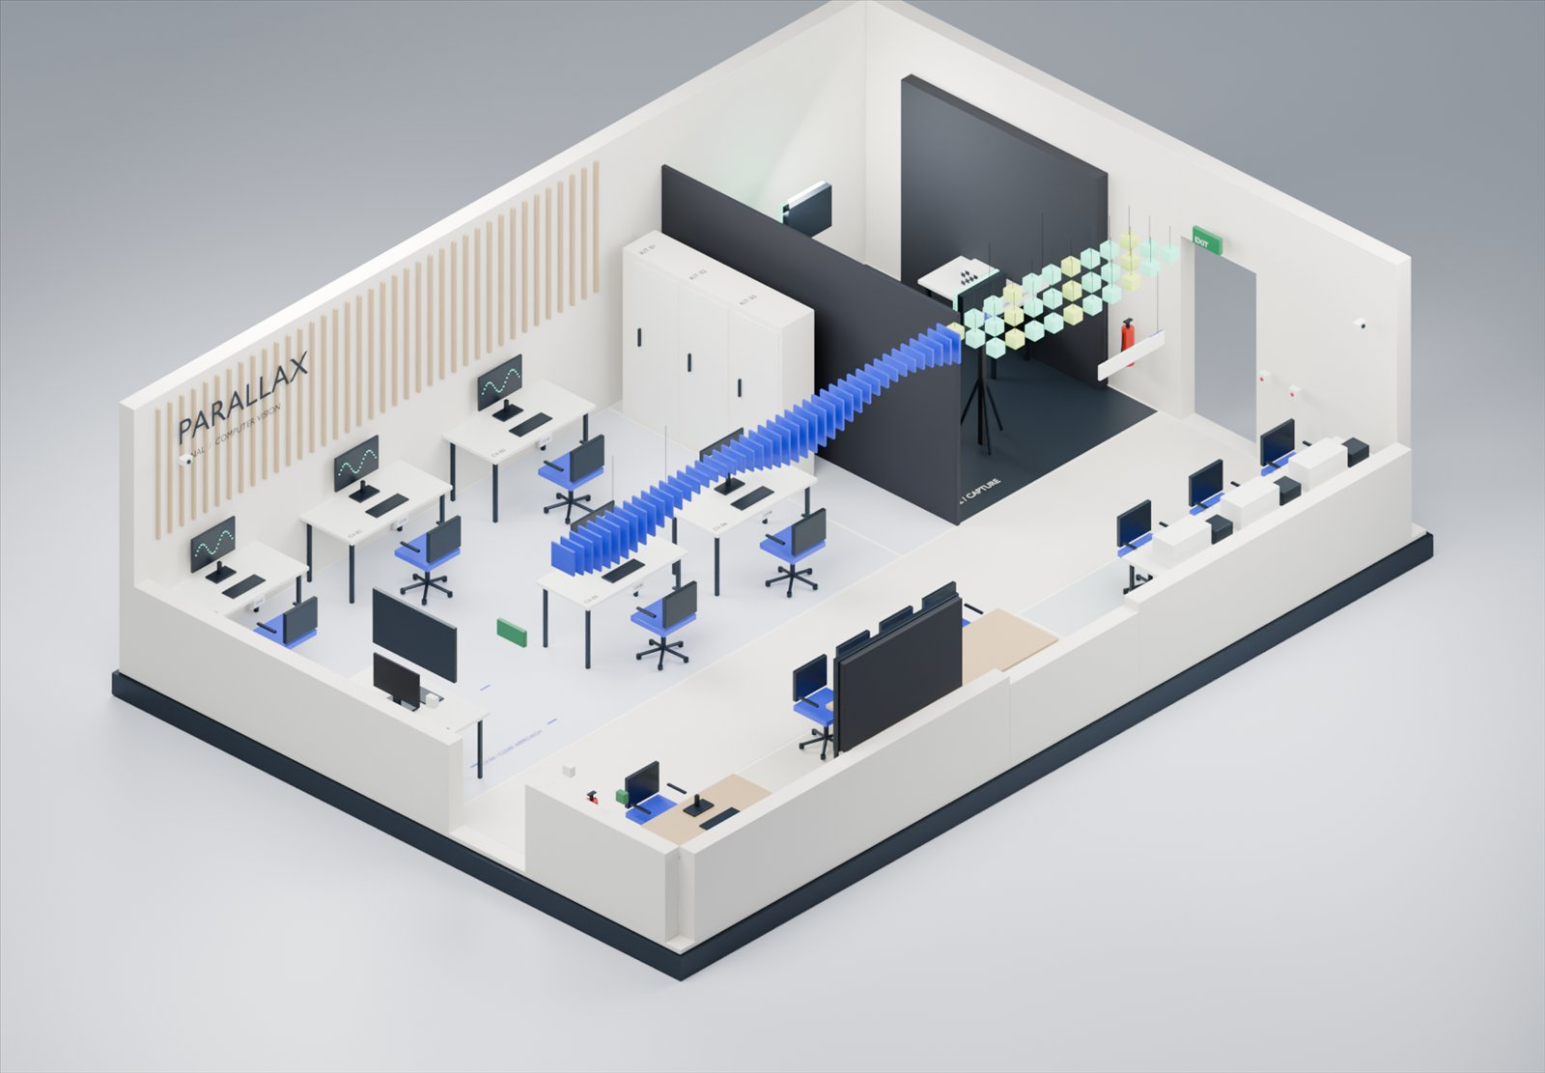
PARALLAX
A 70 m² Signal & Computer Vision Lab
Physical planning and a runnable local UI/UX proposal
01 / PARALLAX / 0:00-0:55
Notes:
Timing: 55 seconds. Segment 0:00-0:55.
Introduce the project as a physical and digital laboratory proposal. The assignment supplies seventy square metres. Our assumed P4-D envelope is ten by seven metres. Explain that the room render is an authored model and the interactive app uses local example records. The demonstration shows a student's evidence journey, equipment recovery, sustainability and local guide AI. Distinguish this proposal from an installed or certified lab. Source: assignment text in apps/lab-web/evidence/u09-audit/assignment-text.txt and spatial/lab_geometry.json.

Slide 2
A practical depends on more than a free station
A complete kit must share one usable interval.
Evidence needs its method, source and settings.
Recovery needs a receipt and a responsible owner.
02 / PARALLAX / 0:55-1:50
Notes:
Timing: 55 seconds. Segment 0:55-1:50.
Explain the concrete failure consequences. A booked camera bench can still lack a light or calibration target. A plausible graph can omit the reference that produced it. A saved draft can be mistaken for confirmed submission. These are prospective problems and authored scenarios. We have not measured local frequency. Our response preserves complete dependencies and distinct task states. Source: research/U02_RESEARCH_SYNTHESIS.md, research/U02_TRACEABILITY.csv and research/U02_HYPOTHESIS_REVIEW.md.

Slide 3
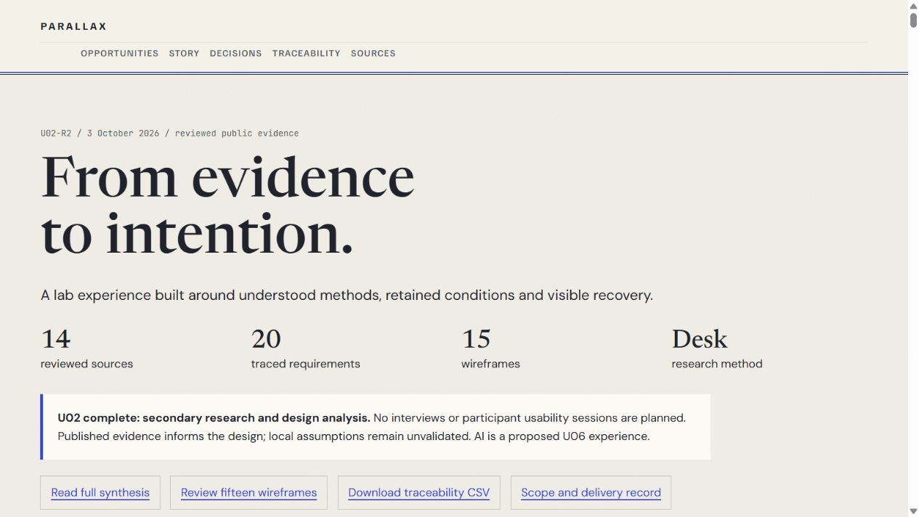
Fourteen sources inform the design
Secondary research and design-artifact analysis
Six role lenses and six evidence tensions
Zero local participants, with limitations stated
03 / PARALLAX / 1:50-2:45
Notes:
Timing: 55 seconds. Segment 1:50-2:45.
State the research method plainly. The user excluded primary participant studies. We reviewed fourteen public sources covering education, provenance, operating policies, access, ventilation, sustainability and AI. The source register records reading depth and partial access. Personas remain hypothetical role lenses. Sources such as Holmes, Wieman and Bonn support comparison and reflection as a design rationale, without transferring an effect size to PARALLAX. Source: research/U02_SOURCE_REGISTER.md, S01 https://arxiv.org/abs/1508.04870, and research/U02_DESK_RESEARCH_METHOD.md.

Slide 4
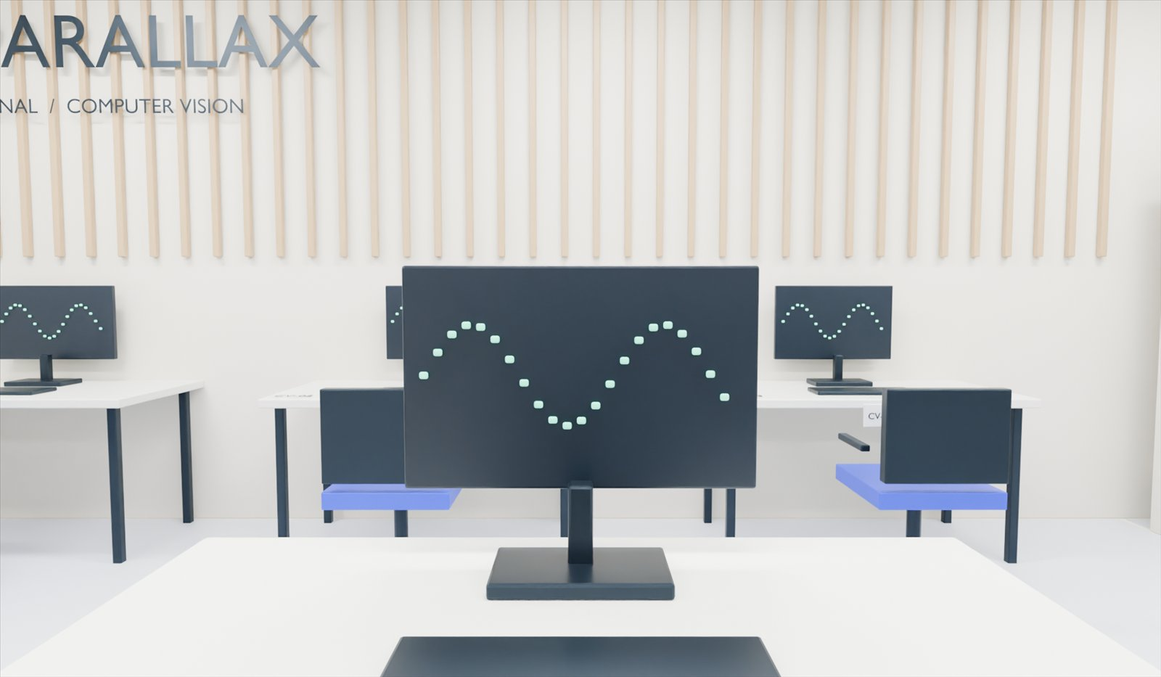
The journey keeps ownership visible
Prepare and reserve the complete kit
Arrive, record and compare retained evidence
Reflect, confirm the receipt and close the session
04 / PARALLAX / 2:45-3:40
Notes:
Timing: 55 seconds. Segment 2:45-3:40.
Walk through the intended student journey and point out handoffs. Preparation acknowledgement does not replace institutional training. Reservation does not prove the room conditions are suitable. Capture freezes context. Reflection remains the student's own writing. A receipt confirms the local submission state and portable items require return. Faculty and technicians receive separate task views. Visitors receive a limited public projection. Source: research/U02_RESEARCH_SYNTHESIS.md, prototype/fixtures.json and apps/lab-web/PARITY.md.

Slide 5
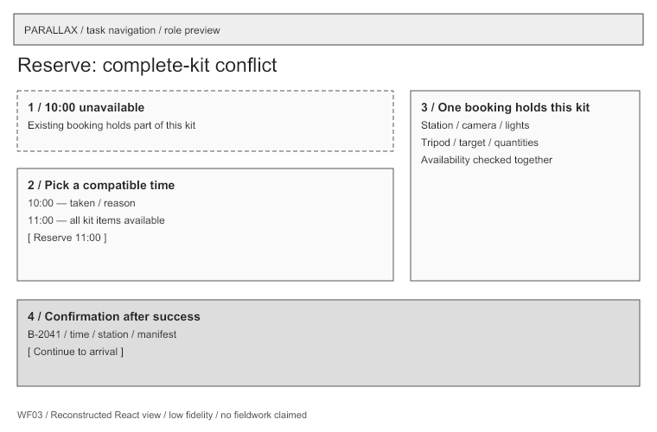
Fifteen boards make decisions inspectable
Requirements, sources and alternatives accompany each board.
WF03 retains the conflict and compatible alternative.
The original twelve layouts remain preserved.
05 / PARALLAX / 3:40-4:35
Notes:
Timing: 55 seconds. Segment 3:40-4:35.
Show the booking board and identify the whole-kit conflict. An understandable refusal is part of the designed path. Explain that fifteen boards include the twelve original layouts and three supplementary faculty or asset boards. An annotation is structural evidence, while connected implementation requires its own proof. The local wireframe page exposes editable data, generator and SVGs. Source: design/wireframes/boards.json, research/U02_DESIGN_DECISIONS.md and planning/U02_DELIVERY_RECORD.md.

Slide 6
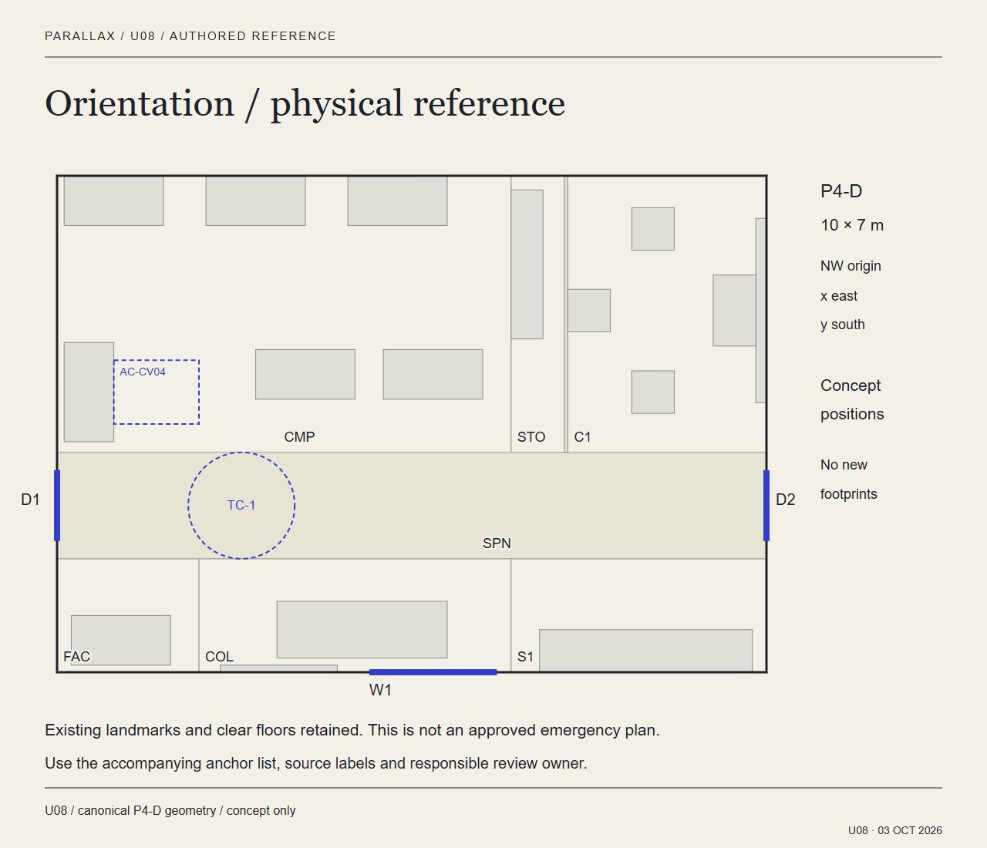
P4-D fits the assumed seventy square metres
Seven zones total 70 m².
A 1.5 m spine preserves circulation in the model.
The plan, model and labels share canonical geometry.
06 / PARALLAX / 4:35-5:30
Notes:
Timing: 55 seconds. Segment 4:35-5:30.
Describe computing, storage, capture, circulation, faculty, collaboration and signal work. The source uses metres from the north-west inner wall. The geometric validation checks furniture fit and the accessible approach. These checks do not establish escape capacity, installed services or actual access. Teaching capacity and rotation require occupied-room review. The handoff includes Blender and GLB sources. Source: spatial/lab_geometry.json and spatial/exports/upgrade-validation.json. Retained planning rules are conceptual inputs, not a new compliance determination.

Slide 7
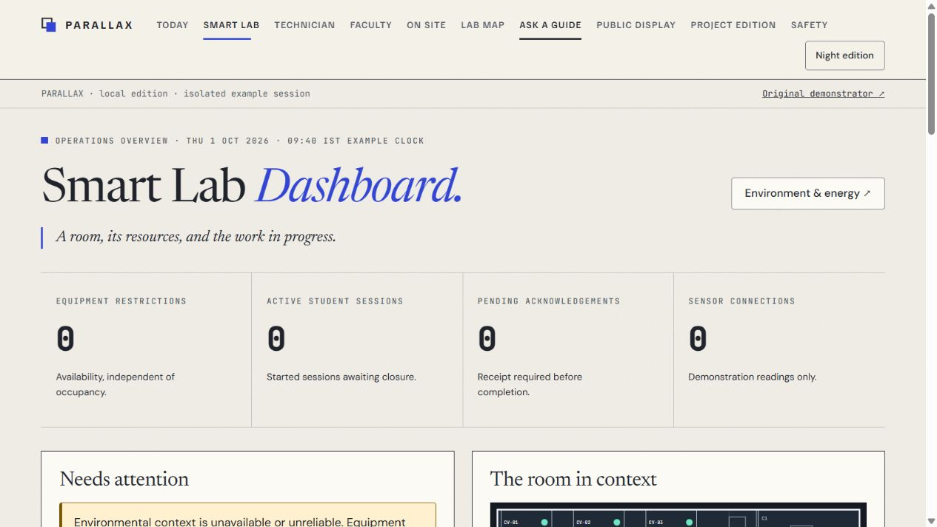
The dashboard shows what its sources can support
Availability and occupancy remain separate.
Missing, stale and disconnected readings remain explicit.
No connected sensor or composite safety score appears.
07 / PARALLAX / 5:30-6:25
Notes:
Timing: 55 seconds. Segment 5:30-6:25.
Open the dashboard if the live preview is available. Show resource state, active sessions and source status. Select a recent example, then a delayed example in the environment desk. Emphasize that changing the demonstration does not rewrite a retained capture. Source timestamps and quality are visible. A free asset does not certify room conditions. Source: planning/U04_DELIVERY_RECORD.md and apps/lab-web/src/domain/observations.ts. The screenshot was captured on the isolated validation origin.

Slide 8
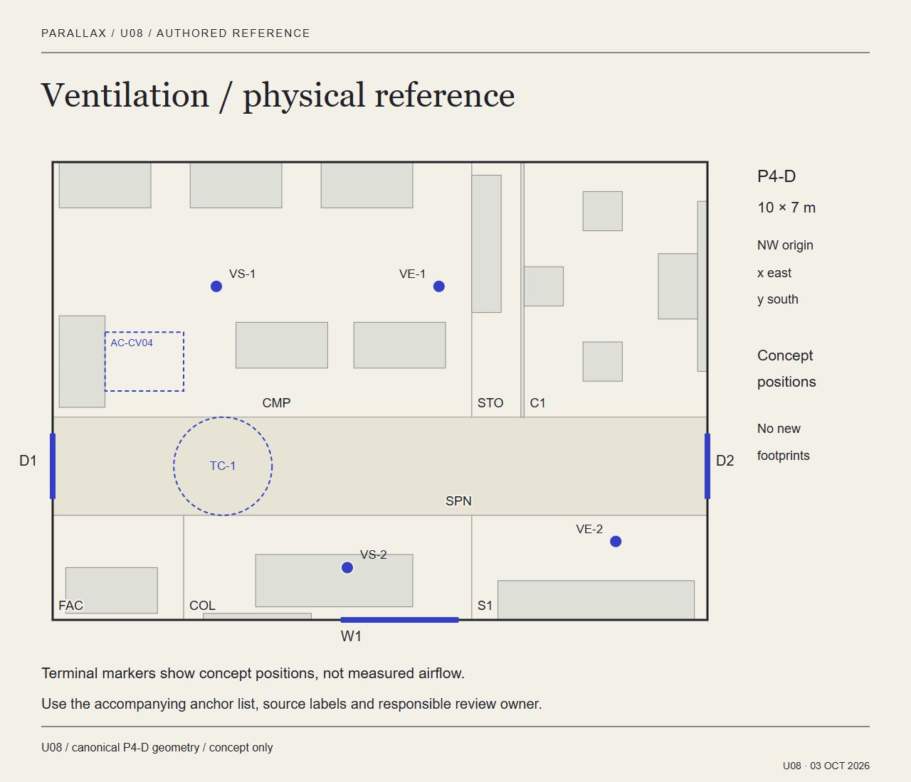
Sustainability proposals carry assumptions and owners
Watts, kWh and missing intervals have separate records.
Standby protects bookings and essential services.
Five physical specifications cover the assignment.
08 / PARALLAX / 6:25-7:20
Notes:
Timing: 55 seconds. Segment 6:25-7:20.
Show the period ledger. A gap keeps the total unknown rather than treating missing data as zero. Standby previews are upper bounds based on declared loads, without switches or measured savings. The five specifications cover lighting, ventilation, smart power, repairable furniture and traceable materials. Each names an owner and acceptance evidence. One assumed window cannot establish airflow. Sources: planning/U04_SUSTAINABILITY_SPECIFICATION.md, S09 https://www.hse.gov.uk/ventilation/using-co2-monitors.htm and S10 in research/U02_SOURCE_REGISTER.md.

Slide 9
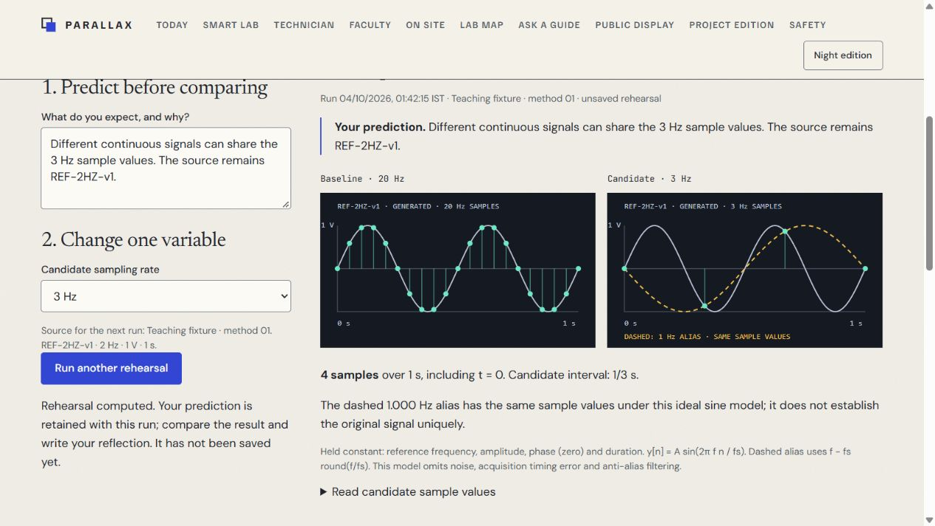
E01 reveals an ambiguous sampling choice
Reference: 2 Hz, 1 V, one second
3 Hz: four samples fit a signed -1 Hz alias
20 Hz: twenty-one samples retain the same reference
09 / PARALLAX / 7:20-8:50
Notes:
Timing: 90 seconds. Segment 7:20-8:50.
LIVE DEMONSTRATION: open E01 rehearsal. Enter a prediction, select three hertz and run. Identify the four inclusive samples and the alias that passes through them. Compare with twenty hertz while holding the reference fixed. Ask what the sample points alone cannot establish. Mention the four-hertz zero-phase boundary explicitly if asked: its values are numerically zero and remain ambiguous. These are computed teaching samples. Rehearsal is separate from the primary session. Source: prototype/fixtures.json, apps/lab-web/src/domain/rehearsal.ts and planning/U05_DELIVERY_RECORD.md. If live execution is unavailable, use the matching static demo frames.

Slide 10
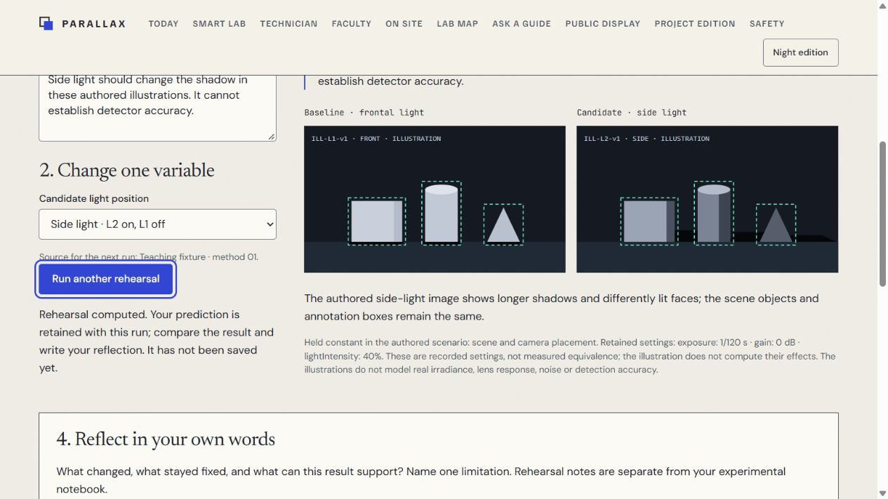
E06 asks for a bounded comparison
Two authored lighting conditions remain labelled.
The view retains the condition and source.
A student explains difference, uncertainty and next action.
10 / PARALLAX / 8:50-10:05
Notes:
Timing: 75 seconds. Segment 8:50-10:05.
LIVE DEMONSTRATION: open E06 lighting rehearsal, predict the effect of side light and reveal the authored condition. Identify the visible change and explain a limit. This is an illustration rather than detector output. Then show the retained-condition comparison path. The designer walkthrough checks whether difference, uncertainty and next action are visible. No participant comprehension or camera accuracy is claimed. Source: apps/lab-web/src/features/Conditions.tsx, apps/lab-web/src/features/Rehearsal.tsx and planning/U05_DELIVERY_RECORD.md. A narrow capture illustrates the available mobile-equivalent path.

Slide 11
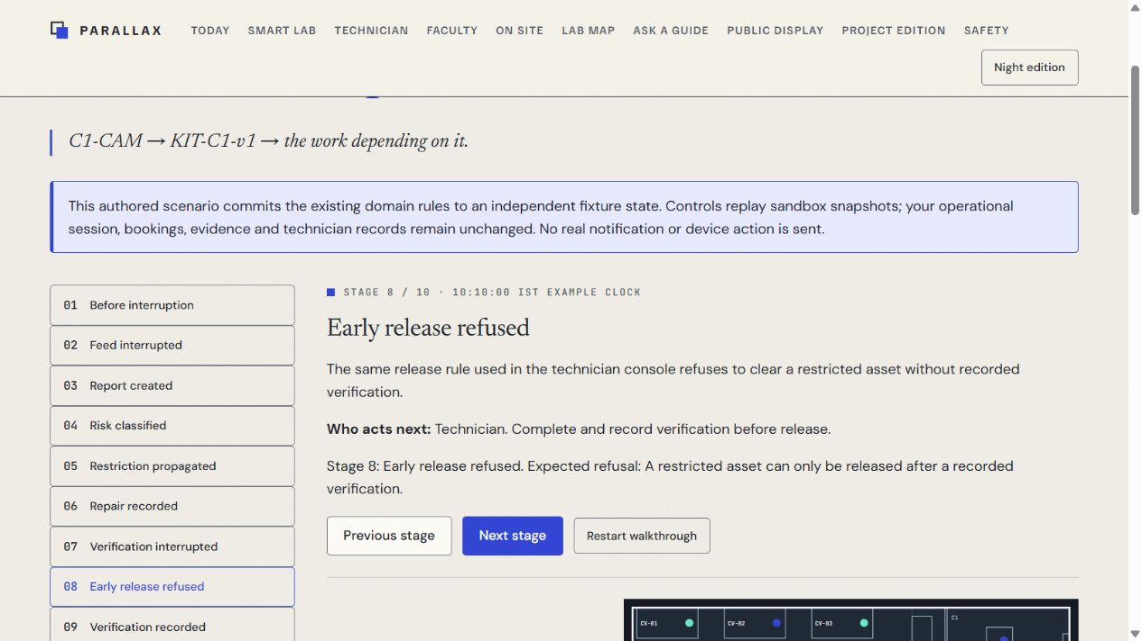
A repair keeps restrictions until verification
Report, classify and restrict the affected asset.
Retain existing student evidence through interruption.
Verify the complete requirement before restoration.
11 / PARALLAX / 10:05-11:35
Notes:
Timing: 90 seconds. Segment 10:05-11:35.
LIVE DEMONSTRATION: open the ten-stage fault walkthrough. Advance through restriction and repair into interrupted verification. Point out that starting repair or reporting a fault alone does not authorize restoration. Early release is refused. Complete the named verification requirements and inspect the public projection. The sandbox remains separate from the primary student activity. Source: apps/lab-web/src/domain/faultStory.ts, apps/lab-web/tests/u05.test.tsx and apps/lab-web/evidence/u09-audit/fault-frames.json. If the interactive app fails, the static frame player preserves this sequence.

Slide 12
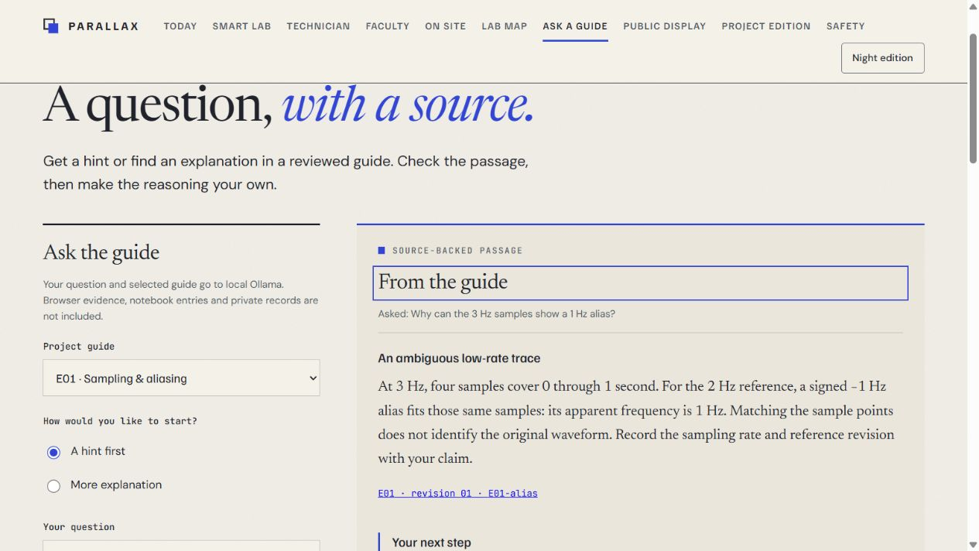
Local Ollama returns a passage with its revision
llama3.2:3b selects reviewed public-guide sections.
The server checks publication before and after inference.
Cancellation and manual reading remain available.
12 / PARALLAX / 11:35-12:50
Notes:
Timing: 75 seconds. Segment 11:35-12:50.
LIVE DEMONSTRATION: ask why three-hertz samples can show a one-hertz alias. Show the returned E01 revision 01 / E01-alias citation and the student prompt. The model selects section IDs. Reviewed source text supplies the answer wording. It receives no browser evidence, grades or live equipment state, and it has no action tools. The earlier evaluation passed thirty-nine authored cases with twenty-seven real local calls. This final check includes another real answer. It does not establish general model relevance or learning. Source: planning/U06_DELIVERY_RECORD.md, apps/lab-server/README.md and apps/lab-web/evidence/u09-final/assistant-answer.txt.

Slide 13
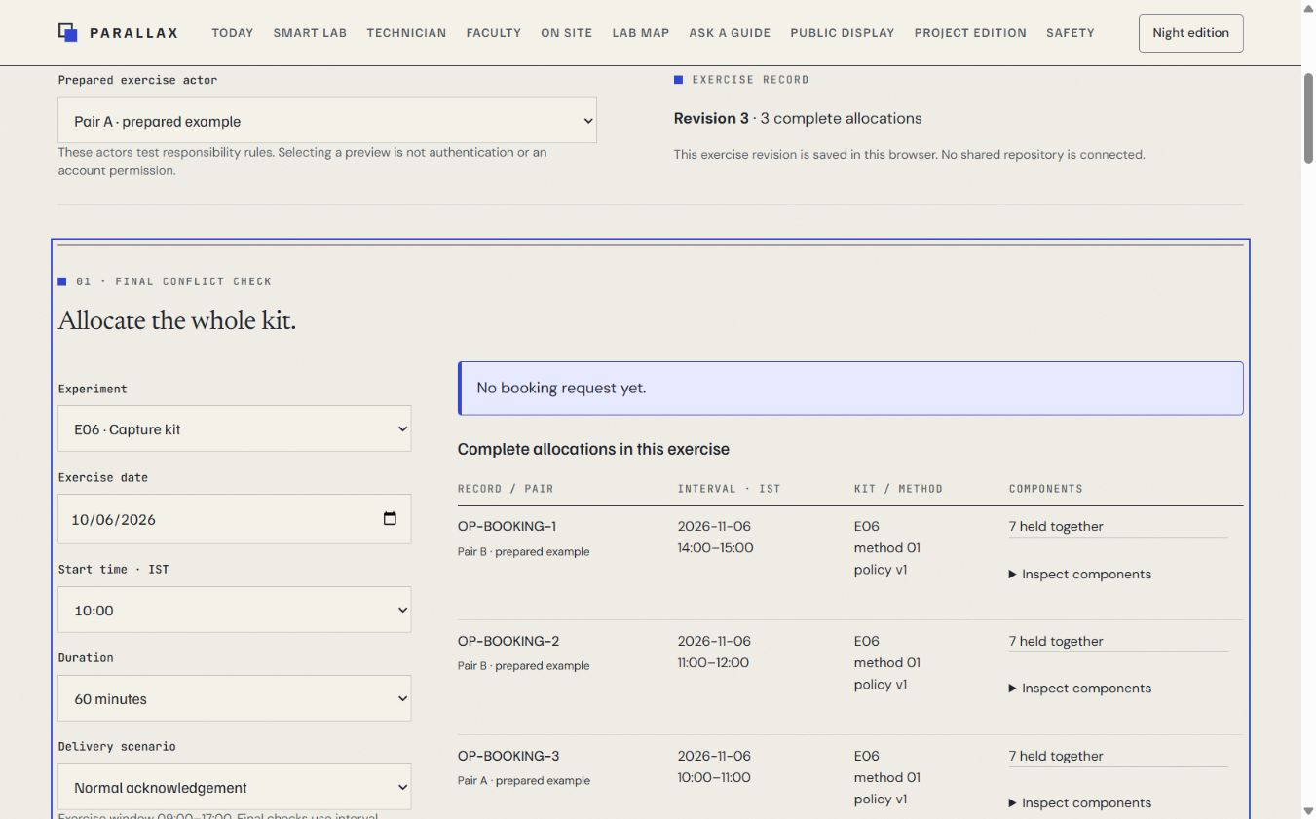
The operations exercise preserves complete dependencies
Competing requests serialize in a local repository.
Retries keep a stable request and allocation identity.
Offline drafts revalidate before allocation.
13 / PARALLAX / 12:50-13:50
Notes:
Timing: 60 seconds. Segment 12:50-13:50.
Show the independent operations desk and its saved request lookup. Mention both lights in the complete C1 manifest. Explain that a draft cannot overwrite a slot taken before its revalidation. Versioned policy can pause a new method while retaining an existing session's evidence. These are local exercise rules. A shared authenticated database, cross-device concurrency and institutional approval remain separate integrations. Source: planning/U07_DELIVERY_RECORD.md and apps/lab-web/tests/u07.test.tsx. Public projection excludes private request actors and internal details.

Slide 14
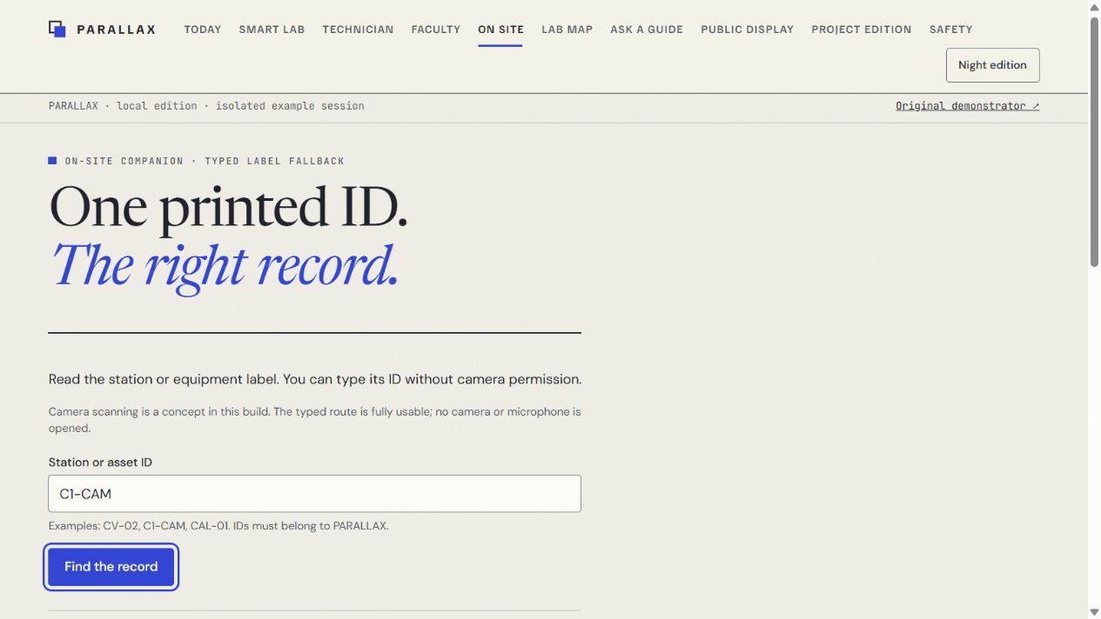
The final checks retain the original behavior
139 React tests and 16 service tests pass.
Eight scene remounts retain stable renderer counters.
Keyboard, narrow layout and exact-text export have fresh evidence.
14 / PARALLAX / 13:50-14:30
Notes:
Timing: 40 seconds. Segment 13:50-14:30.
Explain the final refinement: the typed lookup now uses sixteen-pixel text and a forty-four-pixel control. Route changes discard stale QA results. Generated scene copies own cleanup without altering scientific calculations. Thirty-six local two-frame feedback samples stayed below twenty-six milliseconds. These are scoped technical observations. Spoken screen-reader use, actual zoom, second-browser/device checks and native download confirmation remain open external checks. Source: planning/U09_DELIVERY_RECORD.md and apps/lab-web/evidence/u09-final. Avoid presenting an automated scan as accessibility certification.

Slide 15
One current entry opens the whole submission
Working app, report, editable deck and source evidence
Figma designs, Blender model and static demonstration
Clear local scope and an explicit external verification list
15 / PARALLAX / 14:30-15:00
Notes:
Timing: 30 seconds. Segment 14:30-15:00.
Open submission/index.html and identify the live app, report, Figma, source and backup demo links. Close with the supported contribution: an inspectable physical/digital proposal and preserved evidence/recovery boundaries. The team must add truthful names and contributions before institutional submission. The deck schedule totals fifteen minutes. An automated playback is a technical timing check, while a human presenter must rehearse actual delivery. Source: submission/README.md, submission/EVIDENCE_INDEX.md and submission/EXTERNAL_CHECKS.md.

