Slide 1
CUSTOMER RETENTION PROJECT
Data Visualization Project

Slide 2
REPORT
We will take few important parameters from the dataset to arrive at certain conclusions about the “Customer Retention Project”.
The important attributes/parameters we have chosen for the analysis are listed below,
Age of the Customer.
City of Shopping.
Type of Internet Used for the Shopping.

Slide 3
Important parameters continued.......
Mode of Payment for online Shopping.
Loading Speed of the website
Longer Delivery Periods
Fastest Order Delivering Store
Restricted Payment Options
Efficient Website
Online Retailer Recommendation.

Slide 4
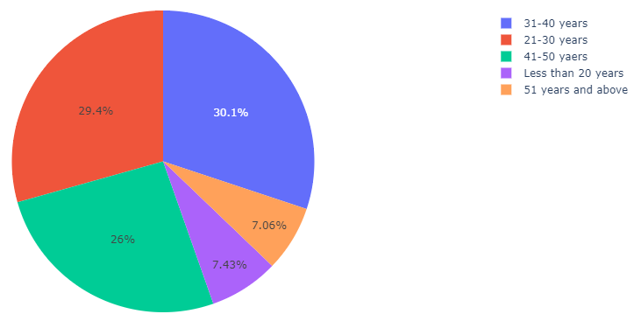
Age of the Customer.
Most of the customers are from 31-40 years age group followed by the 21-30 years age group.
On third position we have 41-50 years old age group.
Very Few people are from the 51+years old group and less than 20 years old group.

Slide 5
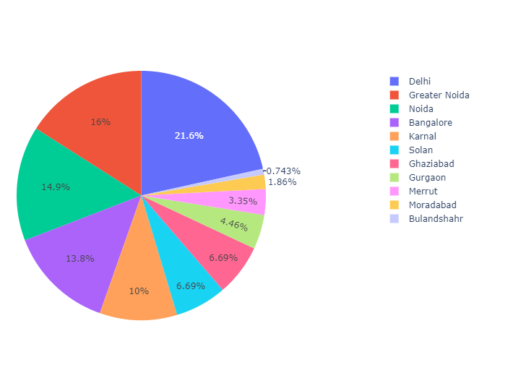
City of Shopping.
List of the Cities according to the number of product orders from cities in Descending order .
1.Delhi
2. Greater Noida
3.Noida
4.Bangalore
5.Karnal
6.Solan
Most orders are from the Delhi followed by the Greater Noida.
Least number of orders are from the Bulandshahr followed by the Moradabad.

Slide 6
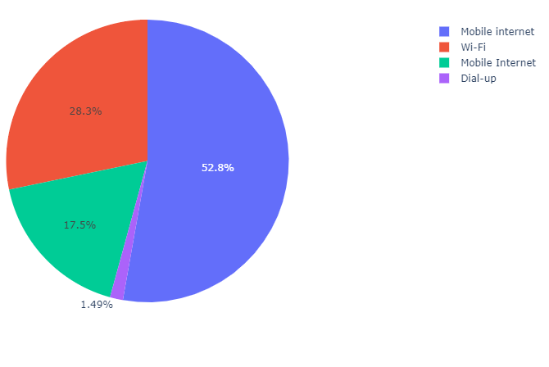
Type of Internet Used for the Shopping.
Mobile-Internet is the most common internet source used by the customers for the online shopping.
After the Mobile-Internet ,comes Wi-Fi at second number as the source of internet for the online shopping.

Slide 7
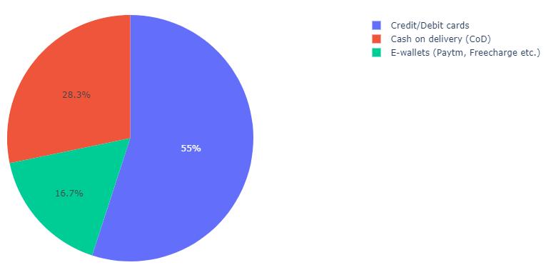
Mode of Payment for online Shopping.
Credit/Debit Cards are the most favorite choice of the customers for the payment option.
Cash on Delivery comes at the second number.
E-wallet is the least common method for the payment method.

Slide 8
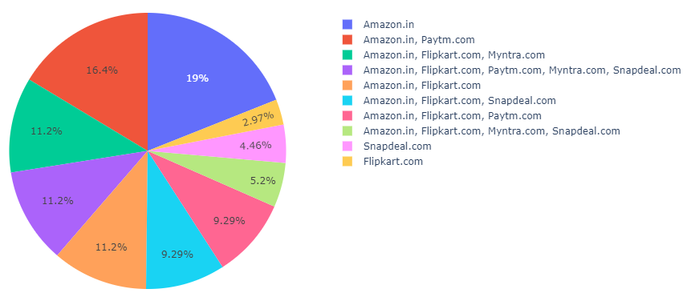
Loading Speed of the website
Most People voted for the Amazon for the fastest loading website.
We have listed the website name according to their loading speed:-
1.Amazon.in
2.Paytm.com
3.Flipkart.com
4.Myntra.com
5.Snapdeal.com

Slide 9
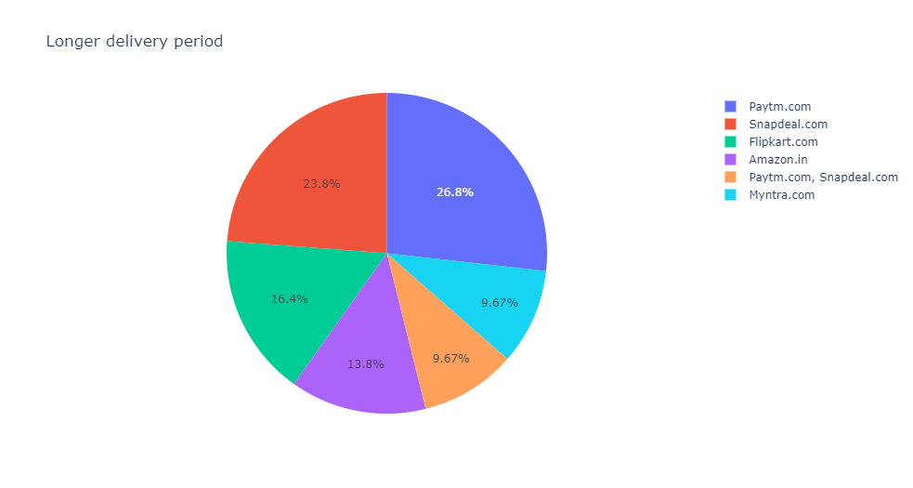
Longer Delivery Periods
Most lately delivering online retail store is “Paytm.com”.
We are giving the list of the online retail store according to their longer delivery periods:-
1.Paytm.com
2.Snapdeal.com
3.Flipkart.com
4.Amazon.in

Slide 10
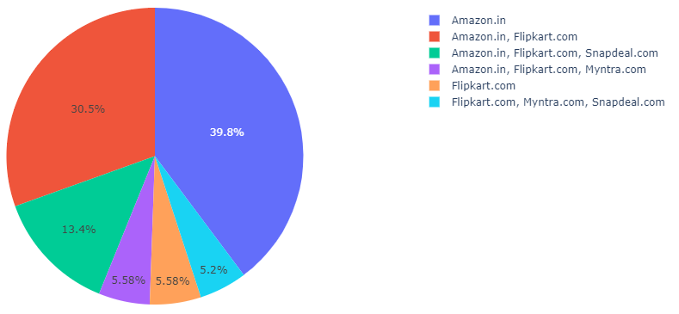
Fastest Order Delivering Store
Fastest order delivering website is the “Amazon.in” followed by the “Flipkart.com”.
Slowest order delivering website is the “Snapdeal.com” followed by the “Myntra.com”.

Slide 11
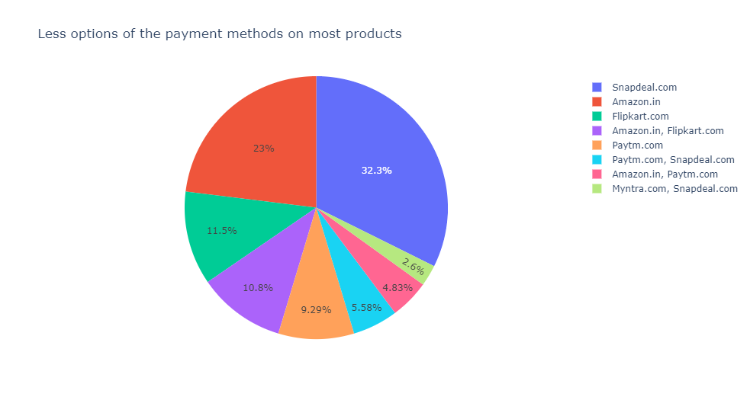
Restricted Payment method Options
Website which offers many payment method restrictions on most of the products are in the following order.
1.Snapdeal.com
2.Amazon.in
3.Flipkart.com
4.Paytm.com
5.Myntra.com

Slide 12
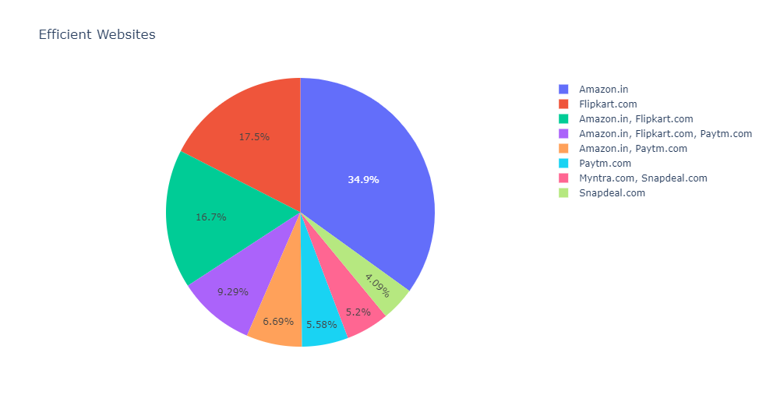
Efficient Website
Data says most Efficient Website is “Amazon.in”
After Amazon its “Flipkart.com”
Least efficient website is “Snapdeal.com”.

Slide 13
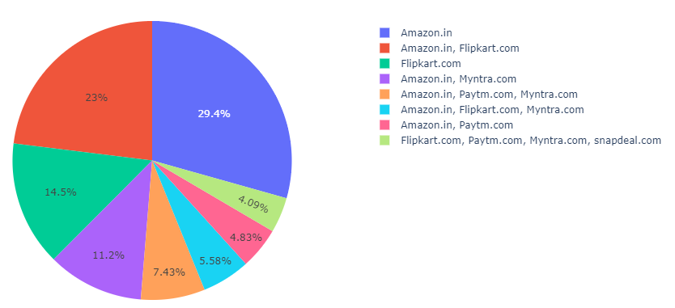
Online Retailer Recommendation.
Most people are recommending the “AMAZON.IN” to others.
After Amazon people’s favorite is “FLIPKART.COM”.
Least recommended website is “SNAPDEAL.COM”.

Slide 14
Insights/inferences
Amazon.in is the peoples favorite choice for the online shopping ,since it is offering the sales of its products with various additional benefits like “Fastest delivering orders", "Fastest loading and responsive website", "More products are available for any section of item” etc.
Flipkart is also performing good but it comes after the Amazon.
Least rated online retailer companies are Snapdeal.com and Paytm.com ,very less proportion of the population are following them due to the various reasons like “Very long delivery periods", "Slow loading website", "Less varieties of the products are listed on them” etc.

