Slide 1
Business insights
(IPL Data)

Slide 2
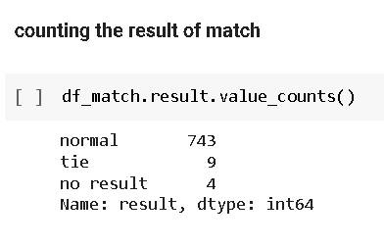
At first I have calculate the total number of type of result so that I can get the overview of the match , and I got three type of result
Normal
Tie
No result
Only 9 matches are tie and 4 match have no result rest matches are normal.

Slide 3
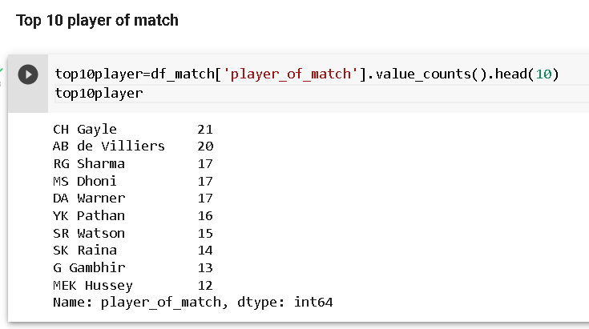
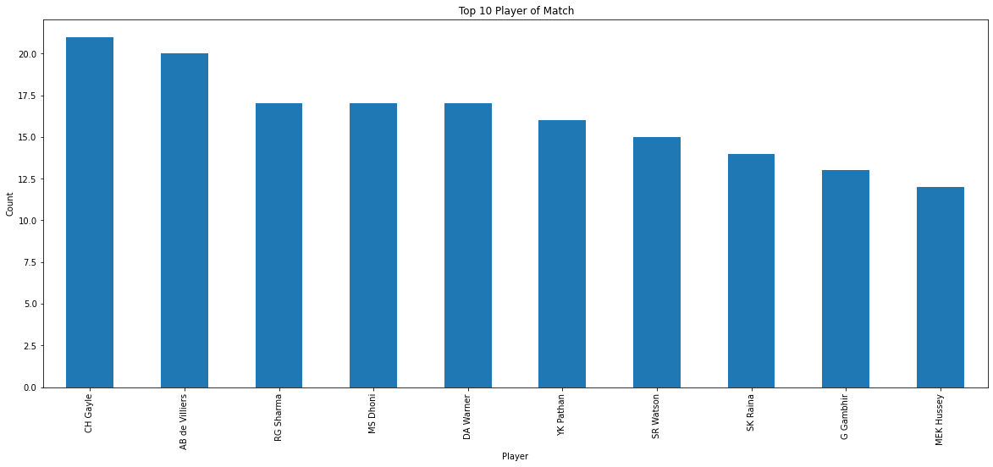
After finding the match overview ,I have find our top 10 player that played well, so CH Gayle and AB de Villiers did it very well. CH Gayle and AB de Viliers have been the two standout match-winners for their teams in the 12 seasons so far. They have won the player of the match award 21 and 20 times respectively.

Slide 4
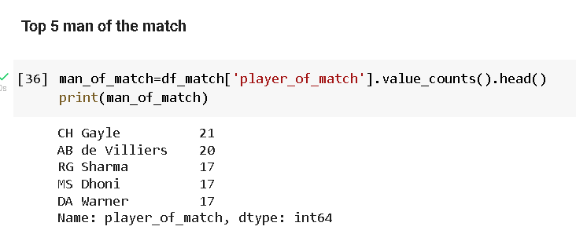
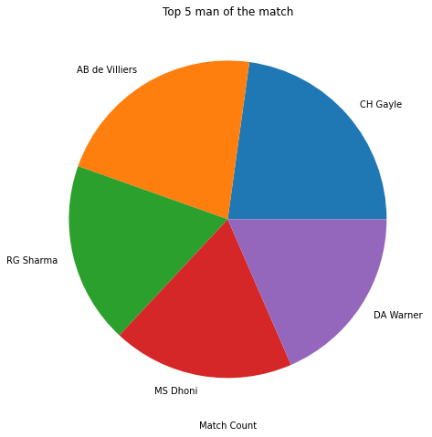
After finding the Top 10 player I have calculated the top 5 man of the match who played very well and I got,
CH Gayle, AB de Villiers , RG Sharma , MS Dhoni , and DA Warner .
Out of these 5 players CH Gayle the one who got 21 times man of the match.

Slide 5
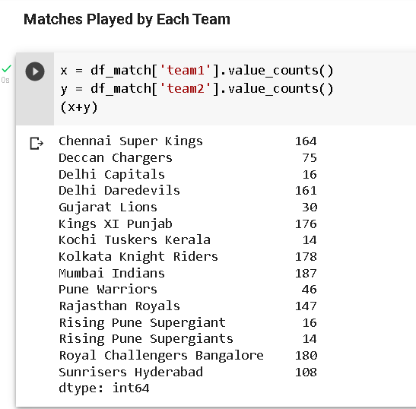
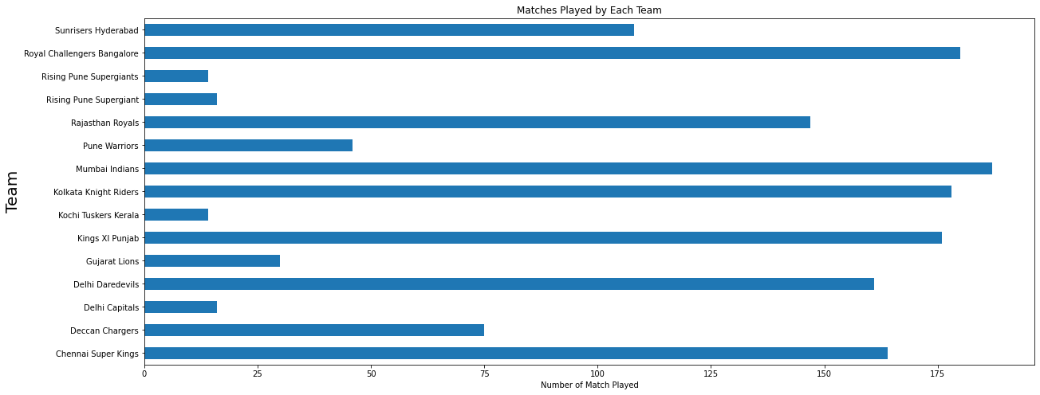
if we talk about the no of matches played by each team we can see that Mumbai Indians have played maximum number (187) of matches and Due to the brief expansion , change of owners, removal and banning of teams, there have been 15 teams who have played in the IPL.

Slide 6
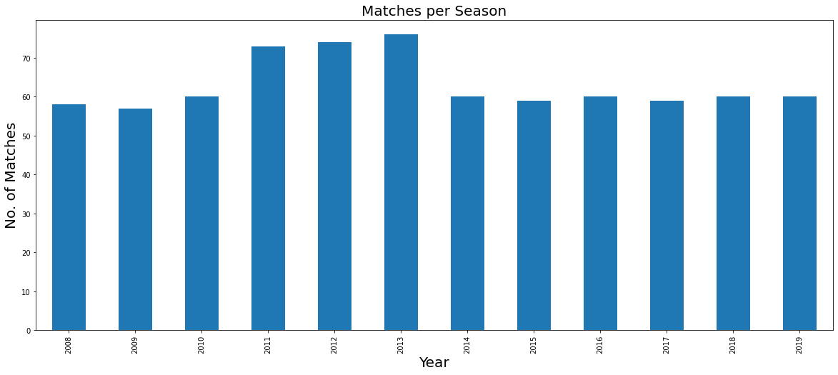
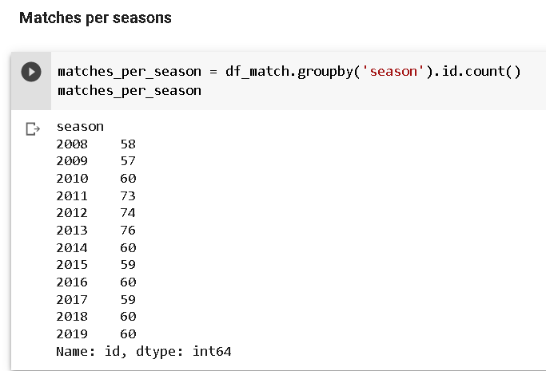
The maximum number of matches had been played in year 2013 , and least matches had been played in 2009.
In 2010,2014,2016,2018,2019 the number of matches are same (60) matches per year

Slide 7
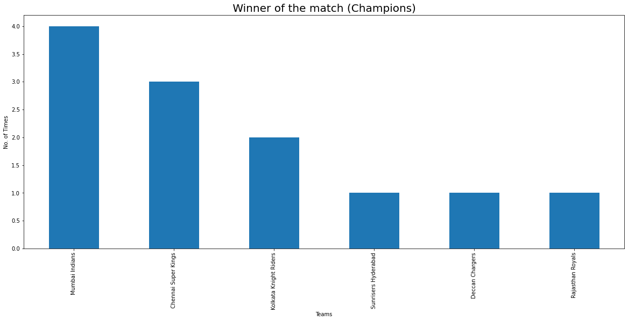
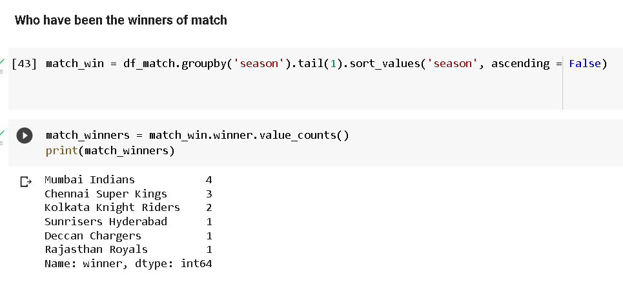
Throughout the season the Mumbai Indians are the champions or winner of the match
Out of 12 matches Mumbai Indian wins 4 and got the ranked 1 followed by Chennai super king with 3 win

Slide 8
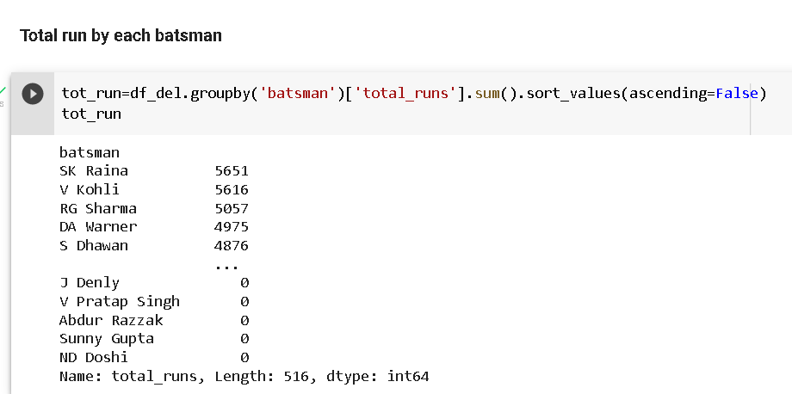
The total runs of each batsman is represented throughout the whole season of IPL where ,
SK Raina scored the maximum run of (5651) and followed by virat kolhi (5616) runs and RG sharma (5057) runs and
DA warner and Shikhar Dhawan.

Slide 9
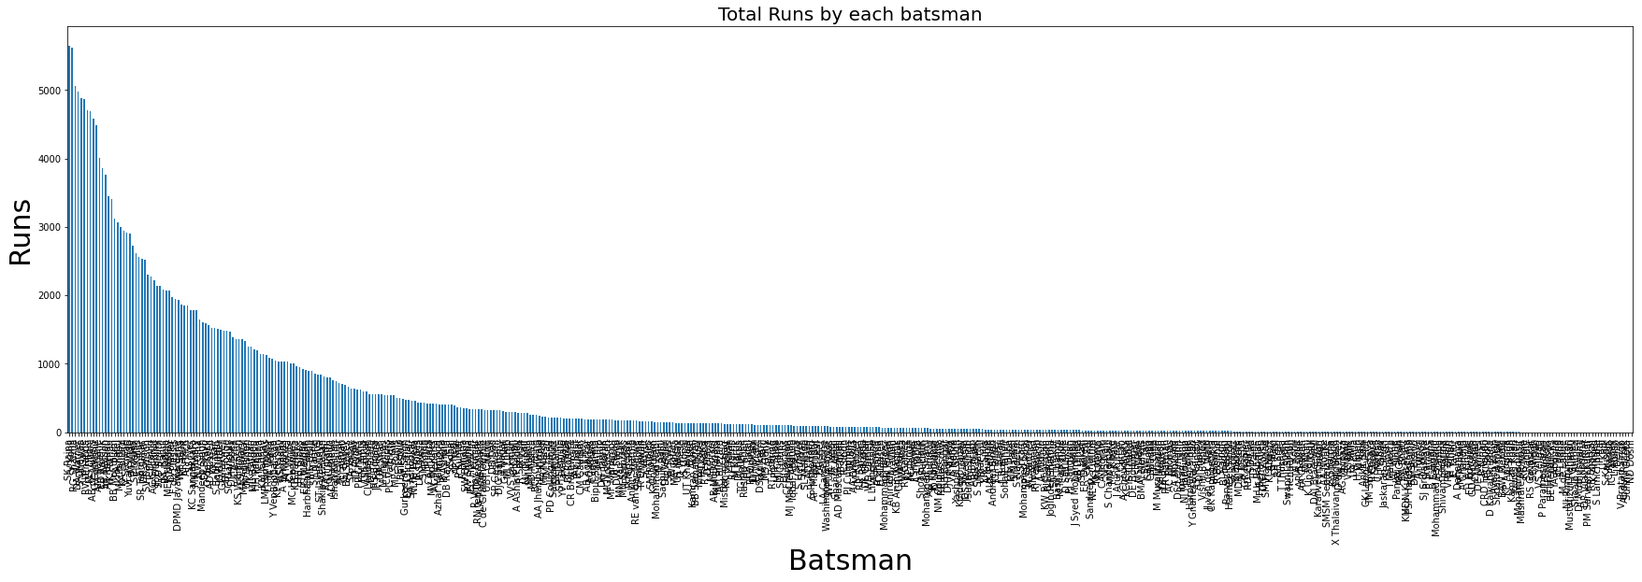
This is the graphical illustration of the total runs of the each batsman in every seasons

Slide 10
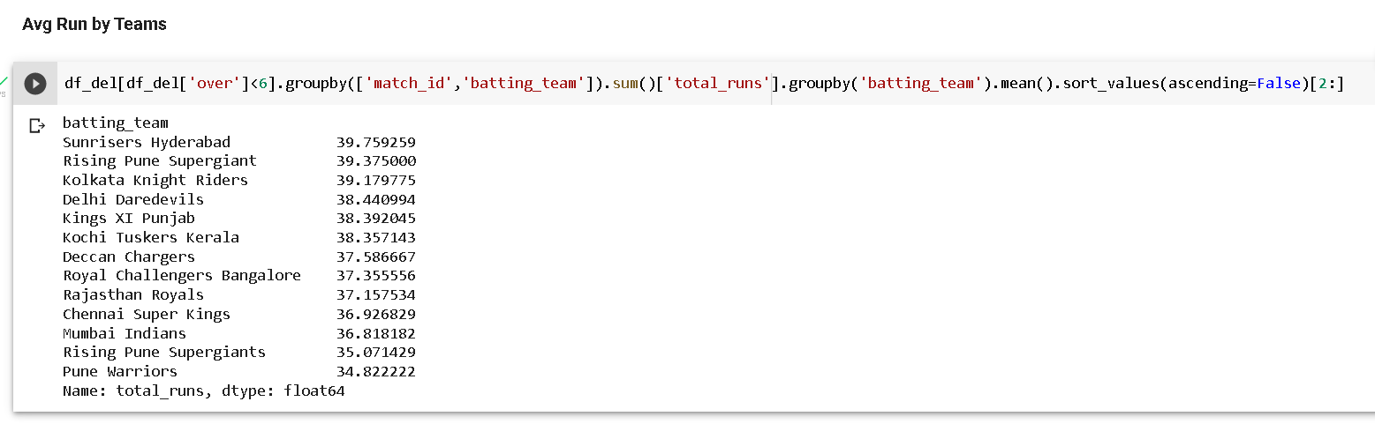
Sunrisers Hyderabad has the best average in the powerplay with an average of 40 runs followed RPS(rising pune supergiant).

Slide 11
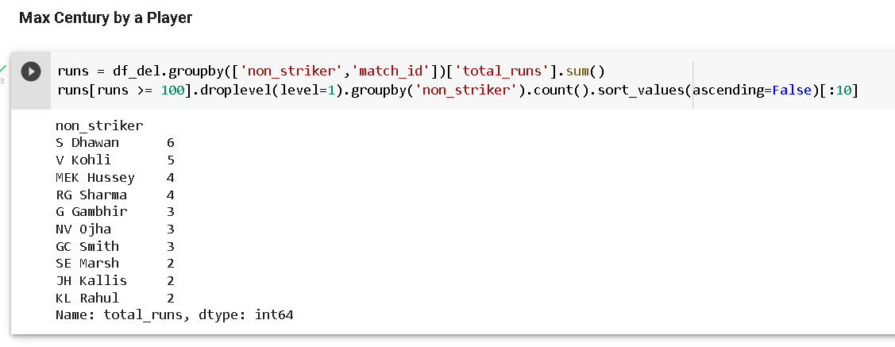
Shikhar Dhawan is at the top of the list in scoring the most number of centuries in IPL history. He has hit six tons and has scored 4876 runs in IPL.
His former teammate Virat Kohli has scored five hundred’s and he is at the second spot in the list followed by MEK Hussey ,RG Sharma,G Gambhir and NV ojha
This can be calculated by grouping the columns non_striker and match_id and then calculating the sum.

Slide 12
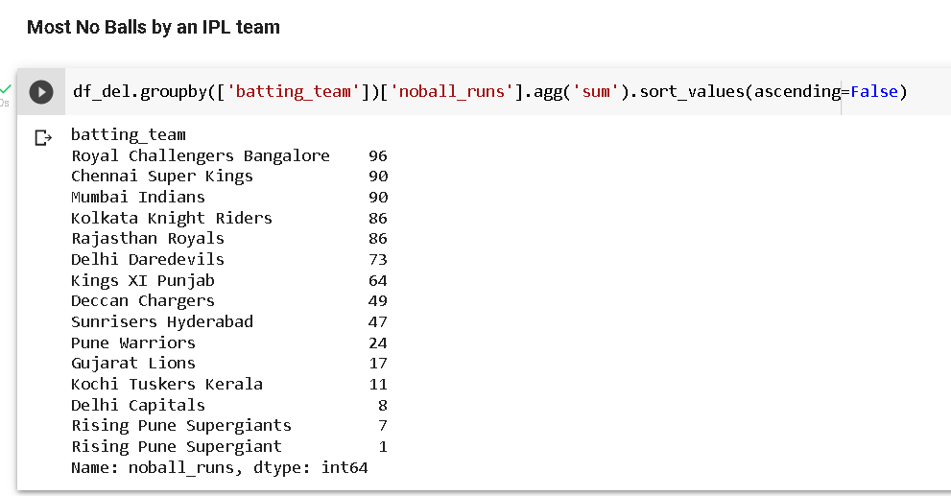
Royal Challengers Bangalore has given most no balls i.e 96 followed by Mumbai Indians and Chennai Super Kings (90)

Slide 13
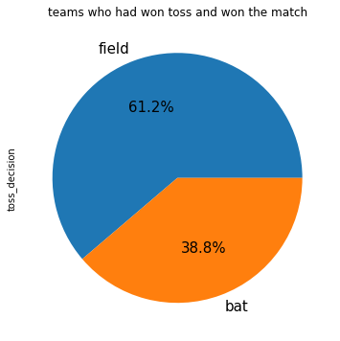
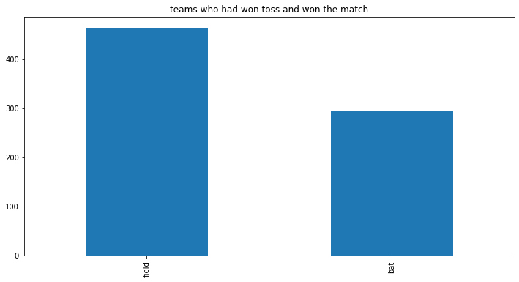
As per data if the team select the fielding after winning the toss the chances of winning will increase.
In the most of the matches maximum team select to field first (61.2%)
Rest 38.8% select to bat first .
The winning percentage after toss is when the team select to field as compare to bat because they can analyse how much run they need to win and can update their strategy.

Slide 14
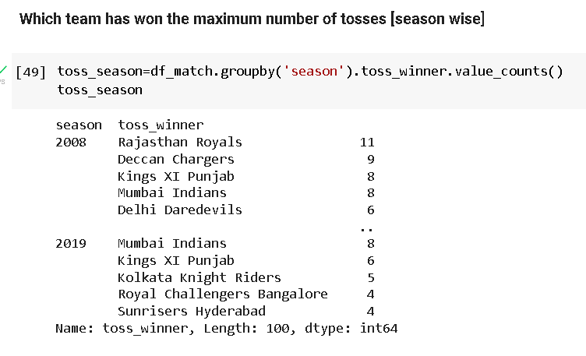
Kolkata and Mumbai in 2013 and Chennai in 2019 have won the most no. of tosses in a season - 12.
Except 2012, 2015 and 2019, the IPL winning teams have been amongst the top two in terms of toss win percentage. In 2012 and 2015, Kolkata Knight Riders and Mumbai Indians were 6th best (won 7) in winning tosses while in 2019 Mumbai were 4th best (won 8).

Slide 15
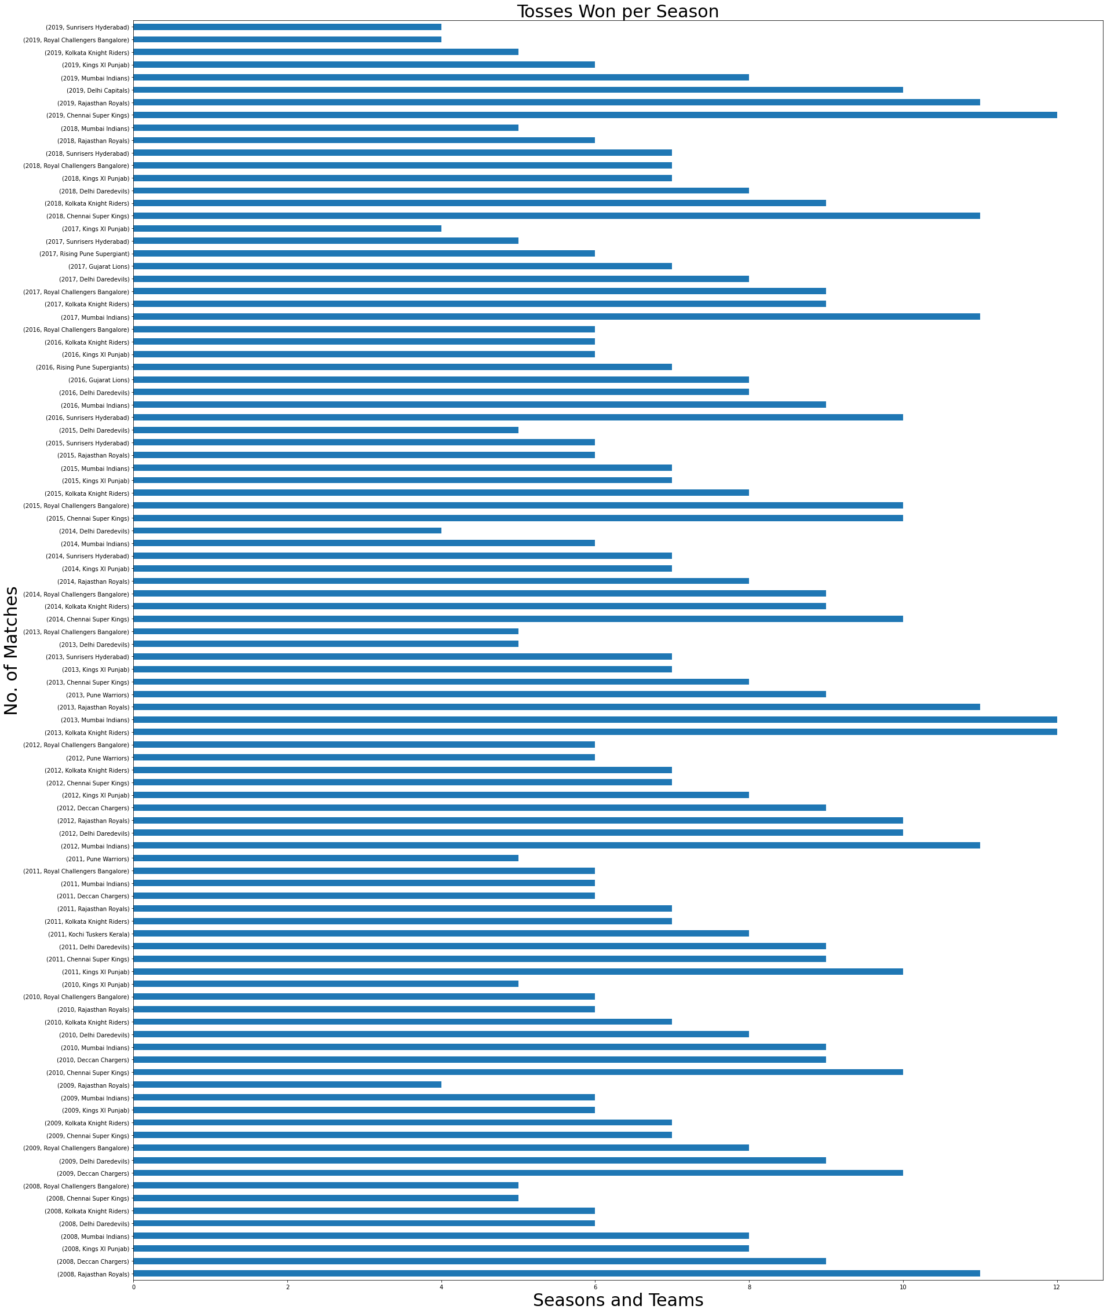

Slide 16
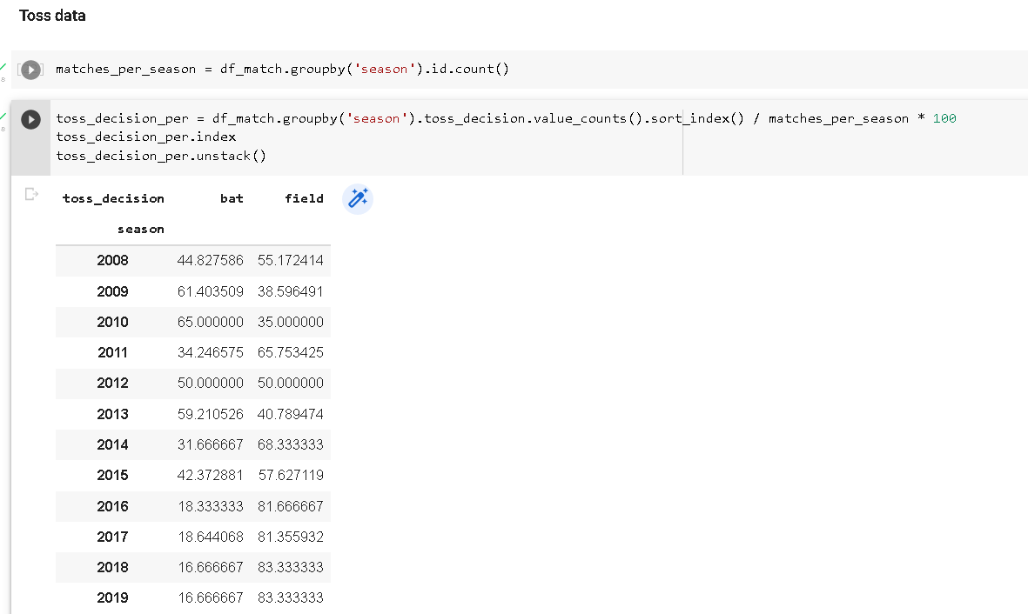
For 2008-2013, teams seem to have been favoring both batting first and second. However, since 2014, teams have overwhelmingly chosen to bat second. Especially since 2016, teams have chosen to field for more than 80% of the times, the percentage of times batting first was chosen is more in seasons 2009, 2010 and 2013.
With the use of data analysis and an increasing trend in ODIs to bat second as there is a fixed target to achieve, teams chose more and more to bat first.
This made the batsmen tasks easier as they could now have a clear thought of how to scale the target put in front of them.

Slide 17
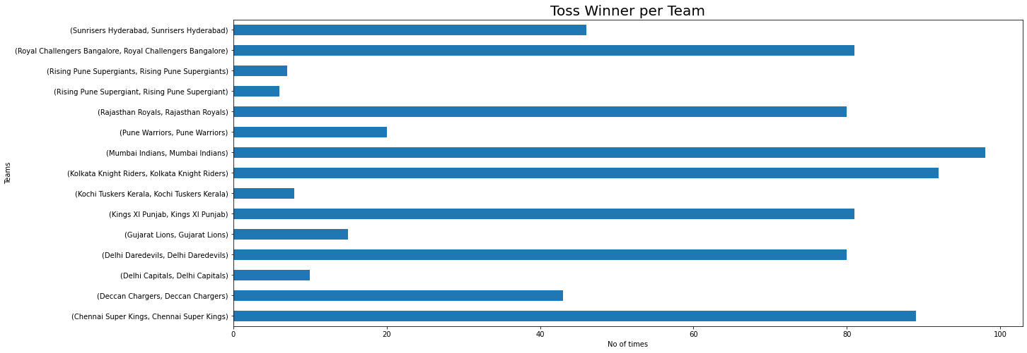
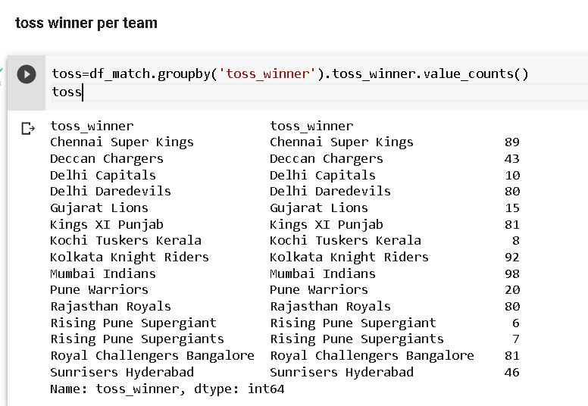
Mumbai Indians and Kolkata knight rider wins the maximum toss
Mumbai Indian wins 98 tosses and Kolkata knight rider wins 92 toss and then Chennai super king,royal challenger bangalore, Rajasthan Royals and Delhi daredevils.
Rising pune Supergiant are the most toss loosing team this team only wins at 6 and 7 times out of 98 tosses

Slide 18
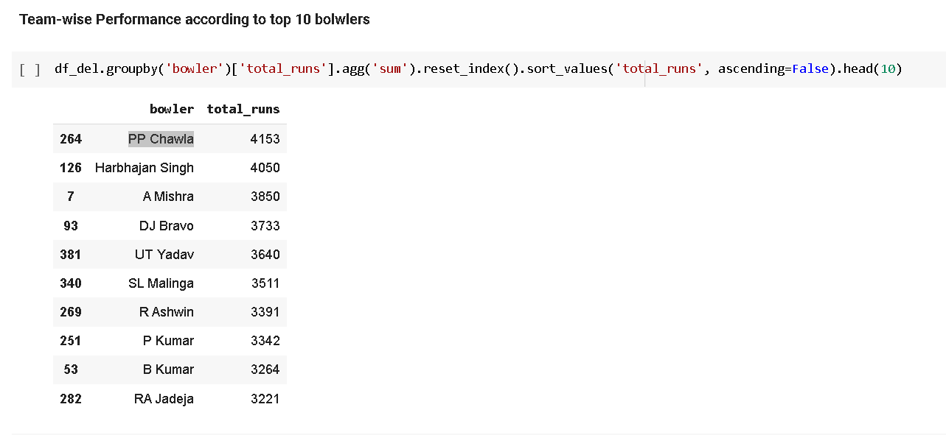
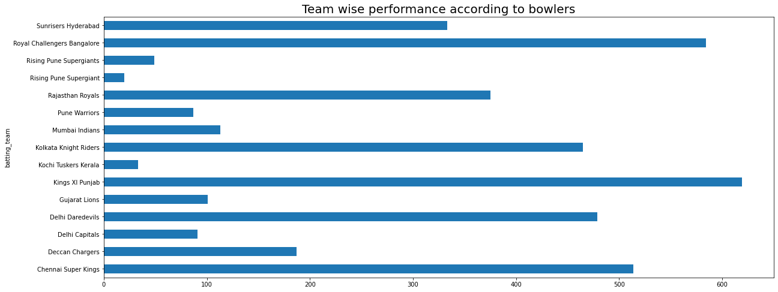
The maximum runs given by bowler PP Chawla-(4153) but if we take bowler as Harbhajan Singh then the team which perform well is Kings XI Punjab and then followed by Royal Challenger Bangalore.

Slide 19
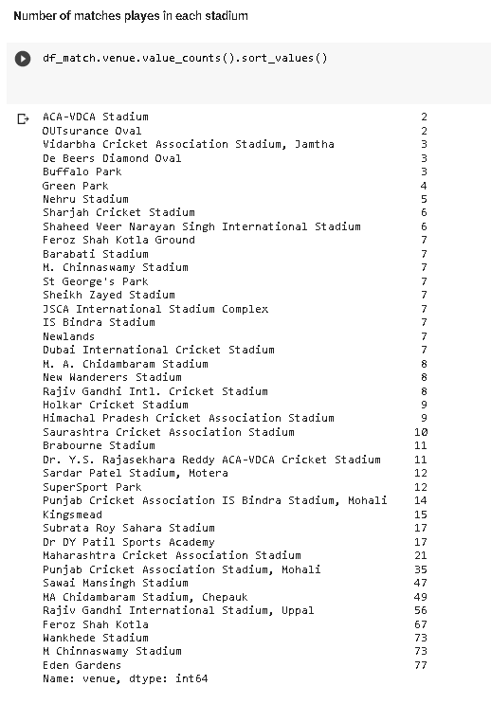
The maximum number of matches are played in Eden Garden and followed by M Chinnaswamy Stadium and Wankhede Stadium.
The minimum number of matches are played in ACA-VDCA Stadium.
The average 7 matches are played in these stadium- Feroz Shah Kotla Ground, Barabati Stadium, M. Chinnaswamy Stadium , St George's Park , Sheikh Zayed Stadium, JSCA International Stadium Complex, IS Bindra Stadium , Newlands , Dubai International Cricket Stadium
The average 8 matches are played in these stadium - M. A. Chidambaram Stadium, New Wanderers Stadium and Rajiv Gandhi Intl. Cricket Stadium.

Slide 20
Though teams have overwhelmingly chosen to field first, the win percentage after choosing to bat or field is not that one-sided. However, their difference is on the rise.
Chennai and Mumbai are the two teams with the highest win percentage. The fact that they are the only two teams that were part of the first season as well, in the top 5, shows their dominance.
Mumbai Indians have played the most no. of matches in the IPL. Due to the brief expansion , change of owners, removal and banning of teams, there have been 15 teams who have played in the IPL.
Mumbai Indians have the won the IPL 4 times, the most. They are followed by Chennai at 3 and Kolkata Knight Riders at 2. Sunrisers Hyderabad, Deccan Chargers and Rajasthan Royals complete the IPL Champions list, all winning once each.
For the first six seasons (2008-2013), teams were figuring out whether batting first or chasing would be better after winning the toss. This could be down to the fact that the IPL and T20 cricket, both were in their early stages where teams were trying different strategies.
since 2014, teams have preferred chasing, especially in the past 4 seasons (2016-2019), where teams have chosen to field more than 4 times out of 5. This can be put down to the fact that having a set total to chase makes things simpler. This can also be a result of teams preferring to chase in ODIs as well.
Except 2012, 2015 and 2019, the IPL winning teams have been amongst the top two in terms of toss win percentage every season. In 2012 and 2015, Kolkata Knight Riders and Mumbai Indians were 6th best (won 7) in winning tosses while in 2019 Mumbai were 4th best (won 8).
Eden Gardens has hosted the most no. of matches so far. S Ravi has umpired the most no. of matches till now.
There have been 80 matches (excluding the ties) where the margin of victory has been 10 runs or less. This is pretty close since 10 runs is basically two boundary shots away.

