Slide 1




CIT OPEN SOURCE CLUB
Hands-On Session Series - 1
Introduction to Ansible

Slide 2

Agenda
Highlights
CIT OPEN SOURCE CLUB
What is Ansible
Advantages of Ansible
Ansible Use-Cases
Architecture of Ansible
Playbooks
Handson session
o your investors, such as KPIs, updates, and asks.

Slide 3

What is Ansible
Highlights
CIT OPEN SOURCE CLUB
Ansible is an open-source configuration management and provisioning tool.
Ansible lets you to control and configure nodes from a single machine.
Ansible uses SSH to connect to server and run the configured task
Introduce the general updates you will be reporting
on to your investors, such as KPIs, updates, and asks.

Slide 4
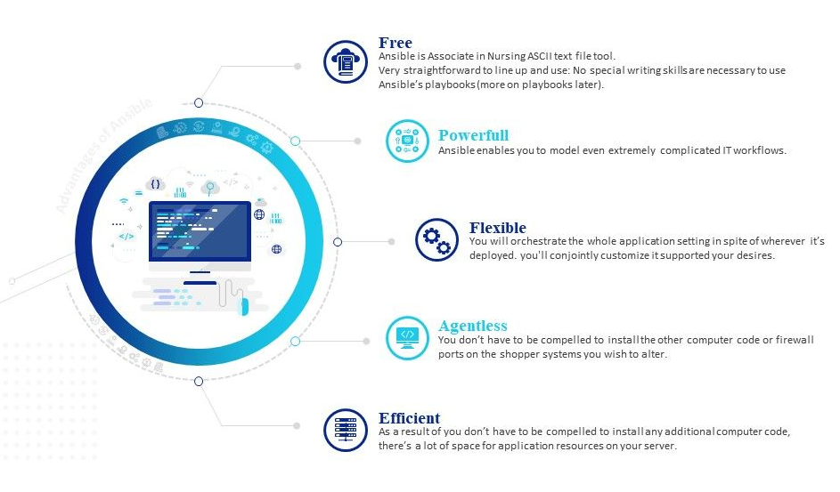
Advantages of Ansible
Highlights
CIT OPEN SOURCE CLUB
Introduce the general updates you will be reporting
on to your investors, such as KPIs, updates, and asks.

Slide 5

Ansible Use - Cases
Highlights
CIT OPEN SOURCE CLUB
Provisioning
Configuration Management
App Deployment
Continuous Delivery
Security & Compliance
Orchestration
Introduce the general updates you will be reporting
on to your investors, such as KPIs, updates, and asks.

Slide 6
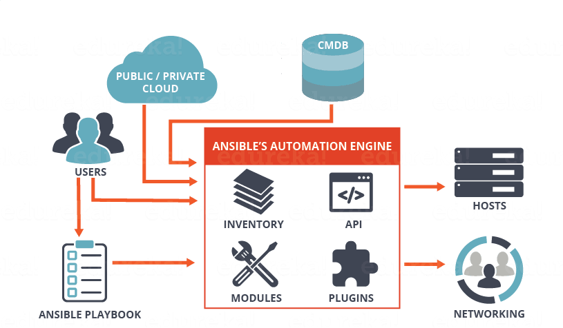
Architecture of Ansible
Highlights
CIT OPEN SOURCE CLUB
Introduce the general updates you will be reporting
on to your investors, such as KPIs, updates, and asks.

Slide 7

Playbook
Highlights
CIT OPEN SOURCE CLUB
Playbooks are simple YAML files. These files are simple to write and maintain and there are written in natural language.
Playbook contains Plays.
Plays contain tasks.
tasks call modules.
Introduce the general updates you will be reporting
on to your investors, such as KPIs, updates, and asks.

Slide 8
Example of Ansible
Highlights
CIT OPEN SOURCE CLUB
Create yaml file
---
- hosts: all #server host or group name
become: yes
tasks:
- name: install apache2
apt: name=apache2 update_cache=yes state=latest
Run the file:
ansible-playbook filename.yaml
Introduce the general updates you will be reporting
on to your investors, such as KPIs, updates, and asks.

Slide 9

Companies that are using Ansible
Highlights
CIT OPEN SOURCE CLUB
Introduce the general updates you will be reporting
on to your investors, such as KPIs, updates, and asks.

Slide 10









CIT OPEN SOURCE CLUB
Workshop on Cloud Computing and Devops
Contact Us
www.opensource.cittumkur.org
citopensource@gmail.com
citoss@cittumkur.org
PROJECTS

