Slide 1
ORCA-EMS
MID-TERM PROJECT · INTELLIGENT AGENTS AND MULTI-AGENT SYSTEMS
Can AI agents that negotiate route ambulances and share hospital capacity better than fixed rules?
Orchestrated Response and Capacity Allocation · OpenAI Agents SDK · gpt-4o-mini
github.com/pranavpatel0741/ORCA-EMS
Notes:
Introduce the project in one sentence: a simulated town where AI agents coordinate ambulances and hospitals during emergencies. The question is not whether agents can talk, but whether their talking improves outcomes compared with fixed rules. Everything is on the public GitHub repo, including every model answer, so the results can be checked.

Slide 2
The nearest ER is not always the right ER
THE PROBLEM
Ambulances usually go to the nearest ER, even when it is full.
A full ER causes offload delay: the crew waits with the patient and the ambulance is out of service.
In a mass-casualty incident the nearest hospital floods while others still have beds.
Status boards are self-reported, refresh every 15 minutes or so, and cannot negotiate.
RESEARCH QUESTION
When does negotiation between AI agents improve emergency coordination, and when are rules enough?
H1
Negotiation reduces conflicts and capacity failures.
H2
Negotiation gets critical patients to care faster under scarcity.
H3
The benefit is larger in a surge and with incomplete information.
Notes:
Explain offload delay: a crew cannot leave until the ER takes the patient, so a crowded ER also removes ambulances from service. In a mass-casualty event the nearest hospital gets overwhelmed while others have space. Real status boards show information but cannot negotiate. That gap is what the agents try to fill, and these three hypotheses are what I tested.

Slide 3
A fictional town of 50,000, sized from U.S. per-capita ratios
SIMULATED ENVIRONMENT
4
22
4 + 2
2
hospitals: two trauma centers, a community hospital, a private hospital
ER beds and 114 ward beds; patients board in the ER when wards are full
city ambulances plus 2 private units through mutual aid
trauma surgical teams; nurses with coverage limits, lendable between hospitals
First responders: police secure violent scenes; fire crews free trapped victims.
Patients: severity, needs, and a synthetic survival curve that falls with time to care.
Same seed, same calls, patients and hospital load.
Complete info live hospital capacity; victim counts known at the call.
Partial info status board refreshed every 15 min; victim counts known only after the first unit reports.
Notes:
The town is small on purpose so it can be run many times. Resource counts come from national per-capita averages, scaled to 50,000 residents. All data is synthetic and seeded, and assumptions are in ASSUMPTIONS.md. The important design choice is the two information settings: with partial information, hospital capacity is only updated every 15 minutes, like a real status board.

Slide 4
Four agent roles that talk in structured messages
AGENTS · OPENAI AGENTS SDK · TYPED OUTPUTS
1
Assessment
2
Dispatch
3
Hospital A–D
4
Allocator
Reads calls and scene reports; estimates urgency and victims.
Assigns ambulances and proposes a hospital per patient.
One per hospital; checks its own beds and nurses.
Settles conflicts between dispatch and hospitals.
→ priority report
→ PROPOSE
→ ACCEPT · COUNTER · REJECT
→ final assignment
// real answer from Hospital A's agent (gpt-4o-mini)
sender hospital_A recipient dispatch
type COUNTER incident MCI-2
accepted MCI-2-P08
counter "We can accept MCI-2-P09, but only if
we receive additional nurse coverage"
nurses requested 2
Every message has sender, recipient, type, incident ID and proposed action.
Each agent sees only what its role would know.
Answers are checked against what the agent was shown.
Notes:
These are the four roles the brief asks for, built with the OpenAI Agents SDK and typed outputs, so every answer has a fixed structure. The example is a real answer from the Hospital A agent during the bus crash: it accepts one patient and counters on the second unless it gets two more nurses. That nurse request then becomes a negotiation with the other hospitals.

Slide 5
Propose, reply, resolve, with rules as a safety net
NEGOTIATION AND SAFETY
↺ counter → revised proposal, up to 3 rounds
Dispatch
Hospital
Allocator
Safety check
Execute
proposes
accept · counter · reject
resolves conflicts
rules R1–R9
risky decisions → human review
Contract Net, adapted
Safety rules on every decision
Labeled rule backup
The classic announce / bid / award protocol becomes propose / counter / resolve.
Critical patients ride alone and go to trauma centers; no entry to unsecured scenes; minimum nurse coverage.
If an answer is unusable or names something it was not shown, the rule-based policy decides and the log says so.
Notes:
Negotiation follows the Contract Net idea from multi-agent systems. A hospital can counter, and dispatch gets up to three rounds to revise. The allocator steps in when they still disagree. Every decision, from agents or baselines, passes the same safety rules, and risky ones go to human review. If the model gives an unusable answer, a rule-based backup decides, and the dashboard shows which one decided.

Slide 6
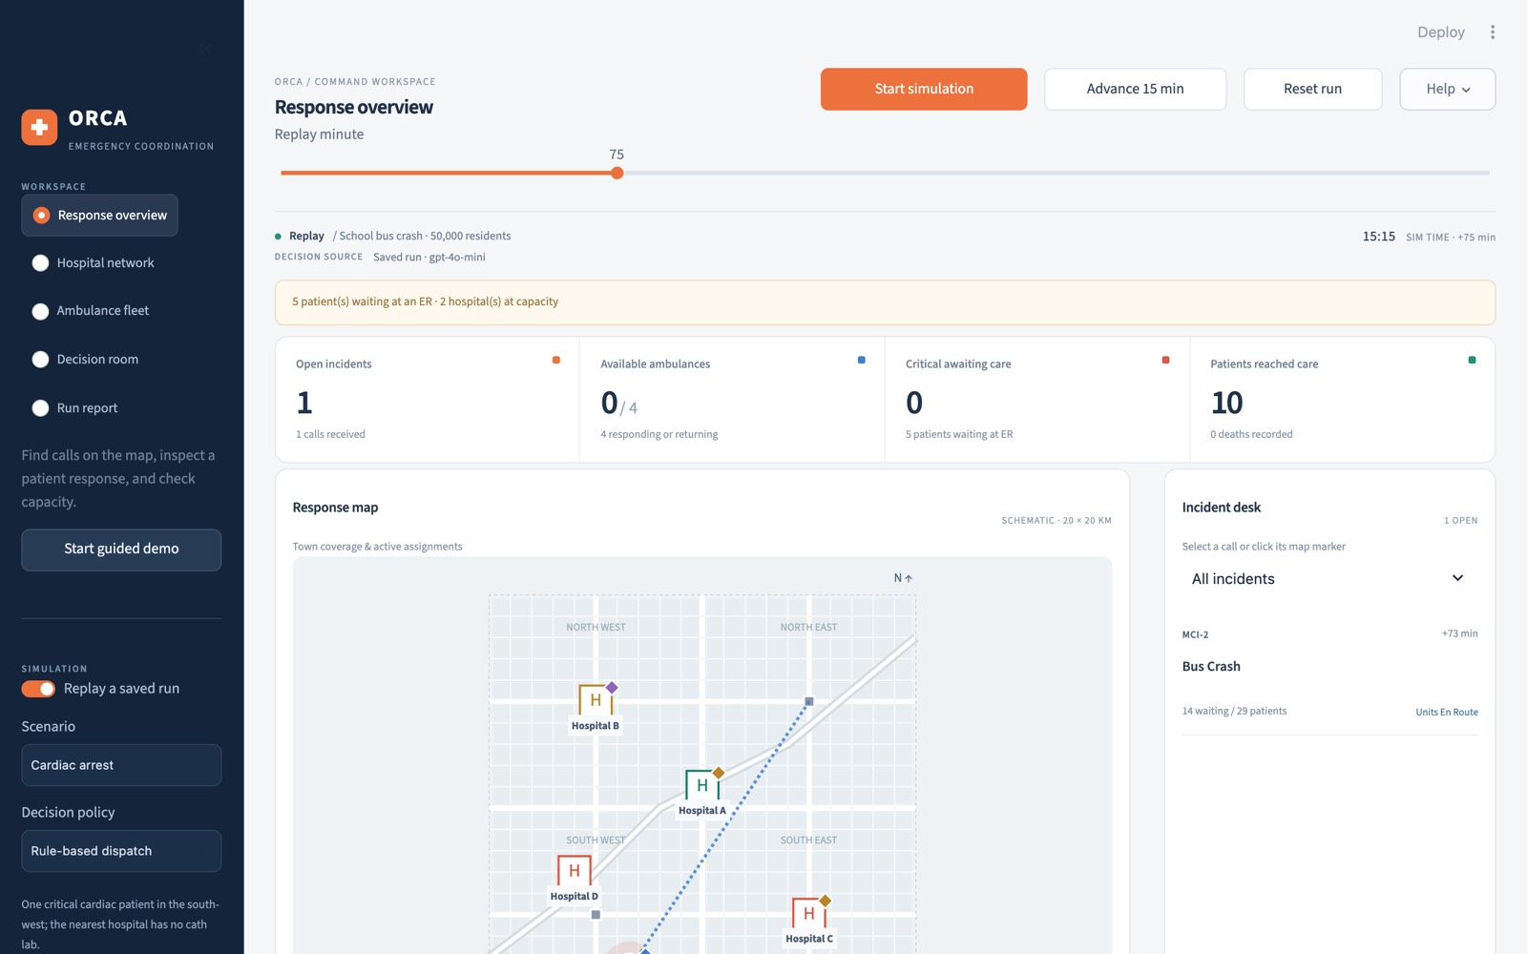
A live command dashboard
DYNAMIC VISUALIZATION · STREAMLIT + PLOTLY
Response overview
map, severity, assigned units, counters
Hospitals · Ambulances
ER beds, nurses, trauma teams, unit status
Decision room
messages, proposals, decisions, who decided
Run report
response time, served, unserved critical, conflicts
School bus crash, minute 75, replay of a real gpt-4o-mini run
Notes:
This is where I switch to the live demo. Each workspace maps to one of the views the brief asks for. The Decision room is the key one: every message shows who produced it, so you can tell a real model answer from the rule backup. Saved runs replay with no internet or API key.

Slide 7
80 paired runs on identical scenarios
EXPERIMENT
Paired: each seed fixes calls, patients and hospital load for every policy.
Surge day: a shooting at minute 30 and a bus crash with 28–34 victims at minute 35.
Baselines use the same observations and travel times as the agents.
Metrics: critical patients in care within 60 min, call-to-care time, response time, ambulance minutes at the ER, deaths, cost.
POLICIES
Nearest hospital
how it is often done today
Rule-based
severity queue, capacity-aware, mutual aid
Agents, no negotiation
hospitals cannot counter
Agents, negotiating
the full system
4 policies × 2 info × 2 demand × 5 seeds = 80 runs
Notes:
To show a measurable improvement I compare four policies on exactly the same scenarios. The agents without negotiation isolate the effect of negotiation itself. The rule-based baseline is deliberately strong, so the agents have to beat good rules, not a strawman. This grid was re-run on the final code, after the audit I mention at the end.

Slide 8
Agents got every critical patient into care within 60 minutes
RESULT 1 · NORMAL DAY, INCOMPLETE HOSPITAL INFORMATION
Critical patients in care within 60 min
100% agents
0% both baselines
The agents used scene reports and hospital facts to avoid hospitals that turned out to be full: care came 15–31 minutes sooner.
Notes:
This is the clearest result. On a normal day with a stale status board, both baselines send critical patients to hospitals that look free but are not, and none of them reach care within an hour. The agents use the scene reports and hospital facts and get every critical patient there within 60 minutes. Negotiation does not add anything here because hospitals rarely need to counter on a normal day.

Slide 9
Negotiation cut ER waiting, but agents responded slower
RESULT 2 · MASS-CASUALTY SURGE
PARTIAL INFORMATION
COMPLETE INFORMATION
Policy | Call to care | Response | ER wait | Deaths
Nearest | 63 | 25 | 288 | 3.8
Rule-based | 63 | 48 | 536 | 3.6
Agents, no negotiation | 65 | 62 | 558 | 3.6
Agents, negotiating | 60 | 70 | 504 | 4.0
Policy | Call to care | Response | ER wait | Deaths
Nearest | 62 | 32 | 299 | 3.6
Rule-based | 67 | 46 | 548 | 3.0
Agents, no negotiation | 69 | 56 | 540 | 3.4
Agents, negotiating | 66 | 48 | 517 | 3.4
Vs the same agents without negotiation: 54 fewer ambulance minutes waiting at ER doors, critical care 3–5 min sooner.
Vs the baselines: first ambulance arrives later, deaths about the same; 33–37% of critical patients in care within 60 min for every policy.
Mean of 5 seeds, minutes. ER wait = ambulance minutes at the ER beyond a 10-min base.
Notes:
In the surge, negotiation helps compared with the same agents without it: hospitals push back before they overflow, so ambulances spend less time stuck at ER doors. But the agents commit ambulances to the mass-casualty patients first, so other calls wait longer for a first unit. Nearest-hospital looks good on ER waiting only because it piles patients into one hospital and leaves more of them not in care. Deaths are about the same across policies.

Slide 10
An honest scorecard
WHAT HELD UP AND WHAT DID NOT
H1
Negotiation reduces capacity failures
Not supported
Self-audit before the final run
Some answers named patients or hospitals the agent had not been shown, and two metrics were wrong. I fixed both and re-ran all 80 runs.
H2
Faster critical care under scarcity
Mixed
H3
Bigger gain in surge and partial info
Not supported
25%
69
≈$1
The clear gain is on a normal day with incomplete information, not in the surge.
decisions by the rule backup
model calls per run
whole grid cost
Notes:
I want to be clear about what did not work. Two of three hypotheses were not supported, and the third is mixed. Before the final run I audited my own system and found the agents sometimes referred to patients or hospitals they had never been shown. I added checks, so those answers now go to the rule backup, which is why a quarter of decisions come from the backup. The old results are archived for comparison.

Slide 11
Descriptive evidence from a synthetic town
LIMITATIONS AND NEXT STEPS
Limitations
Next steps
Synthetic patients; outcome model not clinically validated.
Straight-line travel; no street network.
One town, 5 seeds, one small model.
Doctors modeled as trauma surgical teams only.
Shadow mode on real dispatch logs.
Hospital transfers and street-network travel.
Stronger models and more seeds.
Better self-check tools to cut the rule-backup rate.
Notes:
The main limitation is that everything is synthetic, so the numbers describe this simulation, not real patients. With five seeds and one small model, the results are descriptive. The most useful next step would be shadow mode on real dispatch data, where the agents suggest but do not act.

Slide 12
Agents help most when information is stale
THANK YOU · QUESTIONS
Code, report, results
Run the dashboard
Write-up
github.com/pranavpatel0741/ORCA-EMS
python dashboard_v2/run.py
docs/REPORT.md
Notes:
Summarize in one line: the agents add real value when hospital information is incomplete, and in a full mass-casualty surge they are about as good as good rules. Point to the repo for the code, report and every recorded model answer, then take questions.

