Slide 1

A Presentation
on
“AI Student Agent: An Autonomous AI Learning Assistant for Real-Time Online Classes”
Presented By:
1. Aman Choudhary (70012300166) 2. Pranav Patil (70012400176) 3. Mohit Patil (70012400178)
Under the Guidance of:
Dr. Pravin Landge (Faculty Mentor, Department of Information Technology)
Information Technology Department
SVKM’S NMIMS, MPSTME, Shirpur Campus
2026-27

Slide 2
Outline
01
Objective of Project
Goals, ambient listening, and persistence
05
System Architecture
5-Layer pipeline and audio routing conduit
02
Literature Survey
Comparative analysis of 18 publications
06
Result Analysis / Implementation
10/10 test matrix, latency & cost savings
03
Problem Statement
Split-attention, autonomy & memory gaps
07
Conclusions and Future Scope
Engineering achievements & roadmap
04
Proposed Solution
Hybrid edge-cloud multi-threaded architecture
08
References
Standard IEEE academic citations

Slide 3
Objective of Project
1
2
3
Zero-Cloud-Cost Ambient Listening & ASR
Contextual Trigger & Autonomous In-Call Chat
Post-Session Synthesis & Notion Persistence
Virtual Audio Conduit: Intercept Google Meet audio via VB-Audio Virtual Cable as a 16 kHz mono 16-bit PCM stream without microphone feedback loops.
Offline Speech Recognition: Deploy VOSK toolkit with Kaldi WFST acoustic modeling locally on CPU, achieving sub-500ms latency at $0 cloud cost.
Noise Filtering: Apply SciPy Butterworth 4th-order bandpass filter (300 Hz–3,400 Hz) to eliminate 50 Hz hum and enhance speech formants.
Sliding Context Deque: Maintain in-memory 50-word rolling history, extracting 15 words upon trigger detection to prevent hallucinations.
Fuzzy Phonetic Matching: Utilize normalized Levenshtein distance (Sim >= 0.80) and confidence score gating (>= 0.70) with compound lookahead ('just in' -> 'Justin').
Grounded Q&A Dispatch: Query OpenAI GPT-4o-mini for grounded responses and inject into Google Meet chat via Selenium in < 4.0 seconds.
Lossless Serialization: Compile all raw lecture PCM audio frames into a master debug_audio.wav file upon session termination.
Whisper-1 Master Transcript: Execute asynchronous batch transcription via OpenAI Whisper-1 API to yield verbatim timestamped transcripts.
Structured Notion Sync: Synthesize hierarchical study guides (Topic, Concepts, Definitions) and export formatted block trees to Notion via REST API.

Slide 4
Literature Survey
Paper / Source | Key Contribution | Limitation | How AI Student Agent Addresses It
Radford et al. (2023) [OpenAI Whisper] | Weakly supervised Transformer ASR; human-level accuracy across accents. | High streaming latency and 25 MB file payload boundary. | Employed for post-session master notes; lightweight VOSK used for live speech.
Povey et al. (2011) / Alpha Cephei (2026) | Kaldi WFST toolkit & VOSK: sub-500ms local ASR on consumer CPUs. | Phonetic ambiguity on proper names and homophones. | Two-stage lookahead + normalized Levenshtein distance string matching.
Dewan et al. (2023) | End-to-end verbatim meeting transcription architecture. | Virtual loopback echo and microphone feedback corruption. | Isolated unidirectional VB-Audio Cable conduit eliminating virtual loopback echo.
Laskar et al. (2023) | Role-directed LLM prompting for meeting summarization. | Lacks real-time in-call grounding; context limits on long calls. | Rolling 50-word context deque feeds immediate lecture discourse to GPT-4o-mini.
Wollny et al. (2021) / Taneja et al. (2024) | Taxonomy of educational chatbots (90% operate at passive Level 1). | Passive web forms; deaf/blind to live audio interactions. | Implements Level 3 autonomous agent acting directly inside Google Meet chat.
Bhardwaj & Kumar (2025) | Robotic process automation in higher education administration. | Rigid DOM selectors break during continuous Google web updates. | Resilient multi-selector fallback chains anchored to immutable ARIA attributes.

Slide 5
Problem Statement
Cognitive Split-Attention Effect: Students struggle to simultaneously absorb complex lecture derivations, take running notes, and watch chat panels (Sweller's Cognitive Load Theory).
Autonomy Gap in EdTech: Existing AI tools (ChatGPT, Copilot) are passive web forms; they cannot listen to live meeting audio or take autonomous action in the call.
Ephemeral Meeting Discourse: Crucial verbal explanations, Q&A interactions, and attendance roll-calls vanish immediately once the Google Meet session terminates.
Unbounded LLM Hallucinations: General-purpose models hallucinate unless strictly grounded in the rolling context of the instructor's immediate lecture discourse.
Live Classroom Scenario
Instructor Spoken Cold-Call
“Justin, can you explain how paging prevents external fragmentation?”
!
Split-Attention Multitasking
Student writing notes -> delayed response -> missing participation grade
X
Engineering Solution:
An autonomous, ambient edge-cloud assistant that joins Google Meet, listens locally with zero API fees, answers cold-calls in <4s, and syncs study guides to Notion.

Slide 6
Proposed Solution
Hybrid Edge-Cloud Architecture
Edge Continuous Listening: Local CPU speech decoding via VOSK runs 100% free ($0/hr), eliminating costly continuous cloud audio streaming.
Frontier Cloud Reasoning: OpenAI GPT-4o-mini is invoked strictly on verified trigger events ($0.001/query), saving over 98% in operational costs.
Unidirectional Loopback & DSP Filtering
VB-Audio Virtual Cable: Routes meeting speaker output directly into PyAudio recording stream without physical microphone feedback or echo.
SciPy Butterworth Filter: 4th-order bandpass filter (300 Hz–3,400 Hz) isolates human speech formants and suppresses ambient electrical hum.
Sliding Context Deque & Fuzzy Trigger
Rolling Discourse Buffer: In-memory collections.deque(maxlen=50) retains the last 50 words, extracting 15 words to ground prompt synthesis.
Fuzzy Phonetic Matching: Normalized Levenshtein metric (Sim >= 0.80) + acoustic confidence (>= 0.70) with lookahead ('just in' -> 'Justin').
Resilient Automation & Notion Persistence
DOM Mutation Resilience: Selenium WebDriver anchors to immutable accessibility attributes (@aria-label) and dynamic WebDriverWait polling.
Notion REST API Adapter: Converts post-session Whisper-1 transcript into hierarchical academic study notes published to student Notion DB.

Slide 7
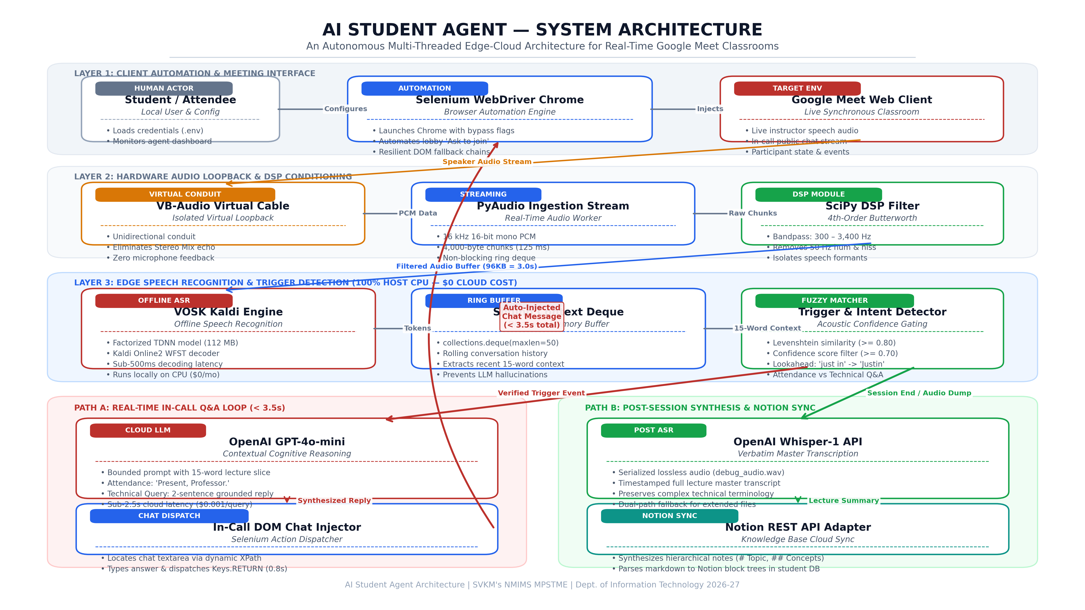
System Architecture
Layer 1 & 2 (Client & Audio Loopback): Selenium Chrome automation bypasses modals; VB-Audio Cable isolates 16 kHz mono stream; SciPy Butterworth bandpass filter suppresses noise.
Layer 3 (Perception Engine): Offline VOSK Kaldi decodes speech locally on CPU; 50-word context deque buffers discourse; Levenshtein detector triggers GPT-4o-mini; Selenium types chat reply in < 4s.
Dual Execution Paths: Real-time in-call Q&A loop (<3.5s turn-taking) and post-session lossless serialization (debug_audio.wav -> Whisper-1 -> Notion database sync).

Slide 8
Result Analysis/Implementation
10 / 10
3.6 s
98.17%
0
Subsystems Verified
Avg Live Turn-Taking
Cloud Cost Savings
GPU Accelerators Needed
Pipeline Stage | Subsystem | Measured Latency | Engineering Target
Audio Ingestion & DSP | PyAudio & SciPy Butterworth | 140 ms – 275 ms | < 350 ms (Met)
Offline Speech Decoding | VOSK Kaldi WFST Graph | 350 ms – 480 ms | < 500 ms (Met)
Context & LLM Q&A | OpenAI GPT-4o-mini API | 1,850 ms – 2,650 ms | < 3,000 ms (Met)
Total End-to-End Latency | Full Perception to Chat Loop | 3.20 s – 4.54 s (Avg: 3.6s) | 3.0 s – 5.0 s (Met)
Economic Cost Model & Host Hardware Footprint:
98.17% Compute Cost Reduction: Pure cloud streaming costs $22.98/month (60 classes), while AI Student Agent hybrid costs $0.42/month ($0.45/semester).
Resource Footprint: Host RAM: 1.18–1.34 GB (<1.5 GB budget) | Host CPU: 18%–26% on Intel i5 | Dedicated GPU: 0% (standard laptop viability).

Slide 9
Conclusions and Future Scope
Project Conclusions:
AI Student Agent has successfully demonstrated that combining local edge acoustic processing (VOSK/Kaldi) with frontier cloud generative models (GPT-4o-mini & Whisper-1) creates an effective autonomous classroom assistant. The system resolves the split-attention dilemma in online learning, maintains sub-4s response latency in live Google Meet chat, and delivers 98.17% cloud cost reductions ($0.42/month) on standard consumer PC hardware without dedicated GPU acceleration.
Dynamic Audio Chunking
Automate PyDub temporal segmentation to process multi-hour WAVs within Whisper's 25 MB limit.
Course-Grounded RAG
Index syllabus and textbook PDFs via ChromaDB / FAISS for deep factual grounding during cold-calls.
Synthetic Spoken Voice (TTS)
Integrate Edge-TTS / ElevenLabs through a virtual microphone for spoken verbal participation.
Cross-Platform Support
Extend automation adapters to Zoom, MS Teams, Cisco Webex, macOS (BlackHole), and Linux.

Slide 10
References
[1] A. Radford, J. W. Kim, T. Xu, G. Brockman, C. McLeavey, and I. Sutskever, “Robust speech recognition via large-scale weak supervision,” in Proc. 40th Int. Conf. Machine Learning (ICML), PMLR vol. 202, pp. 28492–28518, 2023.
[2] D. Povey, A. Ghoshal, G. Boulianne, et al., “The Kaldi speech recognition toolkit,” in Proc. IEEE Workshop Automatic Speech Recognition and Understanding (ASRU), pp. 1–4, 2011.
[3] Alpha Cephei, “Vosk: Offline open-source speech recognition toolkit,” Alpha Cephei Inc., Sep. 2026. [Online]. Available: https://alphacephei.com/vosk/.
[4] A. Dewan, M. Ziemski, H. Meylan, et al., “Developing automatic verbatim transcripts for international multilingual meetings: An end-to-end solution,” arXiv:2309.15609, 2023.
[5] M. T. R. Laskar, X.-Y. Fu, C. Chen, and S. Bhushan TN, “Building real-world meeting summarization systems using large language models: A practical perspective,” arXiv:2310.19233, 2023.
[6] S. Wollny, J. Schneider, D. Di Mitri, et al., “Are we there yet? — A systematic literature review on chatbots in education,” Frontiers in Artificial Intelligence, vol. 4, art. 654924, 2021.
[7] V. Bhardwaj and M. Kumar, “Transforming higher education with robotic process automation: Enhancing efficiency and student learning,” Discover Sustainability, vol. 6, no. 1, 2025.
[8] OpenAI, “GPT-4o mini: Advancing cost-efficient intelligence,” OpenAI Technical Report, 2024. [Online]. Available: https://openai.com/index/gpt-4o-mini-advancing-cost-efficient-intelligence/.

Slide 11
THANK YOU
Questions & Answers
AI Student Agent: An Autonomous AI Learning Assistant for Real-Time Online Classes
Aman Choudhary (70012300166) | Pranav Patil (70012400176) | Mohit Patil (70012400178)
Under the Guidance of Dr. Pravin Landge | Department of Information Technology, MPSTME, SVKM's NMIMS

