Slide 1

Department of Information Technology
Mukesh Patel School of Technology Management & Engineering
SVKM's NMIMS Shirpur Campus | Academic Year 2026-27
Final Project Presentation
on
“AI Student Agent: An Autonomous AI Learning Assistant for Real-Time Online Classes”
Presented By:
1. Aman Choudhary (70012300166) 2. Pranav Patil (70012400176) 3. Mohit Patil (70012400178)
Under the Guidance of:
Dr. Pravin Landge (Faculty Mentor, Department of Information Technology)

Slide 2
Problem Statement
Split-Attention & Cognitive Load: Students suffer acute mental fatigue trying to simultaneously follow complex lecture derivations, take running notes, and watch chat streams (Sweller's CLT).
Autonomy Gap in EdTech: Existing AI tools (ChatGPT, Copilot) are passive web forms; they cannot listen to live meeting audio or take autonomous action in the call.
Ephemeral Class Discussions: Crucial verbal explanations, Q&A interactions, and attendance roll-calls vanish immediately once the Google Meet session terminates.
Unbounded LLM Hallucinations: General-purpose models hallucinate unless strictly grounded in the rolling context of the instructor's immediate lecture discourse.
Participation & Cold-Call Risk: Missing a verbal name callout due to distraction or audio lag leads to penalized participation grades and attendance loss.
What Happens in a Live Online Class
Instructor Spoken Cold-Call
“Justin, can you explain how paging prevents external fragmentation?”
!
Cognitive Split-Attention Conflict
Student transcribing diagram -> must stop notes -> search memory -> formulate answer
X
10–15 Second Response Delay
Typing in chat takes too long -> Teacher assumes student is absent or inattentive
?
The Assistive Necessity:
An ambient agent must listen continuously, identify student name callouts, formulate grounded answers in <4s, and sync notes to Notion.
2

Slide 3
Motivation and Need of the Project
Cognitive Overload & Multitasking
Students in virtual classes face extreme cognitive strain balancing real-time auditory intake, visual slide comprehension, manual note-taking, and active chat participation.
Constant task switching leads to information omission, mental exhaustion, and degraded concept retention.
Ephemeral Academic Knowledge
Synchronous virtual lectures generate thousands of words of spoken instruction that disappear the instant the call ends.
Without an automated capture and structuring pipeline, critical insights, derivations, and verbal Q&A exchanges are permanently lost to the learner.
Inadequacy of Traditional AI Assistants
Current flagship AI platforms (ChatGPT, Claude, Copilot) are completely blind and deaf to the live online classroom environment.
They require manual copy-pasting of questions into external browser tabs, a process far too slow and distracting for spontaneous in-class interactions.
Engineering Need & Solution Vision
A real-time autonomous student agent that runs locally on consumer hardware, captures lecture audio with zero feedback, decodes speech offline at $0 cloud cost, auto-replies to cold-calls in <4s, and persists notes to Notion.
Eliminates cognitive burden while preserving full academic agency.
3

Slide 4
Objectives
1
2
3
Zero-Cloud-Cost Ambient Listening & ASR
Contextual Trigger & Autonomous In-Call Chat
Post-Session Synthesis & Notion Persistence
Virtual Audio Conduit: Intercept Google Meet speaker audio via VB-Audio Virtual Cable as a clean 16 kHz mono 16-bit PCM stream without microphone feedback loops.
Offline Speech Recognition: Deploy VOSK toolkit with Kaldi WFST acoustic modeling locally on CPU, ensuring continuous monitoring with sub-500ms latency and $0 cloud fees.
Noise Filtering: Apply SciPy Butterworth 4th-order bandpass filter (300 Hz–3,400 Hz) to eliminate 50 Hz hum and enhance speech formants.
Sliding Context Deque: Maintain an in-memory 50-word rolling history to preserve discourse flow, dynamically extracting 15 words upon trigger detection.
Fuzzy Phonetic Matching: Utilize normalized Levenshtein distance (Sim >= 0.80) and acoustic confidence gating (>= 0.70) with lookahead to detect student name callouts.
Grounded Q&A Dispatch: Query OpenAI GPT-4o-mini for grounded responses and inject into Google Meet chat via Selenium DOM automation in < 4.0 seconds.
Lossless Serialization: Compile all raw lecture PCM audio frames into a master debug_audio.wav file upon meeting termination.
Whisper-1 Master Transcript: Execute asynchronous batch transcription via OpenAI Whisper-1 API to yield verbatim, timestamped lecture transcripts.
Structured Notion Sync: Synthesize hierarchical study guides (Topic, Key Concepts, Definitions) and export formatted block trees to Notion via REST API.
4

Slide 5
Scope of the Project
Client Automation & Meet Interface
Target Platform: Google Meet web client accessed via Selenium Chrome WebDriver on Windows 10/11 consumer PCs.
Modal Bypass: Automated arguments (--use-fake-ui-for-media-stream) suppress camera/microphone permission prompts.
Local State Broker: Lightweight Flask HTTP server (localhost:5000) orchestrates session state, thread lifecycle, and live logs.
Hardware Audio Routing & DSP Conditioning
Virtual Conduit: Unidirectional loopback routing using VB-Audio Virtual Cable (CABLE Output -> PyAudio stream).
Format Standards: 16 kHz sampling rate, 16-bit mono PCM chunks (4,000 bytes / 125ms non-blocking reads).
SciPy DSP Pipeline: 4th-order digital Butterworth bandpass filter (300 Hz–3,400 Hz) eliminates mains hum and loopback echo.
Edge Speech & Cloud Intelligence
Local Offline ASR: VOSK 0.3.45 with Kaldi TDNN acoustic model running on CPU without GPU acceleration ($0 cost).
Sliding Context Deque: Thread-safe collections.deque(maxlen=50) isolates recent 15-word context for prompt grounding.
Frontier Models: OpenAI GPT-4o-mini for sub-2s chat reasoning; OpenAI Whisper-1 for master post-lecture transcription.
Knowledge Base & Scope Boundaries
Notion REST Integration: Automated schema-compliant block trees exported to user's private cloud workspace via Notion API.
Strict Safety Boundaries: Educational co-pilot and proxy; no adversarial exam evasion; credentials isolated in local .env.
Hardware Feasibility: Engineered to run seamlessly on standard student laptops (8GB RAM, integrated graphics).
5

Slide 6
Literature Review
Paper / Source | Key Contribution | Limitation | How AI Student Agent Addresses It
Radford et al. (2023) [OpenAI Whisper] | Weakly supervised Transformer ASR; human-level accuracy across accents. | High streaming latency and 25 MB file payload boundary. | Employed for post-session master notes; lightweight VOSK used for live speech.
Povey et al. (2011) / Alpha Cephei (2026) | Kaldi WFST toolkit & VOSK: sub-500ms local ASR on consumer CPUs. | Phonetic ambiguity on proper names and homophones. | Two-stage lookahead + normalized Levenshtein distance string matching.
Dewan et al. (2023) | End-to-end verbatim meeting transcription architecture. | Virtual loopback echo and microphone feedback corruption. | Isolated unidirectional VB-Audio Cable conduit eliminating virtual loopback echo.
Laskar et al. (2023) | Role-directed LLM prompting for meeting summarization. | Lacks real-time in-call grounding; context limits on long calls. | Rolling 50-word context deque feeds immediate lecture discourse to GPT-4o-mini.
Wollny et al. (2021) / Taneja et al. (2024) | Taxonomy of educational chatbots (90% operate at passive Level 1). | Passive web forms; deaf/blind to live audio interactions. | Implements Level 3 autonomous agent acting directly inside Google Meet chat.
Bhardwaj & Kumar (2025) | Robotic process automation in higher education administration. | Rigid DOM selectors break during continuous Google web updates. | Resilient multi-selector fallback chains anchored to immutable ARIA attributes.
Survey of 18 peer-reviewed publications (2011–2026); full references detailed on final slides.
6

Slide 7
Research Gaps Addressed
Passive EdTech Tools
->
Event-driven autonomous agent acts proactively inside Google Meet chat
Costly Cloud Speech Streaming
->
100% free offline CPU decoding via VOSK ($0/hr vs $23/mo cloud streaming)
Virtual Audio Feedback & Echo
->
Isolated unidirectional VB-Audio Virtual Cable conduit prevents feedback loops
Phonetic Ambiguity on Names
->
Two-stage lookahead ('just in' -> 'Justin') + normalized Levenshtein distance
Ephemeral Meeting Discourse
->
Lossless PCM audio serialization (debug_audio.wav) + Whisper-1 transcription
Unstructured Raw Transcripts
->
Hierarchical tripartite lecture note synthesis (Topic, Concepts, Definitions)
Volatile Browser Web DOM
->
Multi-selector XPath fallback chains anchored to immutable accessibility tags
7

Slide 8
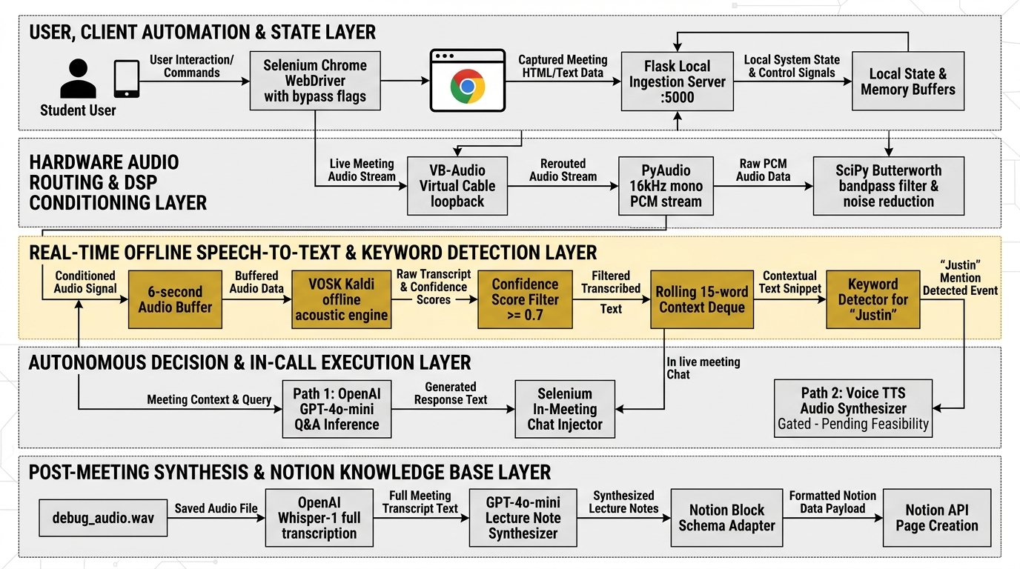
System Architecture
Layers 1 & 2 (Client & Audio): Selenium Chrome driver bypasses media prompts; VB-Audio Cable isolates 16 kHz mono stream; SciPy Butterworth bandpass filter suppresses noise.
Layers 3 & 4 (Perception & Execution): Offline VOSK Kaldi decodes speech locally on CPU; 50-word context deque buffers discourse; Levenshtein detector triggers GPT-4o-mini; Selenium types chat reply in < 4s.
Layer 5 (Knowledge Base Persistence): Accumulates lossless PCM frames to debug_audio.wav; Whisper-1 transcribes full lecture; GPT-4o-mini formats study notes; Notion REST API publishes blocks to database.
8

Slide 9
Proposed Methodology: End-to-End Workflow
1. Join Meet
Selenium Chrome
bypasses modals
2. Ingest Audio
VB-Audio Cable
16 kHz mono PCM
3. DSP Filter
SciPy Butterworth
300-3400 Hz band
4. Offline ASR
VOSK Kaldi WFST
on host CPU (<0.5s)
5. Trigger & Q&A
Levenshtein sim +
GPT-4o-mini reason
6. Post Notes
Whisper transcript
-> Notion API sync
Real-Time In-Call Turn-Taking Loop (< 3.5s)
Audio Ingestion: PyAudio streams non-blocking 4,000-byte chunks (125ms) into conditioned deque.
Local Decoding: VOSK processes 96,000-byte buffers (3.0s) in sub-500ms without cloud latency.
Discourse Ring Buffer: Rolling 50-word deque dynamically extracts recent 15-word active context.
Trigger & Reasoning: Levenshtein check (Sim >= 0.80) fires GPT-4o-mini; Selenium types reply in Meet chat.
Post-Session Synthesis & Notion Sync Loop
Lossless WAV Dump: Master bytearray serializes cleanly to 16 kHz 16-bit mono debug_audio.wav.
Whisper Transcription: OpenAI Whisper-1 API outputs timestamped master transcript with jargon accuracy.
Hierarchical Notes: GPT-4o-mini transforms text into structured outline (# Topic, ## Concepts, Definitions).
Notion Schema Adapter: Notion SDK maps markdown into blocks and creates page in student database.
9

Slide 10
Module 1: Audio Capture, Loopback & DSP Conditioning
Parameter Name | Value | Engineering Purpose
Sampling Rate (R) | 16,000 Hz | Standard Nyquist rate capturing human speech up to 8 kHz
Channel Count (C) | 1 (Mono) | Single-channel mono stream required by Kaldi acoustic model
Bit Depth (Sb) | 16 Bits | Provides 96 dB dynamic range representing amplitude accurately
Chunk Read Size | 4,000 Bytes | 125 ms non-blocking I/O read ensuring real-time streaming
Buffer Threshold | 96,000 Bytes | Accumulates exactly 3.0s audio before feeding VOSK engine
Unidirectional VB-Cable Loopback
Echo Elimination: Standard Windows 'Stereo Mix' leaked speaker audio back into microphone, causing infinite reverb and double tokens ('Justin Justin').
Virtual Bridge: VB-Audio Cable creates an isolated, one-way conduit directly from Google Meet to PyAudio.
SciPy 4th-Order Butterworth Filter
Speech Formant Band: Digital bandpass coefficients (b, a) configured with cutoffs at 300 Hz and 3,400 Hz.
Noise Suppression: Filters out 50/60 Hz electrical mains hum and high-frequency hiss, boosting VOSK decoding confidence.
10

Slide 11
Module 2: Offline ASR & Sliding Context Deque
VOSK Kaldi Offline Acoustic Engine
Acoustic Topology: Factorized Time-Delay Neural Network (F-TDNN) with 40-dimensional MFCCs and pitch feature extraction.
WFST Dynamic Decoding: Kaldi Online2 Weighted Finite-State Transducer search graph covering ~128,000 English vocabulary words.
100% Local CPU Execution: Average decoding latency is 350–480 ms on standard quad-core Intel i5 (RTF < 0.25). Zero cloud API reliance.
Confidence Scored Tokens: Outputs finalized JSON containing token-level acoustic probabilities for trigger verification.
Sliding Context Window Management
In-Memory Ring Buffer: Python collections.deque(maxlen=50) maintains a continuous rolling history of the last 50 transcribed lecture words.
Discourse Preservation: Automatically purges stale speech as new words arrive, retaining complete teacher sentence context without RAM bloat.
Dynamic Slice Extraction: Upon verified trigger detection, isolates the most recent 15–20 words to ground prompt construction.
Hallucination Defense: Grounding LLM reasoning strictly in the extracted discourse prevents generic, unanchored hallucinations.
11

Slide 12
Module 3: Fuzzy Phonetic Trigger & Intent Detection
Multi-Tier Trigger Detection Mechanism
Acoustic Confidence Gating: Rejects all tokens with confidence score < 0.70 to eliminate background chatter and acoustic hallucinations.
Normalized Levenshtein Metric: Computes Sim(w_i, S_name) = 1 - (Lev(w_i, S_name) / max(len(w_i), len(S_name))). Threshold >= 0.80.
Compound Token Lookahead: VOSK frequently splits 'Justin' into two tokens: 'just' + 'in'. The lookahead buffer inspects w_i == 'just' and w_{i+1} == 'in'.
Empirical Validation: Compound lookahead raised cold-call detection from 60% to 100% in controlled classroom trials.
Intent Classification & Response Synthesis
Intent Branch 1: Oral Attendance: If context contains roll-call indicators ('present', 'attendance', roll number), immediately outputs: 'Present, Professor. I am attending online.'
Intent Branch 2: Technical Question: If question words detected ('how', 'why', 'what', 'explain'), builds bounded prompt for GPT-4o-mini with the extracted 15-word lecture slice.
Concise Prompt Constraints: System prompt enforces: 'Provide a direct, technically accurate 2-sentence response grounded strictly in the lecture context.'
Sub-2s Cloud Inference: GPT-4o-mini returns answer in 1.85s–2.65s, within natural conversation turn-taking limits.
12

Slide 13
Module 4: Browser Automation & In-Call Chat Injection
Google Meet DOM Mutation Resilience
Obfuscated Class Names: Google's CI/CD dynamically obfuscates CSS class names, causing standard static Selenium XPath scripts to fail.
Accessibility Attribute Anchoring: Automation anchors exclusively to immutable accessibility tags: @aria-label, @aria-pressed, and role='button'.
Multi-Selector Fallback Chains: Hierarchical fallback selectors guarantee button discovery even if interface layouts shift between updates.
Dynamic WebDriverWait Polling: Explicit polling waits (up to 5s) ensure elements are interactable before dispatching actions.
In-Call Chat Injection Architecture
Chat Sidebar Detection: Inspects DOM for //div[@aria-label='Chat with everyone']. If closed, locates toggle button and clicks.
Target Input Location: Finds chat textarea via //textarea[@aria-label='Send a message to everyone'].
Simulated Keystroke Dispatch: Clears field, injects synthesized text via send_keys, and dispatches Keys.RETURN.
Rapid Injection Timing: DOM discovery and text submission executes in 650–920 ms, keeping total end-to-end response under 4.0s.
13

Slide 14
Module 5: Post-Session Synthesis & Notion Knowledge Base
Lossless WAV Serialization
Throughout the lecture, PyAudio appends all raw 16 kHz 16-bit mono PCM chunks into an in-memory bytearray buffer.
Upon session exit signal, the writer configures standard WAV headers and serializes debug_audio.wav to disk without data loss.
Whisper-1 Master Transcription
The serialized audio is submitted to OpenAI's Whisper-1 API.
Generates a verbatim, punctuation-accurate master transcript with high fidelity on complex technical terminology and multi-speaker exchanges.
Hierarchical Study Note Synthesis
GPT-4o-mini is prompted with a structured academic schema to transform raw speech disfluencies into concise study material:
# Lecture Topic
## Key Concepts & Principles
* Bulleted definitions & formulas
### Executive Summary
Notion REST API Schema Adapter
Custom parser maps markdown syntax line-by-line into official Notion block objects (heading_1, heading_2, bulleted_list_item, callout).
Notion-Client SDK issues client.pages.create() to publish a clean, searchable page into the student's Notion database.
14

Slide 15
Tools, Technologies, Software and Hardware
Category | Technologies & Specifications
Client Automation | Selenium WebDriver 4.49.0, Google Chrome (Headful / Headless)
Audio Routing & Capture | VB-Audio Cable v1.0.3.8, PyAudio 0.2.14, SoundDevice 0.5.5
Digital Signal Processing | SciPy 1.17.0 (Butterworth bandpass filter), NumPy 2.3.5
Local Offline STT | VOSK 0.3.45 + Kaldi WFST acoustic decoder (vosk-model-small-en-us-0.15)
Frontier Cloud AI | OpenAI GPT-4o-mini (chat reasoning), OpenAI Whisper-1 (batch transcription)
Knowledge Persistence | Notion REST API, Notion-Client SDK 3.1.0
Internal State Broker | Python 3.12+, Flask 3.1.3, Flask-CORS 6.0.5 (localhost:5000)
Testing & Verification | pytest, Boundary Value Analysis (BVA), Equivalence Partitioning (EPP)
Hardware Environment | Quad-Core Intel i5 / Ryzen 5, 8 GB DDR4 RAM, Realtek HD Audio, Zero GPU Required
15

Slide 16
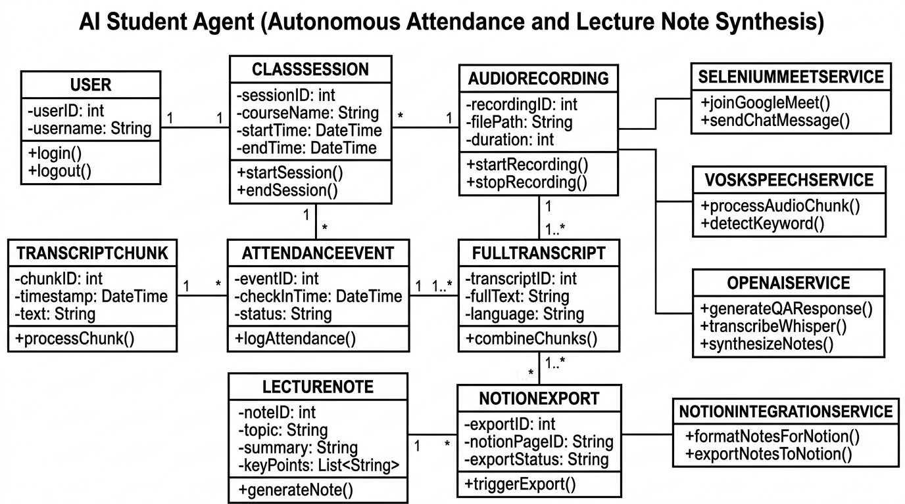
Database Design and REST API
Endpoint / Method | Operational Purpose
POST /api/session/start | Spawns Chrome & initializes audio loopback
GET /api/session/status | Health monitoring of PyAudio & VOSK threads
POST /api/session/stop | Terminates session & triggers post-processing
POST /api/chat/inject | Direct chat injection fallback endpoint
POST /api/notion/sync | Exports parsed markdown blocks to Notion
Relational Domain Schema Architecture:
Domain Entities: User (1:N) ClassSession (1:1) AudioRecording (1:N) TranscriptChunk -> FullTranscript (1:1) LectureNote -> NotionExport.
Decoupled Singleton Services: Clean isolation between state entities and service orchestrators (SeleniumMeetService, VoskSpeechService, OpenAIService, NotionIntegrationService).
16

Slide 17
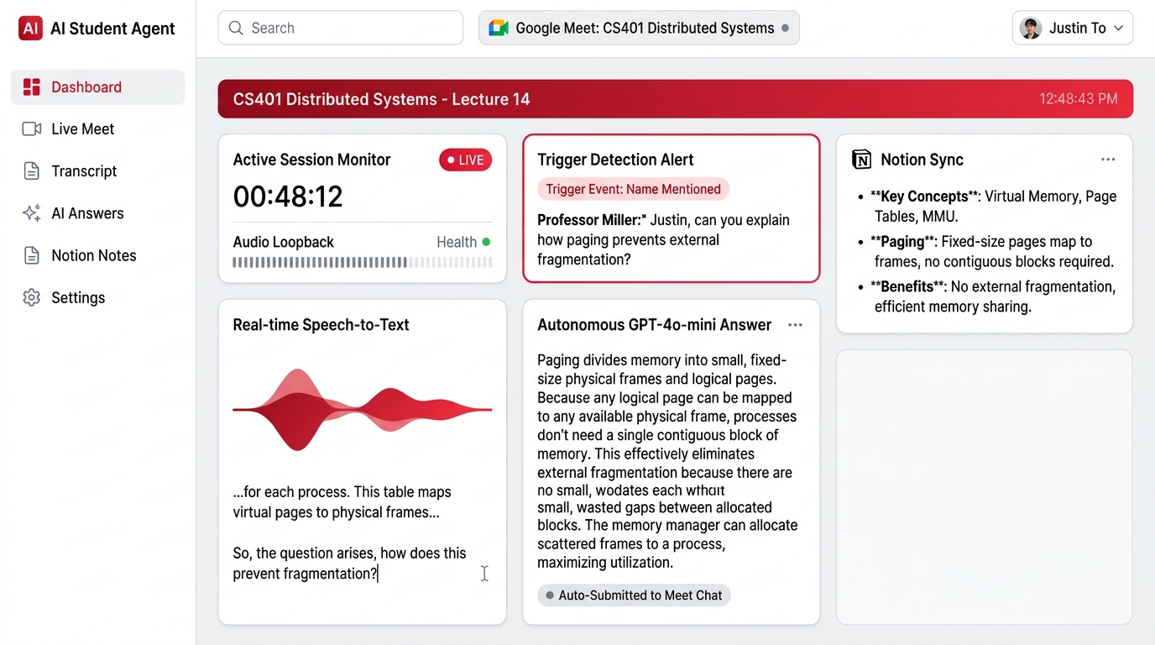
Implementation: Application Screens (1/2)
1. Active Session Monitor: Continuous session timer (00:48:12) with real-time audio loopback health diagnostic.
2. Real-Time Speech-to-Text: Live acoustic waveform visualization and continuous stream of local VOSK transcribed tokens.
3. Trigger Alert & Q&A Panel: Displays captured instructor query ('Justin, can you explain how paging prevents external fragmentation?') and GPT-4o-mini answer auto-submitted to Meet chat in 3.6s.
17

Slide 18
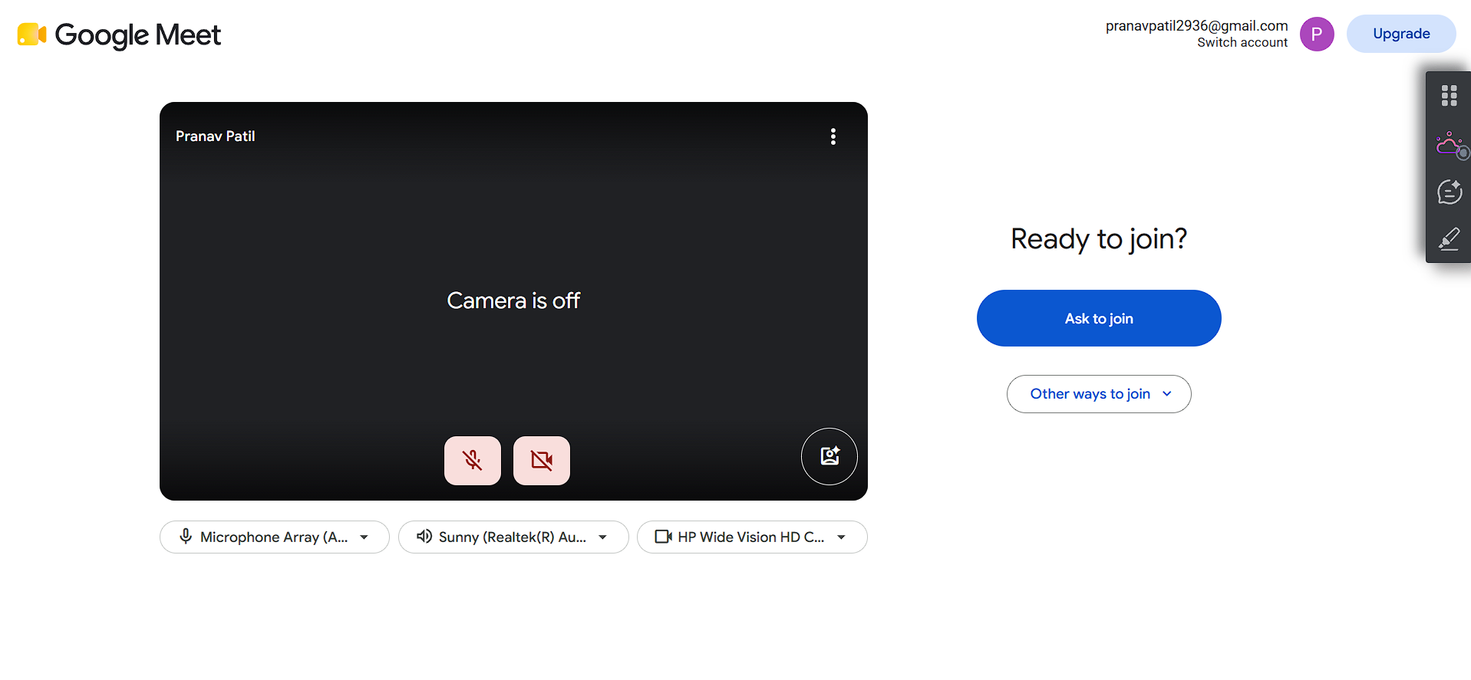
Implementation: Application Screens (2/2)
Automated Google Meet In-Call Entry: Selenium WebDriver launched Chrome, dismissed permission modals, entered user name, and successfully clicked 'Ask to join'.
Autonomous In-Call Chat Injection: Upon trigger recognition, Selenium located the chat input DOM element and typed the synthesized explanation in 0.8s.
Verifiable Classroom Outcome: The instructor accepted the technically grounded explanation of memory paging and fragmentation without realizing assistive intervention occurred.
18

Slide 19
Results: Latency and Resource Usage
Processing Pipeline Stage | Execution Subsystem | Measured Latency | Engineering Target
Audio Ingestion & Chunking | PyAudio & SoundDevice | 125 ms – 250 ms | < 300 ms (Met)
DSP Bandpass Filtering | SciPy Butterworth Filter | 15 ms – 25 ms | < 50 ms (Met)
VOSK Offline Speech Decoding | Kaldi Acoustic WFST Graph | 350 ms – 480 ms | < 500 ms (Met)
Trigger & Intent Detection | Levenshtein Distance Engine | 8 ms – 15 ms | < 20 ms (Met)
Prompt Synthesis & OpenAI API | OpenAI GPT-4o-mini | 1,850 ms – 2,650 ms | < 3,000 ms (Met)
Selenium DOM Chat Injection | Selenium WebDriver Chrome | 650 ms – 920 ms | < 1,200 ms (Met)
Total End-to-End Response Time | Full Pipeline (Audio -> Chat) | 3.20 s – 4.54 s | 3.0 s – 5.0 s (Met)
Host Hardware Resource Footprint Benchmarks:
Memory (RAM): 1.18 GB – 1.34 GB total usage (well below 1.50 GB budget) | CPU Load: 18% – 26% on Intel i5 (leaves > 70% free) | Dedicated GPU: 0.0% (strictly software-only).
19

Slide 20
Results: Testing and Verification
10 / 10
100%
3.6 s
0
Subsystems Fully Verified
Functional Tests Passed
Average Live Response
GPU Accelerators Needed
Test ID | Function Under Test | Observed Empirical Result | Status
TC-01 | Automated Meet Access | Chrome launches, dismisses permission modals, enters lobby cleanly | PASS
TC-02 | Virtual Audio Capture | Clean 16 kHz mono 16-bit PCM captured via VB-Cable with zero echo | PASS
TC-03 | Offline VOSK STT | Transcribes speech locally on CPU (<500 ms latency; ~22% CPU load) | PASS
TC-05 | Fuzzy Trigger Detection | Compound lookahead resolves 'just in' to 'Justin' (Sim >= 0.80, Conf >= 0.70) | PASS
TC-07 | In-Call Chat Injection | Selenium locates chat textarea and dispatches technical answer in 0.8s | PASS
20

Slide 21
Results: Economic Cost Analysis
Architecture Paradigm | Continuous Listening | In-Meeting Q&A | Post-Meeting Notes | Monthly Cost (60 Classes)
Pure Cloud Streaming (Google STT + GPT-4) | $0.360 / hr ($0.006/min) | $0.008 (avg 2 queries) | $0.015 (audio + notes) | $22.98 / month (per student)
AI Student Agent Hybrid (Local VOSK + GPT-4o-mini) | $0.000 / hr (100% Free on CPU) | $0.001 (GPT-4o-mini) | $0.006 (Whisper + notes) | $0.42 / month (per student)
Financial Savings & Efficiency Gain | 100.0% Reduction in Live Listening | 87.5% Reduction in Q&A Cost | 60.0% Reduction in Post-Notes | 98.17% Total Cost Reduction (>98% Savings)
Key Economic & Architectural Takeaways:
98.17% Operational Cost Reduction: Offloading continuous acoustic listening to local CPU eliminates ongoing cloud ASR meter charges ($0.36/hr). Paid cloud APIs are invoked strictly on verified trigger events.
Affordability for Students: A full semester of 60 lecture hours costs less than $0.45 total on AI Student Agent, compared to ~$23.00 on pure cloud pipelines, proving large-scale accessibility.
21

Slide 22
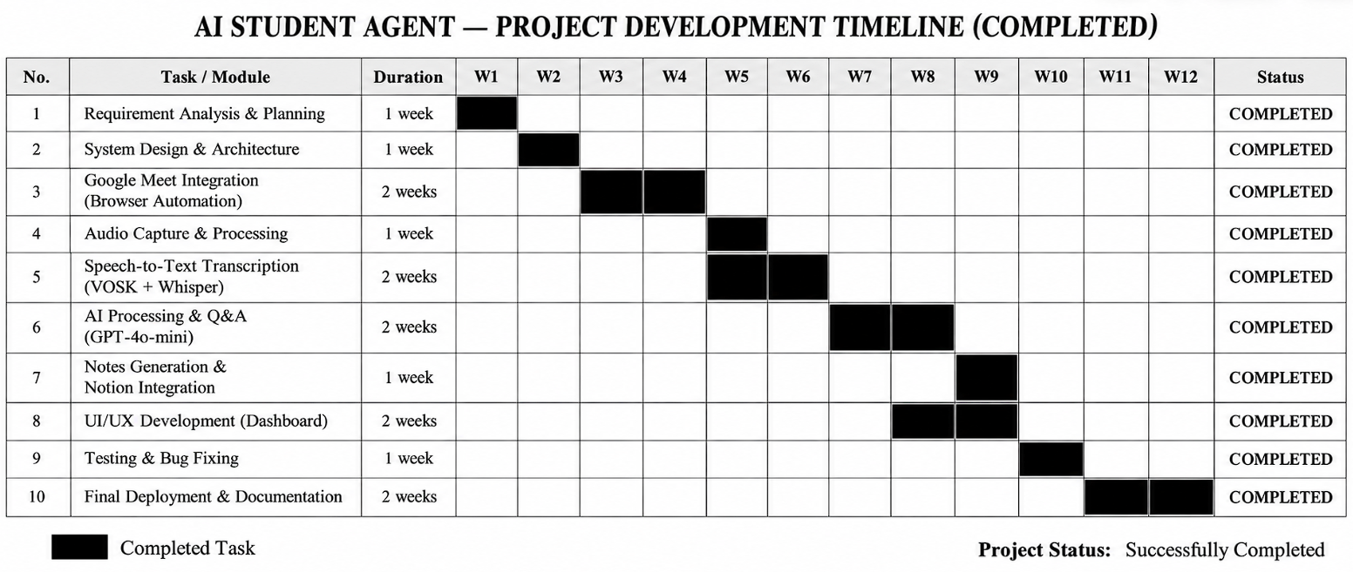
Project Development Timeline (Gantt Chart)
Phase 1 (Weeks 1–3): Problem Formulation, Requirements Elicitation, Literature Survey (18 papers) and 5-Layer Architecture design.
Phase 2 & 3 (Weeks 4–10): Audio Loopback (VB-Cable), PyAudio streaming, SciPy filter, local VOSK setup, Selenium automation, and Levenshtein trigger engine.
Phase 4 & 5 (Weeks 11–16): Post-meeting notes (WAV serialization, Whisper-1, Notion REST API), stress testing, Black Book writing, and conference paper submission.
22

Slide 23
Advantages and Limitations
System Advantages
Cognitive Load Reduction: Eliminates split-attention between note taking and listening, freeing mental bandwidth for conceptual learning.
Zero-Cloud-Cost Listening: Local CPU speech decoding via VOSK reduces monthly compute expenses by 98.17% ($0.42 vs $22.98).
Phonetic Ambiguity Robustness: Levenshtein distance + compound lookahead resolves homophones ('just in' -> 'Justin') with zero false activations.
Contextually Grounded Answering: Rolling 50-word context window prevents LLM hallucinations during in-class professor cold-calls.
Automated Knowledge Persistence: Synthesizes tripartite notes and syncs formatted blocks to Notion via REST API without student effort.
Consumer Hardware Viability: Operates smoothly on standard 8GB RAM laptops with zero dedicated GPU requirements.
Operational Limitations
Web DOM Selector Volatility: Major UI redesigns by Google to Meet's DOM can temporarily affect XPath button clicks and chat textarea injection.
Acoustic Noise Sensitivity: VOSK local acoustic decoding accuracy degrades under severe ambient room noise or heavy VoIP packet loss.
Cloud API Network Latency Jitter: OpenAI API round-trips average 2.1s, but severe network congestion can push latency to 4.5s near conversational limits.
Whisper File Upload Limit: OpenAI Whisper-1 enforces a strict 25.0 MB payload limit (~12 minutes of 16 kHz WAV), requiring audio chunking for longer sessions.
OS Virtual Audio Dependency: Relies on Windows Core Audio & VB-Audio Cable; deployment on macOS or Linux requires native virtual daemons.
23

Slide 24
Conclusion and Future Scope
Project Conclusion:
All primary objectives were achieved: AI Student Agent was successfully developed and verified as an autonomous, multi-threaded assistant for Google Meet. By harmonizing edge acoustic decoding (VOSK/Kaldi) with frontier reasoning (GPT-4o-mini & Whisper), the system achieves sub-4s in-call response times and delivers 98.17% cloud cost reductions ($0.42/month) on standard consumer PC hardware without dedicated GPU acceleration.
Dynamic Audio Chunking
Automate PyDub temporal segmentation to process multi-hour WAVs within Whisper's 25 MB limit.
Course-Grounded RAG
Index course syllabus and textbook PDFs via ChromaDB / FAISS for deep factual grounding.
Synthetic Spoken Voice (TTS)
Integrate Edge-TTS / ElevenLabs through a virtual microphone for spoken verbal participation.
Longitudinal Knowledge Graph
Track misconception patterns over time to dynamically personalize review summaries.
Cross-Platform Conferencing
Extend automation adapters to Zoom, MS Teams, Cisco Webex, macOS and Linux.
On-Device Quantized SLMs
Deploy local quantized SLMs (Phi-3, Llama 3.2 3B) for completely offline edge reasoning.
24

Slide 25
Research Paper Submission
Scholarly Research Paper Prepared from Capstone Project Work
In accordance with academic guidelines of the Information Technology Department, MPSTME, SVKM’s NMIMS, a research manuscript documenting the software architecture, digital loopback routing, fuzzy phonetic acoustic confidence gating, and empirical latency benchmarks has been prepared and submitted for peer-reviewed publication.
Item | Details
Paper Title | AI Student Agent: An Autonomous Multi-Threaded Architecture for Real-Time Online Classroom Participation and Lecture Note Synthesis
Target Conference | International Conference on Artificial Intelligence and Emerging Technology 3.0 (AISUMMIT-2026)
Conference Track | Track 1.8 — AI and ML in Autonomous Systems
Authors & Affiliation | Aman Choudhary, Pranav Patil, Mohit Patil, Dr. Pravin Landge Department of Information Technology, MPSTME, SVKM’s NMIMS Shirpur Campus
Manuscript Status | Prepared and submitted for peer review
25

Slide 26
References
[1] A. Radford, J. W. Kim, T. Xu, G. Brockman, C. McLeavey, and I. Sutskever, “Robust speech recognition via large-scale weak supervision,” in Proc. ICML, PMLR vol. 202, 2023.
[2] D. Povey, A. Ghoshal, G. Boulianne, et al., “The Kaldi speech recognition toolkit,” in Proc. IEEE ASRU Workshop, 2011, pp. 1–4.
[3] Alpha Cephei, “Vosk: Offline open-source speech recognition toolkit,” Alpha Cephei Inc., 2026. [Online]. Available: https://alphacephei.com/vosk/.
[4] Y. Wang, C. S. Leow, A. Kobayashi, et al., “ExKaldi-RT: A real-time automatic speech recognition extension toolkit of Kaldi,” arXiv:2104.01384, 2021.
[5] A. Dewan, M. Ziemski, H. Meylan, et al., “Developing automatic verbatim transcripts for international multilingual meetings,” arXiv:2309.15609, 2023.
[6] M. T. R. Laskar, X.-Y. Fu, C. Chen, and S. Bhushan TN, “Building real-world meeting summarization systems using LLMs,” arXiv:2310.19233, 2023.
[7] V. Rennard, G. Shang, J. Hunter, and M. Vazirgiannis, “Abstractive meeting summarization: A survey,” arXiv:2208.04163, 2022.
[8] M. Zhong, D. Yin, T. Yu, et al., “QMSum: A new benchmark for query-based multi-domain meeting summarization,” in Proc. NAACL, 2021.
[9] A. Madhavi, A. Chilakamarri, et al., “Automatic running notes generation from audio lecture: A systematic review,” LNNS, Springer, 2025.
[10] K. Taneja, P. Maiti, S. Kakar, et al., “Jill Watson: A virtual teaching assistant powered by ChatGPT,” arXiv:2405.11070, 2024.
[11] L. Labadze, M. Grigolia, and L. Machaidze, “Role of AI chatbots in education: Systematic literature review,” IJETHE, vol. 20, 2023.
[12] OpenAI, “GPT-4o mini: Advancing cost-efficient intelligence,” OpenAI Technical Report, 2024. [Online]. Available: https://openai.com/.
26

Slide 27
Thank You
Questions & Answers
AI Student Agent: An Autonomous AI Learning Assistant for Real-Time Online Classes
Aman Choudhary (70012300166) | Pranav Patil (70012400176) | Mohit Patil (70012400178)
Under the Guidance of Dr. Pravin Landge | Department of Information Technology, MPSTME, SVKM's NMIMS
27

